Slide 1
How to Support Your Students Through the Research Process
A guide by Chris StClair, Maranacook HS Literacy Specialist

Slide 2
Guiding Principles
Clear and Effective Communicator
Self-Directed and Lifelong Learner
Creative and Practical Problem Solver
Responsible and Involved Citizen

Slide 3
Addressing the Guiding Principles
Set and define clear goals
Gradual Release of Responsibility
Model expectations and make resources accessible
Support student collaboration and voice
Frequent check-ins
Return to goals frequently
Support student reflection towards improvement

Slide 4
Set and Define Clear Goals
Provide hard copies of rubrics and resources, as well as post them online
Rubrics Have students highlight what’s new, unusual, or surprising.
Analyze a model Use rainbow analysis and compare a model to the rubric to define the success criteria
Timetable Define the timetable for each step of the process and post it online for accountability

Slide 5
Gradual Release of Responsibility
Model Show students how to analyze a resource, how to write a body PP, and how to edit their draft
Support Define the timetable for each step of the process and post online. Check in with students analyzing sources during partner and small group work. Individually support the writing process.
Try on their own Independently analyze a source and write 3rd body PP.

Slide 6
Gradual Release with
Analyzing Sources
Day 1: Rubric, SHEG Documents and Background Essay
Day 2: Rainbow analysis of model, model primary source analysis, 2nd primary source with student support
Day 3: Jigsaw Partner work on sources: Begin Jigsaw
Day 4: Finish jigsaw: Share corroborations as a class
Day 5: Assessment: Analyze 2 documents independently

Slide 7
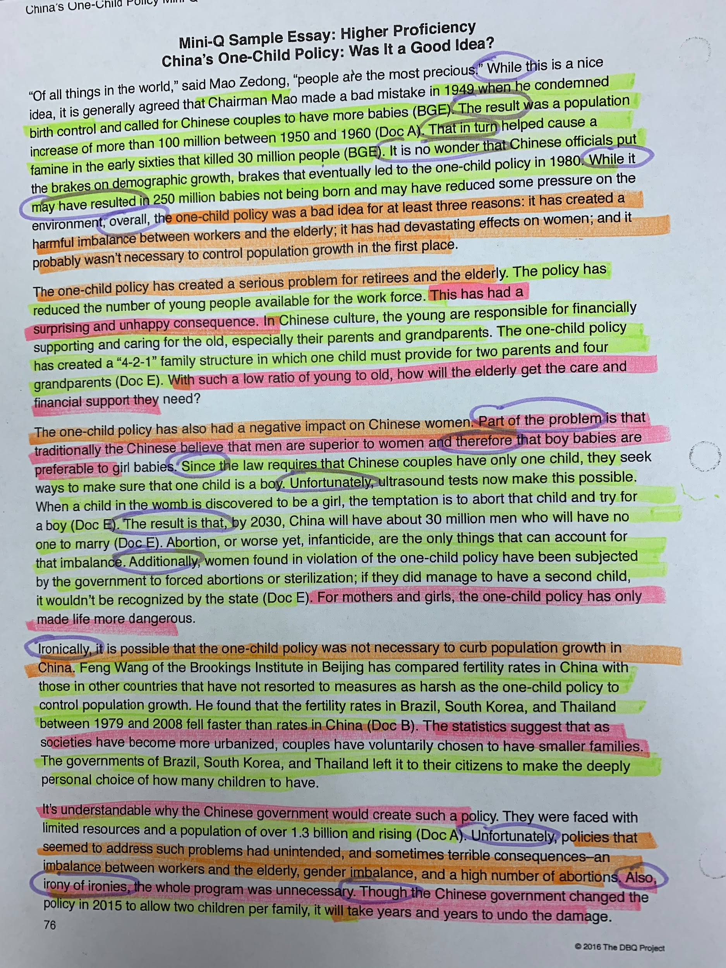
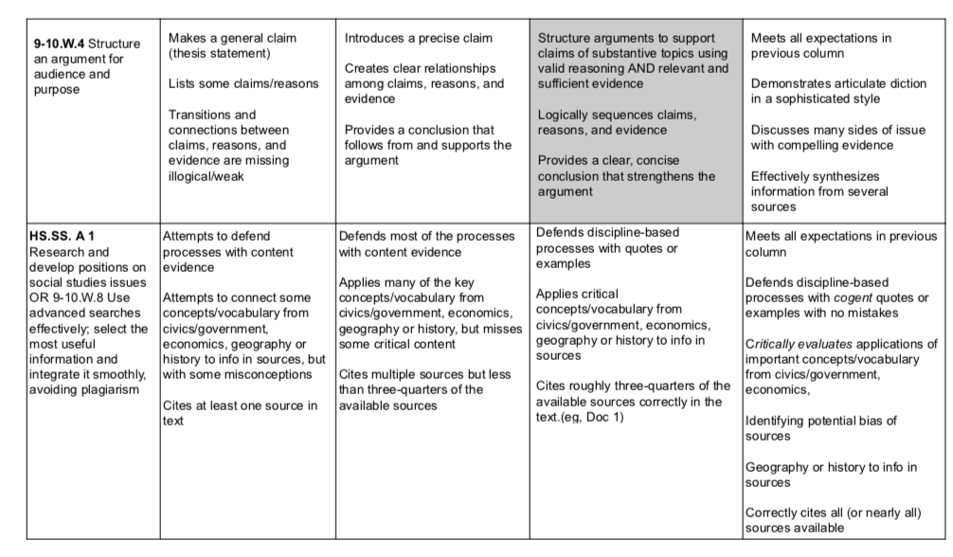
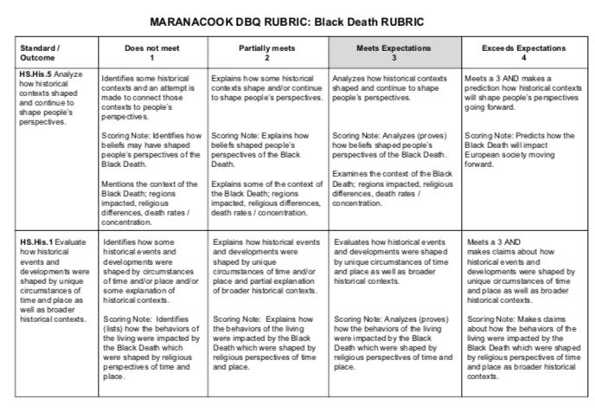
How to Model Efficiently?
Analyze an existing piece of work
To see how it fits the rubric.

Slide 8
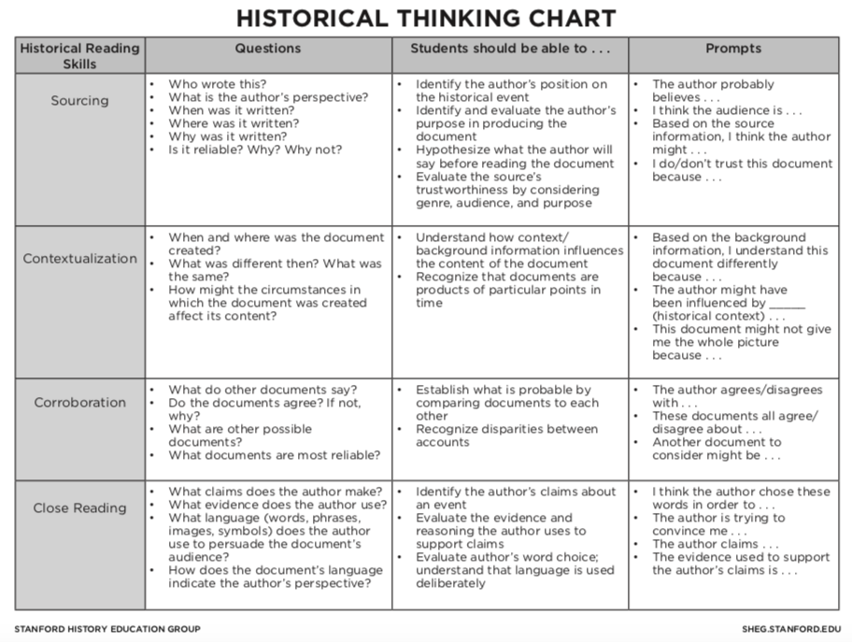
Stanford History Education Group
Rubric
Sourcing
Context
Corroboration
Close Reading

Slide 9
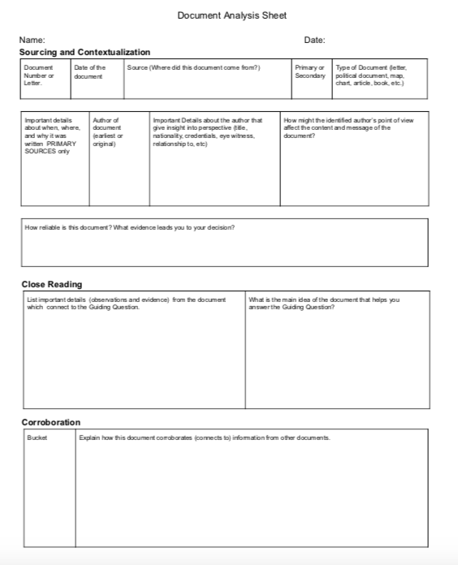
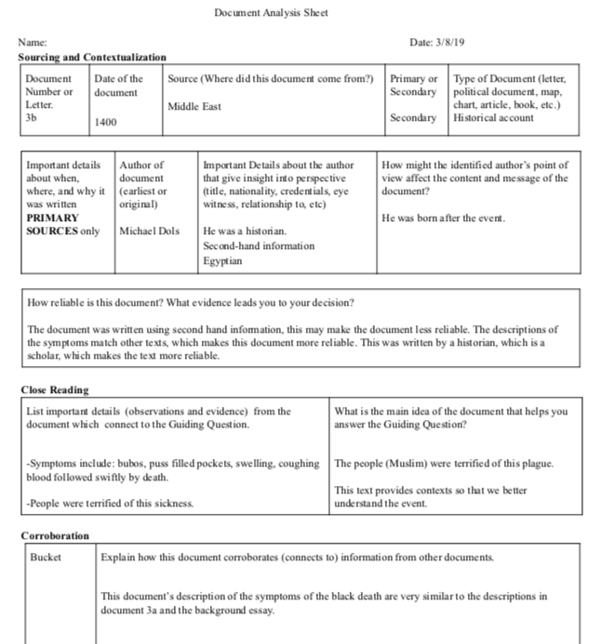
Model what you are looking for from students

Slide 10
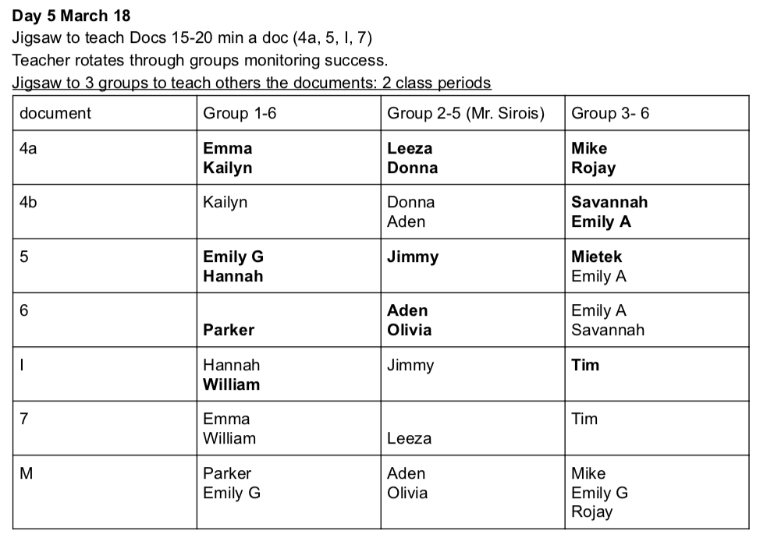
Support Student Thinking and Collaboration
Every student gets the opportunity to be the expert on a document and the leader of their peers.

Slide 11
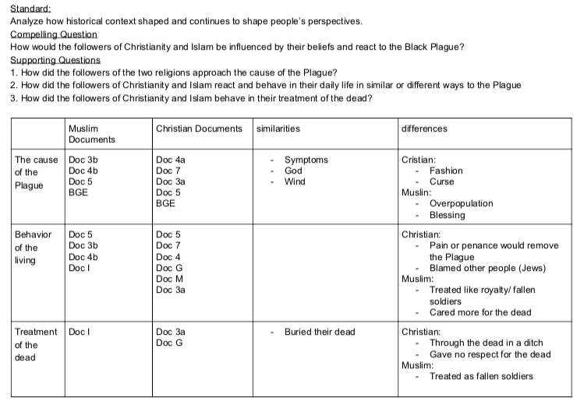
Tip
Record information that students share on the board, on a shared document, or on poster paper.
Provide an Opportunity for student voice

Slide 12
The Writing Process
Review the Rubric Remind students what type of evidence they need to include and which topics they need to cover.
Write thesis and sort documents List each claim and then list 3-4 documents which support each claim
Analyze a body PP
Gradually Release Support
Rainbow edit the draft

Slide 13
Preparing
to Write
Thesis and
Document Sort

Slide 14
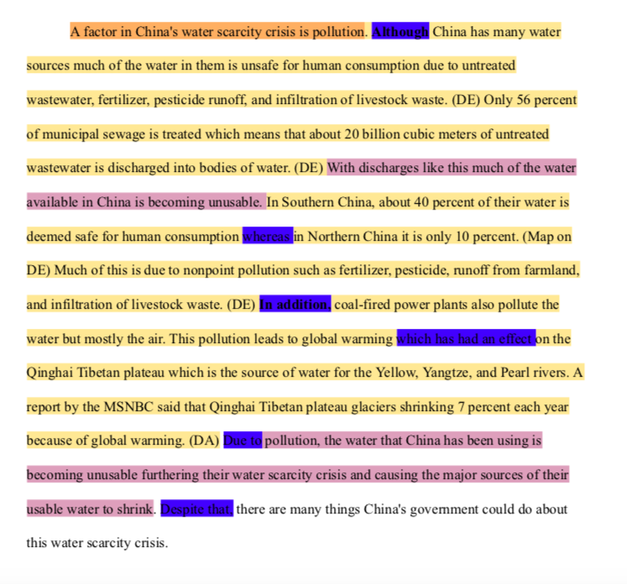
Analyze a Body PP
Look for claim, evidence, transition phrases, and transition to next paragraph

Slide 15
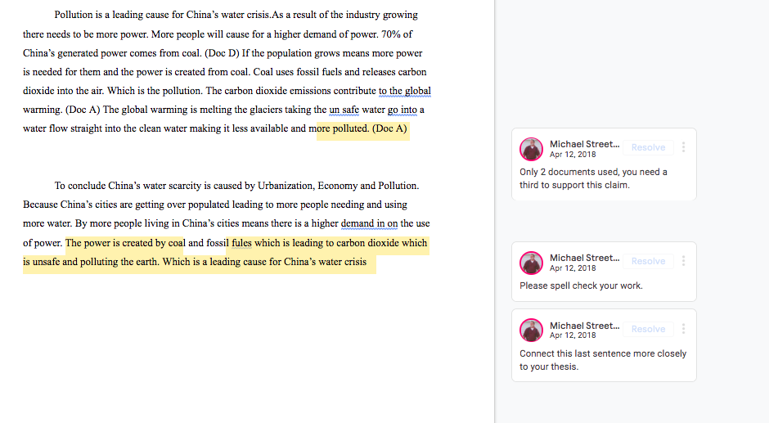
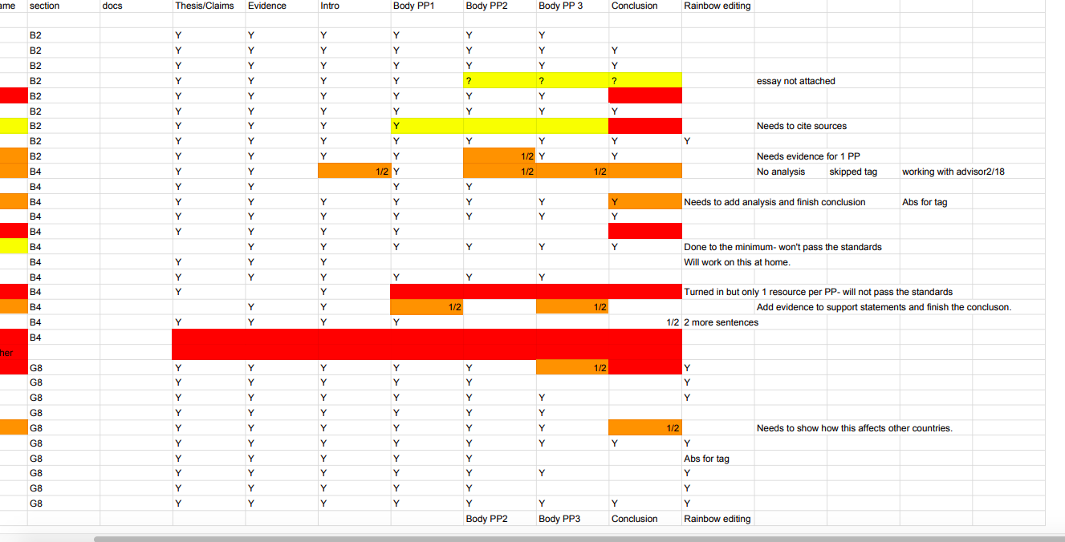
Support
the
Writing
Process
Conference
Track progress
Individual Feedback

Slide 16
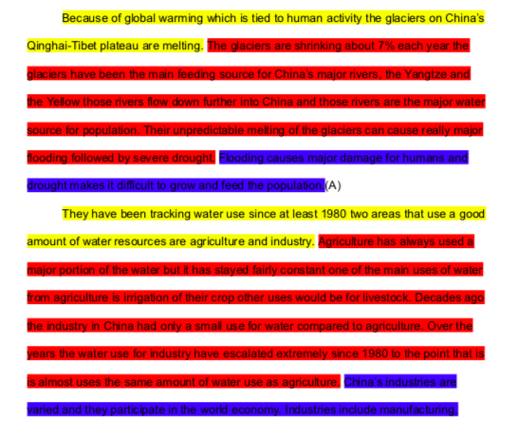
The Editing Process
Review the Rubric
Rainbow Edit
Make Revisions

Slide 17
Reflection and
Goal Setting
Print Final Draft and Attach Rubric
Review Previous work before the next research opportunity
Set Goals for Research and Writing

Slide 18
Student Success
Manageable Bites
Clear Goals
Constant Support
Student Voice
An overwhelming process is broken down into manageable pieces
Students always have a clear understanding of the success criteria
Beginning |  |  |  | End
Students never feel like they are on their own
Students get to learn from each other and have their voice heard and valued

Slide 19
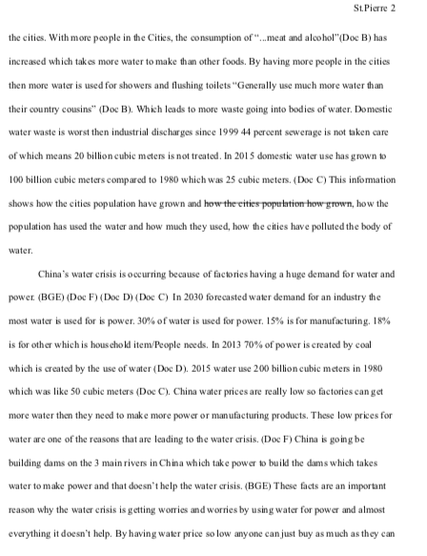
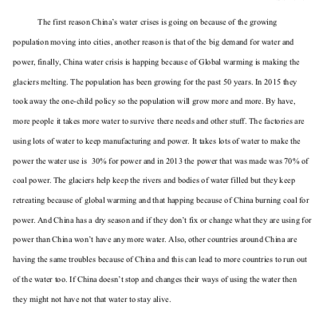
RTI Student Work

Slide 20
Review
Set and define clear goals
Gradual Release of Responsibility
Model expectations and make resources accessible
Support student collaboration and voice
Frequent check-ins
Return to goals frequently
Support student reflection towards improvement

Slide 21
Have Fun!
Enjoy learning from the kids!
My process is constantly evolving.
My students know I am not the expert, but I am constantly revising everything I do.
Contact me
any time
chris_stclair@
maranacook.com

