Slide 1
Regional TA Sessions
Regions 1 and 2
Aroostook and Washington
July 7, 2020
Session #1
START RECORDING

Slide 2
Session #1
Agenda:
8:00-9:00- General Session
a) FY 21 Application Updates
b) Risk Assessment
c) Fiscal Alignment
d) Resources/ Questions
9:00-1:00- District TA sessions
9:00-10:00 Baileyville
10:00-11:00 AOS 96
11:00-12:00 RSU 39
12:00-1:00 RSU 50

Slide 3
General Session
Pre-Assessment
1. What is the due date for the FY19-20 Performance Report?
2. What is the reporting cycle for the FY19-20 Performance Report?
3. Where can a district find its' Risk Assessment rating?
4. Name three changes to the FY21 ESEA application?
5. What is the difference between an expenditure and reimbursement?
Bonus: What is a difference between an obligation and an encumbrance?

Slide 4
FY 20-21 Application & FY19-20 Performance Report Dates
Aug 1 | FY20-21 ESEA Consolidated Application Due
Nov 2 | FY18-19 Extension Carryover Reports Due
Nov 2 | FY 19-20 Performance Report (PR) Due -Report period 7/1/19 to 9/30/20 (15 months) -Title I Carryover Percentage Report and Private School Reconciliation Page will be embedded in PR -Approved Carryover Projects period 10/1/20 to 9/30/21
FY 21 Federal Year at a Glance
(Click on ESEA Coordinators, Annual Update Tab)
https://www.maine.gov/doe/learning/esea/resources#

Slide 5
FY 20-21 Application Major Updates
1. Project Budget Grid: In the past, just one program was selected for the budget, now specific transfer funds will need to be determined.
2. Ranking & Distribution: If a school is at 35% poverty (Col 6) it is still eligible even if no money is allocated to it; GEMS will pre-populate based on info entered in Col 2 and 3
3. Summary of Projects- Smaller colored chart (blue, white, and yellow) will appear at the bottom of larger chart if there are budget errors-overspent or underspent funds
4. ESEA Assurances- Assessments Title IA Questions B & E-mark N/A; no assessments due to COVID 19

Slide 6
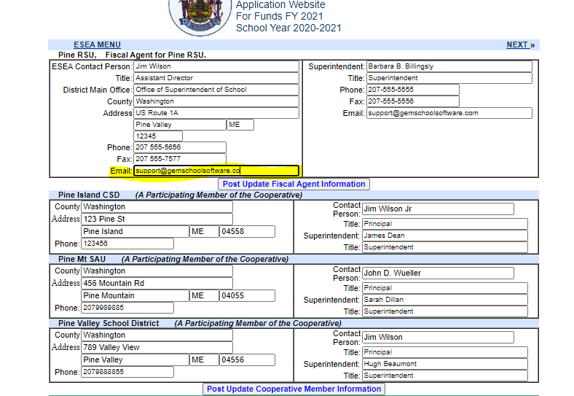
Adding Email Addresses for Notifications

Slide 7
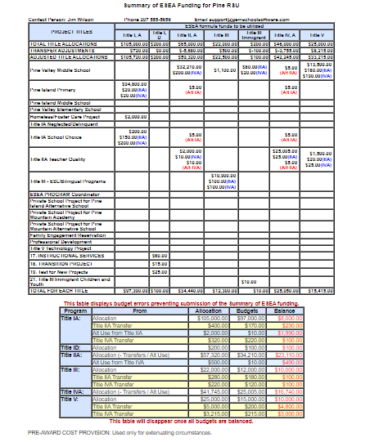
Screen Shot of Summary Sheet

Slide 8
FY 19-20 Performance Report Updates
Due Date-November 2;
Reporting period from 7/1/19 to 9/30/20
2. Reimbursement Alignment: Project budget expenses need to include transfer funds used for project expenses
3. Zoom Training Webinar-Coming Soon
4.Opening-ETA August 1, 2020

Slide 9
Risk Assessment
Required by EDGAR
34 CFR, Parts 76.77.77.78.81, and 85; 2 CFR Part 200.34 CFR Part 200.6-200.79
Annual review of financial, internal control, and programming practices
# of Findings: Low Risk, Moderate Risk and High Risk
Grant Award Notification (GANs) is issued for each Title (after transfers) but risk level is issued to the district
Risk Rating is highlighted in Yellow on the GAN
Factors-Timely submission and approval of application, performance report and invoices; accuracy of reimbursed expenses; audit findings, and etc.

Slide 10
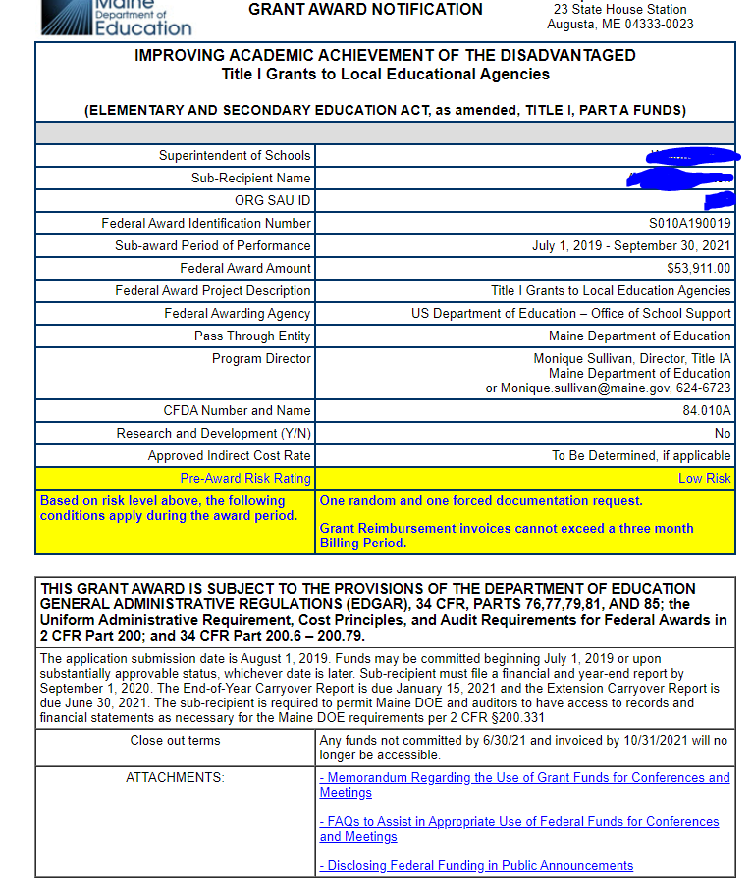
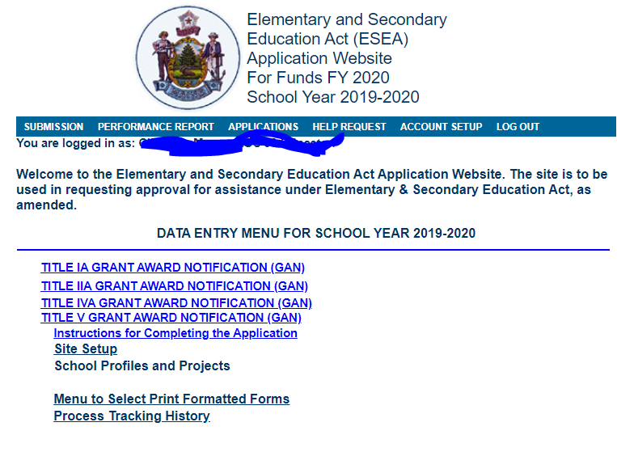
Grant Award Notifications

Slide 11
Fiscal Alignment
Invoicing-It is recommended that invoices occur on a monthly basis; it helps maintain alignment between expenses and reimbursements
Meet monthly with bookkeeper/business manager: it is recommended that the ESEA coordinator meet monthly with the business manager to make sure that expenses are invoiced in an accurate and timely manner
Inaccurate accounting: Can hold up reimbursements and negatively impact Risk Assessment; High and Moderate Risk Assessment ratings result in more monitoring and documentation checks

Slide 12
Responses to Pre-Assessment
Pre-Assessment
1. What is the due date for the FY19-20 Performance Report?
2. What is the reporting cycle for the FY19-20 Performance Report?
3. Where can a district find its' Risk Assessment rating?
4. Name three changes to the FY21 ESEA application?
5. What is the difference between an expenditure and reimbursement?
Bonus: What is a difference between an obligation and an encumbrance?

Slide 13
Resources
Federal Programs Webpage
https://www.maine.gov/doe/learning/esea
https://www.maine.gov/doe/learning/esea/resources
Maine Professional Learning Webinar Library
https://www.maine.gov/doe/webinarlibrary
https://www.youtube.com/user/MaineDOEComm/playlists
ESEA Federal Programs Youtube Playlist
https://www.youtube.com/playlist?list=PL-cO8lcaOYu31eIoN3pO0cZryVH_cJ6l3

Slide 14
District TA Time
Questions?
Agenda
9:00-10:00 Baileyville
10:00-11:00 AOS 96
11:00-12:00 RSU 39
12:00-1:00 RSU 50
Contact Information;
Monique.Sullivan@maine.gov
624-6723
TA Session #2 –July 13
General Session Topics-Monitoring and Compliance
STOP RECORDING

