Slide 1
Reading in high school
Helping all students engage with complex texts
Notes:
Morgan: Redefine text as “source” instead of just text.

Slide 2
Goals for Series
Understand the similarities and differences of reading instruction in high school and in the lower grades
Learn strategies to help students engage with complex texts in any context
Develop instructional plans to address a variety of student needs
Notes:
Morgan: Many strategies for teaching reading are developed for the lower grades. It is essential to help students engage with complex texts and not to replace complex texts with simplified versions. Most important is the need to develop consistent, unified plans to address needs in each content area.

Slide 3
Topics in session 4
Who is a “struggling” reader?
What are the roles of conceptual/experiential knowledge and culture in literacy instruction?​
What are some common misconceptions about vocabulary acquisition?​
How can we differentiate for various kinds of learners?
Notes:
Morgan

Slide 4
Quick Review of Session 3
Notes:
Morgan: This Is a quick review of the research from Reading for Understanding. Major idea: all students must engage with grade level text to improve reading, writing, and communication skills!
In the last few weeks, we have been exploring the idea that literacy, and what it means to be literate, goes well beyond text. Often as students begin to approach and progress through high school there is a shift where reading becomes the primary modality for knowledge building. We hope that now you are starting to see that reading and literacy are different in some key ways. Yes, reading, moreover, the ability to read and to glean information from text is a critical part of our society and is vital, but it its not reading alone that makes us literate. Merriam Webster notes 4 related definitions for "literacy" 1. Educated/cultured; 2. able to read and write; 3. versed in literature or creative writing; 4. having knowledge or competence. No matter what adjective we use to describe ourselves as "teacher" whether is "english" teacher, "biology" teacher, or "math" teacher we are all responsible for assisting students in literacy development. When we consider the experiential diversities of our students, I would venture that many more fall outside of the domain of "average" than ever before. How we approach literacy across domains can play a big role in student engagement, achievement, and desire for learning.

Slide 5
Icebreaker: 5 Minutes
With your partner(s), discuss the attitudes and assumptions that underlie 2-3 of these quotes.
How am I supposed to teach him 1984 when he can’t even speak English?
AP English might not be within reach for you right now.
I teach ninth grade, but he reads at a fourth-grade level.
I can’t get the parents to answer an email, no matter how many I send.
My struggling readers need more support because I can’t get them to the next level.
She just keeps guessing words instead of trying to sound them out.
Notes:
Andrea – 1 min max
Breakout – 5 min

Slide 6
Asset-Orientation: Walking the Walk
We must carefully examine the alignment between what we believe and what we do. How does our approach to literacy express our belief that all students can succeed?
In the chat, complete this sentence:
“I believe all students can succeed, so in my class ___________.”
Notes:
April 30-45 seconds

Slide 7
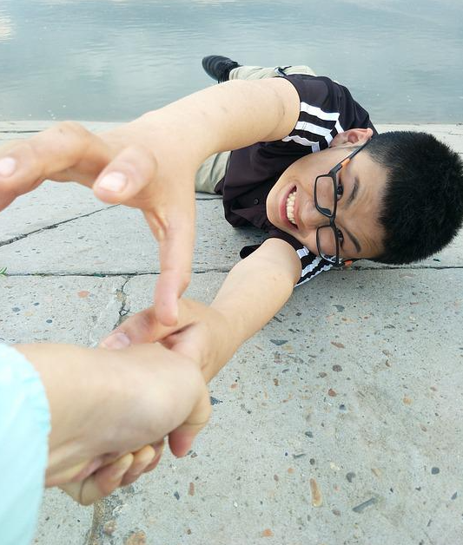
Asset Orientation: Walking the Walk
Terms like “struggling reader” and “reluctant reader” emphasize a student characteristic as the issue at hand.
Notes:
Andrea/April: When I was in 8th grade, I scored at the 35% percentile on the literacy portion of the MEA. I might have been labeled a struggling reader.
MLs are not struggling – natural, normal process of SLA (may look similar to a learning disability)

Slide 8
Asset Orientation: Walking the Walk
All readers may “struggle” under certain conditions. Focus on those conditions and how they can be improved to meet a student’s needs.
Notes:
April/Andrea: If a plant is not thriving, the first thing we check is the soil quality, the sun exposure, the amount of water, to make sure they’re all in balance for what that particular plant needs. Similarly, you have to really know your students as individuals from how they "perform" in school to the nature in which they are accumulating experiences that shape them outside of school. The conditions of their growth include: socioemotional well-being, physical well-being, interest/relevance to student, sense of belonging, motivation, etc.

Slide 9
Asset Orientation: Walking the Walk
Our abilities are not static; they are variable and constantly evolving.
Notes:
April: So when we assign a label or level to a student’s literacy abilities, we risk forming a static, overly generalized view of who that student is and what she can do.

Slide 10
Asset Orientation: Walking the Walk
Students are perceptive when it comes to our beliefs and expectations about their abilities. Inspire students’ belief in their own abilities by expressing high expectations for all.
Notes:
Andrea: How many stories have we heard about a teacher saying one key thing to a student that either built them up or tore them down, and that had life-long implications for that person?
Provide quick anecdote about how some of our current practices start to shape students’ beliefs/perceptions of themselves as different in as early as second grade (pull out, special ed, etc.)

Slide 11
A Tale of Two Students
Student A
Since I was a little kid, my parents have taken me on trips all over Maine, and even to other states, so I get to see all kinds of cool stuff. We’ve been to museums, gone on boat trips, hiked mountains, and seen lots of concerts. I’ve also been in sports and music lessons for years. When I was younger, my parents used to read at least three books to me every night.
Student B
Before my parents got divorced, we used to do things together like cook dinner and read in the evenings. Now, my mom tries to still do that for me and my sister, but she has to work a lot more these days. Since I'm the oldest, I have to help make dinner and get my sister ready for bed. I don't always get my homework done, and even when I do have time, I would rather work on things I like. I'm really good at fixing cars, and I like to imagine what kind of car I might be able to design one day.
Notes:
April
Breakouts of 2-3: 5 minutes
What kinds of assets does each student bring?
Which of these kinds of assets is advantaged in a typical school situation?
Which of these kinds of assets tends to lead to better literacy outcomes? Why?

Slide 12
The Matthew Effect: A Case for Content-Rich Literacy Instruction
“Elementary Education has Gone Terribly Wrong” by Natalie Wexler (Originally titled “The Radical Case for Teaching Kids Stuff”)
Students perform better in reading when they already have knowledge of the subject matter.
Children with less (or different) conceptual and experiential knowledge are often assessed as being at a lower reading level.
They then receive reading materials that are simplified, with the belief that this will help them acquire the discrete, foundational skills of reading.
In turn, they receive less rich content which can lead to disengagement and reading apathy
The gap between the “rich” and “poor” when it comes to conceptual and experiential knowledge thus widens ever further.
Notes:
Andrea

Slide 13
Whole Student Literacy Practices
Oral language precedes literacy.
Use non-assessment assessment techniques to better meet students where they are at.
Notes:
Andrea – Culture and Language practices
1. April is going to talk more about this coming up in a few slides, but I wanted to touch on it here as well. When children are very young, it is suggested that we talk to them. A lot. Name everything we are seeing and touching, and hearing; ask questions about objects in the environment, etc. We never assume a child is going to know all about the items in their immediate environment, we invite conversation with them, and meet them where they are at. You wouldn't give two year old a picture of a playground and expect they would know what each apparatus was when you arrive at the park. But, you might look at a picture of a playground and point out each apparatus, talk about what it might sound like, feel like, what kinds of ways we can use the apparatus, etc. In may many ways, teaching 10th graders is very much the same.
2. A "pretest" need not always be a replica of what students will see on the unit exam. You can, and should, use non-assessment ways to assess where your student is on a particular topic. Let's say you are about to dive into the book To Kill a Mockingbird. You are going to be diving into the theme of good versus evil. What kinds of experiences might students have already had about good versus evil?

Slide 14
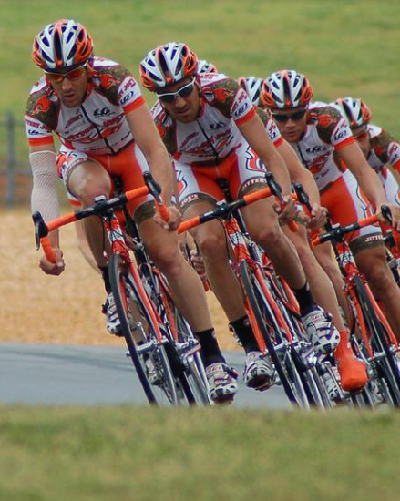
Culturally Responsive Literacy Practices
Culture is what binds together any social group.
Take inventory of your instructional materials:
What cultural lenses are emphasized/deemphasized?
Which cultural identities are represented - and which are not?
How are those identities portrayed?
Are there diverse perspectives and sources of information?
Are there opportunities for your students to see themselves reflected in the materials?
Check out Diverse BookFinder from Bates College!
Notes:
April: Social groups like: cyclists, the Perkins family, Deering High soccer team, a 10th grade English class, transgender people, Americans, residents of Milo, Maine, Republicans, Rwandans, Francophones, the deaf or hard of hearing, etc.
Are identities represented favorably/unfavorably, with complexity or superficially?
Might there be other texts that would help students achieve the learning objectives just as well as (or better than!) the classics/stand bys?

Slide 15
Engaging Students with Culturally Responsive Texts
While watching, take note of one interesting quote from a teacher or student.
Notes:
April
“I love this book because it talks about a country in Africa and I’m from Africa.”
“When we started reading this book, I heard a lot of kids from Africa… they were like finally, we’re learning something about the world, the whole world, and Africa.”
“When they are compelled and interested in the topic, they are willing to work really hard and work with challenging texts.”

Slide 16
Linguistically Responsive Literacy Practices
Integrate the WIDA ELD Standards.
Promote equal value and respect for all languages and language varieties.
Find out what linguistics assets students possess and leverage them.
Encourage translanguaging.
Recognize that oral language precedes literacy.
Focus on vocabulary and conceptual knowledge.
Notes:
April/Andrea
Knowing the basic features of a student’s language can help anticipate challenges
Cognates and false cognates, language comparisons
non-transparent systems of phonics
knowing the degree of literacy a student may have in another language
Talk about sociolinguistics, varieties of English, codes of power
Difference between FLA and SLA/a student may have deep conceptual knowledge of baseball but not yet have the English words yet to express that knowledge

Slide 17
What’s the truth about vocabulary?
Students will absorb academic vocabulary if they’re immersed in it.
Having students look up the definition of a new word is a helpful way for them to learn.
Once you teach a new word, students are responsible for knowing it.
Students know when they don’t know a word.
Multilingual learners should use English definitions rather than translating new words.
It’s usually possible to guess the meanings of words from context.
Notes:
April

Slide 18
Read the paragraph and be prepared to answer the questions on the next slide.
Myriad activities that exemplify sustainability await visitors to The Nordics. Finland, home to 41 national parks, 3 million saunas and outdoor activities like off-road biking and ice paddling, plans to be carbon neutral by 2035. Various areas of Sweden are gaining a reputation for being eco-friendly, including Gothenburg which has been named the world’s most sustainable destination in the Global Destination Sustainability Index for five consecutive years; Stockholm, where nearly 80 percent of hotels are sustainability accredited by a third-party certifying body; and Skellefeå which aims to become an early adopter of electric aviation.
Notes:
Andrea – (omg, this is what students are experiencing.... what can I do about that???
**April (Zimbabwe, Tanzania)

Slide 19
1. By 2035, Nordic hospitality destinations plan to be ___________________.
2. A major focus of the Nordic hospitality mission is _____________.
3. True or False: The Nordic hospitality industry is known for being a leader in establishing a low carbon footprint.

Slide 20
If culture is what binds the people in any group, the same can be true for a classroom group... both whole and small... ​
“This is what we do here."​
​
How those cultures are adopted by principals, teachers, students, and families plays a big role in the overall learning climate​.
​
Teacher behaviors in the high school reading classroom are equally as important as the behaviors of our students when it comes to approaching content instruction or assessment through text.

Slide 21
What is the most powerful intervention that high schools can use to support their students?
(Hint: This intervention is TRUE for all aspects of school – academic, and behavioral... and it's free, and most educators are already trained/familiar with it)
Relationship Building
Relationships with text
 | Literature | Non-literature | Implications
Hook | The part of the story that grabs the reader and makes them want to engage with the text | Generally N/A The interest in learning from non-literature text comes from inside the student and/or is teacher driven | - Disengagement - Apathy - Undesirable or troubling behaviors - Absenteeism - Low scores -Work incompletion
Content | A series of conflicts and resolutions a character encounters... generally in relation to the hook | Facts Figures Long sentences, with big words that focuses on one small aspect of the topic
Follow-Up (+) | The desire to imagine what's next for the character; interest in reading similar stories; interest in reading work by same/similar authors | Wanting to explore more about the topic (or related topics that were wondered or are interconnected in some way; even inventing | - Enthusiasm for learning - Engagement - Potentially higher scores/grades
Follow-Up (-) | Negative feelings and attitudes about literature | Negative attitudes and feelings about subjects/topics/content | Lower levels of achievement; Sometimes labeling
Ask yourself:
What will I do when one or more of my students are having difficulty connecting to the text?
(Answers should not assume reading ability).
Notes:
What do we do when
Students are unable to establish a relationship with a text?
What role does the teacher play as the assigner of the text?
Positive follow-up results
Negative follow up results

Slide 22
A modern perspective of Differentiation
Differentiation begins with teacher decision-making
Who are my students?
What learning diversities do they bring?
Based on what I know about my students, what barriers exist in my instructional plan?
What is my motivation for teaching ________________?
What is my goal for the unit?
What kind of goal setting will I have students do to better assure they will engage with the text
Notes:
1. Differentiation begins before the lesson even starts
2. Teacher's decision-making that informs what decisions they will make about instructional delivery that is driven by assessment of the students they are teaching now. 3P's: Philosophy, Principles, Practices
3. Eliminating, or at least reducing as much as humanly possible, the barriers that will get into students' way during your unit.
4. Ask yourself: What is my motivation for teaching ____________?, What is my goal of the unit?
5. What kind of goal setting will you have students do. IMPORTANT – Goal setting DOES NOT have to be connected to targets or standards. While that is important, that is more often the teachers goal
4. What If you decide you want to teach To Kill a Mockingbird in class, what is your motivation? Is it that TKAM is part of your tradition? Part of the grade-level's tradition?

Slide 23
The Effects of Goal Setting on Frustration
Teacher Motivation | Teacher Goal
Student Goal | Student Motivation
Notes:
Goal setting Matrix

Slide 24
Accommodations and Differentiation
Accommodations
Let's play a game!
1. Turn on your camera if you wear glasses or contacts.
2. Turn on your camera if you have ever used a step stool or ladder to reach something up high.
3. Turn on your camera if you have ever used a fork to eat pizza.
4. Turn on your camera if you have ever put on a sweater to keep warm.
5. Turn on your camera if you have ever used crutches (or a cane, or some other ambulatory device).
Accommodations and Modifications... Why it is crucial we know the difference
Notes:
The Equator
Turn off camera, respond to the statement by turning on your camera if the statement is true for you.
1. Turn on your camera if you wear glasses or contacts.
2. Turn on your camera if you have ever used a step stool or ladder to reach something up high
3. Turn on your camera if you have ever put on a sweater to keep warm
4. Turn on your camera if you have ever used crutches (or a cane, or some other ambulatory device)
Accommodations are tools that every human being uses at some point in time. They are also something that we tend to reserve for a student's 504 or IEP. We allow –some- accommodations, but tend to get really uncomfortable when a student uses "too many" accommodations, OR if they choose to use accommodations that we as educators perceive that they don't need.
Accommodations are really important in the grade-level classroom setting... and they can be used for a variety of purposes. Accommodations are NOT modifications. Never use accommodations to reduce the rigor of the work you are expecting students to do, rather use accommodations to assist the student in getting to that level of rigor.

Slide 25
Full Circle: 5 Minutes
With your partner(s), rephrase 2-3 of these quotes with an asset orientation.
How am I supposed to teach him 1984 when he can’t even speak English?
AP English might not be within reach for you right now.
I teach ninth grade, but he reads at a fourth-grade level.
I can’t get the parents to answer an email, no matter how many I send.
My struggling readers need more support because I can’t get them to the next level.
She just keeps guessing words instead of trying to sound them out.

Slide 26
Resources
WIDA English Language Development Standards
Free Self-Paced eWorkshop on the WIDA ELD Standards Framework
The Atlantic: Elementary Education has Gone Terribly Wrong
Vocabulary Myths by Dr. Keith Folse
SERP Institute: Vocabulary Myths Debunked
Diverse BookFinder

Slide 27
Feedback for contact hours
We will trade feedback for your contact hours. Please complete this form and download the certificate you receive after.
Notes:
Session 4 Feedback https://forms.office.com/pages/responsepage.aspx?id=q6g_QX0gYkubzeoajy-GTmWot5HVlCZMuDf_wKSJo1hUMUxLNzVRV1gyNTlESUxXOTA5MjFHTlRPSS4u

