Slide 1
Art Easel
Unit 3, Week 6

Slide 2
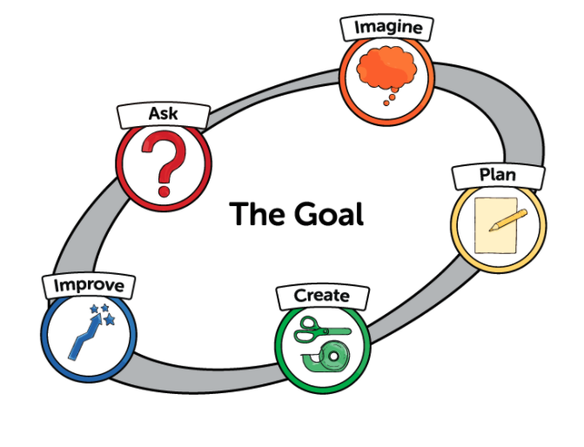
Using the Engineering Design Process
to construct a painting

Slide 3
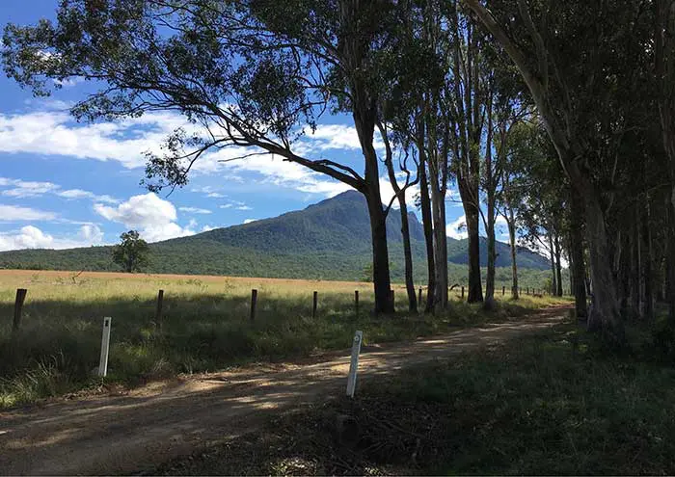
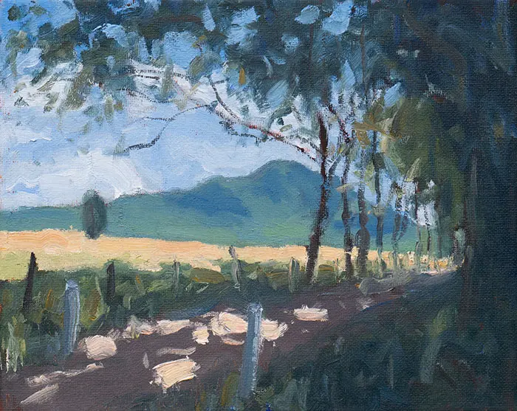
Ask
What am I inspired to paint?
What do I want to express?
Who will be my audience?
https://drawpaintacademy.com/planning-a-painting/

Slide 4
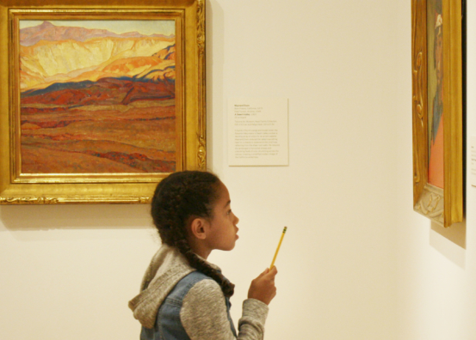
Imagine and Being Inspired
What ideas do I have?
Where can I learn more about this?
Who else can I learn from?
https://www.tacomaartmuseum.org/learning/family-programs/tips-visiting-kids/

Slide 5
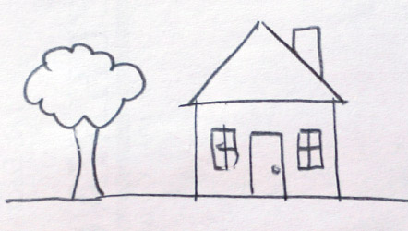
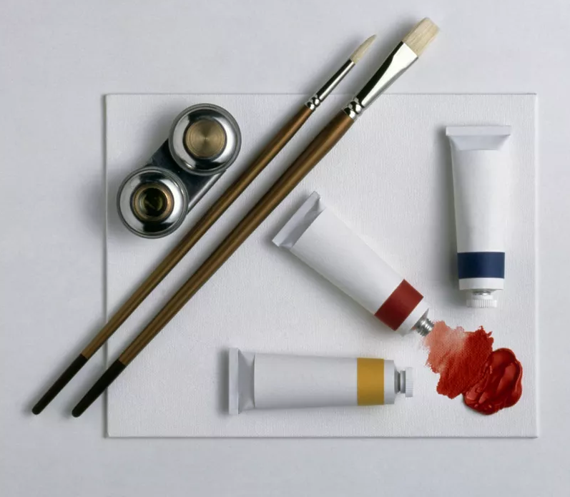
Plan
What will I include in my painting?
What shapes and lines?
What colors will I need?
Do I need to create any new colors?
What painting tools will I need?
https://www.thesprucecrafts.com/your-first-painting-4159810
http://doug-johnson.squarespace.com/blue-skunk-blog/2014/1/12/just-because-its-pretty-doesnt-mean-its-creative.html

Slide 6
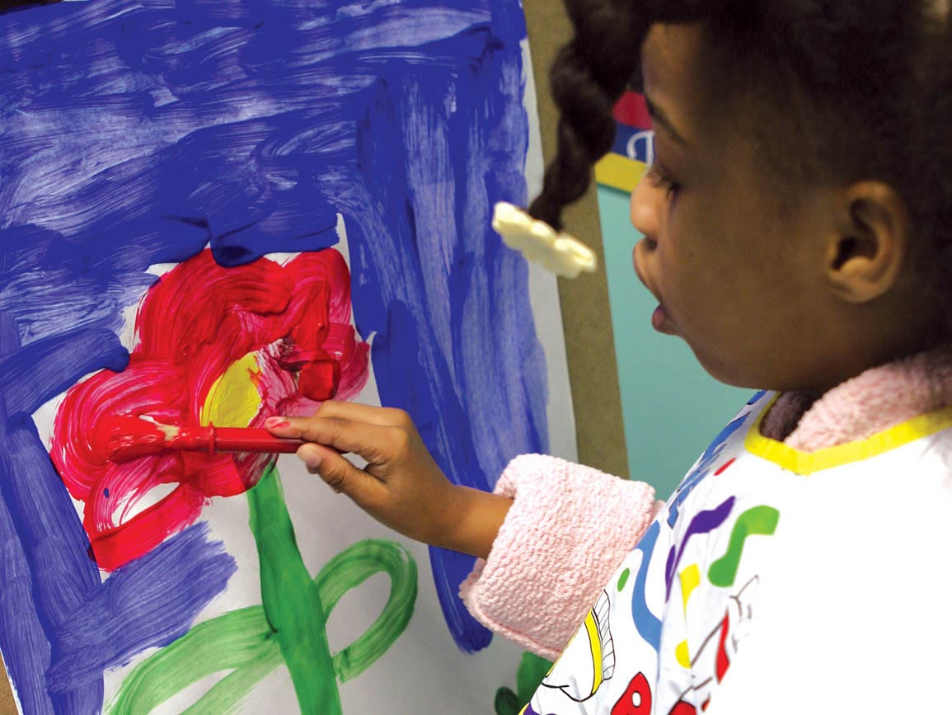
Create
I can follow my plan
to create my painting.
https://www.brighthorizons.com/family-resources/nurturing-creativity-and-imagination-for-child-development

Slide 7
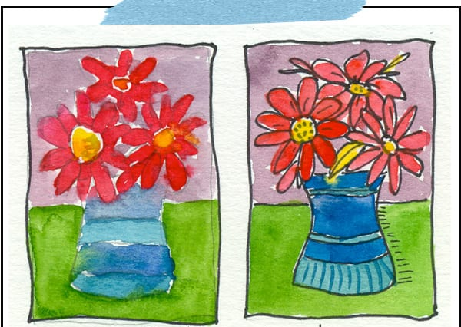
Improve
How do I feel about my painting?
How can I make my painting better?
What else can I add?
How can other people help me?
https://www.deepspacesparkle.com/top-eight-tips-for-teaching-art-to-children/
https://www.seriouslykids.com.au/talking-about-their-art/

