Slide 1
Images from Roxaboxen
Discovery Table
Unit 3, Week 7

Slide 2
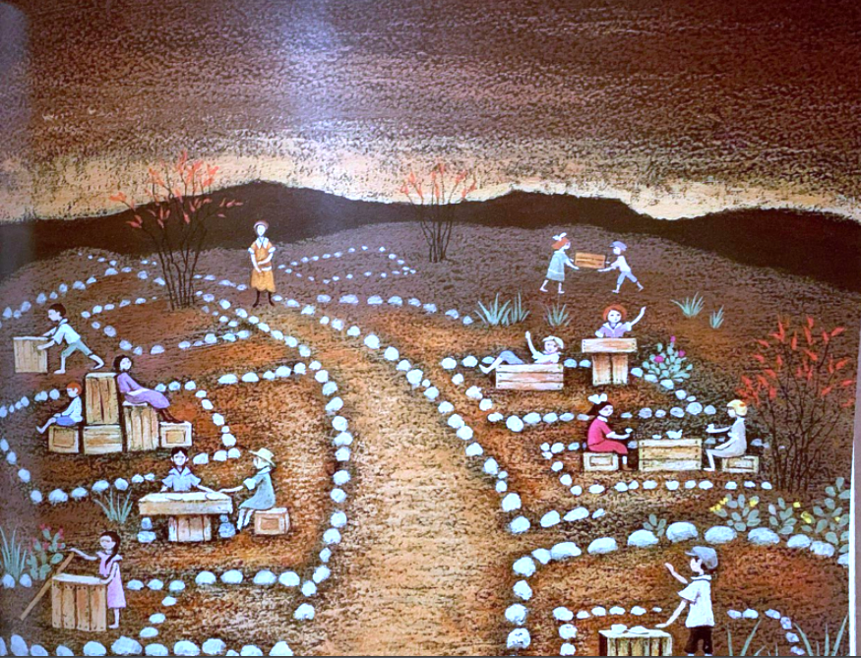

Slide 3
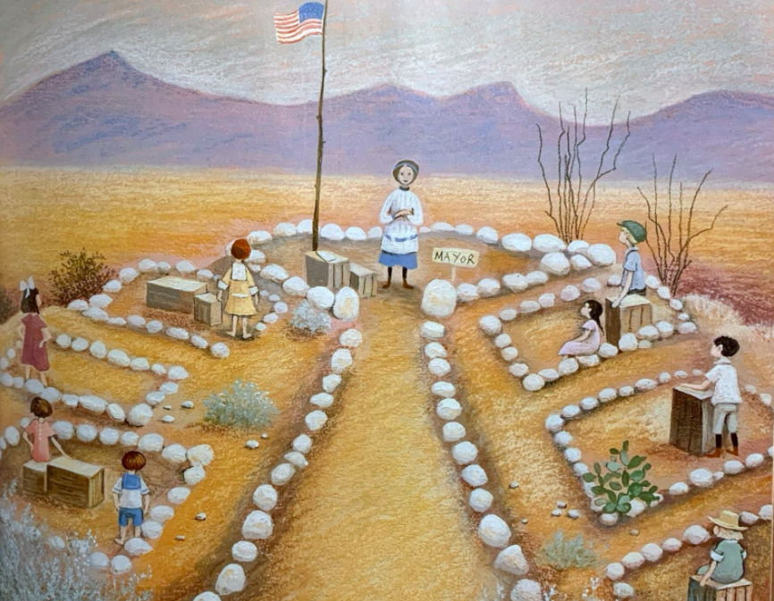

Slide 4
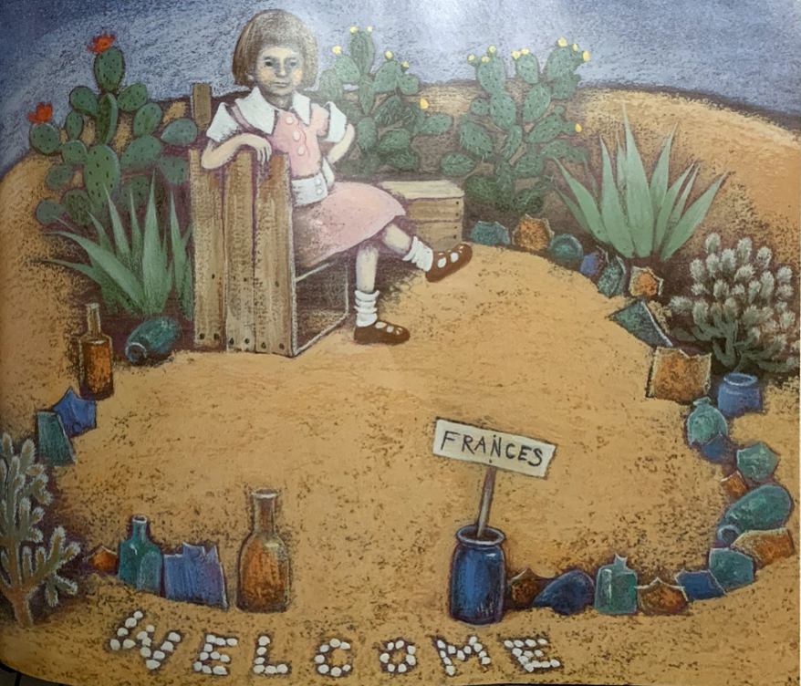

Slide 5
