Slide 1
Tree Images
Dramatization Center
Unit 2, Week 5

Slide 2
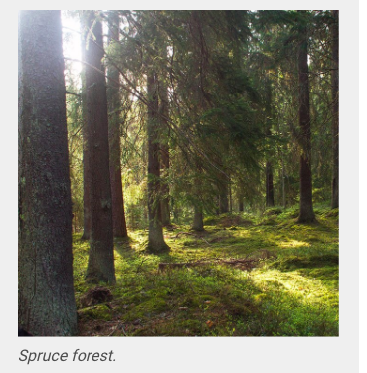
Spruce Forest
https://www.swedishwood.com/wood-facts/about-wood/wood-and-the-environment/wood-is-a-sustainable-construction-material

Slide 3
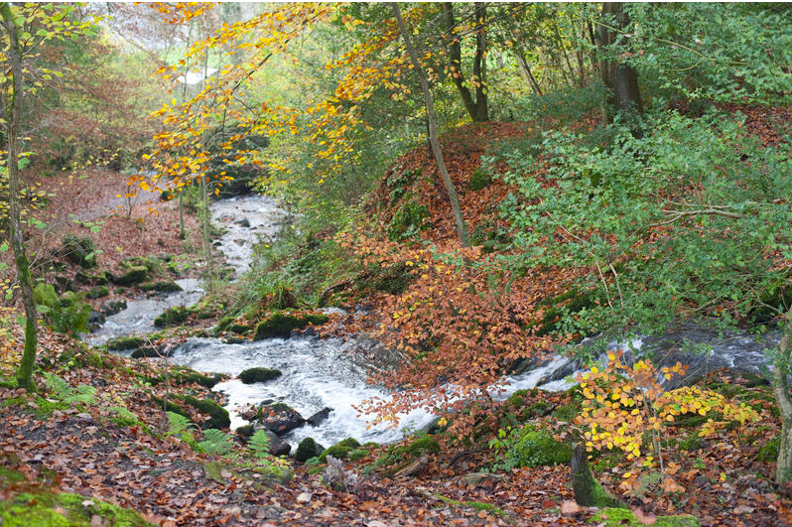
River Flowing through Autumn Woodland
https://www.freeimageslive.co.uk/free_stock_image/woodland-stream-autumn-jpg

Slide 4
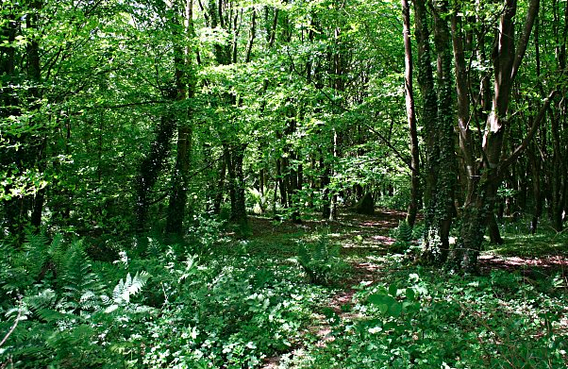
Deciduous Woodland near Stennack (England)
https://commons.wikimedia.org/wiki/File:Deciduous_Woodland_near_Stennack_-_geograph.org.uk_-_177520.jpg

Slide 5
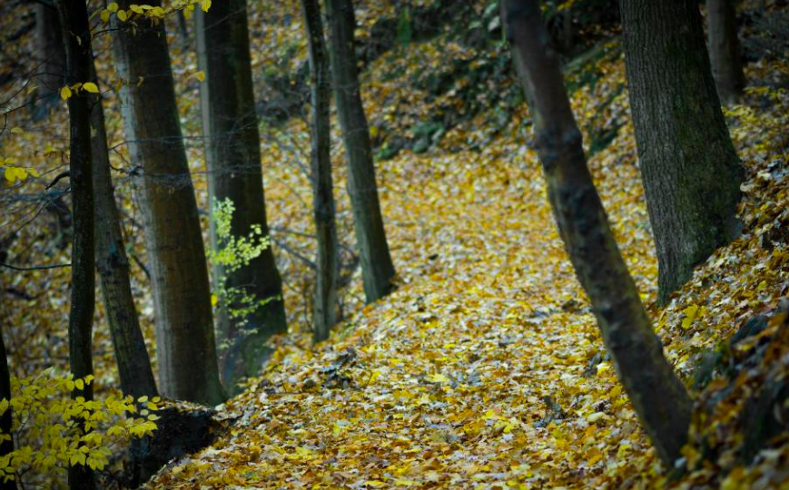
Woodland
https://stocksnap.io/photo/woodland-highland-5D1O0GIWYK

Slide 6
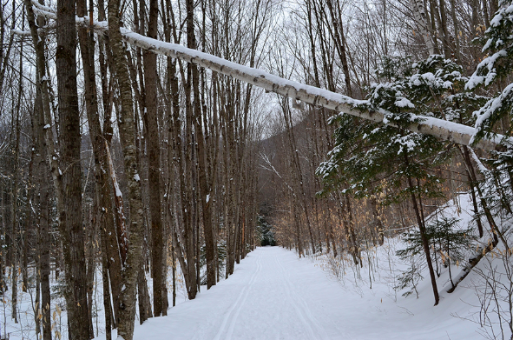
Tracks in the Snow
https://www.bostonmagazine.com/health/new-england-hikes-winter/ Photo by Gary Lerude on Flickr/Creative Commons

Slide 7
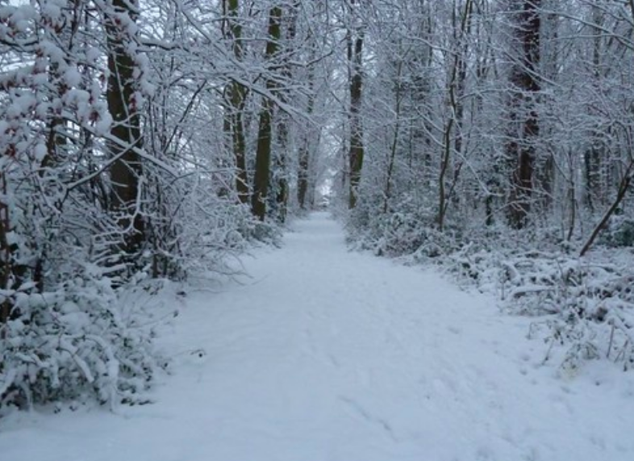
Snow Woodland Path
https://search.creativecommons.org/photos/3016eafe-9ec9-47bb-80c8-4dfc7b422271

