Slide 1
Primary Sources, A Variety of Applications
Shane Gower, Maranacook Community High School
Jamie Karaffa, Bruce M. Whittier Middle School
January 16, 2020
https://mainecouncilsocialstudies.org/

Slide 2
Inquiry with Primary Sources
Shane Gower
Maranacook Community High School
11th grade
US History- all levels

Slide 3
C3 Framework and Inquiry
We have redesigned our units to reflect the Inquiry Design Model supported by the C3 Framework
One of our units covers WW1 and WW2

Slide 4
What Happens When People Fight Over Power?
This is the compelling question we identified for our unit that covers WW1 and WW2. These are our supporting questions for this unit:
What were the results of the First World War?
How does crisis create the need for new systems of government?
How does one event change the course of history?
How can the desire to end conflict create increased tensions?

Slide 5
Standards and C3 Indicators
(Common Core) R7 To integrate and evaluate visual, textual and quantitative content from multiple sources of information to address a question or solve a problem
HS.His.1 Evaluate how historical events and developments were shaped by unique circumstances of time and place as well as broader historical contexts.
HS.His.5 Analyze how historical contexts shaped and continue to shape people’s perspectives.

Slide 6

Student Inquiry
In order to get students engaged in the content and skills I wanted something that would spark curiosity in students in the same way that historians are sparked. I turned to Question Formulation Technique.
https://rightquestion.org/

Slide 7
Question Formulation Technique
“When you use the Question Formulation Technique, you are making one significant change in the traditional dynamic in the classroom: from using your question to prompt student thinking and work to challenging students to come up with their own questions.”

Slide 8
Question Formulation Technique
For this QFT, I give students a primary source document. It is a form from the US Government asking the family of Millard Corson of Madison, ME what they would like to do with his remains. His Mother filled it out and its dated 1921.

Slide 9
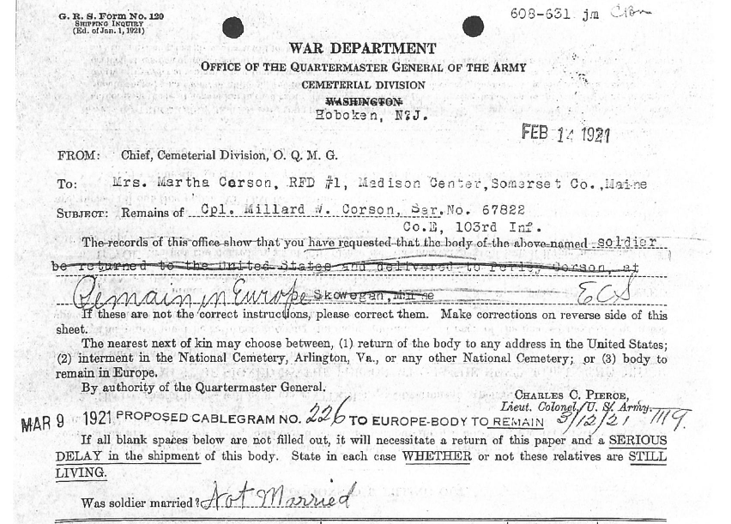
Primary Source
Analysis
In order to analyze this document we use a process we call getting “HAPP(Y)” with it!
H- Historical Context
A- Audience (intended)
P- Point of View
P- Purpose
Y- Why should we care?

Slide 10
H- Historical Context
What is happening in history around the same time as the date of the document that will help us to understand this document?
Students should be able to draw on this context so prior learning must take place
In this case, students watch a 12 minute video about the First World War experience from a soldier’s point of view and a 6 minute video from the ABMC about fallen soldiers and the American Cemeteries
(https://www.youtube.com/watch?v=s2J3eOdo2i0&feature=emb_logo),(https://www.youtube.com/watch?v=PL9eAV3RgHQ&t=184s)
After Historical Context, students get the document

Slide 11
A- Audience (Intended)
The author who created this document, who were they creating it for and how do you know?
Students look at the sourcing information that may or may not include the author and draw inferences based on this information
Students reflect on the message and think about who would need to hear this message?
In this case, it is a form filled out by someone. We are looking at the audience intended by the person who filled out the form not the intended audience for who created the form.

Slide 12
P- Point of View
What is the point of view or perspective of the author of this document, what is the author’s bias or mindset?
Students speculate and infer the mindset of the author and how that has affected the document and our understanding of what it means
In this case, students must think about what it might have been like for the fallen soldier’s mother to have to make this decision and what may have been influencing her decision?

Slide 13
P- Purpose
Why was this document created and what is its message?
Students draw conclusions and make judgments about the documents message
In this case, students must recognize that it appears as though the author made a decision and then changed their mind and tried to cross out the original decision, students automatically begin to wonder why the change of mind may have occurred.

Slide 14
Y- Why should we care?
Why is this document significant, why should anyone care about it?
Students draw conclusions about the importance of this document and how it helps us to understand larger and important concepts in history
In this case, students must think about how the decision made in this document (and then changed) affects the way we remember the sacrifice of this soldier as well as the sacrifice made by his family and informs us about the legacy of the war today.

Slide 15
Primary Source
Analysis
Students make notes on each of the following after watching the videos and looking at the documents
H- Historical context
A- Intended Audience
P- Point of View
P- Purpose
(Y)- Why was this created?

Slide 16
Question Formulation Technique
Once the students have gotten “HAPP(Y)” with the document we are ready for the QFT process.

Slide 17
Primary Source
Analysis
In order to analyze this document we use a process we call getting “HAPP(Y)” with it!
H- Historical Context
A- Audience (intended)
P- Point of View
P- Purpose
Y- Why should we care?

Slide 18
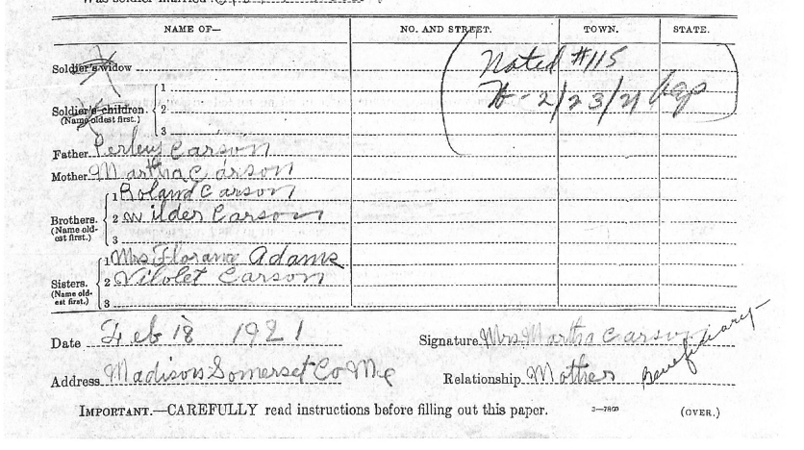

Slide 19
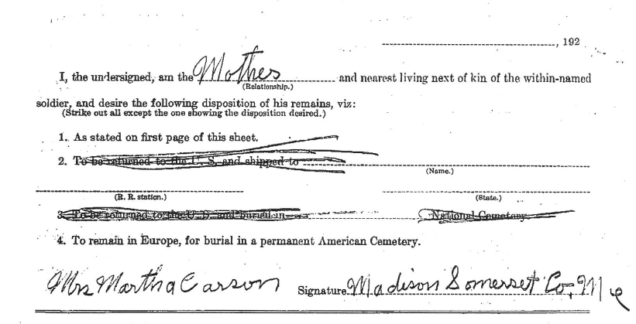

Slide 20
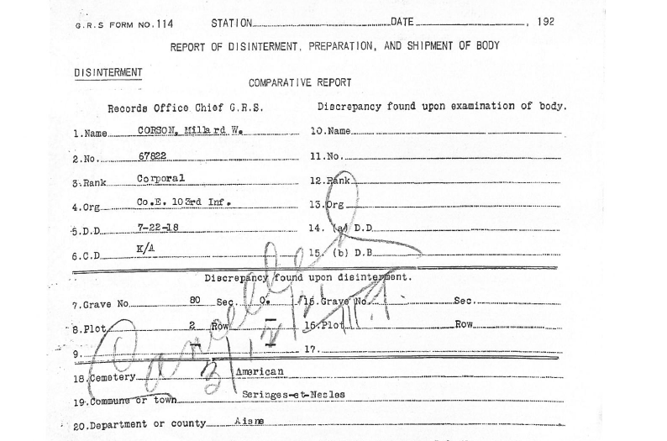

Slide 21
Question Formulation Technique
QFT Steps (for 2 minutes)
Ask as many questions as you can
Do not stop to discuss, judge, or answer any questions
Write down every question exactly as it is stated
Change any statement into a question

Slide 22
Student Sample Questions
Why did his mother change her mind?
How did his mother decide where he would be buried?
What influenced people’s decisions on where to bury their loved ones?
Why did the US Government give families this choice?
Why was he buried in this particular town in France?
Why was this decision made 3 years after his death and how did that affect the decision?

Slide 23
Question Formulation Technique
Next, review your list of questions and identify the closed-ended questions with a “C” and the open-ended with an“O.”
Closed-ended are not arguable and easily answered. Open-ended are the opposite.
Change any closed-ended questions to make them open-ended

Slide 24
Question Formulation Technique
Choose 3 questions from your list that you think are the most important- think about why? Because they are interesting? Difficult? Can help you understand something else that is important? Some other reason?

Slide 25
Sharing the Questions
Share your 3 questions with a partner
Choose 1 of the 3 to put on a sticky note

Slide 26
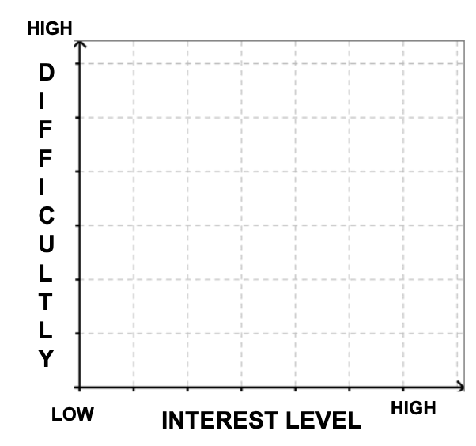
Graphing a Question
Have them “graph” their questions based on a X/Y axis of being “interesting” and their “difficulty” level. Challenge students to move “up” the graph with more interesting and difficult questions.

Slide 27
Graphing a Question
Draw the X and Y axis like you see on the Board. Students then take their sticky notes and post them accordingly.

Slide 28
Graphing a Question
Discuss: how can you move your question up the axis of interest and difficulty? Possibly allow students to edit their questions.

Slide 29
Graphing a Question
Each student now takes one of the sticky note from the graph (not their own). They are tasked with answering the question.

Slide 30
Graphing a Question
How this might look

Slide 31
Assessment
Students create a slideshow with the question they selected and their answer along with any sources used.
Slide show can be shared with the original student who asked the question
Slide show can be presented to the class

Slide 32
Conclusion- Class discussion and connections to the Inquiry
What happens when people fight over power?
What do these questions and answers tell us about the First World War?
What did we learn about life in Maine at the time?
What did we learn about sacrifice?
How can we acknowledge and commemorate the sacrifice of Millard Corson?
Questions?

