Slide 1

Pivoting Practice
Beth Ratway
Notes:
https://drive.google.com/drive/u/0/folders/13sv-IYElDwGczlfEj5W4bYmiGGonyxRE

Slide 2

Welcome
While we wait – Please jot down the following in the chatbox:
  Name
  Grade/courses you teach
  One thing you are interested in learning today

Slide 3
Checking In
https://www.window-swap.com/
Notes:
https://www.window-swap.com/

Slide 4
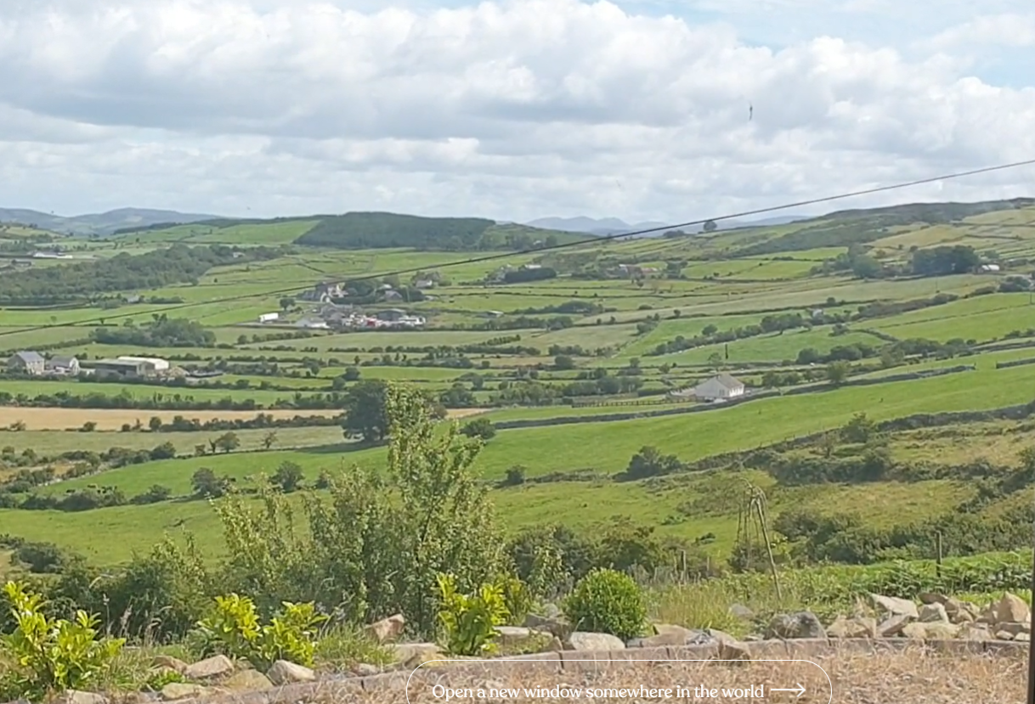



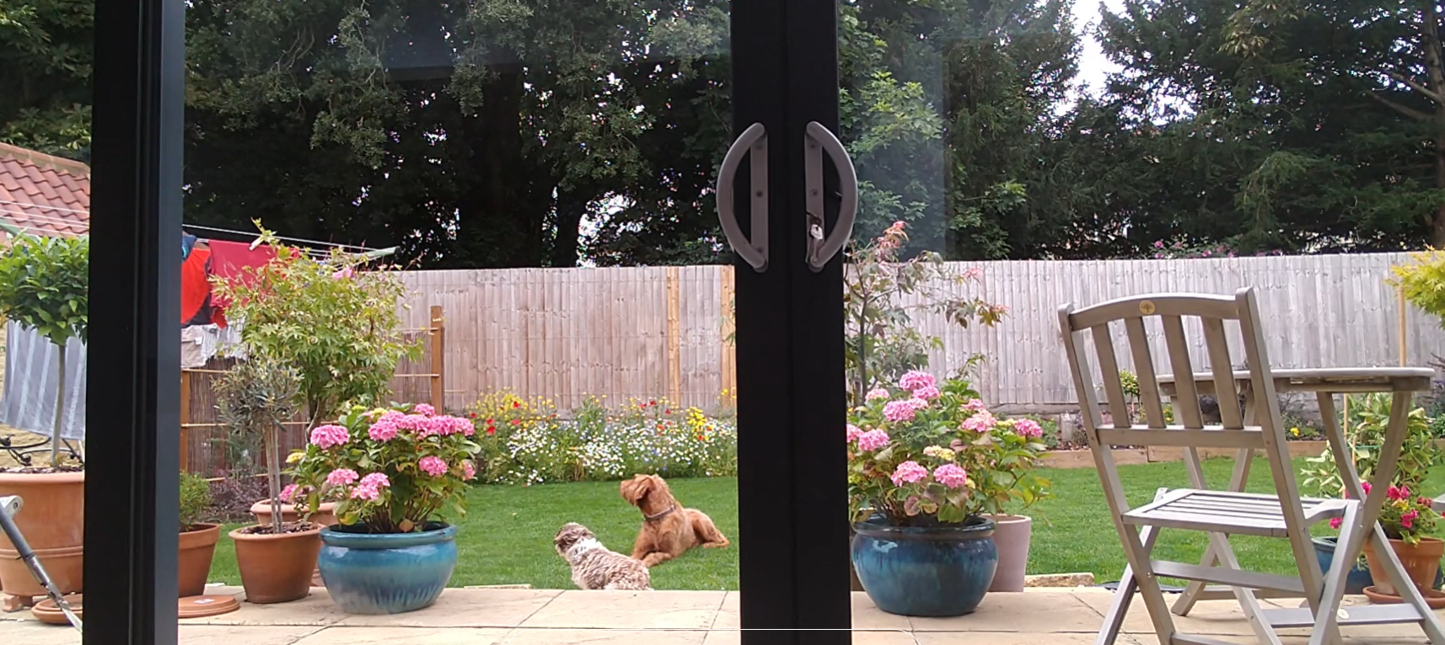
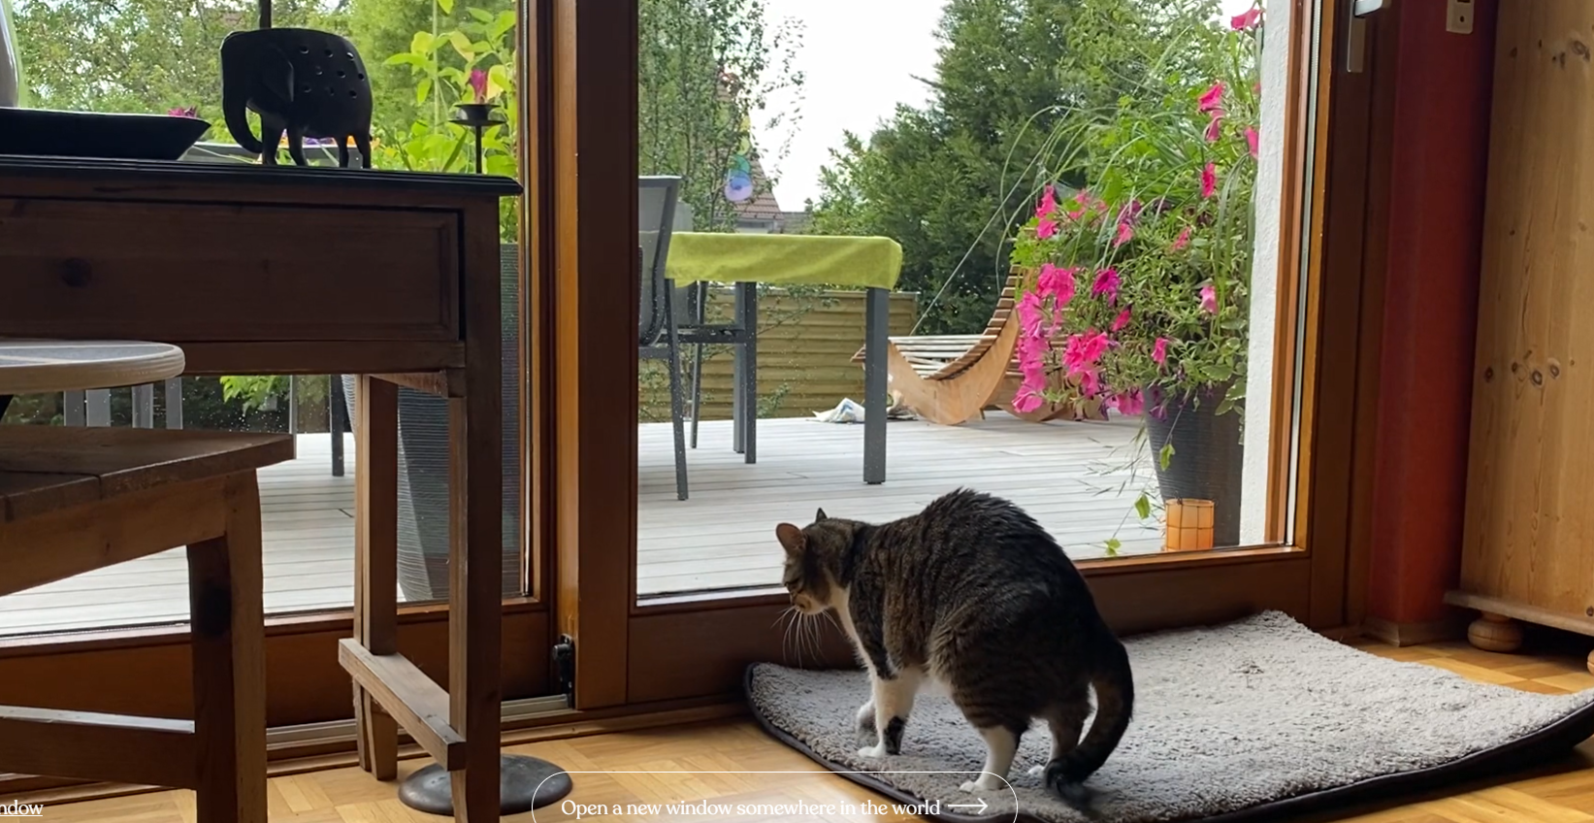
IRELAND
BRAZIL
ECUADOR
EGYPT
UK
GERMANY

Slide 5
What is Pivoting?

Slide 6
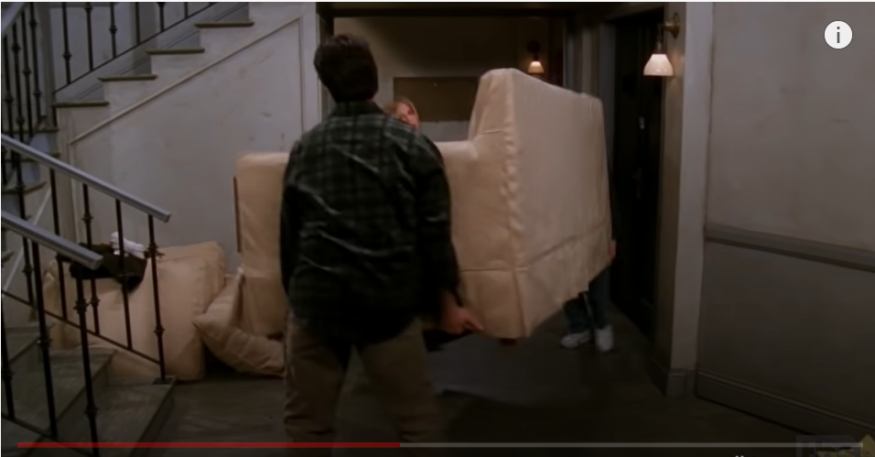
Notes:
https://www.youtube.com/watch?v=8w3wmQAMoxQ – 2:19

Slide 7
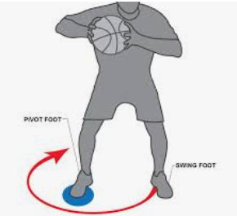
Notes:
Pivot foot is grounded in standards and good practices

Slide 8
Goals for Session
Learn how to ground instructional decisions in a set of central areas of focus.
Dig deeper into each instructional focus area
Learn a specific strategy for each area
Understand the key instructional areas of focus of social studies.
Unpack strategies and tools to support social studies instruction in person and online

Slide 9


We are in this together….
Notes:
Learning together – I do not have all of the answers – just bits and pieces – we need to continuously learn from each other

Slide 10

Protocol for Interaction
Be present and participate.​
Assume good intent.​
Listen to understand.​
Be open to new ideas.
Be open to working outside your comfort zone.
Take time to reflect.​
Please keep muted unless speaking to cut down on background noise.​
Use chat box to communicate any responses or technical issues.​
Others…?

Slide 11
What Do You Want Students to Know and Be Able to Do?
How Will You Know They Learned It?
How Will You Get Them There?
How will we respond when some students do not learn?
How will we extend the learning for students who are already proficient?
Continue to focus on the key questions
Notes:
This is what should ground all you do

Slide 12
What does good instructional practice look like in Social Studies?
PollEv.com/bethratway140
How is this different today???
Notes:
How is this different today?
Jot down your thoughts here
Question 1 - PollEv.com/bethratway140
Question 2 – in chatbox

Slide 13
Current Context
Clear and consistent communication
Creating explicit and consistent rituals and routines
Using research-based instructional strategies
Determining whether to use digital or non-digital tools for an assignment
A focus on authentic learning, where authentic products are created and students have voice and choice in assignments
Notes:
https://www.cultofpedagogy.com/9-ways-online-teaching/

Slide 14
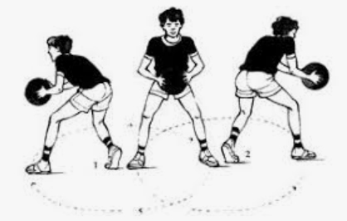
Planning Your Pivot
Notes:
Grounding the work in the standards and good practices

Slide 15

Pivot Foot – Grounded in Good Practice
Creating opportunities for inquiry
Purposefully integrating content and skills (disciplinary literacy?)
Facilitating historical thinking and analysis
Fostering spatial thinking
Creating opportunities for learners to engage in economic ways of thinking
Designing opportunities for civic engagement
Facilitating deliberation and discussions
Designing opportunities for learners to engage in cross-disciplinary studies
Engaging students in the analysis of multiple perspectives, allowing students to understand their place in the world
Engaging students in strategies to be critical consumers of information
Notes:
This comes from looking at multiple components including the standards

Slide 16
How are you currently engaging with students?
PollEv.com/bethratway140

Slide 17


1
2
Notes:
https://www.cultofpedagogy.com/6-ed-tech-tools-to-try-in-2020/

Slide 18
Jot Down Your Thoughts Here
Notes:
https://docs.google.com/document/d/1R8xvg2r0Lco0EkIfkAZMeb8KdRA9EfNNJdNTPrrzdhA/edit#heading=h.lcryqoc2rath

Slide 19
Pivot Foot – Grounded in Good Practice
Creating opportunities for inquiry
Purposefully integrating content and skills (disciplinary literacy?)
Facilitating historical thinking and analysis
Fostering spatial thinking
Creating opportunities for learners to engage in economic ways of thinking
Designing opportunities for civic engagement
Facilitating deliberation and discussions
Designing opportunities for learners to engage in cross-disciplinary studies
Engaging students in the analysis of multiple perspectives, allowing students to understand their place in the world
Engaging students in strategies to be critical consumers of information
Notes:
https://drive.google.com/drive/u/0/folders/1OHuOeqSjVfv6ULohI2-OL2hTfWuOoVYI
Tell participants to look at the number next to their name and open that doc in this folder

Slide 20
Strategies and Resources

Slide 21
Ready for More
https://clalliance.org/wp-content/uploads/2020/02/Design-Pack-Games-And-Learning.pdf

Slide 22
Visible Learning:
Surface and Deep Level High-Leverage Practices
Surface Level
Teacher modeling
Graphic organizers
Leveraging prior knowledge
Vocabulary
Wide reading
Note-taking
Deep Level
Close reading
Class discussions
Metacognitive strategies
Reciprocal teaching
Feedback to the learner
Overview
Notes:
The focus of this presentation grounding us in the purpose of social studies and focusing on those practices – Stefanie in Nov will focus on the process and how to design learning for conceptual understanding in social studies
Point participants to the overview linked in the slide and in their resources folder.
During this time, we are all thinking about ways in which learning can be accelerated in order to make up for any learning lost last spring.
Hattie et al. describes specific instructional strategies that work best in surface level learning and those which work best when in the deep learning phase. Both phases are equally important for student learning and, when used effectively, have the power to dramatically accelerate student learning.
Ask participants to go to their notecatcher and answer the following question:
How do you use “high leverage practices” in your own classroom?
Have a whole group discussion so participants can share their responses.

Slide 23
Resources
PLC/Self Reflection Tool
Notes:
https://docs.google.com/document/d/1vKWflx_nKmv08gWg5RAIbwc1zasbaPoDmvrIsPfHEvI/edit

Slide 24

Questions and Comments
Notes:
Anyone willing to share?

Slide 25

Thank You!
Beth Ratway
bratway@air.org

