Slide 1
Personal Primary Sources for Student Learning
Maine DOE
Virtual PD Offering
4/30/2020

Slide 2
Disciplinary Literacy in Social Studies
Definition of Disciplinary Literacy in Social Studies
(adapted from Jeffrey Nokes)
“Social studies literacy is the ability to construct meaning with multiple genres of print, non-print, visual, aural, video, audio, and multimodal texts; critically evaluate texts within the context of the work that experts in the field have previously done; use texts as evidence in the development of original interpretations of concepts or events; and create multiple types of texts that meet discipline standards.”

Slide 3
Criterialist
With practice and support, students are able to be: Criterialist – critical of all sides until properly evaluated and then one is deemed superior
In order to be able to take this stance, students are:
active in the process of disciplinary thinking
allowed to construct their own independent interpretation of an event different from others
aware of strategies that they can use to effectively weigh the evidence
expected to base claims on evidence

Slide 4
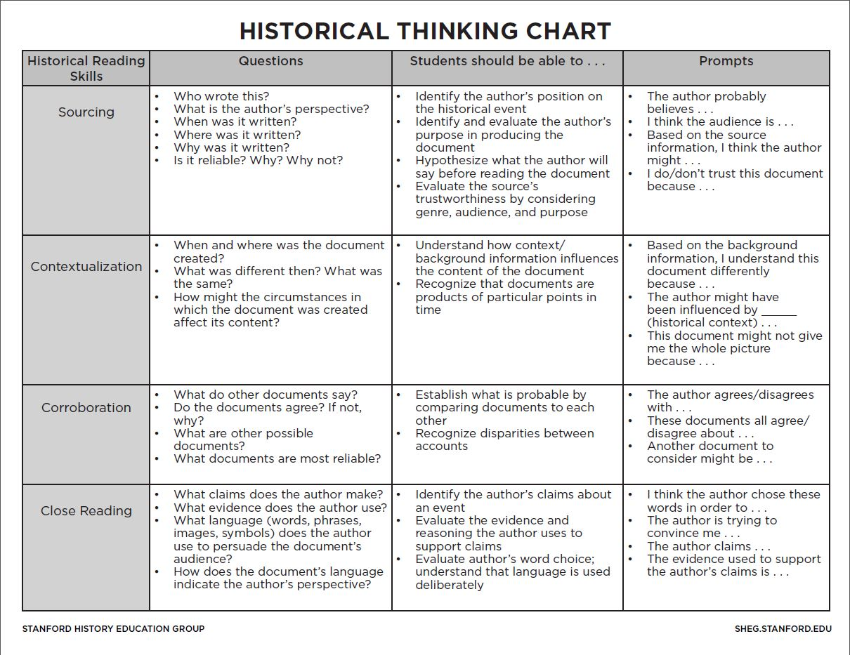
Working With Primary Sources

Slide 5




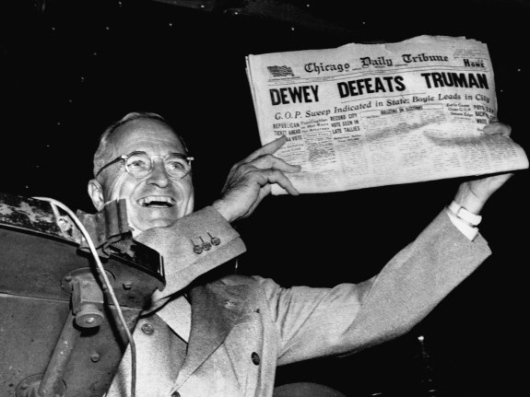
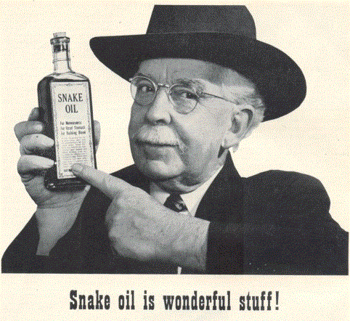

Slide 6
Evaluating the Source
Historical Question: Who was present at the signing of the Declaration of Independence?
Source 1: Hollywood movie about the American Revolution made 2001.
Source 2: Book written by a famous historian who is an expert on the American Revolution, published in 1999.
Which do you trust more? Why?

Slide 7

The Source Matters!
Have your students watch/read different news sources and compare.
What other examples might your students have had where sourcing was called into question?

Slide 8
Evaluating the Source
Historical Question: What was slavery like in South Carolina?
Source 1: Interview with former slave in 1936. The interviewer is a black man collecting oral histories for the Federal Writers’ Project.
Source 2: Interview with former slave in 1936. The interviewer is a white woman collecting oral histories for the Federal Writers’ Project.
Which do you trust more? Why?

Slide 9
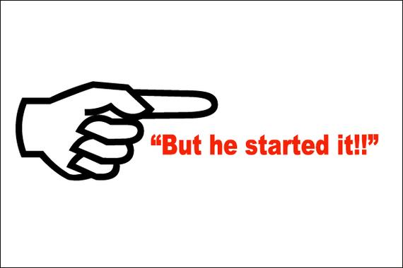
The Source Matters!
Have students have different people share their version of what happened.
What other examples might your students have had where sourcing was called into question?

Slide 10
Evaluating the Source
Historical Question: What was the layout of the Nazi concentration camp Auschwitz?
Source 1: Interview with 80 year-old Holocaust survivor in 1985.
Source 2: Map of concentration camp found in Nazi files.
Which do you trust more? Why?

Slide 11

The Source Matters!
If your students are journaling, have them reflect on what happened BEFORE looking back.
What other examples might your students have had where memory was called into question?

Slide 12
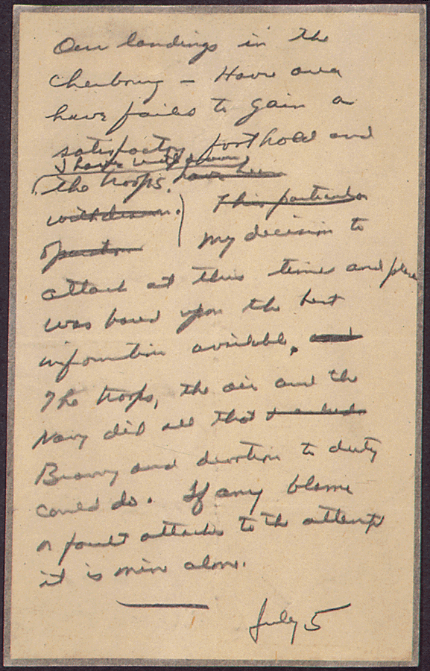
Working With Primary Sources
Help students understand that primary sources are evidence not fact.
"Our landings in the Cherbourg-Havre area have failed to gain a satisfactory foothold and I have withdrawn the troops. My decision to attack at this time and place was based upon the best information available. The troops, the air and the Navy did all that Bravery and devotion to duty could do. If any blame or fault attaches to the attempt it is mine alone."

Slide 13
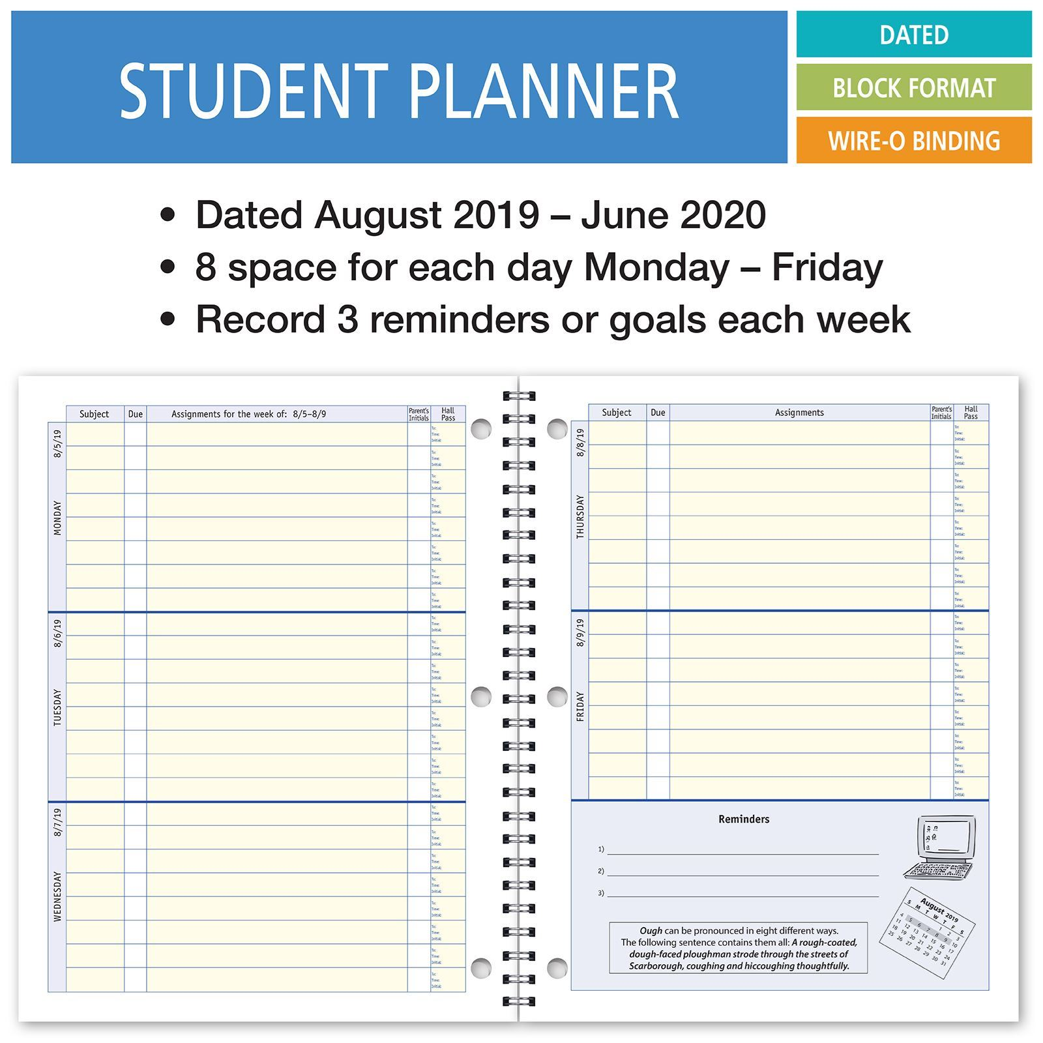
Personal Sources As Evidence?
What pieces of evidence from a student planner could be misleading if looking back in history?

Slide 14
Working with Artifacts
Observations | Inferences
Ability to infer is an essential strategy for comprehension (Afflerbach & Cho 2009)

Slide 15
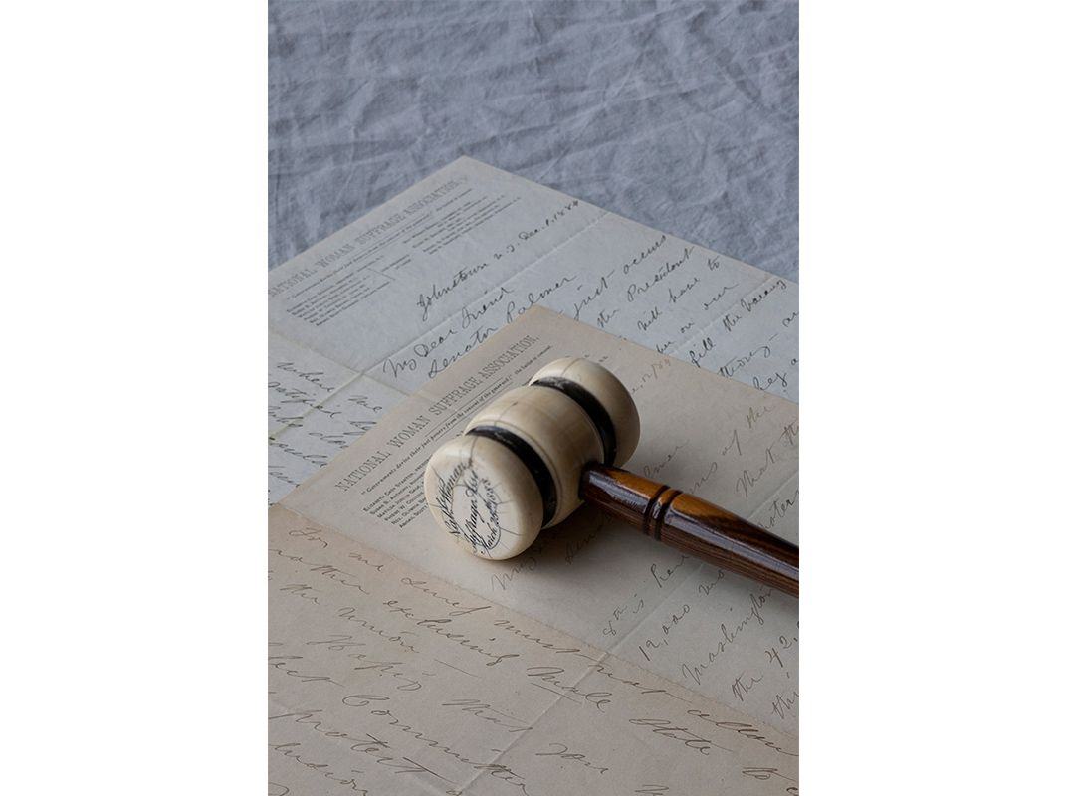

Slide 16
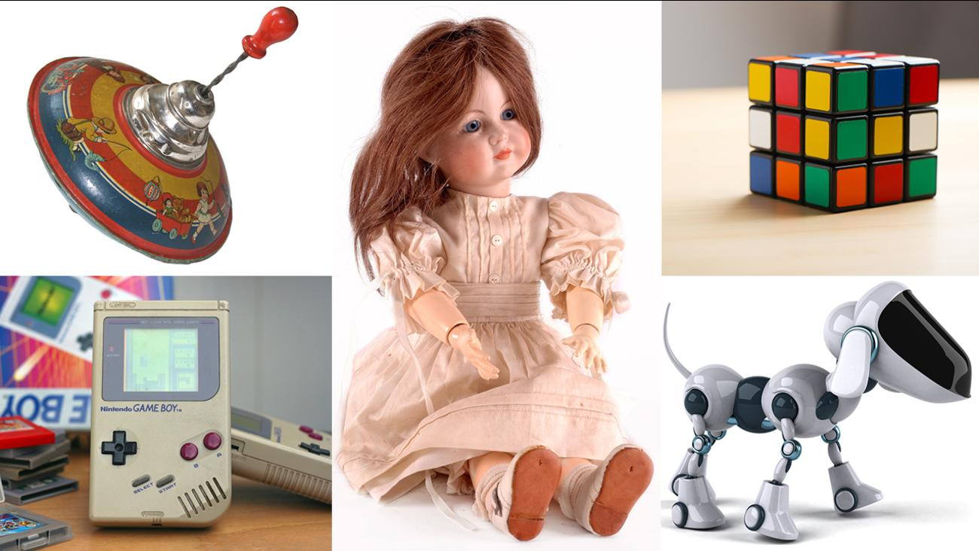
A Closer Look at Their World
What things in their house can they took a closer look at? What might they have missed every day???

Slide 17
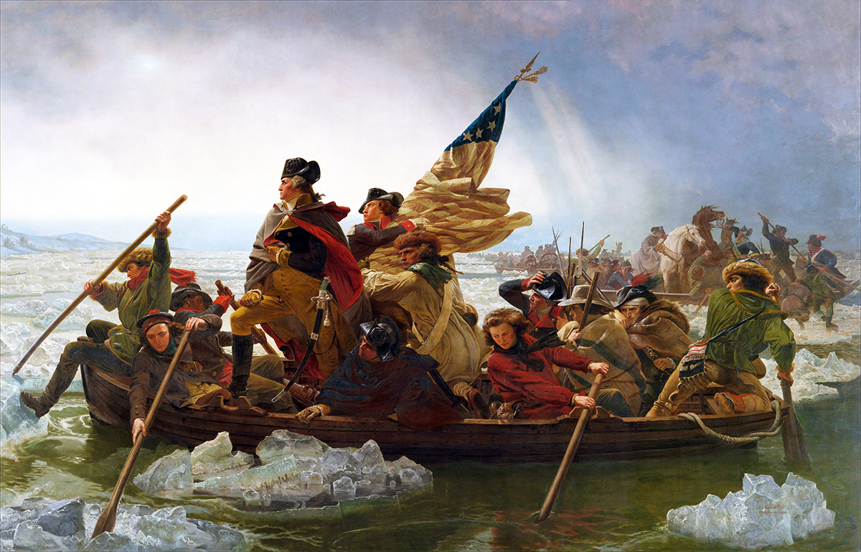
What Are Your Questions?

Slide 18
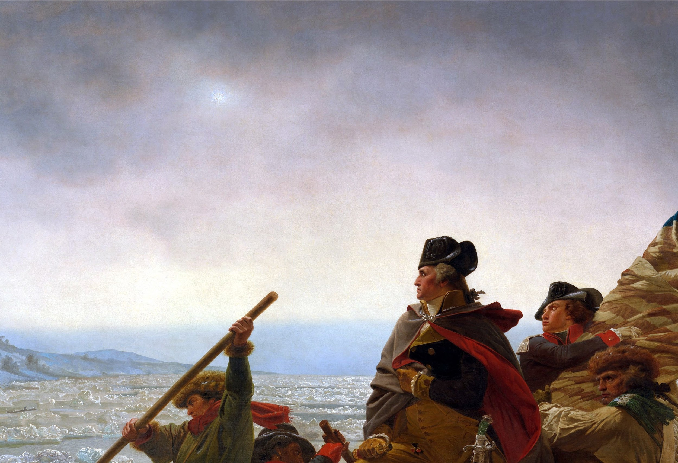
What Are Your Questions?

Slide 19
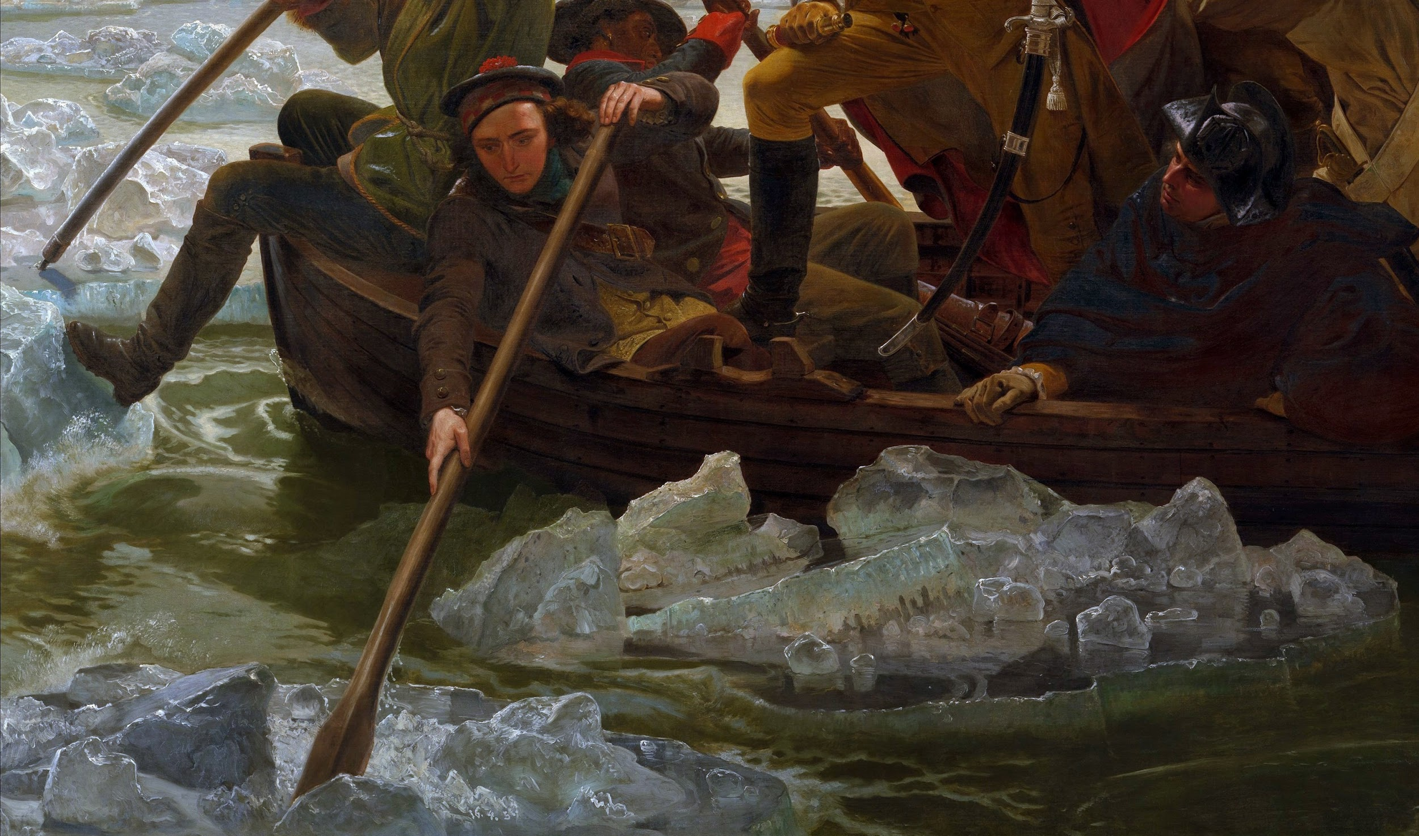
What Are Your Questions?

Slide 20
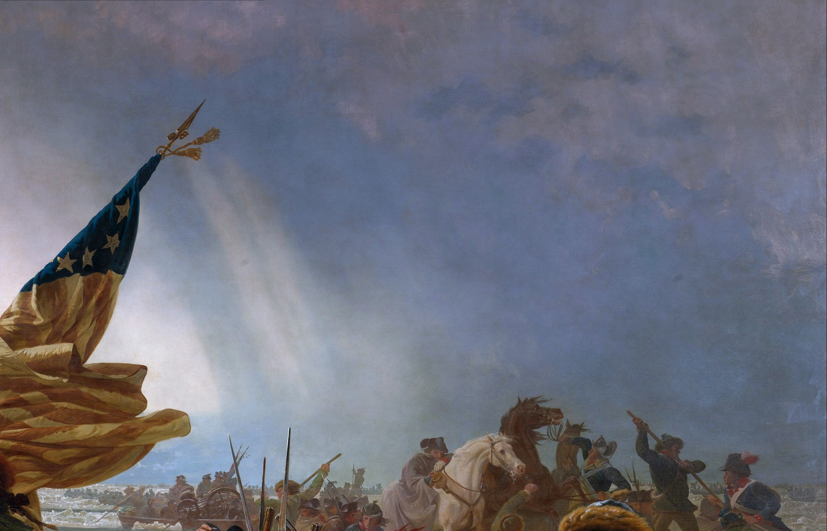
What Are Your Questions?

Slide 21
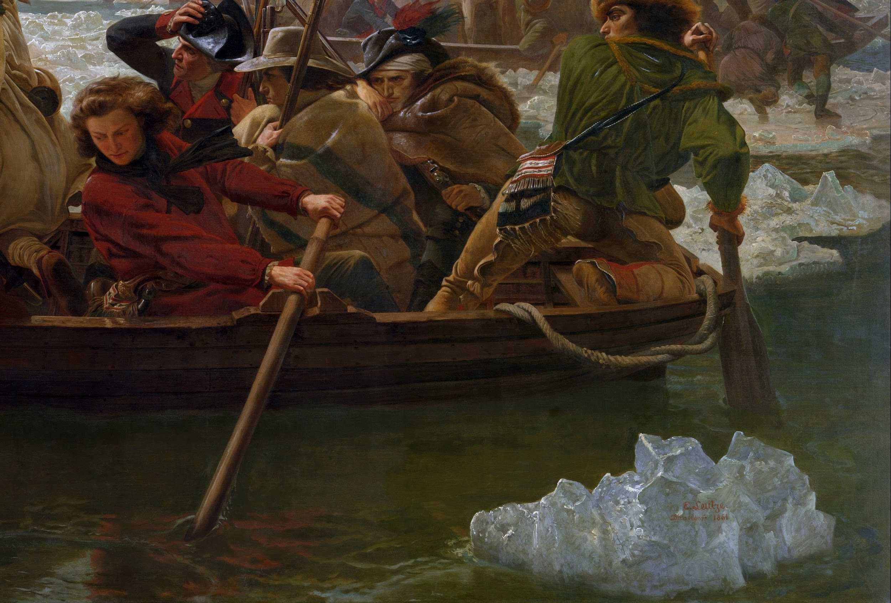
What Are Your Questions?

Slide 22


Slide 23

A Closer Look at Their World
Is there any artwork or photographs in their house that deserves a closer look?

Slide 24
Working with Visual Texts/Maps
Students need explicit instruction in map skills
What type of map is it?
What are the common features of maps?
What is the source of the map?
What is the purpose of the map?
What is the context of the map?
Decoding a map
  Identifying words
  Use of colors and symbols/decoding
  Using index/coordinates to locate details
  Labels
So many more questions can be asked!
Notes:
Gettysburg Maps
https://geoalliance.asu.edu/sites/default/files/LessonFiles/Temporary/Map_AnalysisTool_Mar2015.doc
https://www.archives.gov/files/education/lessons/worksheets/map_analysis_worksheet.pdf
What did you notice first?
What drew you to the section of the map?
Do you think the creator of the map wanted you to look there first?
What type of map is this?
Who created it?
What do you know about him/her?
Are they reliable?
What biases should we be aware of?
When was it made?
What are the titles of the map(s)?
What key map features can you identify?
Scale?
Compass?
Legend?
Other
What is labeled?
What do the labels tell us?
Are there colors or symbols?
If so, what do they stand for?
What is the context of this document?
What can we learn about the event from this map?
i. What is unique information?
ii. What can be corroborated?
Is the map specific to the event?
i. Why or why not?
How does it compare to a current map of the same place?
Why was the map created?
Who was the audience?
What was the message?
What is the purpose of this map?
What stands out to you upon review?
How could you use this map to support an argument?
i. Can it be used to support opposing sides?
How are the maps different?
How could you use all three maps?

Slide 25
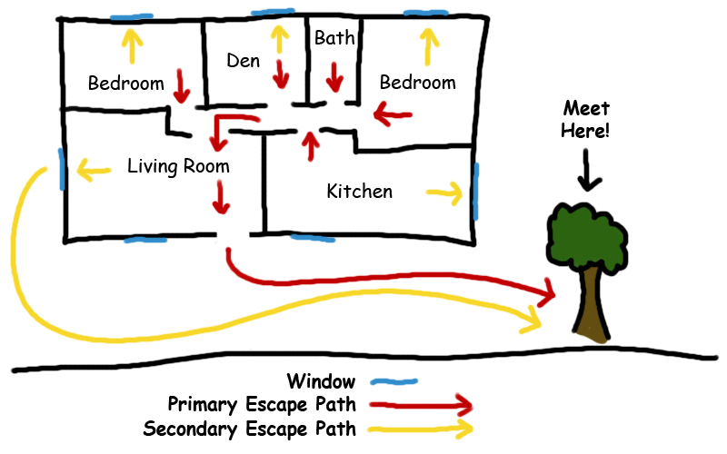
A Closer Look at Their World
Elementary Students: Create a fire plan map for their house.
What is the secondary equivalent?

Slide 26
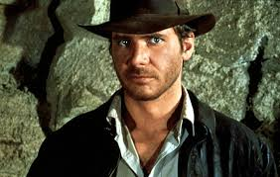
Students as Archaeologists
NO! Not like THAT!!!

Slide 27
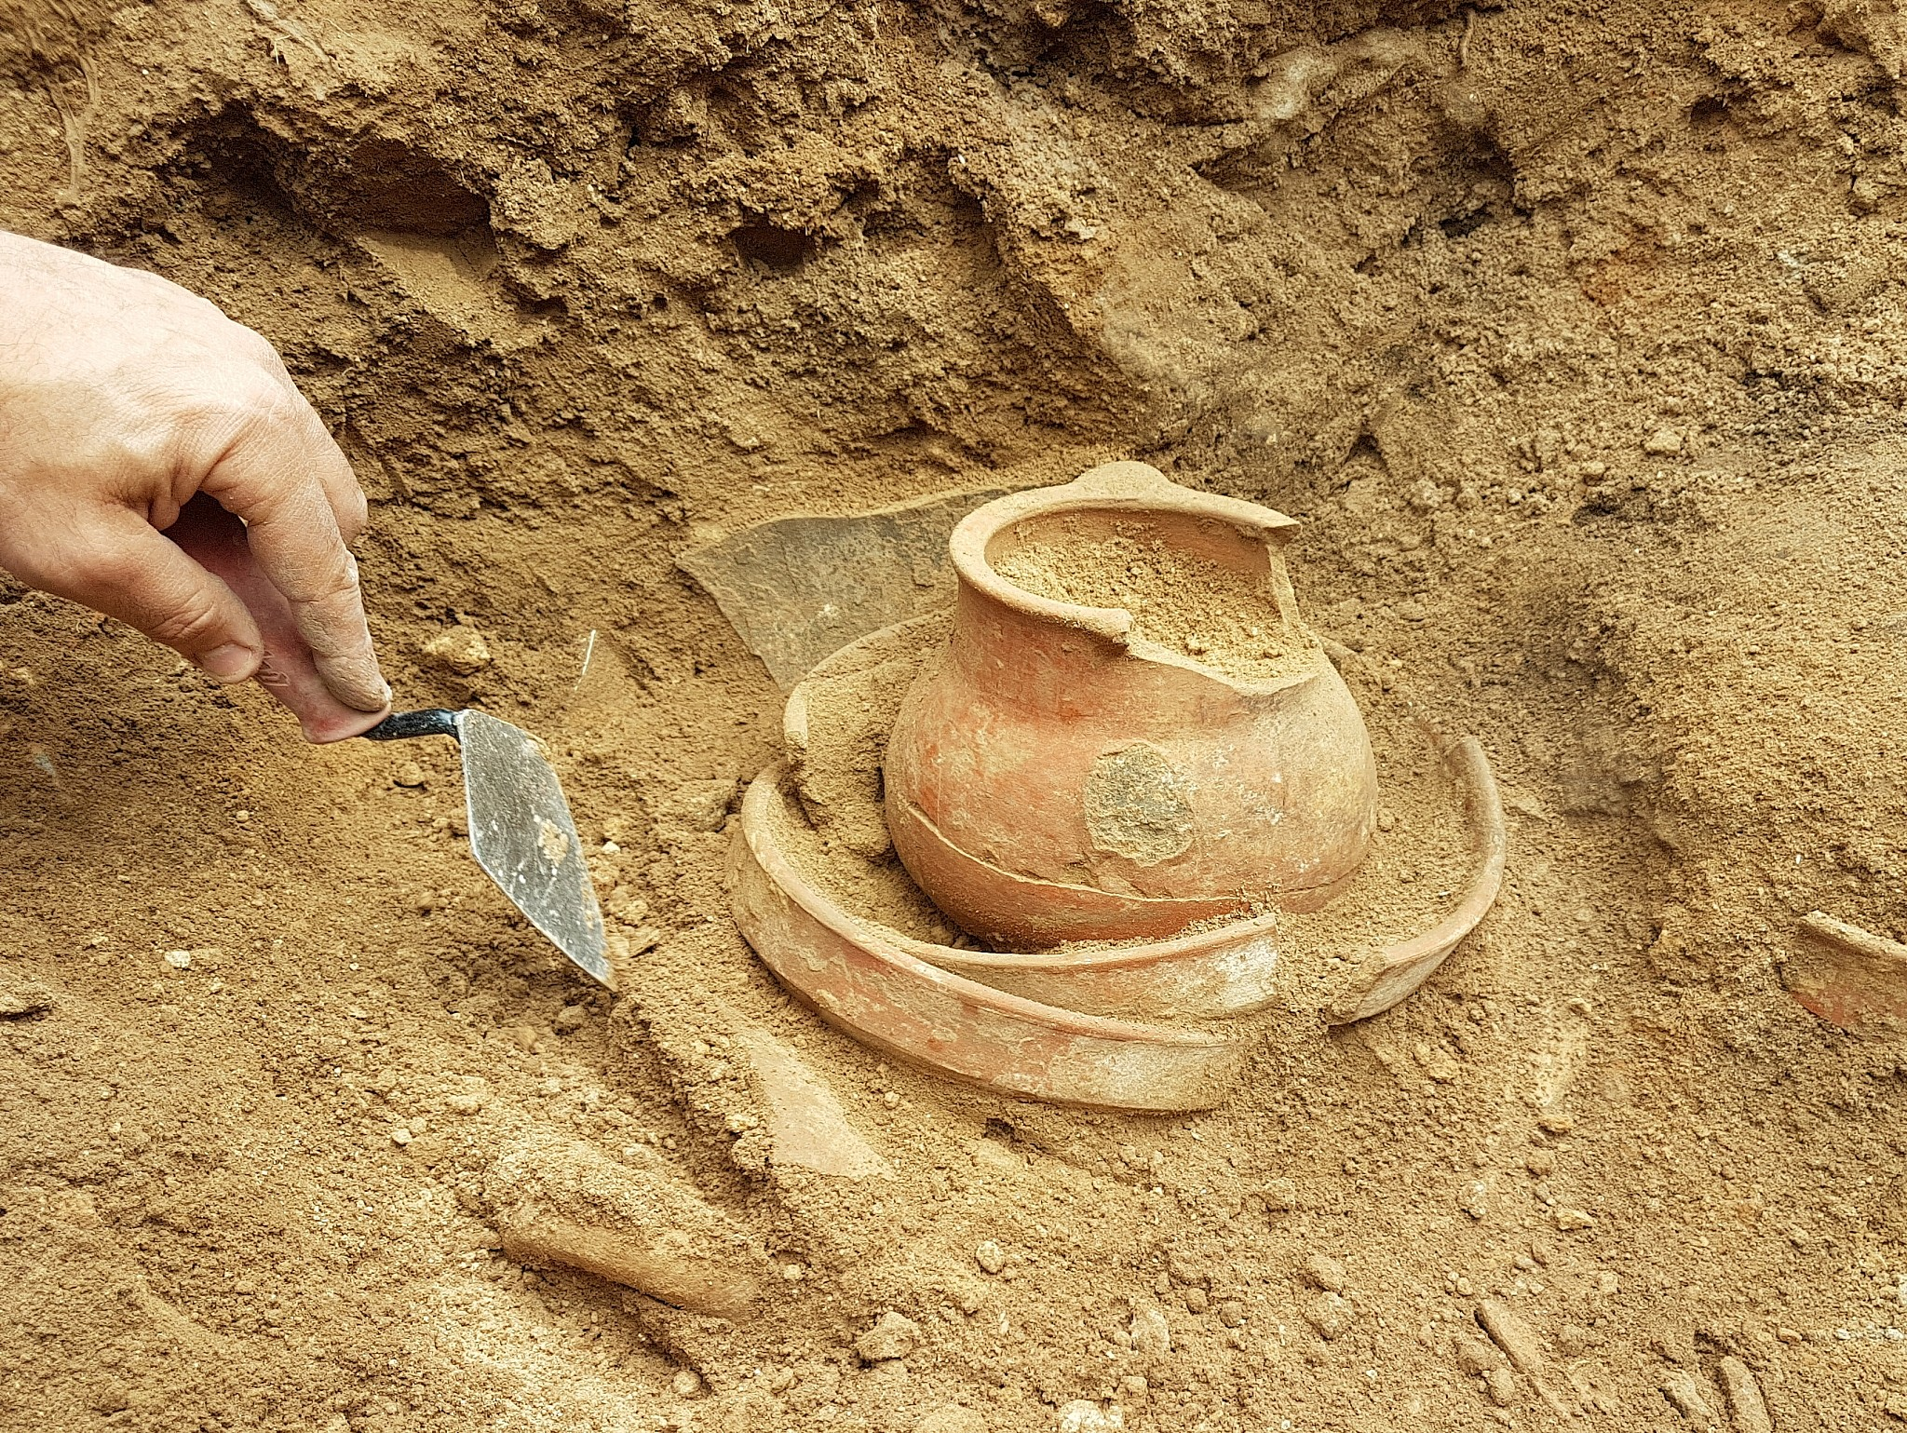
Students as Archaeologists
YES! Like that!!
Any ideas how?

Slide 28

Students as Archaeologists
What story can be written based on their garbage?

Slide 29
Getting Started
Suggestions for getting started
Be ok with small successes and some failure.
Use what is out there.
Structure and Accountability
  Graphic organizers are helpful.
  Use as scaffolding.
  Useful to review student thinking.
  Should be embedded in both formative and summative assessments.
Familiar structure and accountability when working as a class, small group, or individually.
Worry less about coverage!!

Slide 30

Thank you!
Joe Schmidt- Social Studies Specialist
Maine Department of Education
joe.schmidt@maine.gov - 207-624-6828

