Slide 1
The Boys’ City,
a story from Reggio Emilia
FK2 Unit 3, Week 6, Art/Design Studio

Slide 2
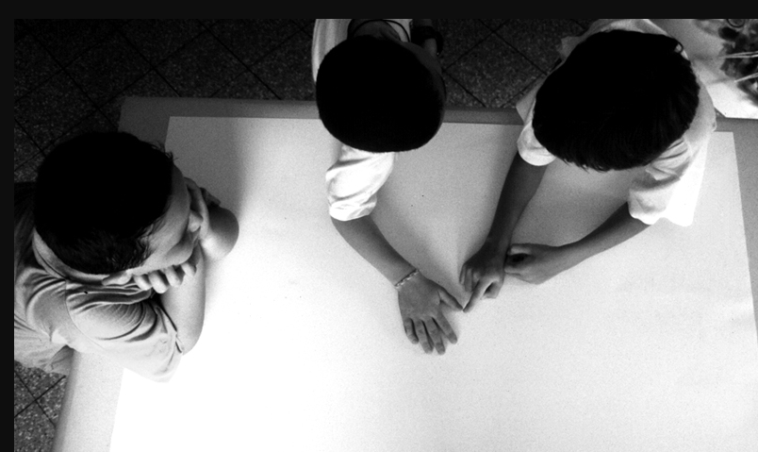
In the atelier, three five year-old boys, Emiliano, Simone, and Giacomo, sit around a big table. Their task is to work together to draw a city.
Emiliano and Simone begin to draw, while Giacomo places himself at the side of the piece of paper with his elbows on the table and his chin resting on his hands.
Notes:
read these slides in the round

Slide 3
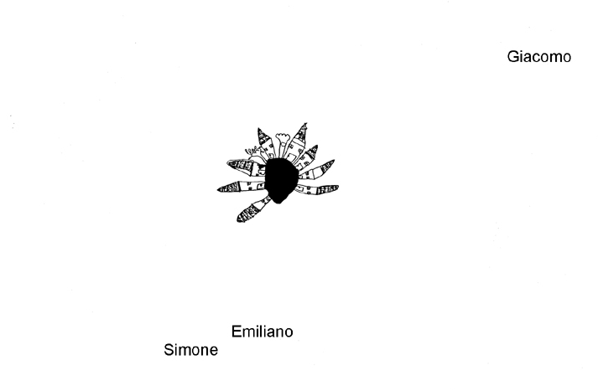
Emiliano: All cities start from a square that's in the middle of the city.
Simone: Okay, we' leave space at the bottom to make the street, that way people can leave and go out.
Giacomo still seems not to participate in the group.
Emiliano and Simone, meanwhile, work close to one another. They switch seats often while the curves of the street they are drawing steadily approach Giacomo.
Simone: The streets go to so many places, and there's one square after another in the city.

Slide 4
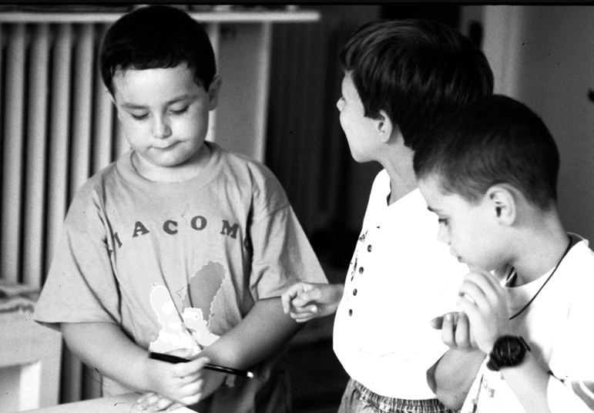
After about twenty minutes, Simone invites Giacomo to participate.
Simone: Giacomo, why aren't you doing anything?
His friend's request makes Giacomo slightly uncomfortable.
Giacomo: Cities have to work, and I have to see if it works.
Emiliano: See, Giacomo, this is a different square, it's the one with the field where the children play, and all the houses are different.

Slide 5
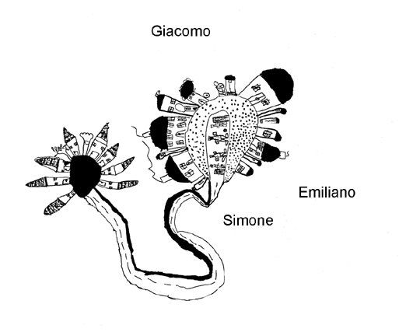
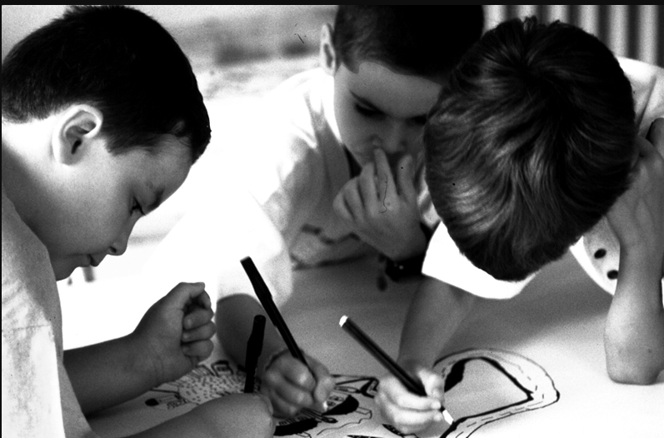
Emiliano: Giacomo, can you draw the roofs of the houses? Come on, try!
Giacomo: I know how to make houses with round roofs.
Simone: Will you help us then?
Giacomo: Okay!
Giacomo: Let's make another square. I'm sure there are lots of squares in the city.
Simone: Should we make one with a soccer player who's practicing?
Giacomo: Yeah, good idea!
.

Slide 6
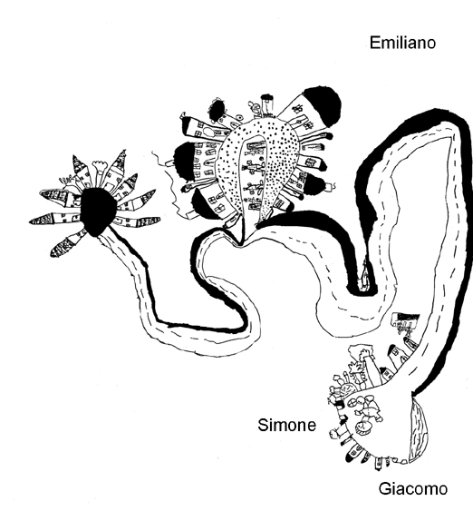
Emiliano decides to move to the other side of the paper to make the sidewalks
Simone and Giacomo form a new pair. The streets that are drawn become connections between one square and another.
Giacomo: In the squares there are people talking.
Simone: There are also some squares for parked cars and for soccer players.
Emiliano: I think cities that don't have squares are kind of strange.
Giacomo: I think they don't work well because the people don't know where to be.

Slide 7
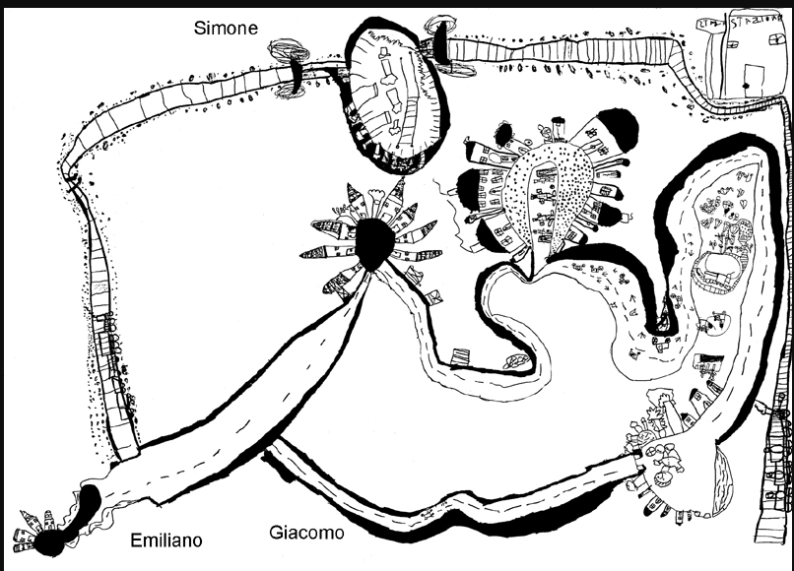
Simone: Cities are all connected by the streets and the railroads, right, Giacomo?
Giacomo: Well, yeah, the streets are important for keeping the city together and for making it work.
Giacomo connects another street to Emiliano's street, while Simone adds the railroad and the playground.
Simone: In the afternoon I go to play at Campo di Marte park.

Slide 8
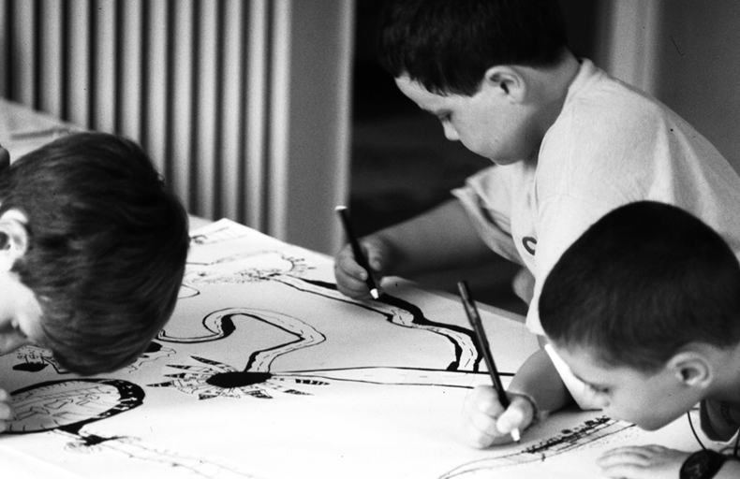
Each boy ow focuses on his own ideas on the map: Simone's railroad, Giacomo's streets that lead to the center of town, and Emiliano's small squares.

Slide 9
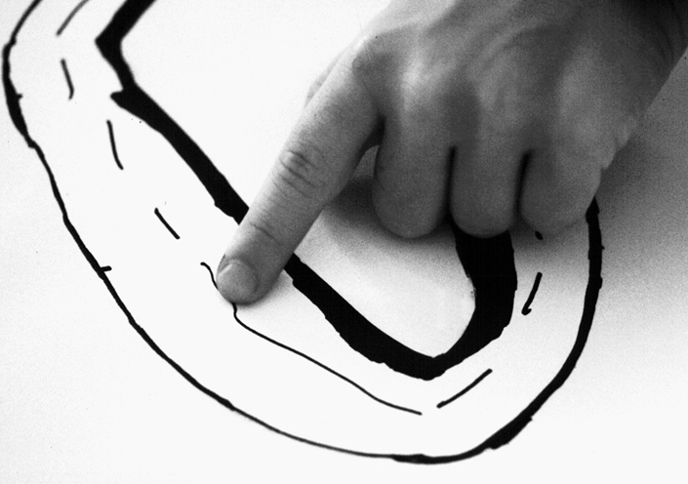
Giacomo: We need to make sure that the whole city is connected and that nobody gets lost.
The children agree to go over the streets with their fingers.
When their work is finished and the children revisit the map with the teacher
Giacomo: We made a beautiful city even though it's a little bit messy.
Emiliano: All the streets take you somewhere. It's a city where you can't get lost, where you're not afraid.
Simone: Maybe this city is called City of the World, because all the people in the world can live here.

Slide 10
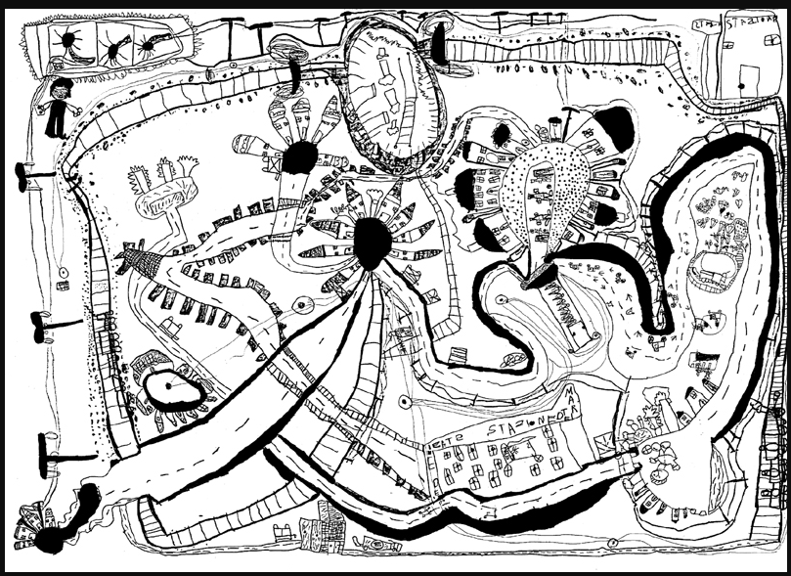
The city is one full of functions and connections. Each element is important to the functioning of a city, essential to the life of the people.

Slide 11
