Slide 1
Our Boston
2014-19
(These are past projects from Boston, for inspiration.)
BPS kindergartners’ ideas for making our city fairer and a more interesting place for children

Slide 2
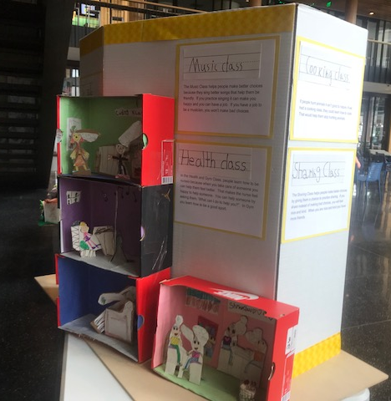
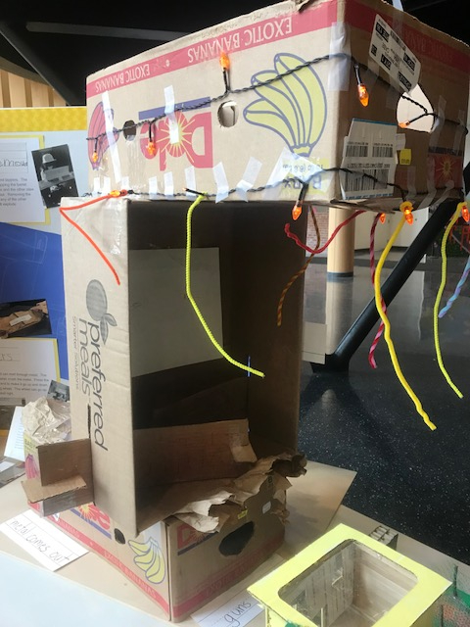
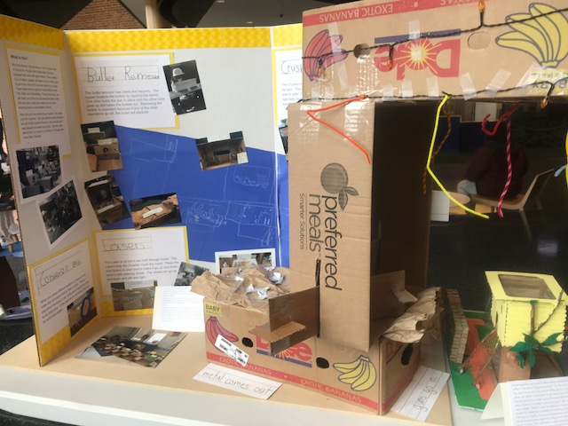
The Gun Crusher and A School for People who Make Bad Choices
A gun crusher because: people need to be more safe. People need food, but they don’t need guns! It will turn the parts into pans for food and toys.
A School for People Who Make Bad Choices because: There are no bad people, just bad choices. By teaching people how make better choices and to be a better person, we can make Boston a better place.
You should also know: The playground for kids will be awesome so kids want to come to school with their parents. The school will be interesting enough to make people want to give up their guns. Since people use guns for hunting, we will make sure they know how to make food so they don’t need guns anymore. We will make some recreation, like archery, available for people who want to still do target practice.
Jerry Pisani - BTU School

Slide 3
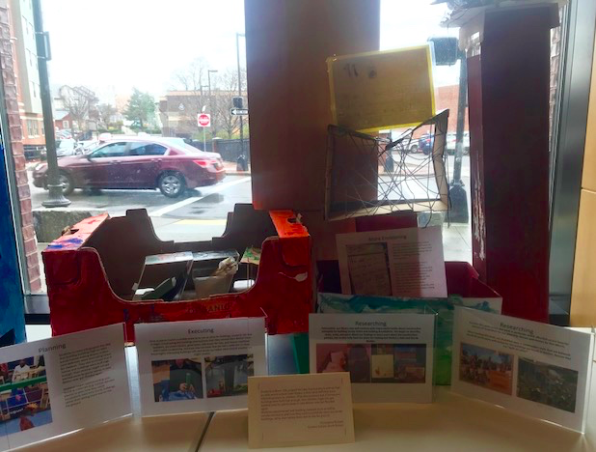
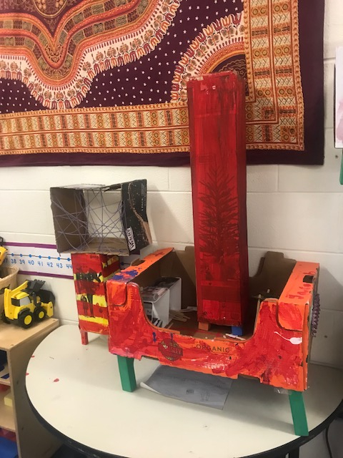
Students in Room 100 grasped the idea that building buildings high on stilts would indeed make Boston a fairer (and definitely more interesting) place for children. They also surmised that if homes and buildings were built high enough, then children might not get washed away by giants waves in case Boston ever got flooded again.
Students experimented with building materials (such as hollow wooden blocks) to plan how they could successfully raise very sturdy buildings, rather than letting them rest on the flat ground.
Christopher Richard - Condon School

Slide 4
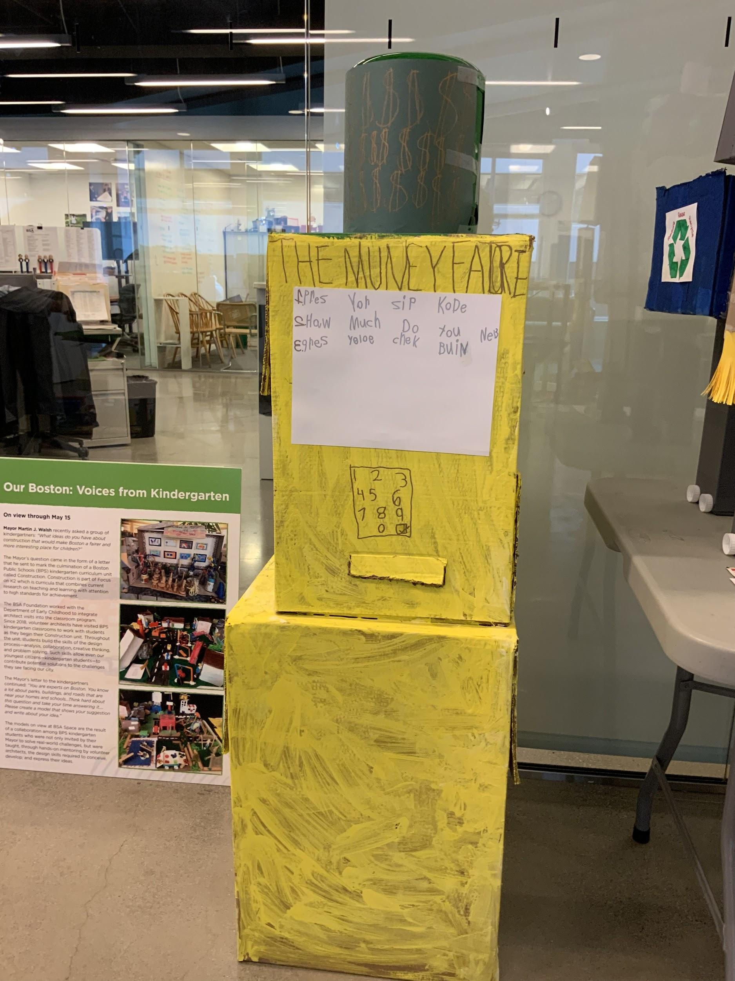
We decided to make "The Money Factory" because many of the students realized that it wasn't fair that some people don't have the things they need. After many conversations, we decided that if the families had money, they can get the things they need. The idea is that the money factory would work much like an ATM. People who have a lot of money would be able to donate money to the machine and those who need money would be able to enter their zip code to retrieve the money.
Traka Smith
Curley K-8

Slide 5
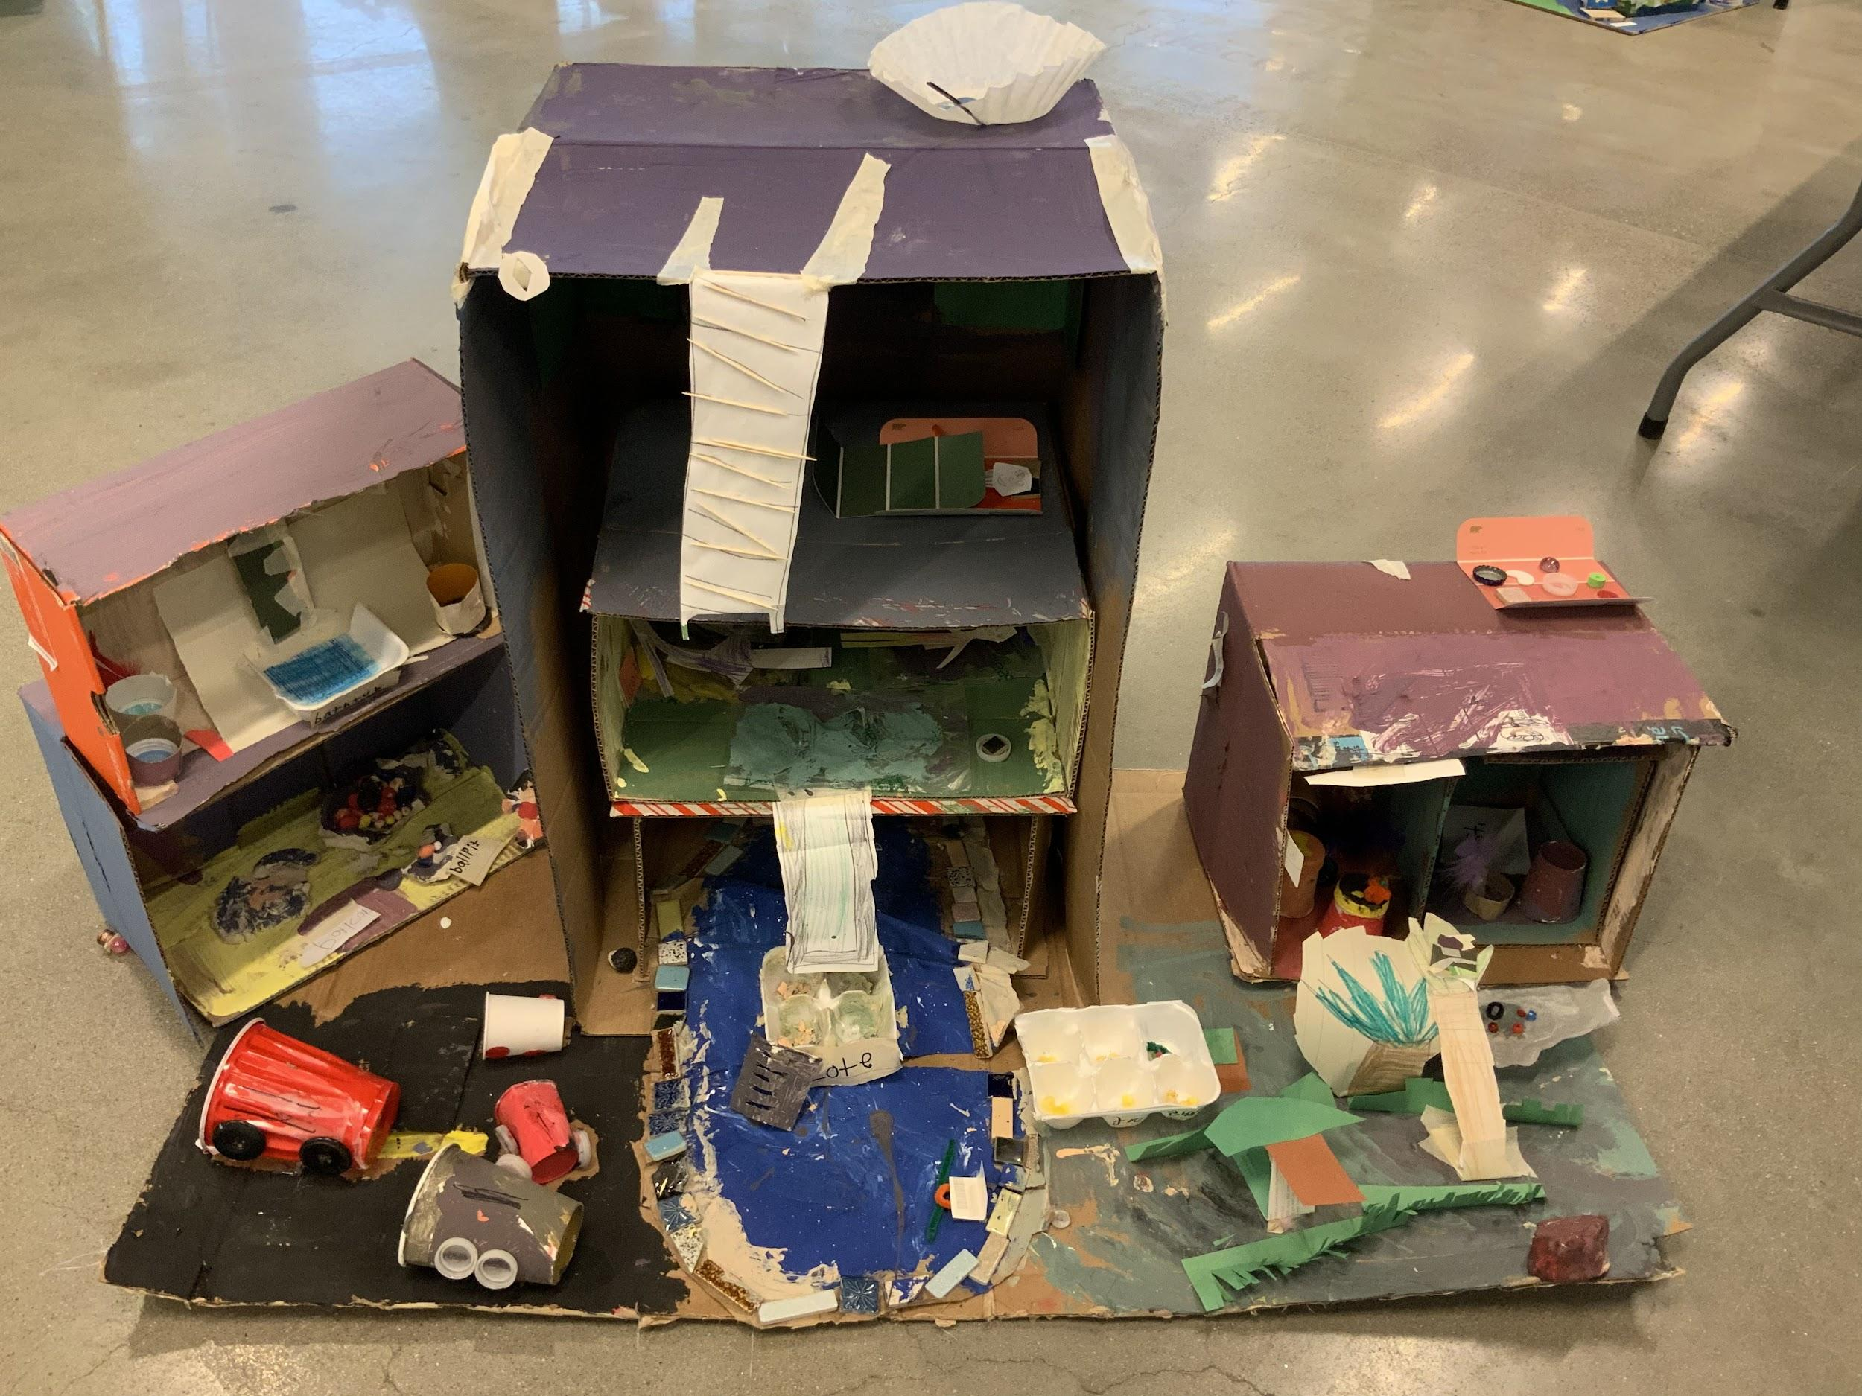
The students in room 210 truly think that we are the best to answer your question of: How can we make Boston Fair and Interesting for all the children in the city. We think this because have studied construction by reading How a House is Built by Gail Gibbons, we have also analyzed and utilized the design process for our constructions. After writing and drawing our ideas as individuals and then collaborating and voting we have decided that Boston Needs a Children’s Hotel. Our Hotel is designed with rooms for children that need a place to live. Our Hotel also has a playroom for children to have fun in, and an indoor/ outdoor pool. When children enter the hotel they are greeted by a robot that will ask them what they would like to eat. Our Hotel also has an area for emergencies, with a fire truck, and a doctor (if someone is in trouble/ danger).
We have researched different hotels by looking at the books in our classroom library and looking at images online.
Marie Tull Mattahunt Elementary School

Slide 6
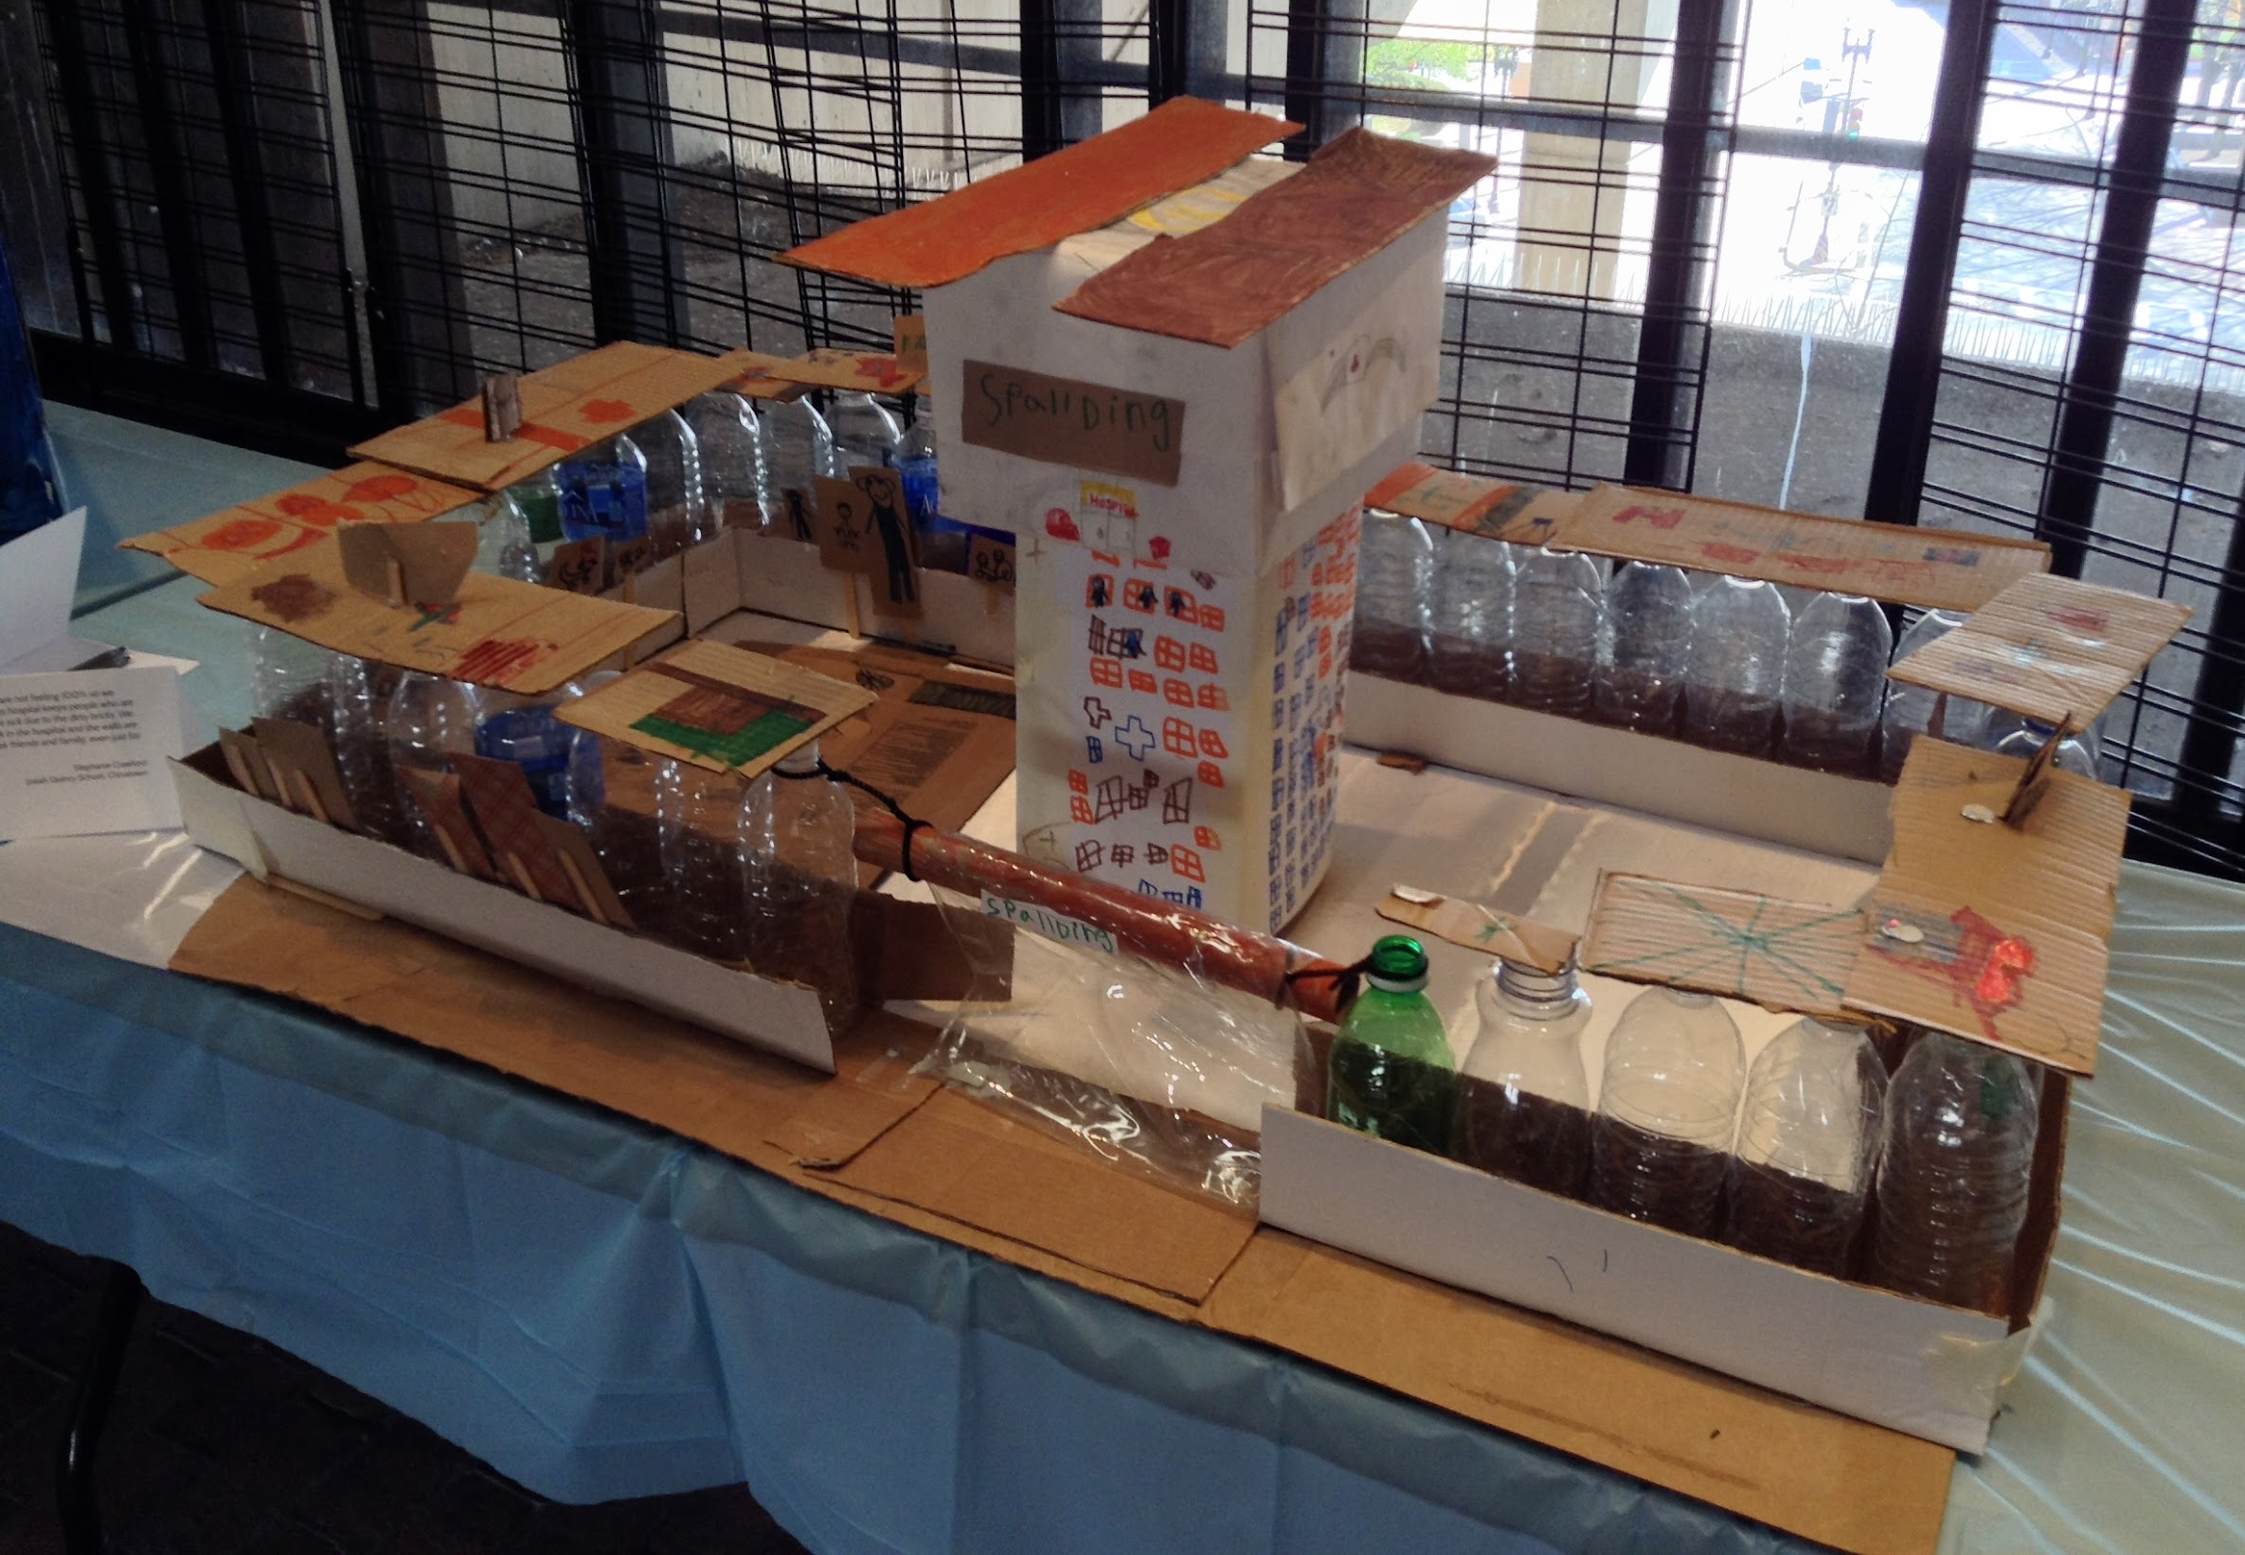
We have love for people who are not feeling 100% so we created a glass hospital. A glass hospital keeps people who are already sick from getting more sick due to the dirty bricks. We also feel that if people are sick in the hospital and the walls are clear, they can always see their friends and family, even just for a moment.
Stephanie Crawford
Josiah Quincy School

Slide 7
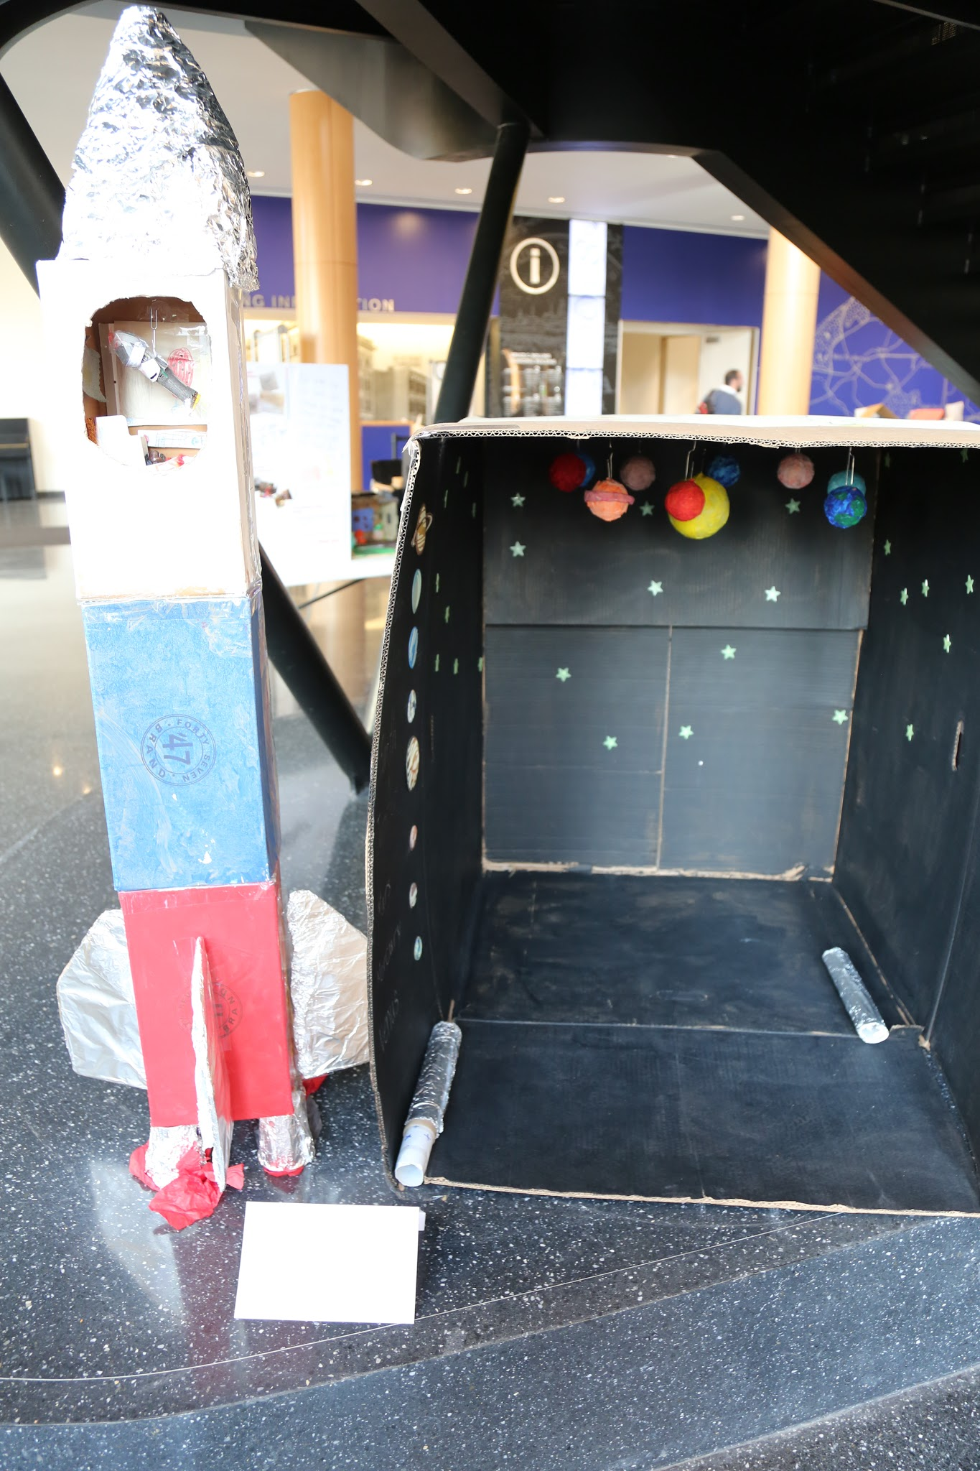
Kids in Boston do not get to see the stars. We had great discussions about why it's hard to see the stars in the city, and the students decided that they wanted to make a planetarium. They didn't stop there; they also wanted to be the first to send kids into space. They designed and created a rocket ship so that anyone who visits the planetarium can also take a trip to space if they so choose.
On the outside of the planetarium are some original constellations that the students created as well as some drawings of the planning process. Look into the rocket ship to see inside where there is zero gravity—be sure to wear your seat belt!
Wendy Nunez-Johnson
Mason School

Slide 8
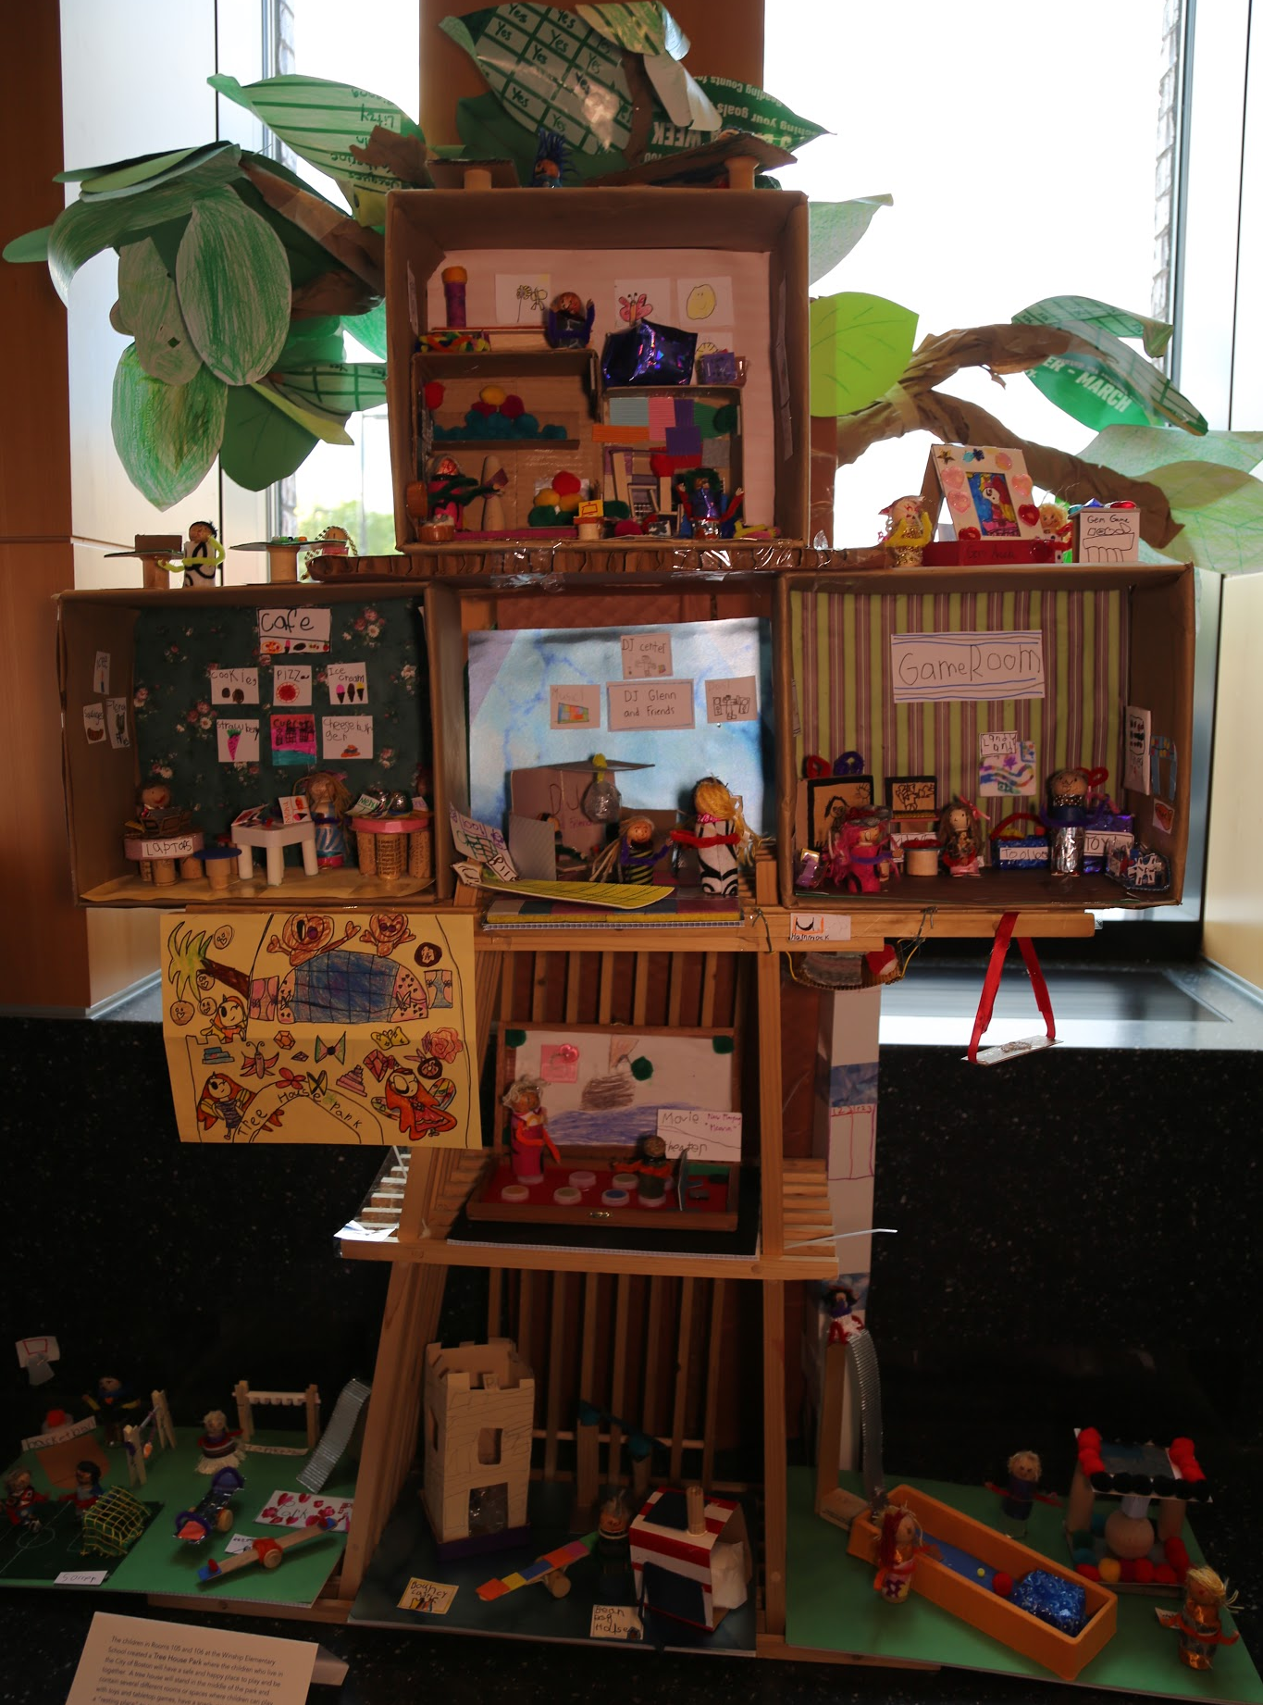
The children in Rooms 105 and 106 at the Winship Elementary School created a Tree House Park where the children who live in the City of Boston will have a safe and happy place to play and be together. A tree house will stand in the middle of the park and contain several different rooms or spaces where children can play with toys and tabletop games, have a snack, go to a movie, relax in a “resting place” to read books and listen to music, play ping pong, swing in a super swing or dance as a DJ spins records. Most activities will be located in the tree house so that it can fit in any neighborhood but there will also be a green space with activities such as basketball court and bouncy castle.
Kathleen Frazier & Lisa Llorente
Winship School

Slide 9
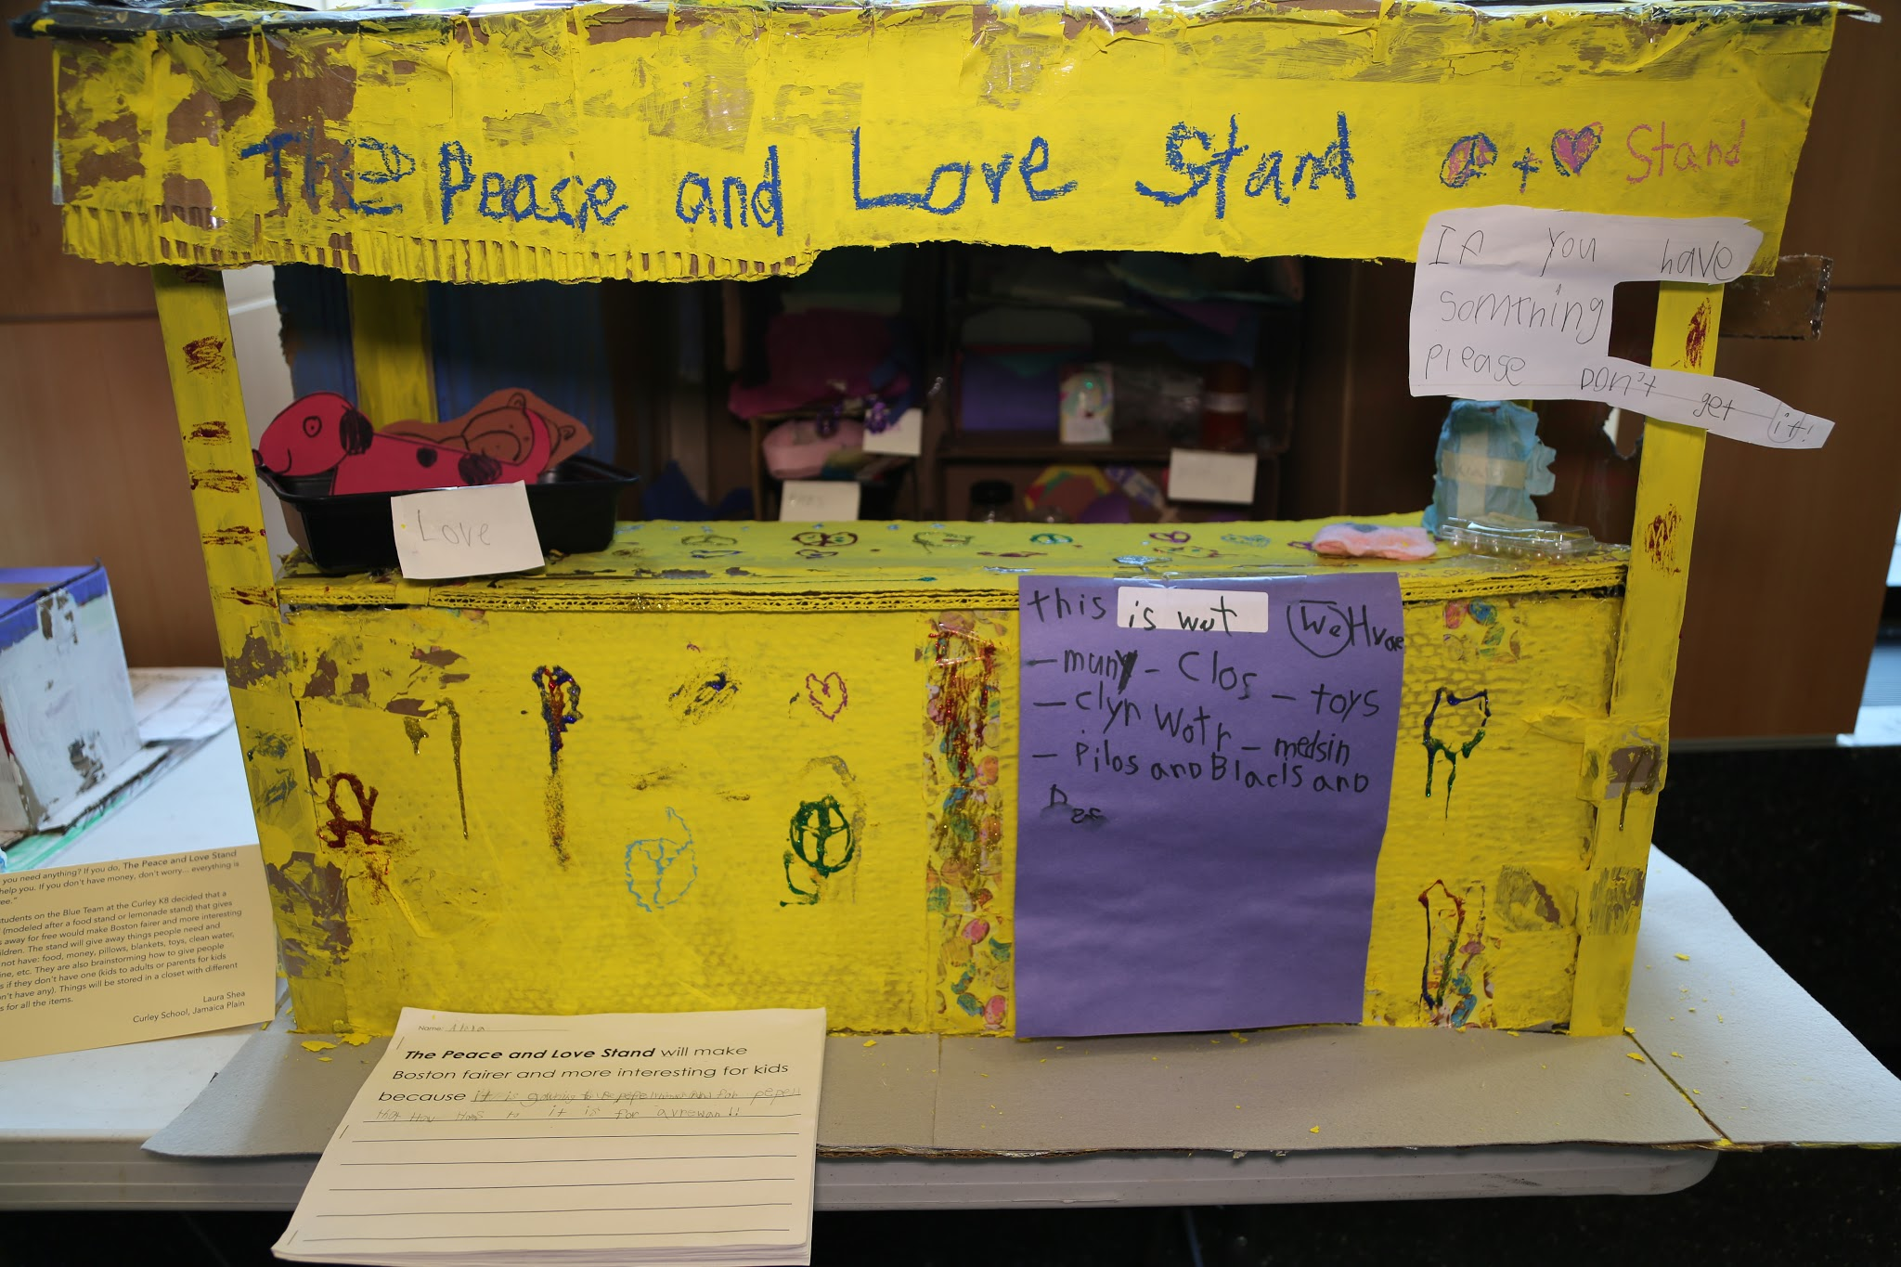
Do you need anything? If you do, The Peace and Love Stand can help you. If you don't have money, don't worry... everything is for free.” The students on the Blue Team at the Curley K8 decided that a stand (modeled after a food stand or lemonade stand) that gives things away for free would make Boston fairer and more interesting for children. The stand will give away things people need and might not have: food, money, pillows, blankets, toys, clean water, medicine, etc. They are also brainstorming how to give people families if they don't have one (kids to adults or parents for kids that don't have any). Things will be stored in a closet with different sections for all the items.
Laura Shea
Curley School

Slide 10
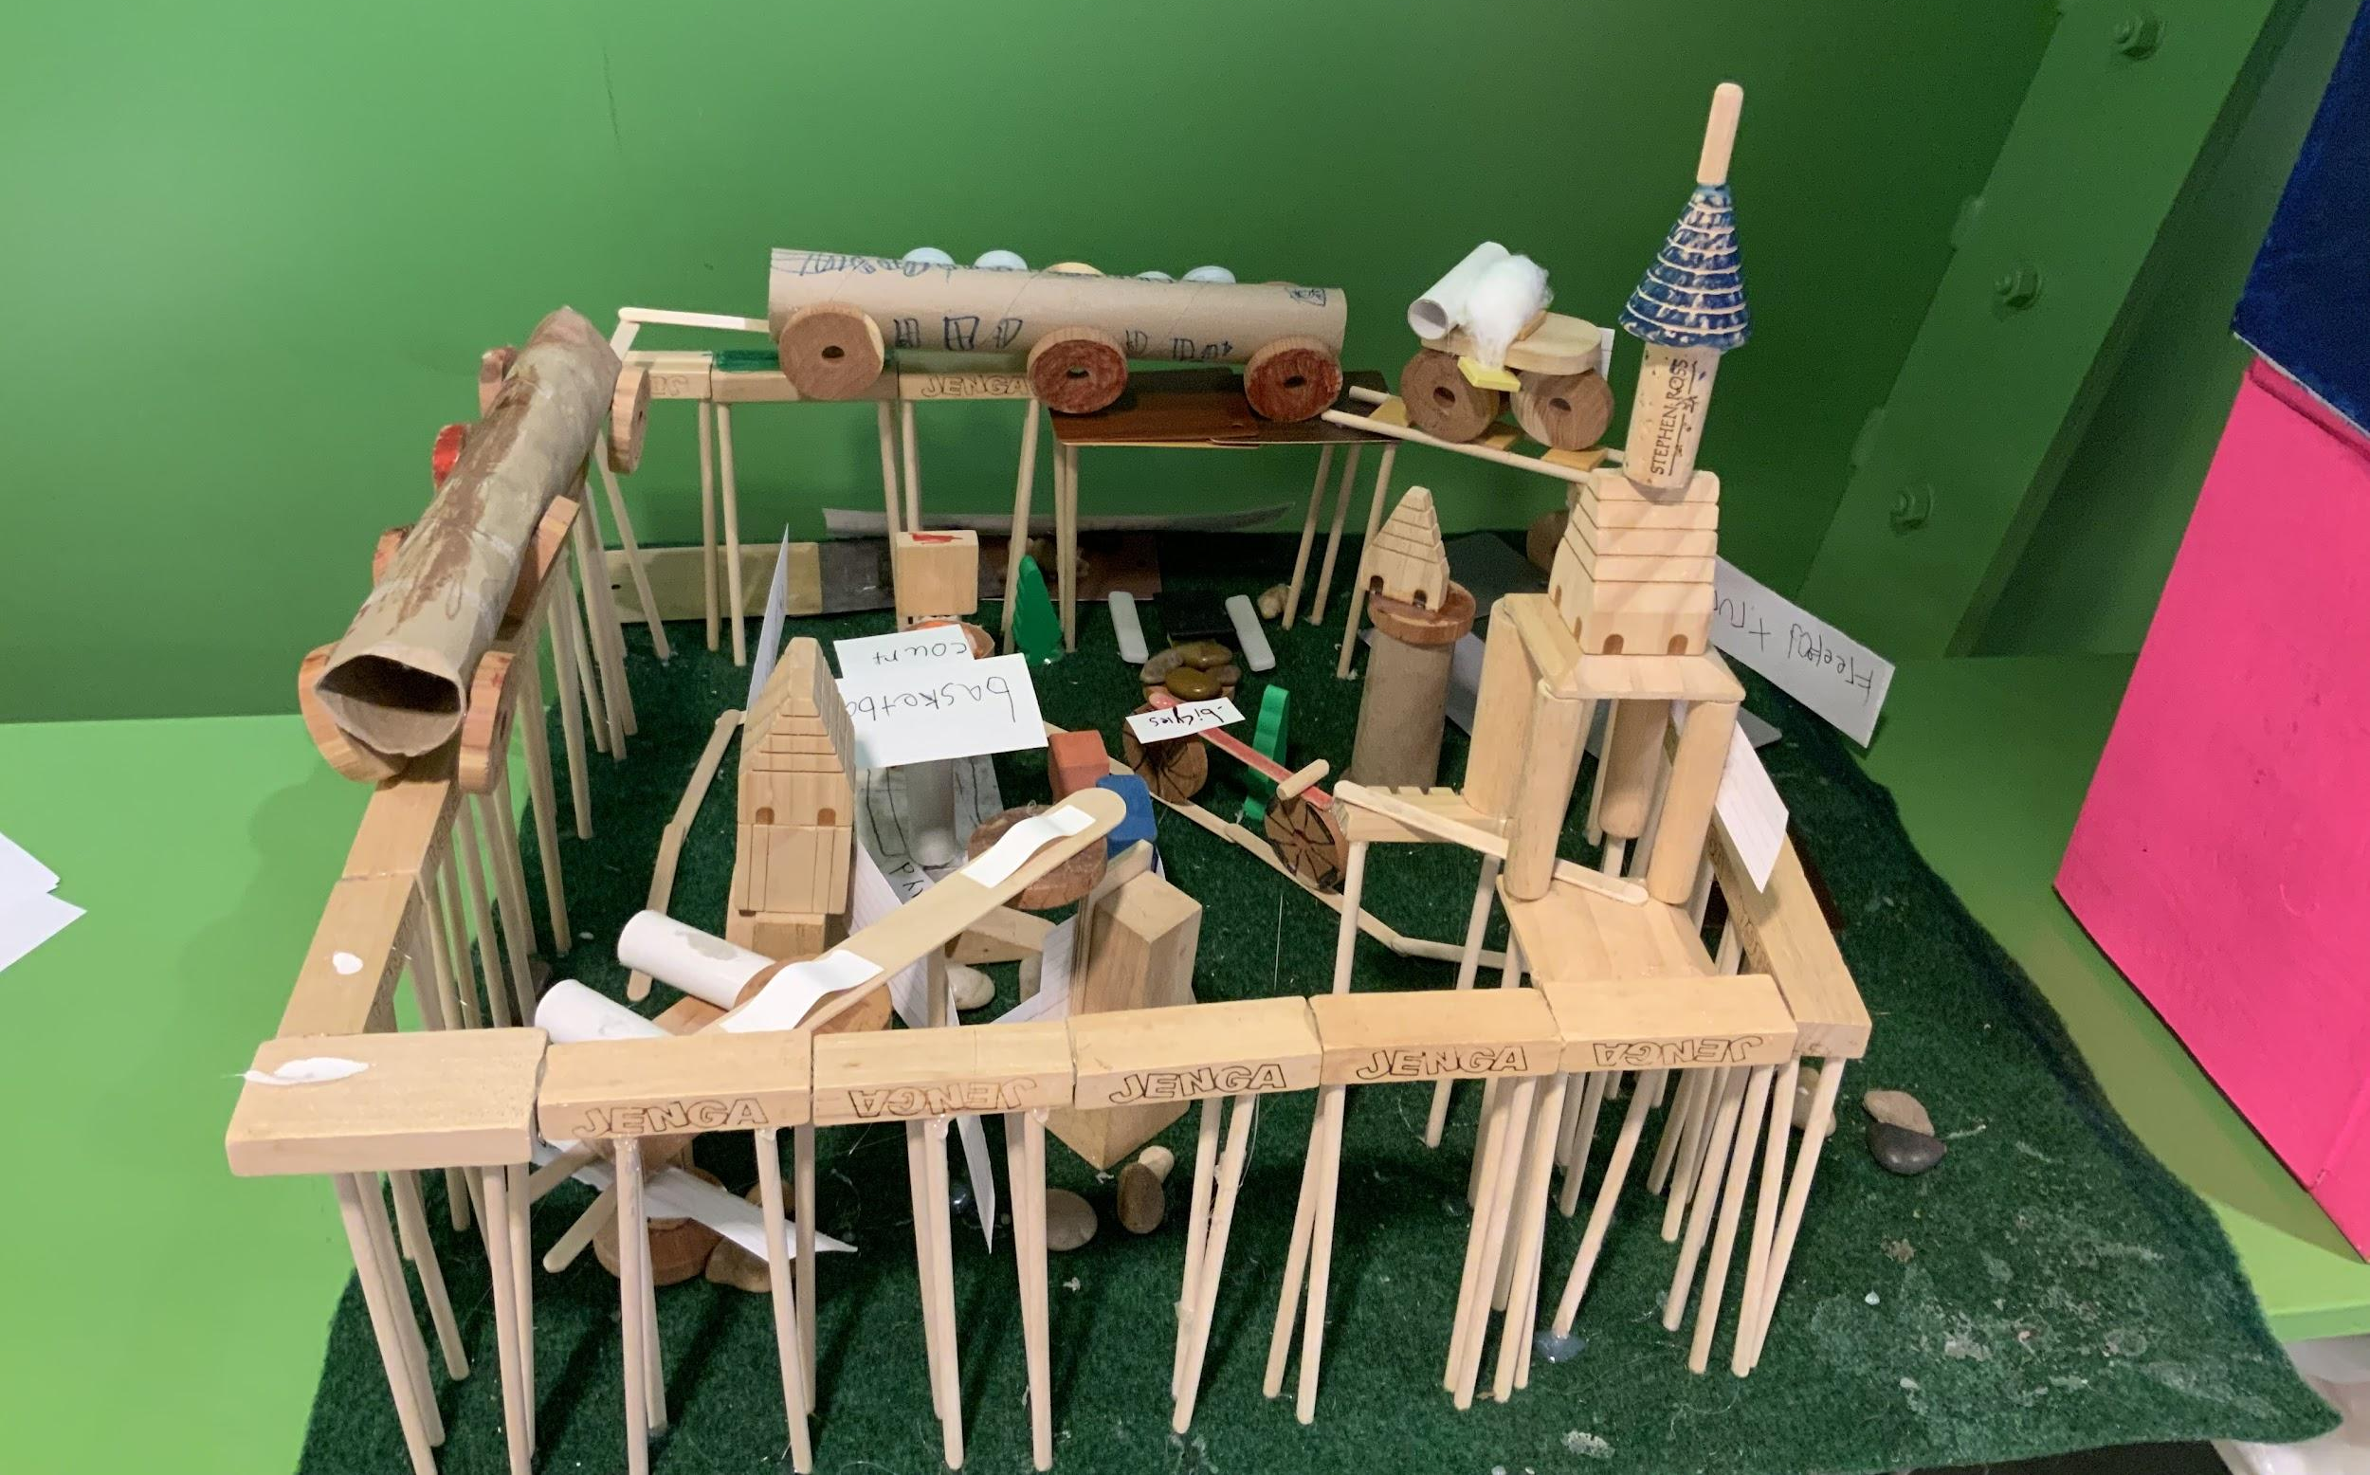
No Traffic Boston: Our Boston project is about making a train that goes around traffic and goes around the city. Our parks need bathrooms and nurses who can help people when they get hurt. Our houses need more bedrooms. There should be free food trucks for people who don’t have food; free Toys R’ Us for kids who don’t have toys.
Jamie O’Brien
Baldwin Early Learning Pilot School

