Slide 1
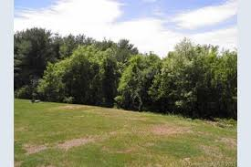
Over in the Meadow

Slide 2
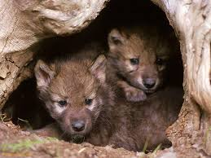
Over in the meadow
In a cozy, little den,
Lived an old mother wolf
And her wolf pups ten.
"Howl," said the mother.
"We howl," said the ten.
And they howled all day
In the cozy, little den.

Slide 3
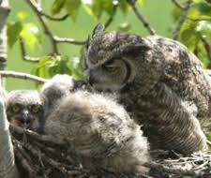
Over in the meadow
In a nest built of sticks,
Lived an old mother owl
And her little owlets six.
"Hoot," said the mother.
“We hoot," said the six.
And they hooted all day
In the nest built of sticks.

