Slide 1
Images from Roxaboxen
Dramatization Center
Unit 3, Weeks 7 and 8

Slide 2
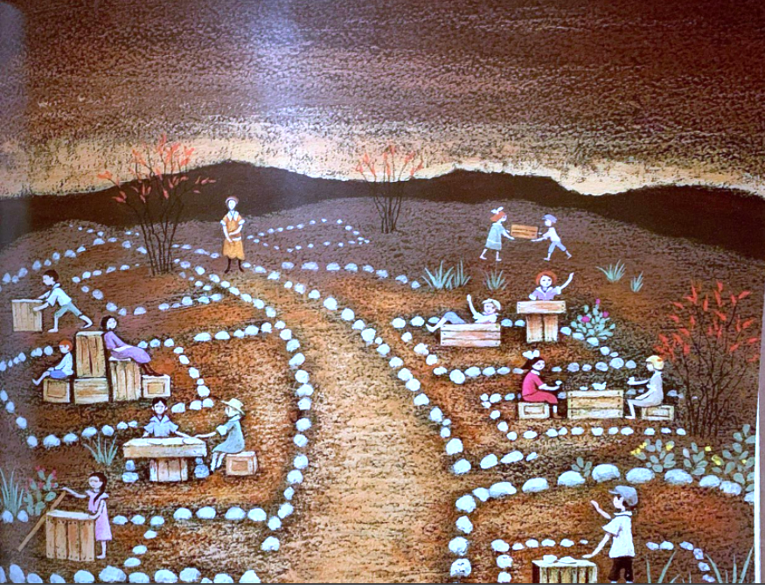

Slide 3
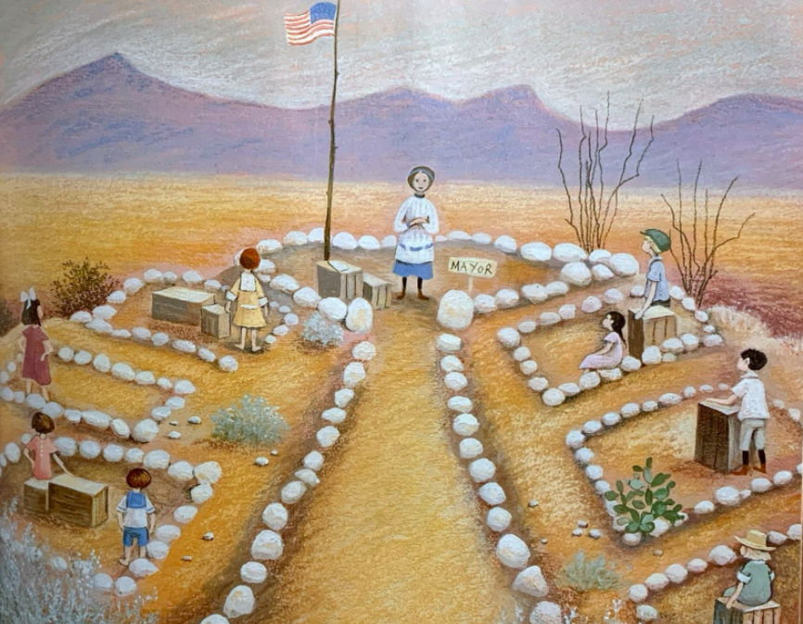

Slide 4
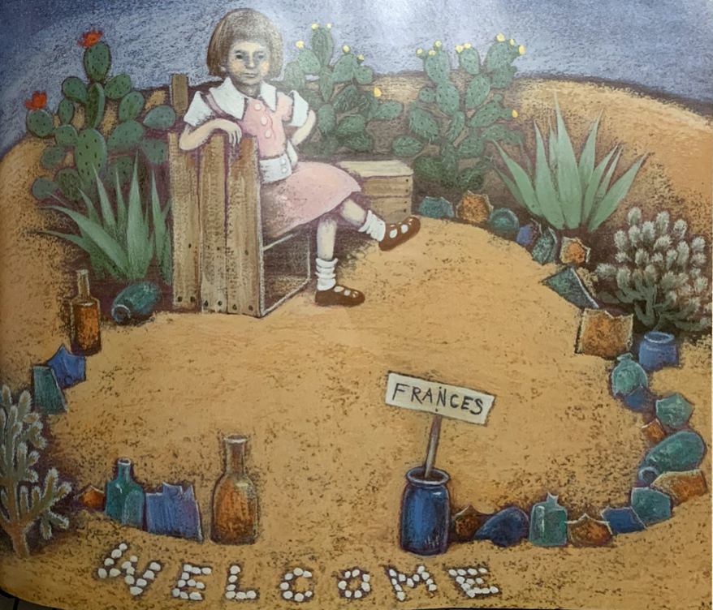

Slide 5
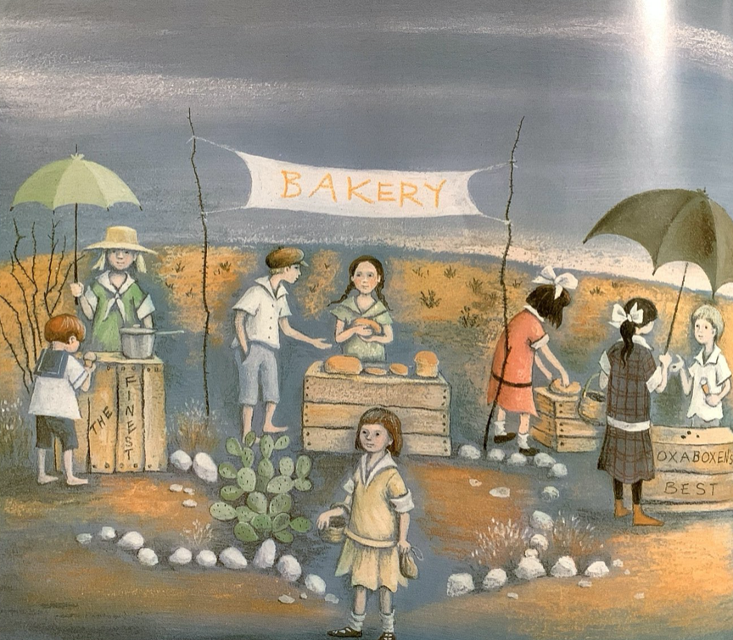

Slide 6
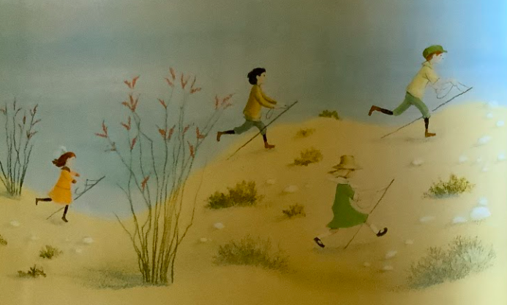

Slide 7
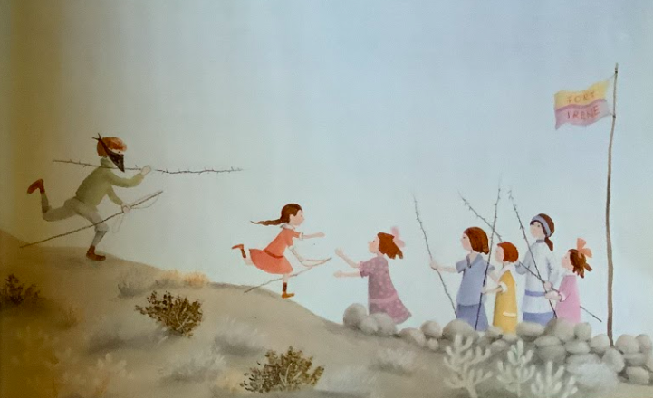

Slide 8
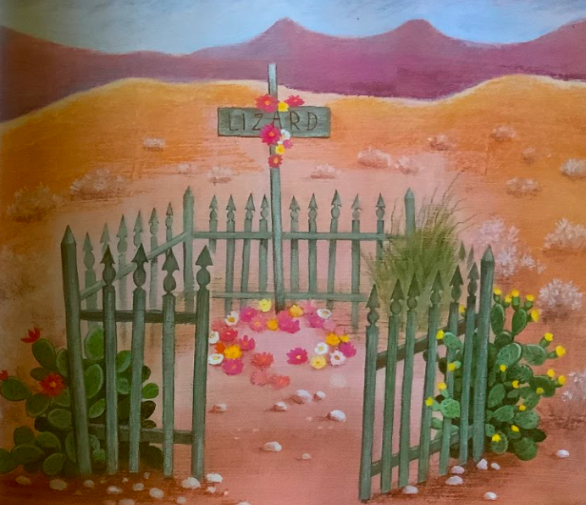
Notes:
A note of caution about this slide: Please be sensitive to the children in the classroom and their recent and/or past experiences with death and dying. Be prepared to have conversations and to offer support, if needed.

Slide 9
