Slide 1
Block Center
Unit 3, Week 1
REPLACE WITH IMAGES FROM YOUR TOWN

Slide 2
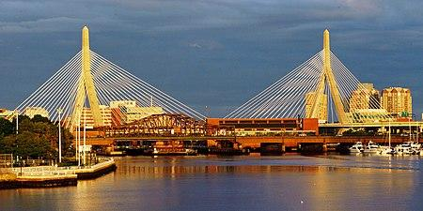
Leonard Zakim Bunker Hill Memorial Bridge, Boston
https://en.wikipedia.org/wiki/Leonard_P._Zakim_Bunker_Hill_Memorial_Bridge

Slide 3
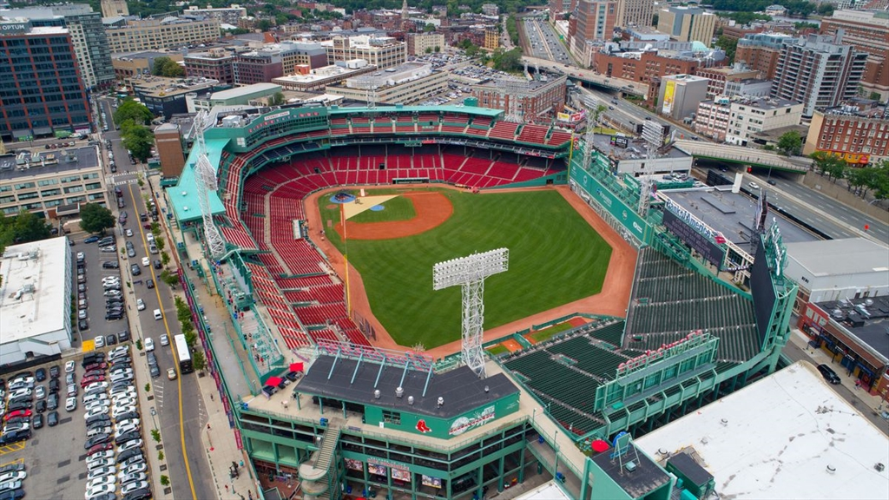
Fenway Park Boston
http://www.odualumni.org/s/1672/bp20/interior.aspx?sid=1672&gid=2&pgid=1992&cid=3708&ecid=3708&crid=0&calpgid=388&calcid=1182

Slide 4
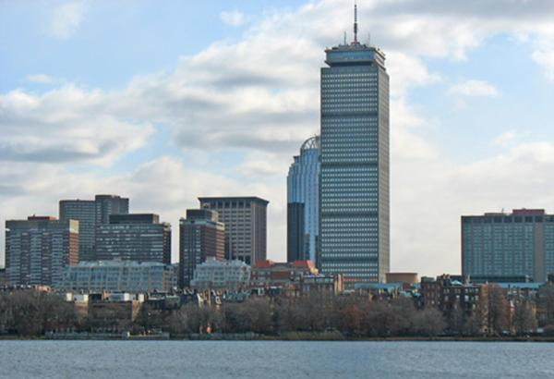
Prudential Tower, Boston
https://www.playworks.org/new-england/2014/12/10/bostons-prudential-tower-shines-blue-in-support-of-playworks/

Slide 5
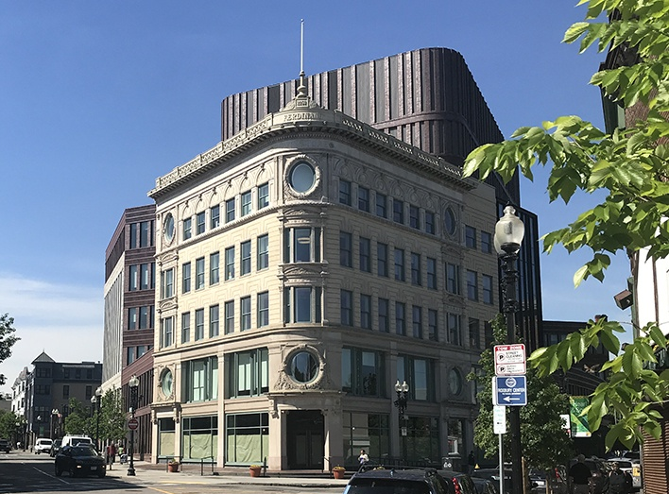
Nubian Square, Roxbury
https://www.bostonmagazine.com/news/2019/12/19/dudley-square-name-change-nubian-square/

Slide 6
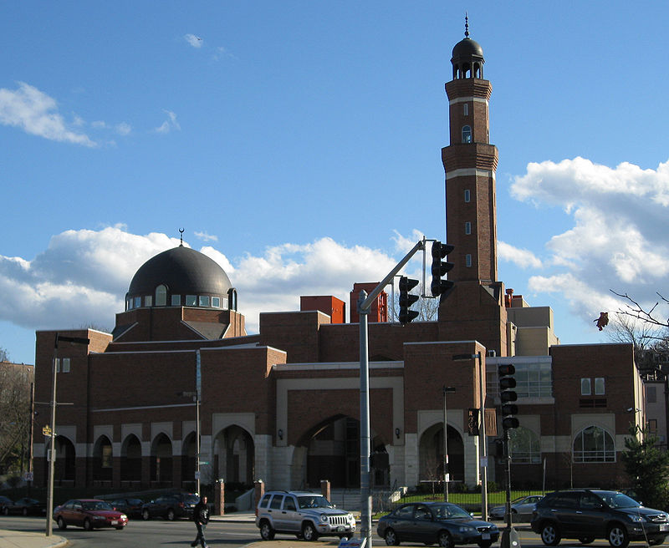
Islamic Society of Boston, Roxbury
https://en.wikipedia.org/wiki/Islamic_Society_of_Boston#/media/File:RoxburyMosque2.JPG

Slide 7
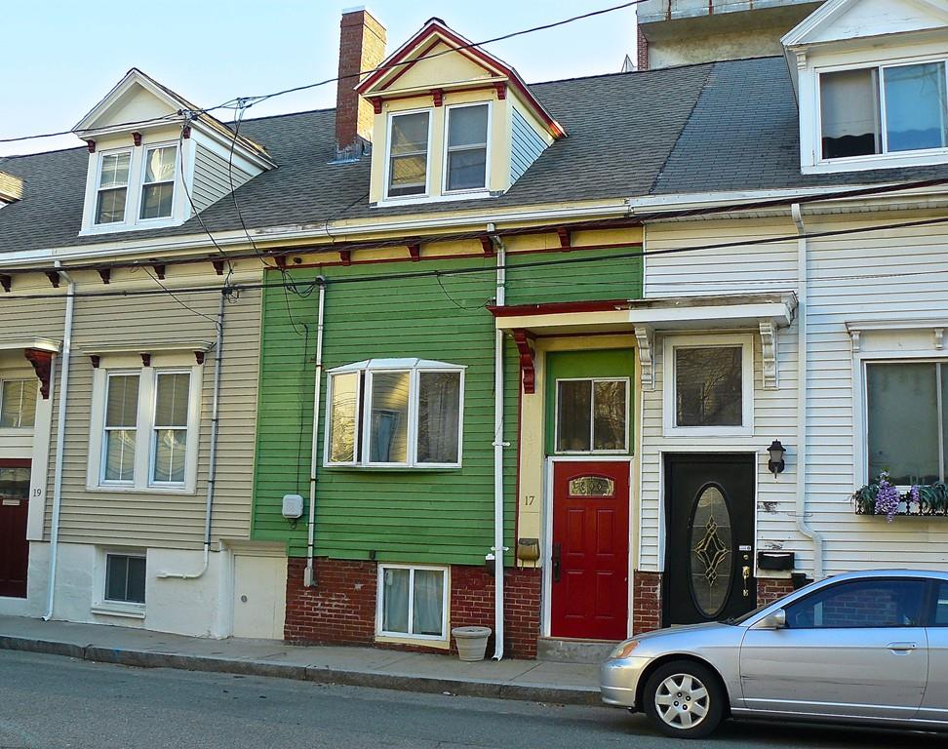
Row Houses, East Boston
https://www.bostonmagazine.com/property/2016/05/13/east-boston-open-houses/

