Slide 1
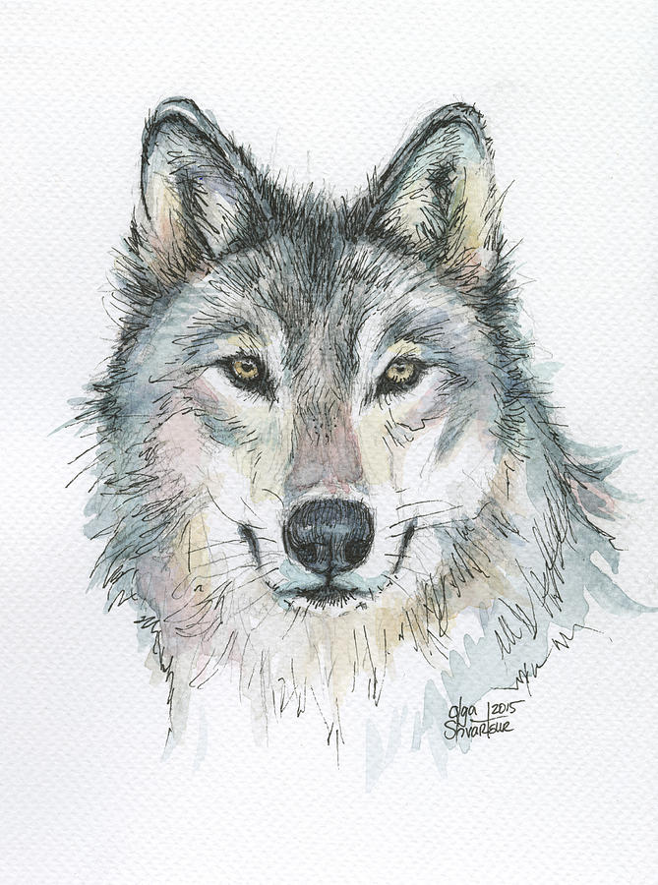
Wolf
Olga Shvartsur
https://fineartamerica.com/featured/wolf-olga-shvartsur.html

Slide 2
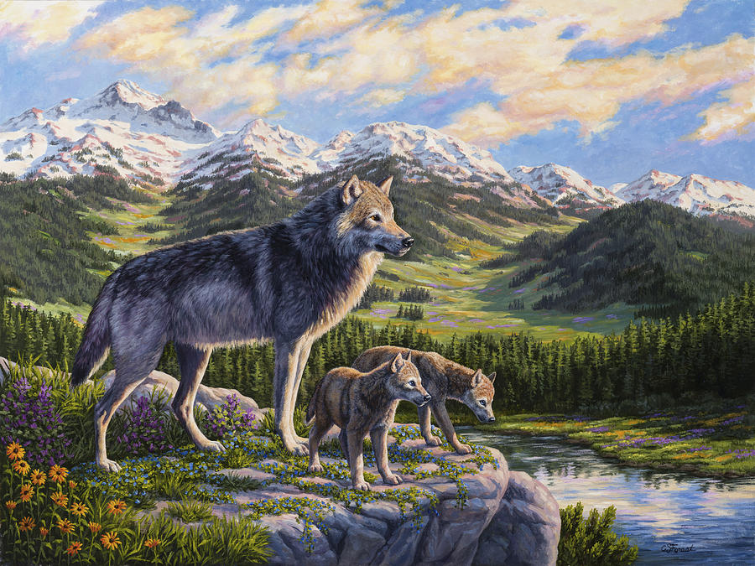
Passing It On
Crista Forest
https://fineartamerica.com/featured/wolf-painting-passing-it-on-crista-forest.html

Slide 3
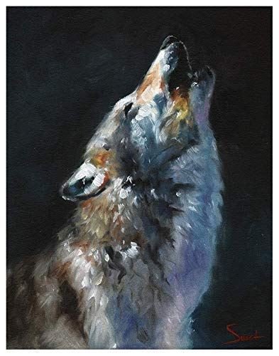
Howling Wolf
Eric Sweet
https://www.amazon.com/Wolf-Painting-Print-Decor-Wall/dp/B017S72SGQ

Slide 4
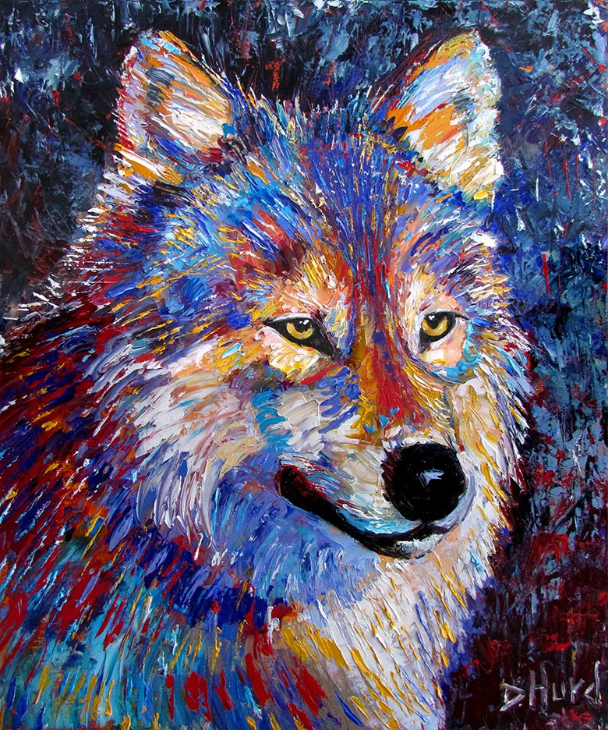
Wolf
Debra Hurd
https://www.amazon.com/Wolf-Painting-Print-Decor-Wall/dp/B017S72SGQ

Slide 5
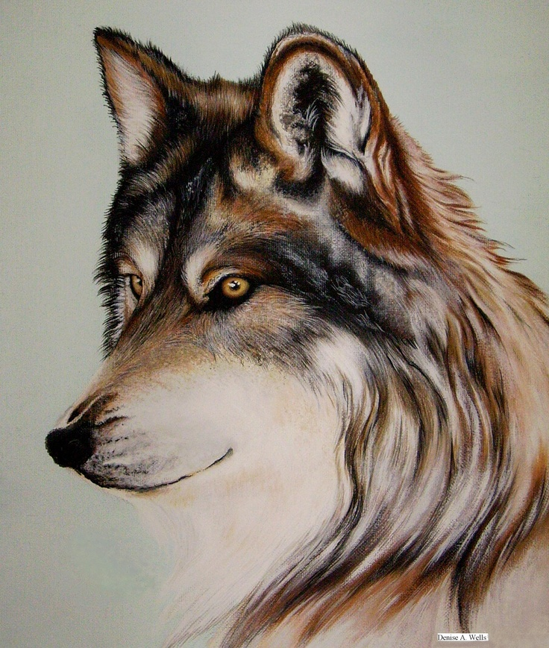
Wolf Stare
Denise A. Wells
https://www.artranked.com/topic/Wolf+Acrylic

Slide 6
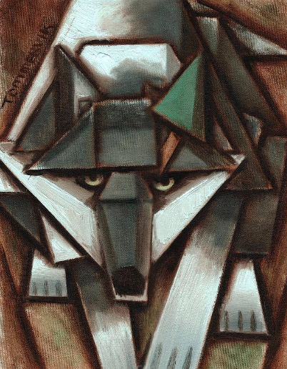
Grey Tree Wolf
Tommervik
https://tommervik.com/product/gray-wolf-tree-painting/

Slide 7
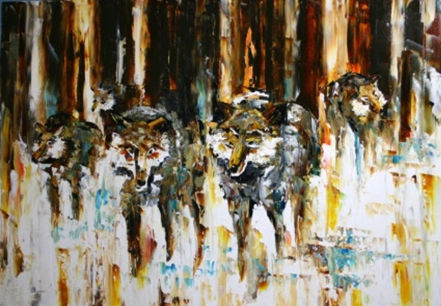
Wolf Pack
Laurie Justus Pace
https://www.dailypainters.com/paintings/30973/WOLF-PACK-Abstract-Wildlife-by-Laurie-Justus-Pace/Laurie-Justus-Pace/

Slide 8
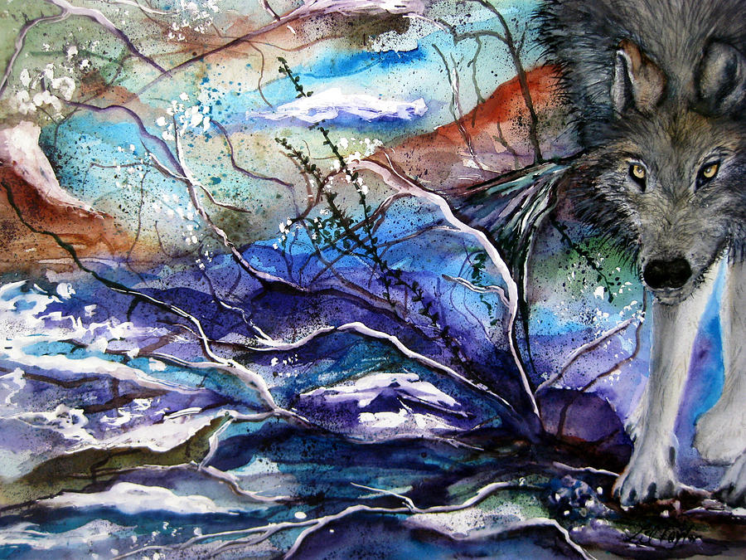
Abstract Wolf
Lil Taylor
https://fineartamerica.com/featured/abstract-wolf-lil-taylor.html

