Slide 1
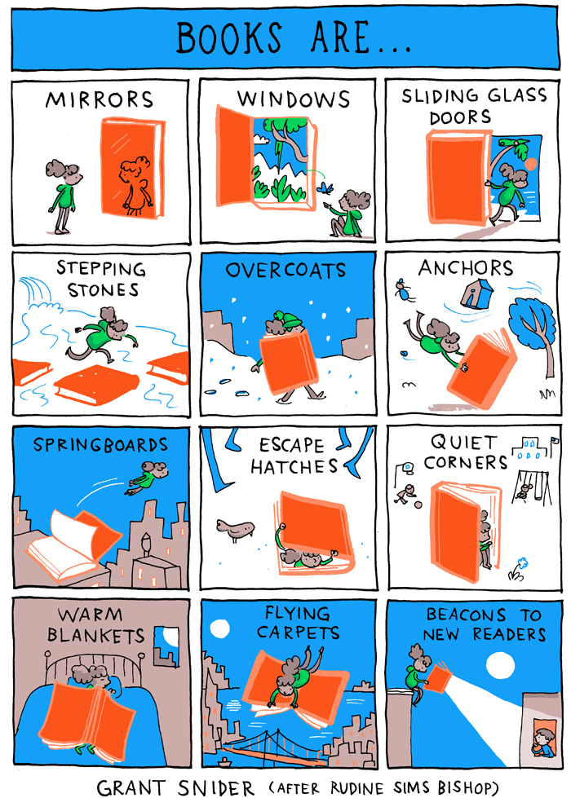
Warm up…
Take a moment to study the image. Which analogy do you relate most to and why? Use the chat to discuss with your (virtual) tablemates as they arrive. Be sure to introduce yourselves if you don’t know one another.
https://www.mackincommunity.com/2018/11/14/building-a-diverse-book-collection-providing-windows-mirrors-sliding-glass-doors-and-beyond/

Slide 2
Getting more bang for your book: read alouds and social studies inquiry For Grades k-2 Jennifer zoumberis

Slide 3
Jennifer Zoumberis
Georgia Department of Education
Social Studies and Special Education Content Integration Specialist
jzoumberis@doe.k12.ga.us

Slide 4
Our goal:
Explore some favorite titles and talk about how they can spark powerful learning that stretches across the curriculum.

Slide 5
Our Agenda
Read Aloud Resources
More Bang for EVERY book!
Spotlight Books
Read Aloud Tools
Some of my Favorite Titles
Closing
This Photo by Unknown Author is licensed under CC BY-SA-NC

Slide 6
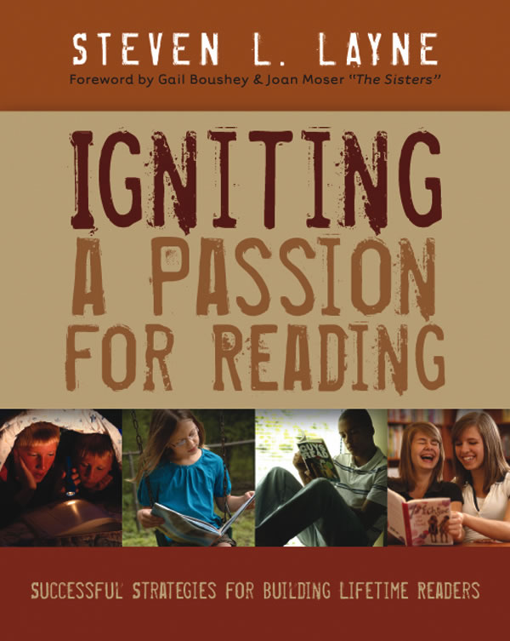
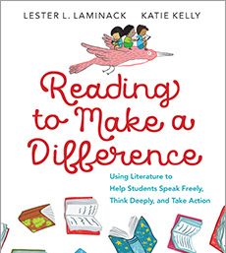
A few suggestions…

Slide 7
Where to find great titles – especially for Social Studies
Notable Tradebooks in Social Studies –
https://www.socialstudies.org/publications/notables
Book list for each year with title, brief description, publisher
Carter Woodson Award Winners - https://www.socialstudies.org/awards/woodson/winners
Winners from each year: title, cover, publisher
Georgia Council for Social Studies – Children’s Literature page http://www.gcss.net/site/page/view/childrens-literature
Specific to Georgia standards: title, some brief descriptions

Slide 8
More BANG for EVERY book!!!!!
Preview the cover: What do you see? What do you think? What do you wonder?
Check out the back matter: What was the author’s purpose? Why did they write this book? What kinds of sources did they use?
Video/Photo Analysis: Stop and ask frequent questions as you read/watch. Ask questions and have students support their thinking. Be intentional about sharing your thinking as you read.
Make Writing/Reading Connections: stop and jots, retell, summarize, talk about the characters, setting, main idea, compare and contrast books/characters/themes
Arts Connections: Draw, sing, re-enact parts of the book
Look through all of the Lenses: Historian, Geographer, Economist, Political Scientist

Slide 9
Essential Questions for I Walk With Vanessa
How can we change the way others are treated?
How do our choices impact others?
How can we show kindness to others?
What should we do when we see someone not being treated kindly?
How can ONE person make a difference?
How can this book relate to events today or events in our history?
As we look at the book, think about how you could use this book in your classroom.
While Reading the book… I Walk With Vanessa
https://youtu.be/bF1FhV_Bw3w

Slide 10
Ideas for I Walk with Vanessa
Video analysis
Photo analysis
Do a video think aloud using the book.
Stop and talk about what students notice.
Stop and talk about the changes they see happening.
Stop and talk about how the characters are feeling.
This could be completed on a chart tablet or in Social Studies Journals.
Print or display pages from the book to study.
Ask questions about what is happening in the illustrations. What do you see? What do you think? What do you wonder?
Ask the students to prove their thinking.
Arts connections
Writing/reading connections
Draw a picture of a way you could be kind.
Give students cards to role play or act out how they could respond to a friend in need.
Play songs about friendship.
Make posters or signs promoting kindness.
Have stop and jots for what is happening/changing.
Write speech bubbles or thought bubbles for the characters based on what is happening on the page.
Read books with similar themes. How are the characters alike/different?
Write about how the book relates to events going on in the world today/years past?

Slide 11
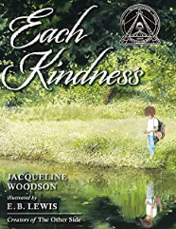
Books with Similar Themes
Be Kind by Pat Zietlow Miller
The Invisible Boy by Trudy Ludwig
Each Kindness by Jacqueline Woodson
If you Plant a Seed by Kadir Nelson
One by Kathryn Otoshi
What if Everybody Did That? By Ellen Javernick

Slide 12
Some tools…

Slide 13
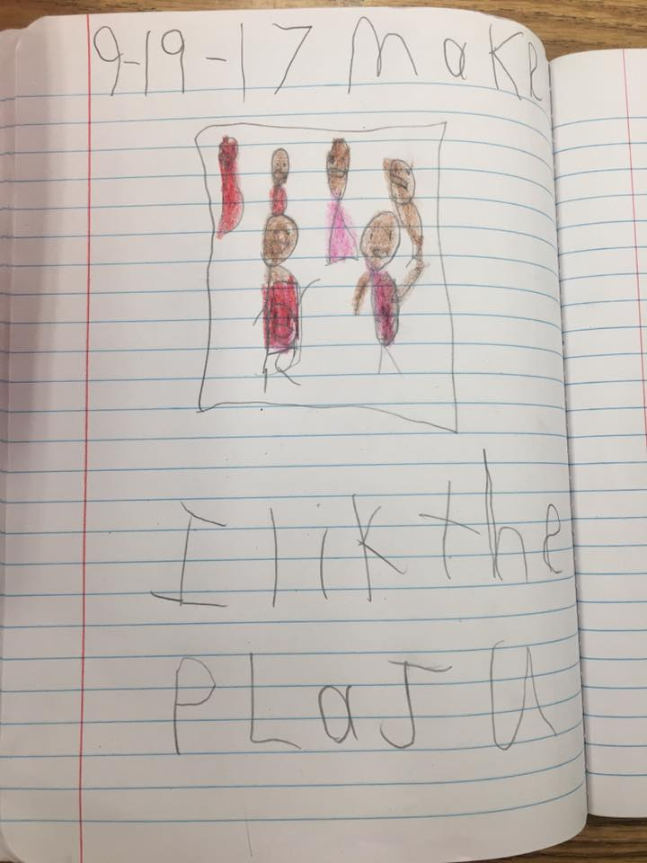
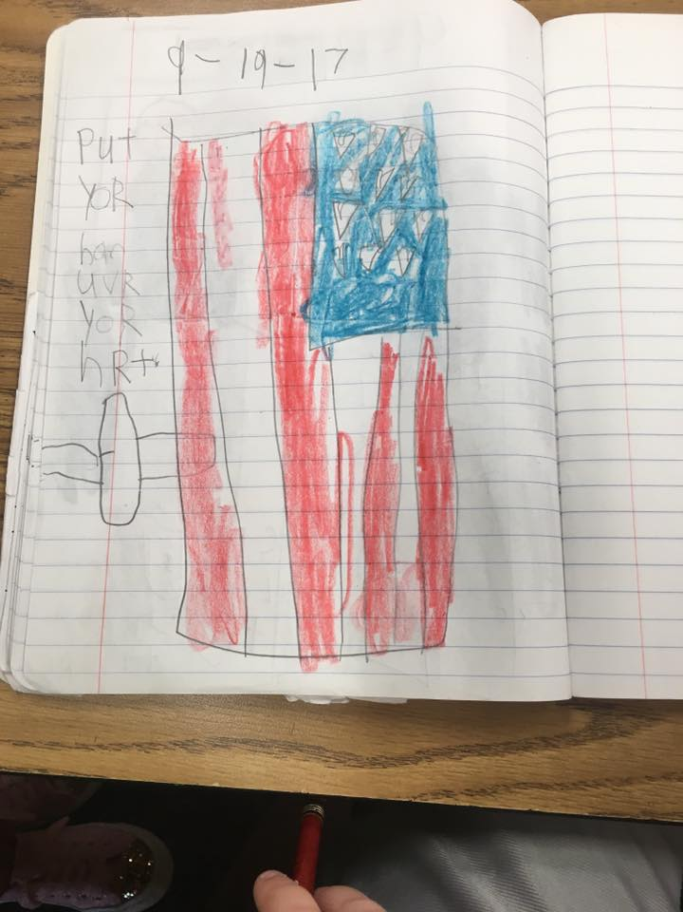
Social Studies Journals
A small piece of tape on the spine works well to identify the journal.

Slide 14
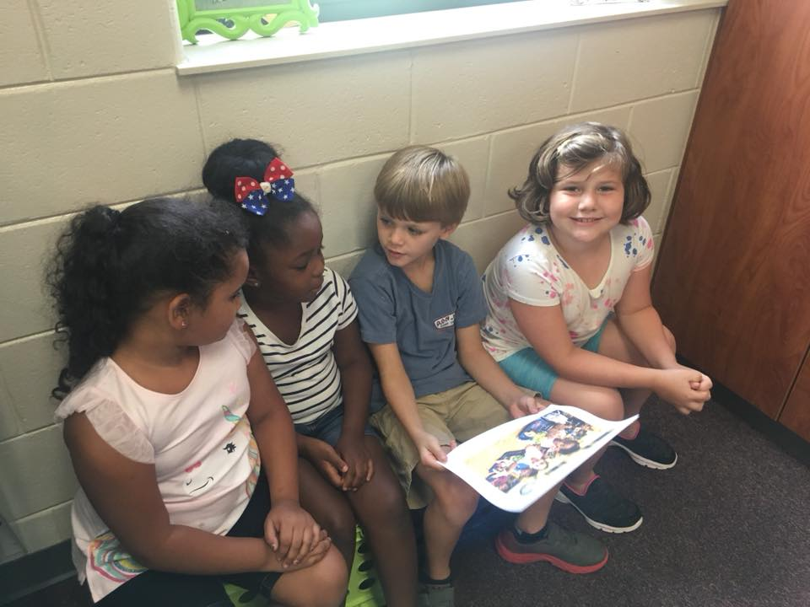
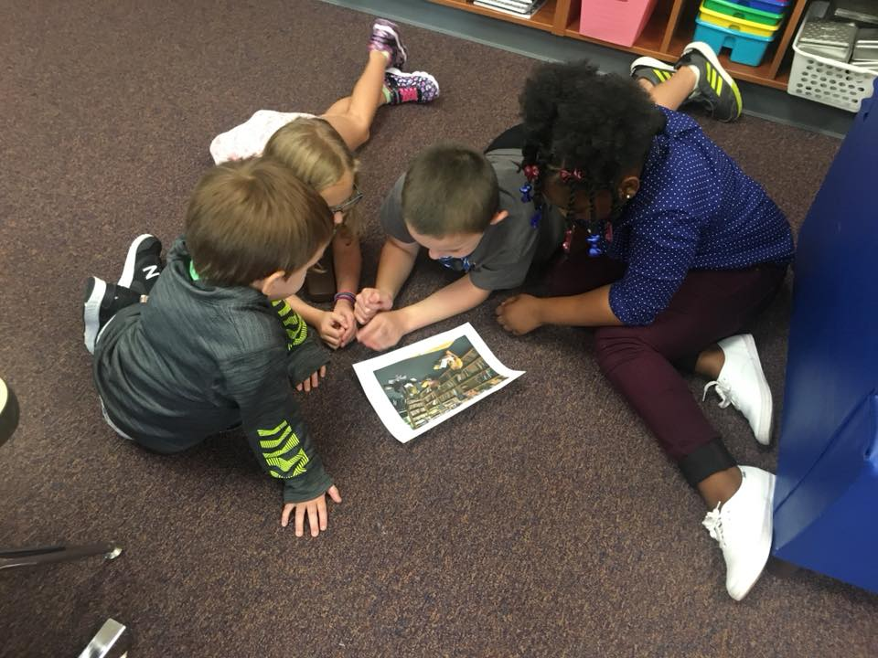
Talk it out…

Slide 15
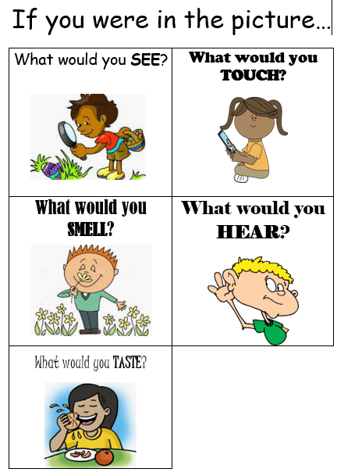
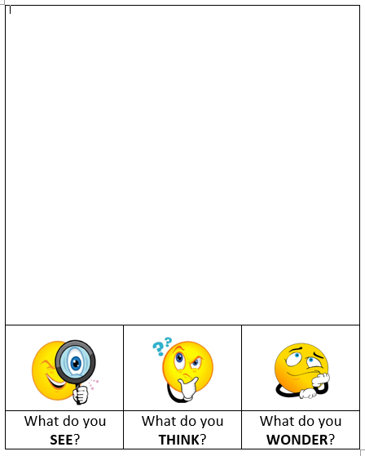
Image/Illustration Analysis
Look at an image/illustration from the inside.
After modeling, give students a chance to use this strategy individually, in partnerships, or in groups.

Slide 16
Jon Klassen Hat Series
https://www.socialstudies.org/publications/ssyl/November-december2019/economic-thinking-with-jon-klassens-animal-hat-books
Scarcity
Making choices
Opportunity costs
Costs/Benefits
Innovation
Supply and Demand
Economic Decision Making

Slide 17
Take a Snapshot
What did you see?
Give an example from the book.
Give an example from your life.
Snapshot Notes is a strategy created by Jennifer Lynn Gallagher and Eibhlin Kelly. This organizer is a modified version of the organizer shared in the November/December 2019 issue of the NCSS publication Social Studies and the Young Learner.

Slide 18
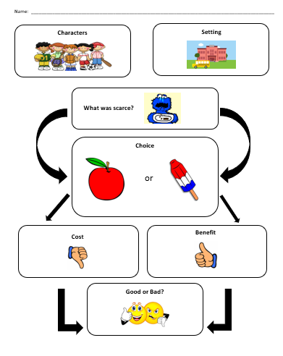
Content Story Map
What did you see?
Give an example from the book.
Give an example from your life.
This organizer is a modified version of the organizer created by Jennifer Lynn Gallagher and Eibhlin Kelly shared in the November/December 2019 issue of the NCSS publication Social Studies and the Young Learner.

Slide 19
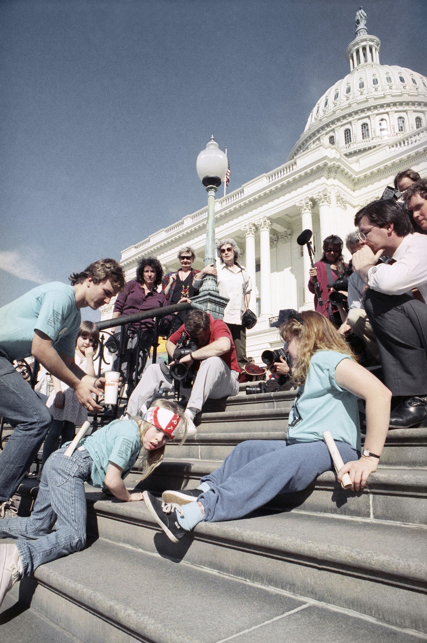
All The Way to the Top: How One Girl’s Fight for Americans With Disabilities Changed Everything Written by: Annette Bay Pimentel Illustrated by: Nabi H. Ali
Study the image: What do you see? What do you think? What do you wonder?
Create a timeline
Take a tour of your school. How did Jennifer’s fight make a difference for the students of your school?
https://www.youtube.com/watch?v=kU9cDyqvH-g
https://www.youtube.com/watch?v=qThC79iYs1U (includes live footage and quote)
"As a matter of fact, I said, 'I'll take all night if I have to” What does her quote mean? What does that tell us about her?

Slide 20
Some of my favorite titles for K-2
This Photo by Unknown Author is licensed under CC BY-ND

Slide 21
Blue Sky White Stars
Written by Sarvinder Naberhaus
Illustrated by: Kadir Nelson
An inspiring and patriotic tribute to the beauty of the American flag, a symbol of America's history, landscape, and people, illustrated by New York Times bestselling and Caldecott-honor winning artist Kadir Nelson Wonderfully spare, deceptively simple verses pair with richly evocative paintings to celebrate the iconic imagery of our nation, beginning with the American flag. Each spread, sumptuously illustrated by award-winning artist Kadir Nelson, depicts a stirring tableau, from the view of the Statue of Library at Ellis Island to civil rights marchers shoulder to shoulder, to a spacecraft at Cape Canaveral blasting off. This book is an ode to America then and now, from sea to shining sea.
https://www.youtube.com/watch?v=xLyAulxJ_Wk

Slide 22
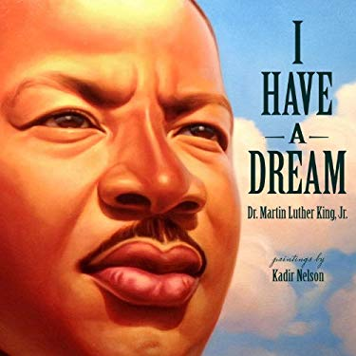
I have a Dream
Written by: Martin Luther King, Jr.
Illustrated by: Kadir Nelson
On August 28, 1963, on the steps of the Lincoln Memorial during the March on Washington, Martin Luther King gave one of the most powerful and memorable speeches in our nation's history. His words, paired with Caldecott Honor winner Kadir Nelson's magificent paintings, make for a picture book certain to be treasured by children and adults alike. The themes of equality and freedom for all are not only relevant today, 50 years later, but also provide young readers with an important introduction to our nation's past.

Slide 23
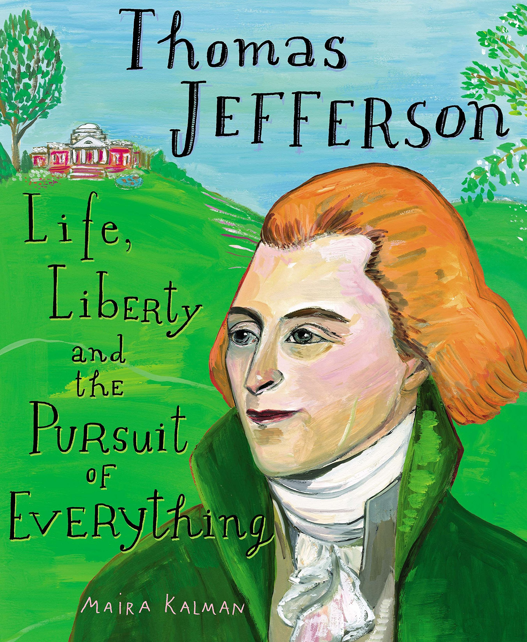
Thomas Jefferson: Life, Liberty, and the Pursuit of Everything
Written and Illustrated by: Maira Kalman
Renowned artist Maira Kalman sheds light on the fascinating life and interests of the Renaissance man who was our third president. Thomas Jefferson is perhaps best known for writing the Declaration of Independence--but there's so much more to discover. Maira Kalman shares a president's remarkable, complicated life with young readers, making history come alive with her captivating text and stunning illustrations.

Slide 24
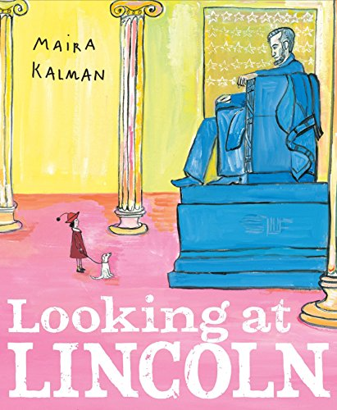
Looking at Lincoln
Written and Illustrated by Maira Kalman
From his boyhood in a log cabin to his famous presidency and untimely death, Abraham Lincoln's remarkable life is revealed in a fresh and exciting way

Slide 25
Fireboat: The Heroic Adventures of the John J. Harvey
Written and Illustrated by: Maira Kalman
The inspiring true story of the "John J. Harvey"--the retired NYC fireboat that was reinstated into emergency service on September 11, 2001--is told, bringing a New York City icon to life and celebrating the energy and hope of a place and its people.

Slide 26
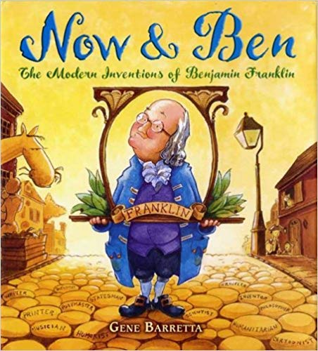
Now and Ben: The Modern Inventions of Benjamin Franklin
Written and Illustrated by: Gene Barretta
The inventions and inspiration of Benjamin Franklin and how they've stood the test of time What would you do if you lived in a community without a library, hospital, post office, or fire department? If you were Benjamin Franklin, you'd set up these organizations yourself. Franklin also designed the lightning rod, suggested the idea of daylight savings time, and invented bifocals-all inspired by his common sense and intelligence.

Slide 27
Thomas Jefferson Builds a Library
Written by: Barb Rosenstock
Illustrated by: John O’Brien
As soon as Thomas Jefferson learned to read, he found his passion: books, books, and more books Before, during, and after the American Revolution, Jefferson collected thousands of books on hundreds of subjects. In fact, his massive collection eventually helped rebuild the Library of Congress--now the largest library in the world. Barb Rosenstock's rhythmic words and John O'Brien's whimsical illustrations capture Jefferson's passion for the written word as well as little-known details about book collecting.

Slide 28
Water and Land: Land and Water Forms Around the World
Written and Illustrated by: Christy Hale
A lake turns into an island. A cozy bay into a secluded cape. A gulf with sea turtles transforms into a peninsula surrounded by pirate ships.
This unique information book for the very young switches between bodies of water and corresponding land masses with the simple turn of a page. Readers will delight as the story of Water Land unfolds and will see just how connected the earth and the water really are.

Slide 29
Miss Pinkletink’s Purse
Written by: Patty Brozo
Illustrated by: Ana Ochoa
Generous and eccentric, Miss Pinkeltink fills her huge purse with everything from a toilet plunger to roller skates, and then gives it all away. She offers tape to fix a flat tire and a bone to a kitty: Miss Pinkeltink’s gifts never quite hit the mark, / but she gave what she had, and she gave from the heart. And then, with nothing left to give or to shelter herself, she huddles on a park bench, trying to sleep in the rain. And that’s where Zoey sees her from her bedroom window and knows that something must be done.

Slide 30
The United States v. Jackie Robinson
Written by: Sudipta Bardhan-Quallen
Illustrated by: R. Gregory Christie
Jackie Robinson broke boundaries as the first African American player in Major League Baseball. But long before Jackie changed the world in a Dodger uniform, he did it in an army uniform. As a soldier during World War II, Jackie experienced segregation every day—separate places for black soldiers to sit, to eat, and to live. When the army outlawed segregation on military posts and buses, things were supposed to change. So when Jackie was ordered by a white bus driver to move to the back of a military bus, he refused. Instead of defending Jackie’s rights, the military police took him to trial. But Jackie would stand up for what was right, even when it was difficult to do.

Slide 31
How to Build a HUG: Temple Grandin and Her Amazing Squeeze Machine
Written By: Amy Guglielmo and Jacqueline Tourville
Illustrated by: Giselle Potter
As a young girl, Temple Grandin loved folding paper kites, making obstacle courses, and building lean-tos. But she really didn’t like hugs. Temple wanted to be held—but to her, hugs felt like being stuffed inside the scratchiest sock in the world; like a tidal wave of dentist drills, sandpaper, and awful cologne, coming at her all at once. Would she ever get to enjoy the comfort of a hug? Then one day, Temple had an idea. If she couldn’t receive a hug, she would make one...she would build a hug machine!

Slide 32
Now it’s your turn… What books do you LOVE?
Copy this link from the chat feature.
https://drive.google.com/file/d/1jhHT0iXCKTWiDFwX_d9B0krkPaxGYLrO/view?usp=sharing
Add your favorite book titles and how/why you use them.

Slide 33
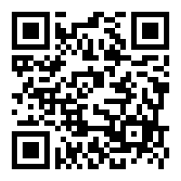
Thank you for spending Time with us today! jzoumberis@doe.k12.ga.us
Getting More Bang For Your Book K-2
Jennifer Zoumberis
https://forms.gle/i37at9uYGMznfQcr8
This Photo by Unknown Author is licensed under CC BY-SA

