Slide 1
Teacher Performance Evaluation and Professional Growth (T-PEPG) Model
Module 1: Model Overview
Notes:
Massachusetts Department of Elementary and Secondary Education
1

Slide 2
Module 1: Model Overview
Module 1: Model Overview
The first module provides a big-picture overview of the key features of the T-PEPG model and unpacks the basic structure and terminology of the MSFE rubric by examining the rubric’s standard indicators in preparation for self-assessment, reflection, and goal setting
Module 2: Student Learning Objectives
Module 3: Reflection and Goal-Setting
Module 4: Evidence, Observation, and Feedback
Module 5: Reflecting and Adjusting

Slide 3
Agenda
Welcome (5 minutes)
Connecting (10 minutes)
Hopes and Worries
Learning (50 minutes)
T-PEPG Foundations, Elements, and Process
Where Is the Rubric in the Four Step Evaluation Process?
Getting to Know the Points of Contact Framework
Implementing (55 minutes)
The MSFE Rubric and Companion Guide
Levels of Performance
Taking a Deep Dive Into the Companion Guide
Reflecting and Wrap-Up (5 minutes)
Revisiting Hopes and Worries, Preparing for Module 2

Slide 4
Intended Outcomes
At the end of this session, participants will know and be able to
Understand the T-PEPG model foundation, elements, and four-step process
Understand the NBPTS professional practice standards, indicators, and rubrics (MSFE Rubric), especially their structure and use in evaluation
Use the Companion Guide to deepen familiarity with and understanding of the instructional and professional practices in the MSFE Rubric

Slide 5
Connecting
Connecting
10 minutes

Slide 6
Connecting Activity: Hopes and Worries
First sticky note: Write down your biggest hope for the new teacher evaluation model (e.g., what you hope you or your students might gain from it).
Second sticky note: Write down your most significant worry or concern about the new model.

Slide 7
Learning
Learning:
T-PEPG Foundations, Elements, and Process
50 minutes

Slide 8
Why T-PEPG?
“Systematic changes to standards, curricula, instructional practice, and assessment will achieve little if efforts are not made to ensure every learner has access to highly effective teachers and school leaders.”
–Maine DOE Education Evolving, 2012

Slide 9
T-PEPG Goals and Purpose
Provide all students with effective teachers throughout their public school experience and improve student learning and growth by:
Serving as the basis for professional development that can improve instructional effectiveness
Clarifying expectations and serving as a guide for teachers as they reflect upon and improve their effectiveness.
Facilitating collaboration by providing a common language to discuss performance
Focusing the goals and objectives of schools and districts as they support, monitor, and evaluate their teachers
Serving as a tool in developing structures of peer support for teachers
Serving as a meaningful measurement of performance of individual teachers

Slide 10
The Professional Cohort Framework
Purpose:
Locus of support and training for teachers in achieving their professional goals and growing increasingly effective.
Focus:
Aligned with 4-step evaluation process
Mechanism for teacher training and critical review and approval of SLOs and professional goals.
Leadership:
T-PEPG Lead (insert name)
Professional Cohort Facilitators (insert name(s))
Selected based on administration’s prior knowledge of teachers’ qualities and skills.

Slide 11
The Professional Cohorts for [Insert District]
Topics (Year 1)
T-PEPG overview (Insert Date, Location)
Professional practice/Core Propositions (Insert Date, Location)
SLO development (Insert Date, Location)
Assessment selection (Insert Date, Location)
Professional goal-setting (Insert Date, Location)
SLO tuning, review, and approval (Insert Date, Location)
Observation, review, and feedback (Insert Date, Location)
Gathering evidence (Insert Date, Location)
Data and reflection (Insert Date, Location)

Slide 12
National Board for Professional Teaching Standards: Five Core Propositions
Teachers are committed to students and their learning
Teachers know the subjects they teach and how to teach those subjects to students
Teachers are responsible for managing and monitoring student learning
Teachers think systematically about their practice and learn from experience
Teachers are members of learning communities

Slide 13
MSFE Rubric
1. Teachers are committed to students and their learning.
1.1 Understanding of Students
1.2 Application of Learning Theory
1.3 Classroom Climate
5. Teachers are members of learning communities.
5.1 Professional Collaboration
5.2 Engagement With Caregivers and Community
Core Proposition 1
2. Teachers know the subjects they teach and how to teach those subjects to students.
2.1 Subject Knowledge
2.2 Pedagogical Content Knowledge
2.3 Goal-Focused Planning
Core Proposition 5
Core Proposition 2
4. Teachers think systematically about their practice and learn from experience
4.1 Reflective Practice
4.2 Continuous Professional Growth
Core Proposition 4
Core Proposition 3
3. Teachers are responsible for managing and monitoring student learning.
3.1 Managing Classroom Routines and Expectations
3.2 Student Engagement
3.3 Assessment of Student Progress

Slide 14
MSFE Rubric
The five Core Propositions and 13 standard indicators align closely with the InTASC Model Core Teaching Standards as required by Chapter 180, Section 5.
Four performance level definitions:
1. Ineffective
2. Developing
3. Effective
4. Distinguished

Slide 15
Multiple Measures of Effectiveness
Core Propositions 1, 2, 3, and 5
Professional Practice
Professional Growth
Core Proposition 4
Student Learning and Growth
Student learning objectives
Student Perception
(Year 3)
Student perception survey, not included until Year 3

Slide 16
The Four-Step Evaluation Process
Step 1: Expectations and Goal-Setting
Step 4: Professional Growth Plans
Fall
Step 2: Evidence, Feedback, and Growth
Spring-Fall
Fall-Spring
Late Winter-Spring
Step 3: Reflection and Rating

Slide 17
Point of Contact Framework Overview
Point of Contact Menu
Formal Observation
Extended Classroom Observation
Series of Informal Classroom Observations
Video Lesson Review
Curriculum Review
Student Engagement Analysis
Review of Student Learning Data
Professionalism Observation/Conference
Other
Person to person
Documented
Evidence based

Slide 18
The Four-Step Evaluation Process
Step 1: Expectations and Goal-Setting
Step 4: Professional Growth Plans
Fall
Step 2: Evidence, Feedback, and Growth
Spring-Fall
Fall-Spring
Late Winter-Spring
Step 3: Reflection and Rating

Slide 19
Calculating the Summative Effectiveness Rating
Professional Practice Rating (CPs 1, 2, 3, and 5)
Rating of Impact on Student Learning and Growth
Summative Effectiveness Rating
Professional Growth Rating (CPs 4.1 and 4.2)
Ineffective
Developing
Effective
Distinguished
Negligible
Low
Moderate
High
Ineffective
Partially Effective
Effective
Highly Effective

Slide 20
The Four-Step Evaluation Process
Step 1: Expectations and Goal-Setting
Step 4: Professional Growth Plans
Fall
Step 2: Evidence, Feedback, and Growth
Spring-Fall
Fall-Spring
Late Winter-Spring
Step 3: Reflection and Rating

Slide 21
Professional Growth Plan Overview
Self-Directed (Highly Effective/Effective) | Monitored (Partially Effective) | Directed (Ineffective)
3 years | 2 years | 1 year
Two professional goals with a timeline from one to three years | Two goals developed with support; aligned to the areas in need of improvement | Goals aligned to areas in need of immediate improvement, timelines from 60 days to one year
Professional Cohort may be outside of district | School- or district-based Professional Cohort | Administrator-approved Professional Cohort
At least 2 SLOs per year | At least 2 SLOs per year | At least 2 SLOs
Mid-cycle reflection | Mid-cycle reflection | Mid-cycle reflection

Slide 22
Implementation Timeline
Year 1 (2015–2016)
Summer: T-PEPG leads and cohort facilitators trained
Fall: Professional cohorts begin; teachers set at least one SLO and related professional goals.
Winter: Regular meetings of cohorts; begin points of contact
Spring: Regular meetings of cohorts; continue points of contact
Year 2 (2016–2017)
Summer: T-PEPG leads and cohort facilitators trained
Fall: New teachers trained; cohorts continue; second SLO and related professional goals developed; points of contact continue
Winter/Spring:
Self-evaluation and evidence submission
Summary evaluation conferences held
Every teacher receives summative effectiveness rating and is placed on a differentiated professional growth plan

Slide 23
Learning Activity 1a: Where Is the Rubric in the Four-Step Evaluation Process?
Work with an elbow partner
Turn to Handout 1
Sort the evaluation activities into the Four-Step Evaluation Process

Slide 24
The Rubric in the Four-Step Evaluation Process
C
F
K
H
Step 1: Expectations and Goal-Setting
Step 4: Professional Growth Plans
Fall
Step 2: Evidence, Feedback, and Growth
A
D
E
G
Spring-Fall
Fall-Spring
Late Winter-Spring
Step 3: Reflection and Rating
B
I
J

Slide 25
Learning Activity 1b: Getting to Know the Points of Contact Framework
Read and follow instructions in Handout 2
Work with a small group to complete the questions
Share out

Slide 26
Break

Slide 27
Implementing: MSFE Rubric and Companion Guide
55 minutes

Slide 28
MSFE Rubric
Core Proposition 1
Core Proposition 5
Core Proposition 2
Core Proposition 4
Core Proposition 3
Companion Guide, p. 3

Slide 29
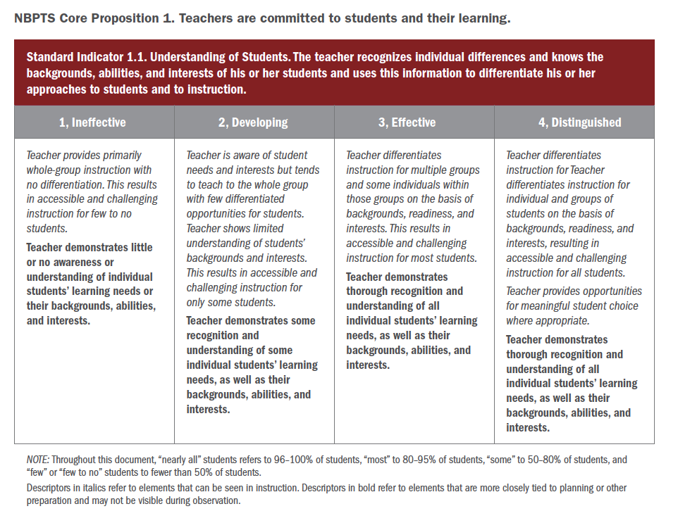
MSFE Rubric
Core Proposition
Standard Indicator
Performance Level
Core Proposition 1
Performance Level Descriptions
Italic = can be seen in instruction/ observation
Bold = elements tied to planning or preparation
Core Proposition 5
Core Proposition 2
Core Proposition 4
Core Proposition 3
Explanatory Notes

Slide 30
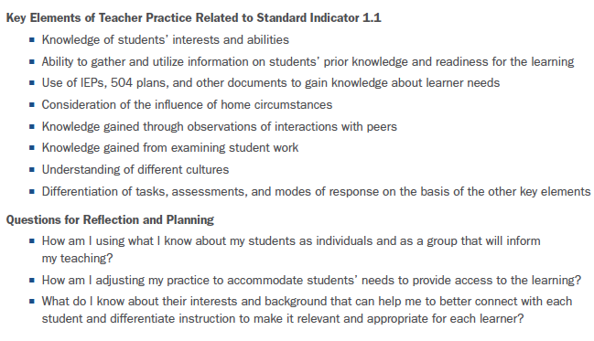
MSFE Rubric Companion Guide
Descriptive Narrative
Key Elements
Questions for Reflection

Slide 31
MSFE Rubric Companion Guide

Slide 32
MSFE Rubric Companion Guide

Slide 33
Implementing Activity 1a: Levels of Performance
Work with your table group
Identify key words that are used across the performance level
Record your responses on Handout 3

Slide 34
Learning Activity 1b: Taking a Deep Dive Into the Companion Guide
Divide into 5 groups of 3–5 people each, working with teachers in a grade or subject area similar to your own.
Each group will be assigned one Core Proposition.
Assign each group member one standard indicator in the Core Proposition.
Complete Handout 4.
Step 1. Turn to the “Effective” level page for your standard indicator; read the level descriptor and the critical attributes. Jot down in your own words what the indicator is about.
Step 2. Read through the “Possible Examples”; choose one that resonates with your own classroom(s), and craft your example to share with your group.
Step 3. Read the professional learning section and consider the follow-up questions in the handout.
Step 4. Share out with your group.

Slide 35
Wrap-Up/Debrief From Activity 1b
Discuss: “How could the Companion Guide and this exercise be extended into existing collaborative opportunities at my school to ensure each teacher has a clear understanding of each Core Proposition and standard indicator?”

Slide 36
Reflecting and Wrap-Up
Reflecting and Wrap-Up
5 minutes

Slide 37
Revisiting Hopes and Worries
Has your hope or worry changed? Why or why not?

Slide 38
Next Steps
Bring some student data to Module 2, Student Learning Objectives, relevant to the class/course that will be the focus of your SLO. These data may include
Student assessment scores from the prior year (both for classes you taught last year and test scores of your current students)
Data from course pre-assessments
Information on students with IEPs, 504 plans, and gifted and talented designations
Course grades to date

Slide 39
Looking Forward to Module 2
Module 2 will provide details about the SLO process. Participants will engage in activities designed to increase their understanding of the SLO process and have time to begin drafting their SLOs for the 2015–2016 school year.

Slide 40
Presenter name
XXX-XXX-XXXX
xxxxxxxxxxx@xxx.xxx
1234 Street Address
City, State 12345-1234

