Slide 1
Office Hours MSAA & MSAA Science
March 4, 2022
Please post questions you may have in the chat box – we will work to answer them during the session and add them to a Q & A document.
We will begin shortly.
Notes:
As always, we are glad you are able to join us today and are hopeful the information provided in these sessions is helpful and beneficial to your work.
As we enter the pre-assessment season, some of our upcoming office hours will be assessment-specific based on the timing of the administration windows. Today, the main focus of our time together will be Maine’s alternate assessments in math, literacy and science. As always, the assessment team members are here to support and answer yours questions.

Slide 2
MSAA and MSAA Science
As a reminder, every student in grades 3-8 and 3rd year of HS participate in either a general or alternate assessment in the content areas of ELA/literacy and mathematics.
Students with the most significant cognitive disabilities who have been found eligible per the IEP Team using state criteria for eligibility participate in alternate assessments. Maine’s alternate assessment in ELA/literacy and math is the MSAA, and the MSAA in Science.
MSAA | Department of Education (maine.gov)
Notes:
I know that this slide will be repetitive information for many of you, and so I’ll move through it quickly. This is an overview of our Maine alternate assessments. Just like with general assessments, students participating in an alternate science assessment do so in grades 5, 8, and 11.
There is a detailed process for determining eligibility to participate in alternate assessments, and this is a local decision by the student’s IEP Team using state guidance resources and multiple data points.

Slide 3
MSAA/MSAA Science Timeline
Date | Action | Whom | Deadline
Now | TA administers sample items to students | TC (please check in with all TA) | Prior to the administration of the assessment
2/22/22 | User accounts created for TA/TC | DOE Districts | 3/14/22
2/22/22 | TC establish classrooms in MSAA Platform | TC | 3/14/22
2/28/22 | Training modules go live in MSAA Platform | TC TA | 3/14/22
2/28/22 | TA reviews Directions for Test Administrators (DTA) to prepare/organize for administration | TC (please check in with all TA) TA | Prior to the administration of the assessment
Notes:
Here is an overview of our timeline for the MSAA this year, and I’ll go into detail on each of these actions on subsequent slides. Truthfully, the alternate assessment timeline began back in August of 2021, when the Team began reaching out to Directors about alternate assessment participation, the 1%,

Slide 4
MSAA/MSAA Science Timeline
Date | Action | Whom | Deadline
3/1/22 | Alternate assessment snapshot | DOE | 3/1/22
3/4/11 | Alternate Assessment Open Office Hours | DOE | 3/4/22
3/11/22 | Alternate Assessment Open Office Hours | DOE | 3/11/22
3/7/22 | TA Training, Live Webinar | DOE | 3/7/22
3/14/22 | MSAA & MSAA Science administration window | Districts | 4/29/22
7/18/22 | Online reporting for student, school and district reports in the MSAA Platform | DOE Districts | 9/9/22

Slide 5
Sample Items and Best Practice Videos
Sample items provide both students and the TA the opportunity to interact with the types of items, platform, and any accessibility features/ accommodations as appropriate prior to the administration of the assessment.

Slide 6
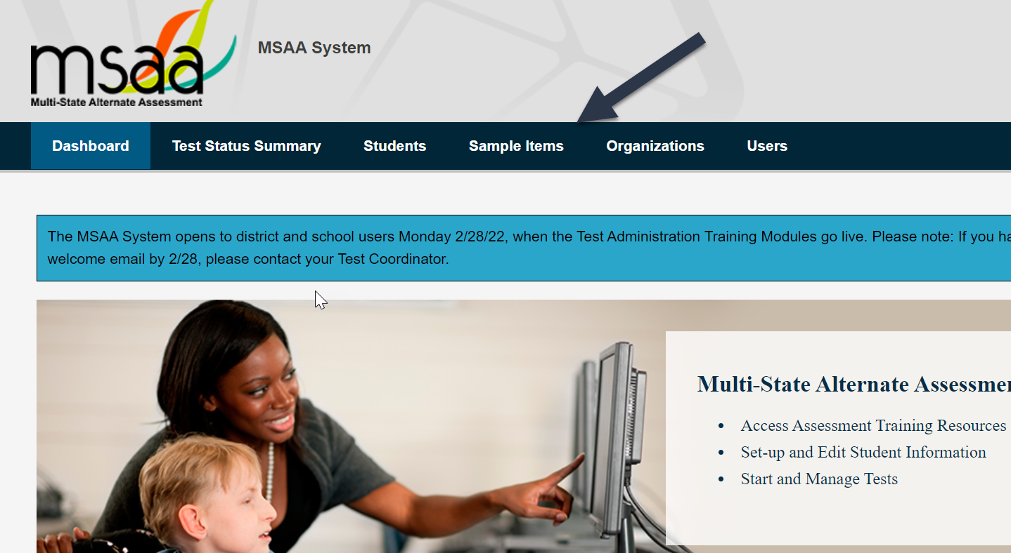
Sample Items and Best Practice Videos
Msaaassessment.org

Slide 7
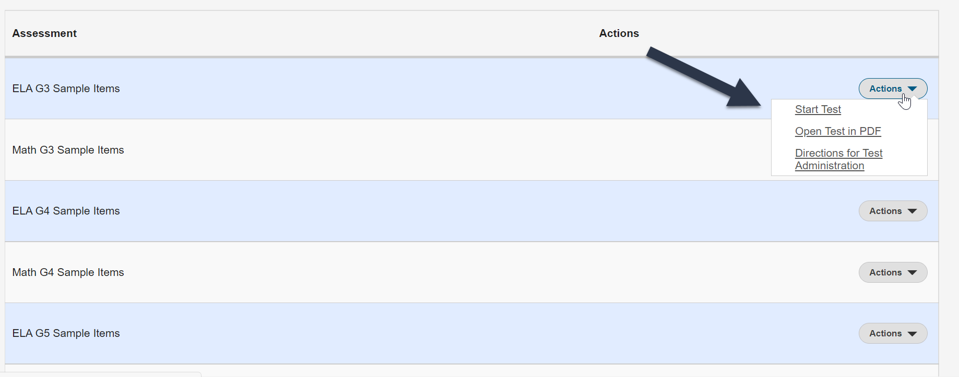
Sample Items and Best Practice Videos

Slide 8
Sample Items and Best Practice Videos
One unique feature of MSAA/MSAA Science sample items is the Teachers Guides resources. These guides are found on the same page of the MSAA website and support teachers in determining what the student knows and can do in relation to the corresponding alternate academic achievement standards for each practice item.

Slide 9
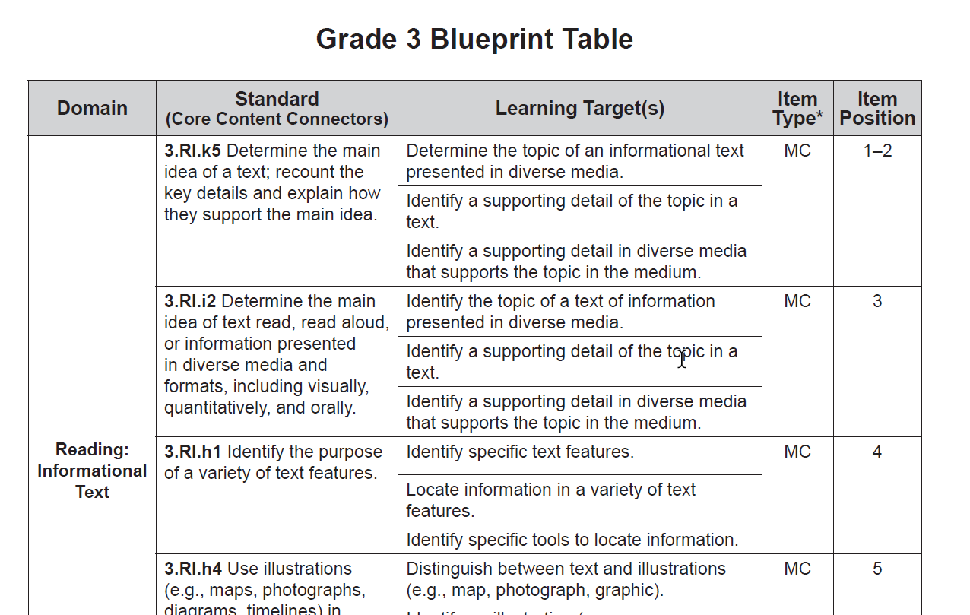
Sample Items and Best Practice Videos

Slide 10
Sample Items and Best Practice Videos

Slide 11
User Accounts and Creating Classrooms
Based on a field survey shared with Special Education Directors in early January, Test Coordinators were identified for the MSAA.
Within that survey, Directors had the option for DOE to create the TA accounts as well for the district.
Accounts were created on 2/22/22, and users received a welcome email from the MSAA System.

Slide 12
User Accounts and Creating Classrooms
In schools where more than one student is eligible to participate in the MSAA, the creation of classrooms is highly recommended.
TC can create unique classrooms and assign a specific student and TA to that classroom. This also protects student PII, as the TA will only be able to view the assessment, materials and progress of that student.

Slide 13
User Accounts and Creating Classrooms

Slide 14
Preparing for Assessment Training Modules and DTA
There is a series of six modules for both TA and TC, including a final quiz. Training modules are mandatory for both roles. Without the qualifying score on the final quiz and completion of each module, TA cannot access the student assessment materials.
Additionally, TA must build in time prior to the administration to review the Directions for Test Administrators (DTA). This is a highly accommodated form which includes:
directions, items and options read aloud
alternative text for students who are blind/have visual impairment
Manipulatives, resource sheets
Tactile graphics as appropriate (developed by TA)

Slide 15
DOE Support and Technical Assistance
Open Office Hours for MSAA TC:
3/4/22 10am-12pm (concluded)
3/11/22 10am-12pm
TA Live Webinar Training
3/7/22 3-4pm

Slide 16
DOE Support and Technical Assistance
Technical assistance can take many different forms, including:
Training onsite or virtually
Modeling the administration of an item or session
Check-ins pre, during or post-assessment
Support in coordinator with out of district partners
Assessment observation with feedback provided
Additionally, the Team has reached out to several districts regarding onsite technical assistance visits this year, to include assessment observations. This not only is required in order to meet federal peer review, but it also informs planning for professional development in the upcoming school year. Technical assistance data from the Winter 2022 ACCESS for ELLs administration has yielded critical data related to the student assessment experience and how the Team can best support the field in terms of future trainings.

Slide 17
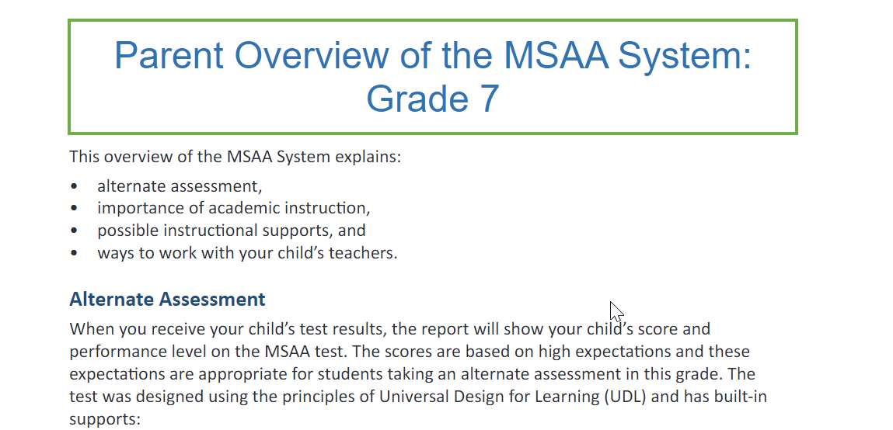
Online Reports
The online reporting window opens on 7/18/22 and closes 9/9/22. During this window, districts will have the opportunity to download district, school, and student level reports. In addition to reports, there are also parent guides for each grade level to support families in their understanding.

Slide 18
Questions & Answers
Notes:
Review of Q from the chat

Slide 19
Questions or Support? @maine.gov
Jodi Bossio-Smith
MSAA Math & ELA/Literacy, MSAA Science
ACCESS for ELLs & Alternate ACCESS for ELLs
Nancy Godfrey
NWEA Math & ELA/Literacy
Maine Science
Regina Lewis
NAEP & International Assessments
Varun Motay, Data Analyst Cheryl Brackett, Management Analyst
Notes:
Please don’t hesitate to reach out to the team with any questions or concerns.

