Slide 1
Fake News: What It Is, Why It Works, and What Social Studies Can Do About It
Wayne Journell
University of North Carolina at Greensboro
Webinar for Maine Educators
February, 2020

Slide 2
SUNY Press, 2017
Recipient of 2018 Exemplary Research in Social Studies Award from NCSS

Slide 3
Chapters:
Foreword—Rebecca Klein, HuffPost
Introduction: Fake News and the Imperative of Civic Education—Wayne Journell
Why Does Fake News Work? On the Psychosocial Dynamics of Learning, Belief, and Citizenship—H. James Garrett
Real Recognize Real: Thoughts on Race, Fake News, and Naming Our Truths—Ashley Woodson, LaGarrett King, & Esther Kim
Teens, Social Media, and Fake News—Ellen Middaugh
How Students Evaluate Digital News Sources—Sarah McGrew, Joel Breakstone, Teresa Ortega, Mark Smith, & Sam Wineburg
Teaching in the Twilight Zone of Misinformation, Disinformation, Alternative Facts, and Fake News—Avner Segall, Margaret Crocco, Anne-Lise Halvorsen, and Rebecca Jacobsen
Judging Credibility in Un-Credible Times: Three Educational Approaches for the Digital Age—Erica Hodgin & Joe Kahne
Political Memes and the Limits of Media Literacy—Wayne Journell & Chris Clark
Two Truths and Fake News: Lessons for Young Learners—Jenn Hauver
Afterword—Jeremy Stoddard
Teachers College Press, 2019

Slide 4
Defining Fake News
“Fake news” is not new
The term “fake news” has become ubiquitous in the past couple of years, but there is not a clear definition of what it means
For the purposes of this presentation, I want to delineate between actual fake news and Trump’s version of fake news

Slide 5
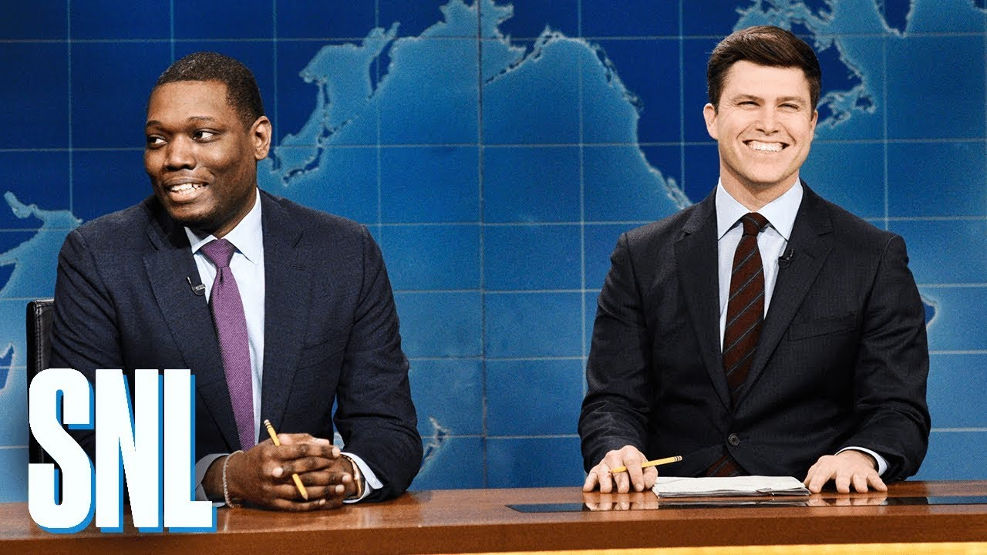
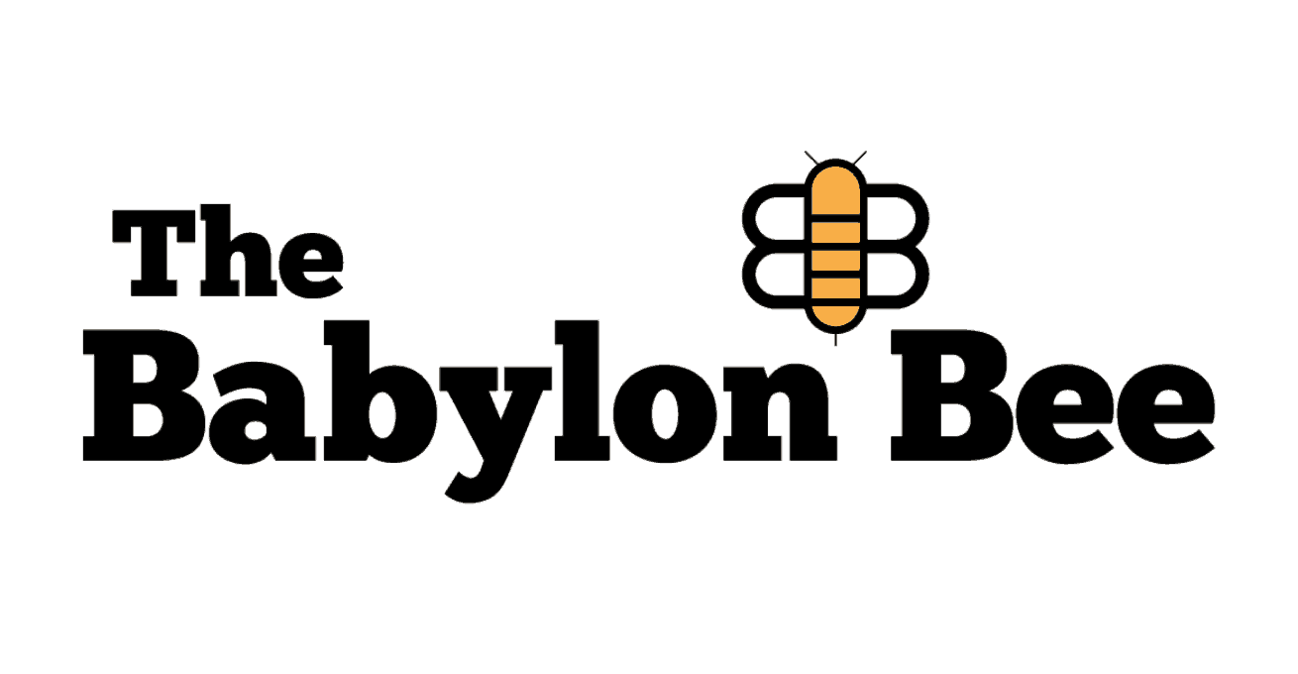
Defining Fake News: Actual Fake News

Slide 6
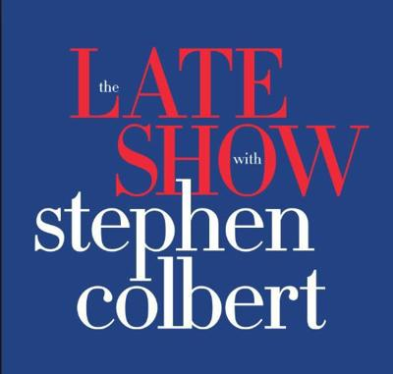
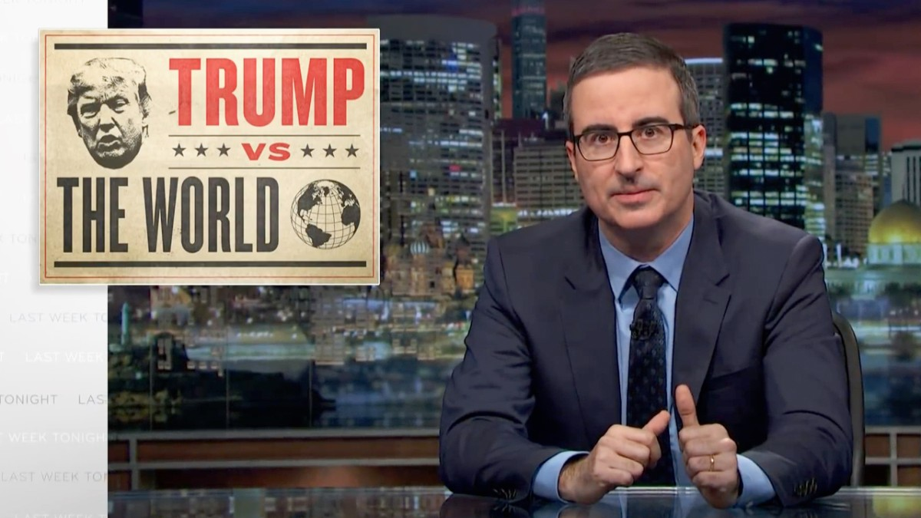
Defining Fake News: Actual Fake News

Slide 7
Defining Fake News: Actual Fake News

Slide 8
Defining Fake News: Actual Fake News

Slide 9
Defining Fake News: Actual Fake News

Slide 10
Defining Fake News: Actual Fake News
Reaches millions (SPLC, 2018)
Peddles conspiracy theories; here are a few:
“Pizzagate”
U.S. govt orchestrated 9/11, Sandy Hook, and OK City bombing
Antonin Scalia was murdered
Obama is head of Al-Qaeda
U.S. govt is using juice boxes and city-controlled water to turn people gay

Slide 11
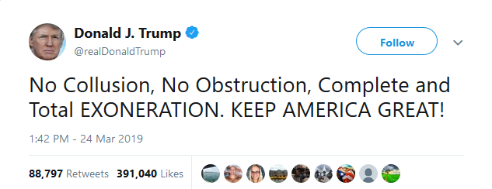
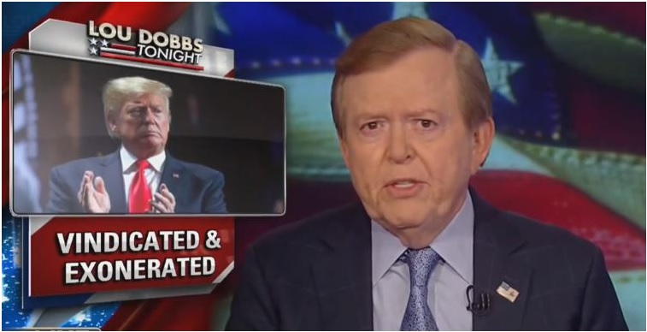
Defining Fake News: Actual Fake News

Slide 12
Defining Fake News: Actual Fake News

Slide 13
Defining Fake News: Trump’s Version

Slide 14
Separating Bias From Accuracy

Slide 15
Separating Bias From Accuracy

Slide 16
Why Fake News Works
Both actual fake news and Trump’s version of fake news “work” for the same reasons:
Psychosocial factors
Increasing political and social polarization
Self-Selection into echo chambers

Slide 17
Why Does Fake News Work?
Motivated reasoning (Dusso & Kennedy, 2015; Taber & Lodge, 2016) and confirmation bias (Nickerson, 1998)
People interpret new information in ways that bolster existing beliefs/worldviews
Oftentimes, people engage in motivated reasoning and confirmation bias unwittingly

Slide 18
Why Does Fake News Work?

Slide 19
Why Does Fake News Work?
Backfire effect—For some/many people, encountering factual evidence that challenges preconceived beliefs actually makes those prior beliefs stronger (Nyhan & Reifler, 2010; Wood & Porter, 2019)

Slide 20
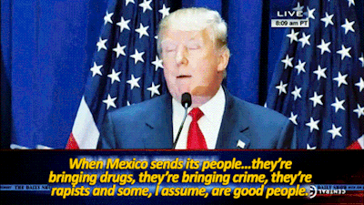
Why Does Fake News Work?

Slide 21
Why Does Fake News Work?

Slide 22
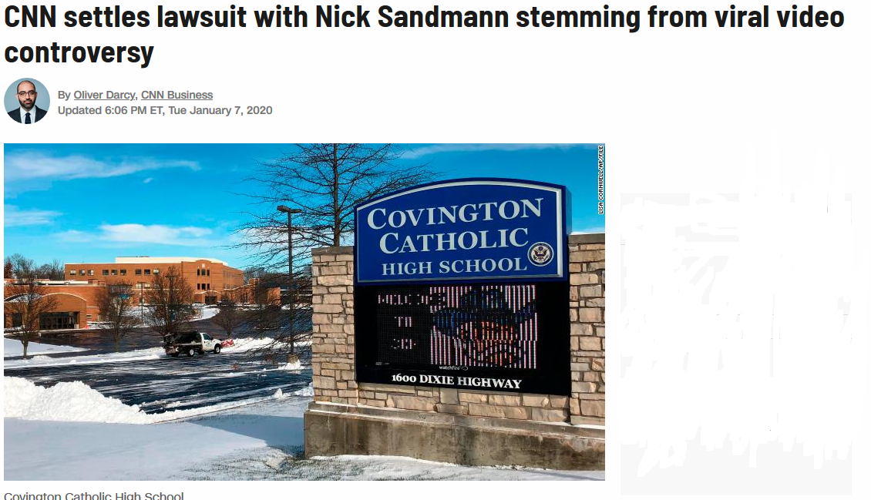
Why Does Fake News Work?

Slide 23
Creating the Perfect Storm
Motivated reasoning, confirmation bias, and the backfire effect have always been part of the human condition
However, we have created conditions that allow fake news to thrive
Political polarization
Self-Selection into echo chambers

Slide 24
Political Polarization In the U.S.
The United States has always been polarized politically
And that polarization has often occurred along geographic lines
Increasingly, however, that political polarization is correlated with social polarization

Slide 25
1860 Election

Slide 26
2016 Election

Slide 27
1928 Election

Slide 28
1996 Election

Slide 29
2016 Election

Slide 30
Cultural/Social Polarization
Popularity of Duck Dynasty, 2016
Popularity of Modern Family, 2016

Slide 31
So, What’s Different Now?
People “see” the other side more often now than in the past (e.g., via TV, social media)
As a result, negative partisanship is on the rise
Characterized by not just allegiance to one’s preferred political party, but also negative perceptions of the opposing party (Abramowitz & Webster, 2016, 2018)
Research shows that many Americans’ connections to political identity is stronger than racial, ethnic, or religious identity (Westwood et al., 2018)
In addition, there has been a rise in partisan cable news networks and online media outlets
And people regularly self-select news outlets that adhere to their preconceived worldviews

Slide 32
Self-Selection Into Echo-Chambers
Sometimes we cannot control being in echo chambers (e.g., where we work)
However, Americans are increasingly self-selecting to isolate themselves into ideological echo chambers:
In the news that we consume
In the spaces we inhabit on social media

Slide 33
Self-Selection Into Echo-Chambers
This type of ideological segregation is problematic for many reasons:
Research shows that when people are exposed to differing views, tolerance grows
Conversely, when likeminded people are together, intolerance grows and people are motivated to action (Mutz, 1996)
It creates an ideological “news bubble” that keeps people from hearing the whole story about any given issue

Slide 34
Self-Selection Into Echo-Chambers
“I was surprised to hear there was anything negative in the Mueller report at all about President Trump. I hadn’t heard that before … I’ve mainly listened to conservative news and I hadn’t heard anything negative about that report and [that] President Trump has been exonerated.”

Slide 35
The Role of “Big Data”
Even if people do not self-select to be in social media echo-chambers, social media will try to create ones for them
Social media runs on algorithms that push advertisements, etc. based on a digital profile of your likes/dislikes
Political parties and others (e.g., the Russians) have used these profiles to push political propaganda

Slide 36
So, What Do We Do About It??
In this “post-truth” era, social studies has a unique opportunity to pierce the ideological echo-chambers students find themselves in.

Slide 37
Implications for Social Studies
Move beyond traditional media literacy approaches
--Media literacy remains important for the following reasons:
1) Students are bad at it (McGrew et al., 2018,
2019)
2) Research shows that students who have more
media literacy instruction have greater
inclination toward accuracy motivation (Kahne &
Bowyer, 2017)
But media literacy alone is not enough, and new forms of media (e.g., memes) do not lend themselves to traditional media literacy approaches

Slide 38
Implications for Social Studies
Refocus attention on the psychosocial elements of why fake news works
--Have students study their own biases and proclivity to consume news that fits their worldviews
--Have students analyze social media for evidence of motivated reasoning/confirmation bias

Slide 39
Implications for Social Studies
Embrace the political
--For too long, the field of social studies has shied away from politics
--Social studies doesn’t have to be partisan, but it should be political
--21st century issues, such as fake news, can only be understood and dealt with if students recognize polarization, partisanship, and how politicians/media prey on individuals’ beliefs/desires
--Students also need to recognize how they are complicit, perhaps unwittingly, in these processes

Slide 40
Implications for Social Studies
Avoid the “good people on both sides” stance
--The only way our democracy can improve is if people call out those who are doing damage to it
--“Everyone is entitled to his own opinion, but not his own facts”—Daniel Patrick Moynihan

Slide 41
Implications for Social Studies
Pierce the echo-chambers
--Ensure that students are consuming high-quality media from both sides of the aisle
--Have students evaluate the same news stories from right and left sources to understand bias and spin

Slide 42
Thank you!
Contact info: awjourne@uncg.edu
www.waynejournell.com

