Slide 1
Ready Or Not
Statehood comes to Maine

Slide 2
Present concepts through people,
the more local the people, the better.
Maine remains a medium-sized small town;
people know other people.
The core of the story remains the same;
local details provide immediacy.

Slide 3
Source material available:
Local historical societies/libraries
State Library
Digital Maine
State Archives
State Museum
Maine Historical Society
Maine200.org
Maine Public
Masthead Maine
with people willing to help.

Slide 4
Light Reading
Maine Becomes a State - Ron Banks
Maine: a Narrative History - Neil Rolde
Wabanaki Homeland and
the New State of Maine - Micah Pawling
Maine Adjutant General Reports - John Hodsdon
A Story of Maine in 112 Objects - Bernard Fishman
Eminent Mainers - Douglas Stover
Maine – The Pine Tree State
From Prehistory to the Present- Ed Churchill
History of the State of Maine - William Williamson

Slide 5
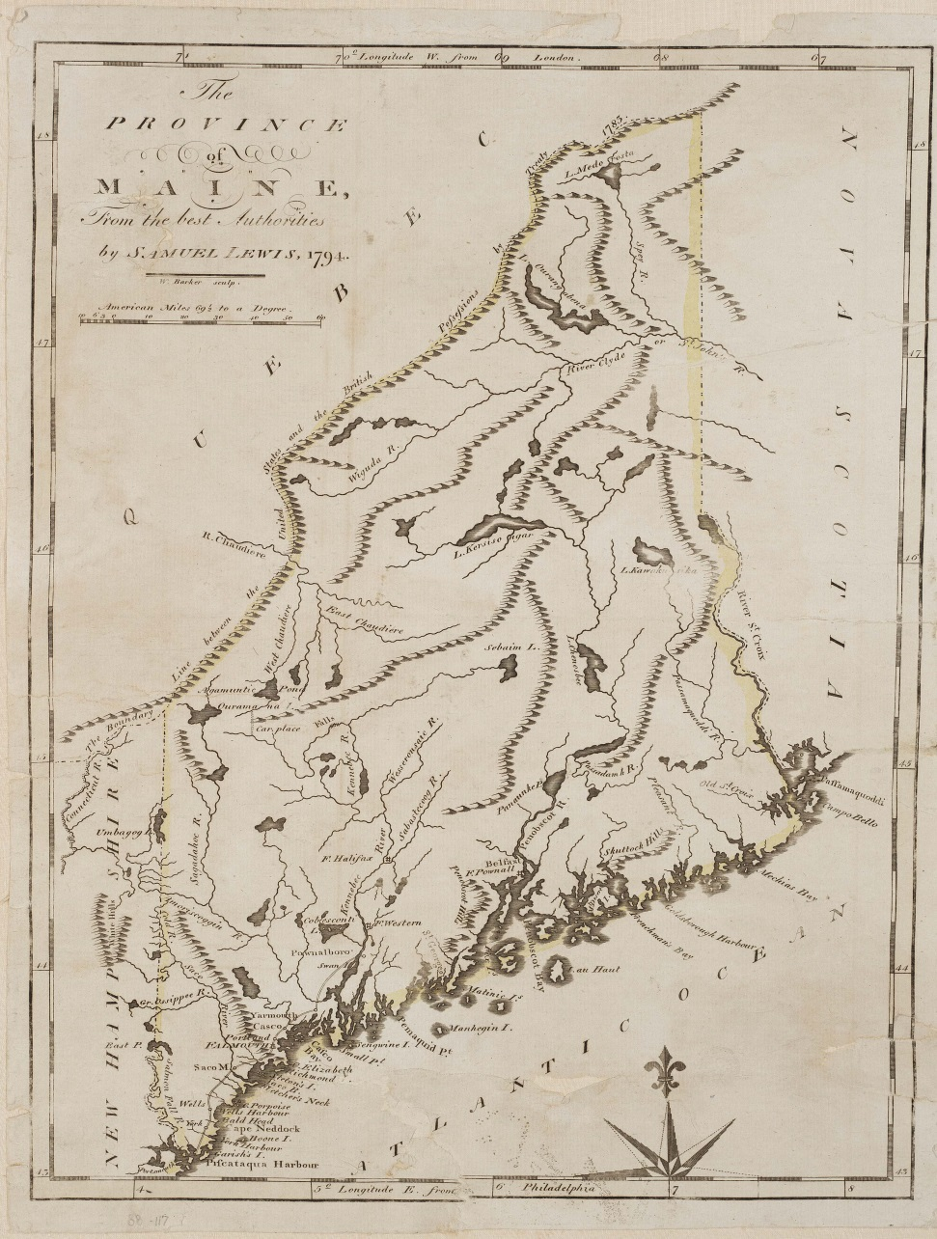
Maine: America’s Eastern Frontier

Slide 6
Voting Issue
INDEPENDENCE!!
July 26th, 1819
CITIZENS OF MAINE
Shall Maine be a free, sovereign and and independent State…
….What shall we lose by separation? The privilege of being governed by Massachusetts. What shall we gain? The right of governing ourselves.
~~ From broadside election flyer,
July 21, 1819

Slide 7
Voter’s pleasure
Separation vote: July 26, 1819
Yeas Nays
York 2086 1646
Cumberland 3315 1394
Lincoln 2523 1534
Hancock 820 761
Kennebec 3950 641
Oxford 1893 550
Somerset 1440 237
Washington 480 138
Penobscot 584 231
TOTALS 17091 7132

Slide 8
Call of Duty
Rufus King
U.S. Senator from New York
George Washington’s Minister to Great Britain
1816 Federalist Party presidential nominee
Half-brother to Maine’s William King
William recruits Rufus to repeal “Coasting Law” that requires Maine merchants to pay duties to ship cargo beyond New Hampshire
March 1819 revision removes major obstacle to businessmen supporting statehood

Slide 9
Show Me Missouri
“..if the law restricting Missouri was passed, it never could be carried into effect against her will, without a resort to force, which would have produced civil war, and probably disunion.”
~~ Maine Representative Mark L. Hill, of Phippsburg, letter to Citizens of Maine,
March 31,1820
Notes:
Hill considers the stages of Missouri’s designation as a territory in 1805, 1812, improvements made to land by slaveholding farmers

Slide 10
Deal, with a warning
“…but his momentous question, like a fireball in the night, awakened and filled me with terror. I considered it as once the knell of the Union. It is hushed, indeed, for the moment, but this is a reprieve only, not a final sentence….”
~~ Thomas Jefferson, letter
to Maine Rep. John Holmes, of Alfred
Notes:
US Constitution 3/5 of a person, no resolution to slavery

Slide 11
Grappling With Slavery
“...as it is, we have the wolf by the ear, and we can neither hold him, nor safely let him go. Justice is in one scale, self-preservation in the other.”
~~ Thomas Jefferson, letter
to Rep. John Holmes, 1819

Slide 12
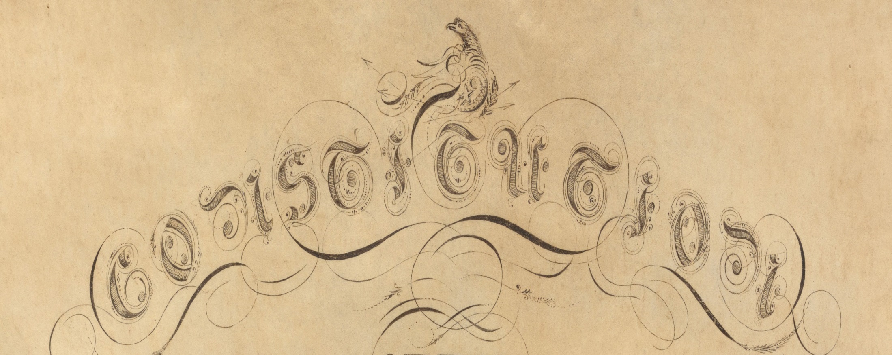
1819 Discussion Time

Slide 13
Watch ME Grow
YEAR POPULATION
1760 20,000 (estimate)
1770 31,257
1780 65,000 (est.)
1790 96,540
1800 151,719
1810 228,705
1820 298,335
1830 399,455
1840 501,793
1850 583,169
1860 628,279

Slide 14
Down to Business
Legislature convenes: May 31, 1820
Money on hand: $60,486
Governor’s salary set: $ 1,500
State Seal created
Town of Kennebunk approved to split from Wells
Lawmaker per diem: $2, and $2 per 10 miles traveled
“An Act to modify and limit the terms and conditions of the Act of Separation relative to Bowdoin College and encourage Literature and the Arts and Sciences”

Slide 15
Protestants denominate
District of Maine
Baptist population Methodist population
1787 – 183 1790 – 0
1800 – 1,600
1810 – 5,144
1820 – 9,328 1820 – 6,000

Slide 16
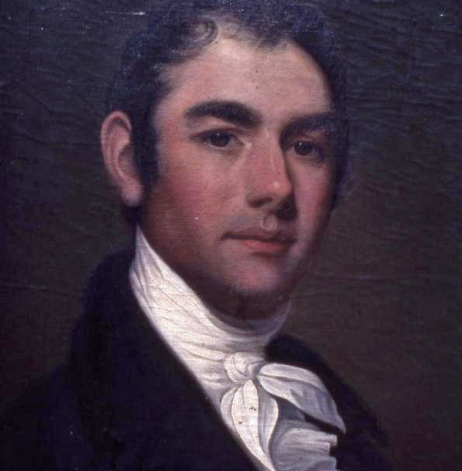
Taking a Bath
Maine’s first Governor
Elected with 96% of vote
Bath businessman
Bowdoin College overseer
Military experience
Statehood booster
Governor William King
Notes:
Benjamin Porter, brother-in-law, Bowdoin Treasurer; Benjamin Orr, Bowdoin President

Slide 17
“Article VIII. Part First. Education. Section 1.
Legislature shall require towns municipalities to support public schools; duty of Legislature.
A general diffusion of the advantages of education being essential to the preservation of the rights and liberties of the people; to promote this important object, the Legislature are authorized, and it shall be their duty to require, the several towns to make suitable provision, at their own expense, for the support and maintenance of public schools…
Article 8

Slide 18
Article 8 – the hidden story
“…. and it shall further be their duty to encourage and suitably endow, from time to time, as the circumstances of the people may authorize, all academies, colleges and seminaries of learning within the State; provided, that no donation, grant or endowment shall at any time be made by the Legislature to any literary institution now established, or which may hereafter be established, unless, at the time of making such endowment, the Legislature of the State shall have the right to grant any further powers to alter, limit or restrain any of the powers vested in any such literary institution, as shall be judged necessary to promote the best interests thereof.

Slide 19
No idea
Gov. William King sends Major Joseph Treat to explore the area of the Penobscot and St. John Rivers – beyond the frontier.
Treat works with Penobscot Tribe Lieutenant Governor John Neptune.
Treat compiles a journal of maps, myths, and descriptions of central, eastern, and northern Maine.

Slide 20
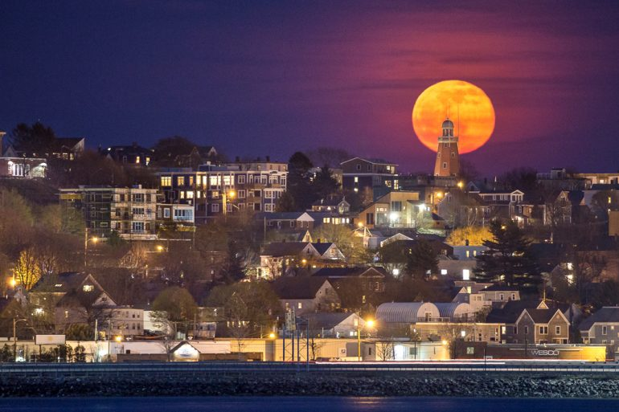
Portland, 1820
Incorporated 1786
Year round seaport
Population, 8,581
Maine’s first capital

Slide 21
At the ready
Portland Militia Companies
Portland Light Infantry
Portland Light Guard,
Portland Rifle Corps
Portland Rifle Guard (2)

Slide 22
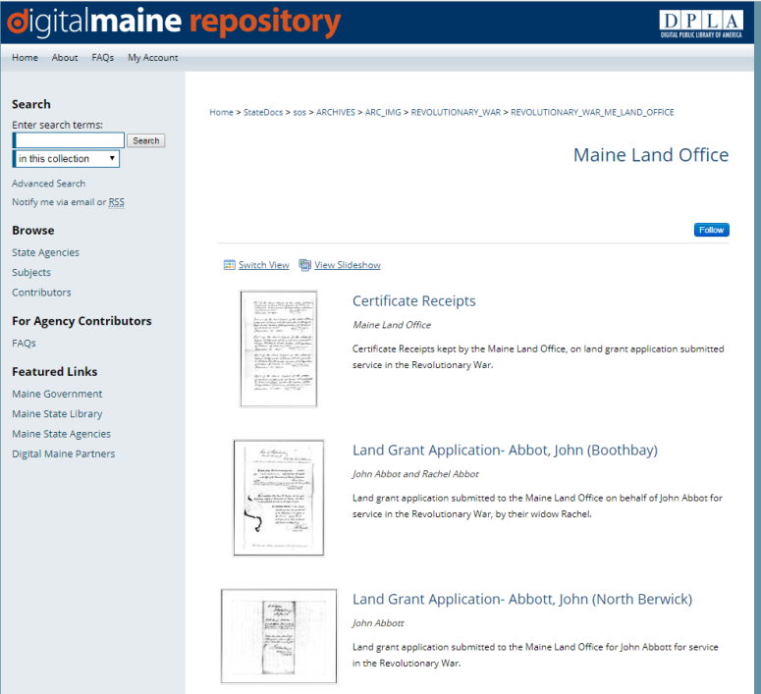
Homeless, not helpless
1835: Maine Legislature recognizes
Revolutionary War veterans
passes Maine Land Bounty Act
https://digitalmaine.com/revolutionary_war_me_land_office/

Slide 23
Where’s Waldo
Veterans provide affidavits to State
State provides land to veterans
Only record of Maine men’s service
Maine Land Office, "Certificate Receipts" (2017).
Maine Land Office. 1017. https://digitalmaine.com/revolutionary_war_me_land_office/1017

Slide 24
Great Aroostook War
1838: Northern boundary dispute with British North America.
British Army and U.S. militia from several states square off in Aroostook County. No shots fired.
Daniel Webster and Alexander Baring (Lord Ashburton) negotiate northern border – 1843, Webster-Ashburton Treaty
Extradition oversight creates legal path to freedom

Slide 25
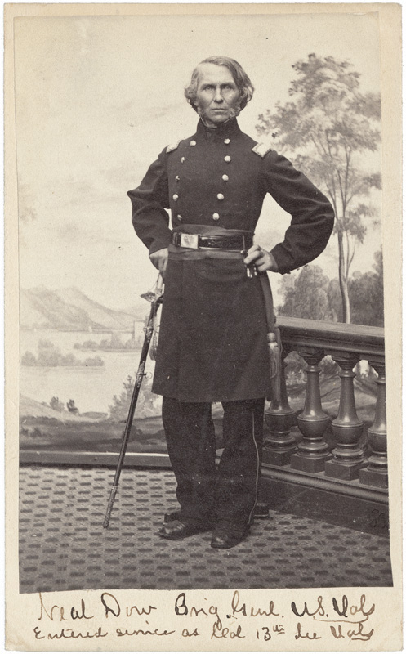
Portland dry dock
Neal Dow, elected Portland Mayor, 1855, pushes Abstinence Order for City.
Dockworkers, distillers, learn Dow signed for purchase of $1,600 in “medicinal alcohol.”
Small protest grows to angry mob.
Dow summons two militia companies to maintain order. One protester is killed.
Portland’s “Rum Riot” kills Dow’s political ambitions.
Neal Dow

Slide 26
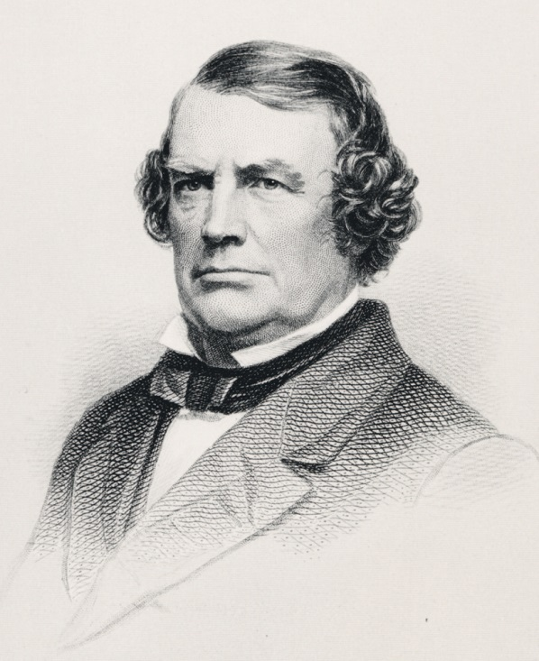
All Aboard
John Poor, teacher, businessman,
attorney, editor, railroad booster,
takes sleigh ride in winter, 1845;
proves Montreal-Portland a quicker route than Montreal-Boston.
St. Lawrence-Atlantic Railroad constructed.
Poor forms Portland Company on city’s waterfront.
Asked by Governor Israel Washburn to serve on three-person commission to assay Portland’s value at Civil War outbreak.
John Poor

Slide 27
Exit, Stage left
John Wilkes Booth performs “Richard III” and “The Corsican Brothers” during his stay In Portland in March and April, 1861.
Upon learning of the firing upon Fort Sumter on April 13, Booth flees the city – leaving behind unpaid hotel bills.

Slide 28
Say what?
“An enemy in possession of Portland would find it to be the terminus of the longest line of railroad in the world. The Grand Trunk railway of Canada embraces a line of 1,131 miles, of which 1,096 miles are in actual operation…
“This line has the capacity to move 10,000 troops between Portland and Quebec or Toronto and Detroit in a single day."

Slide 29
Exceptional Portland
“The highest military authorities would undoubtedly concur in the opinion that Portland should be made the great naval depot of the United States on the Atlantic ocean…Its geographical position commands Canada on the north, and the lower provinces on the east, if properly fortified, as lines of railway, completed or in the process of construction, radiate from it to Quebec and Montreal, and to St. John and Halifax.
“The harbor is one of the finest on the Atlantic ocean, or in the world, and can easily be so fortified as to be as impregnable as Gibraltar, and far stronger than Quebec, Sebastopol, or Cherbourg.”

Slide 30
Can You See?
“As a harbor of refuge, that of Portland is unrivaled, and the approach of a storm is foreshadowed by a movement of vessels in that direction. Between five and six hundred sail have been known to enter Portland harbor for shelter in a single night, and six hundred sail can often be counted, on a clear morning, standing out to sea after an easterly storm. “The first intimation of trouble with any leading foreign power would be the entrance of a hostile fleet into Portland harbor.”
~~ Governor Israel Washburn, letter
to President Abraham Lincoln, October 23, 1861

Slide 31
Gun non-placement
President Lincoln, U.S. Congress respond to Maine.
$100,000 appropriated to arm Maine forts.
Six years later, installations remain unfinished.

Slide 32
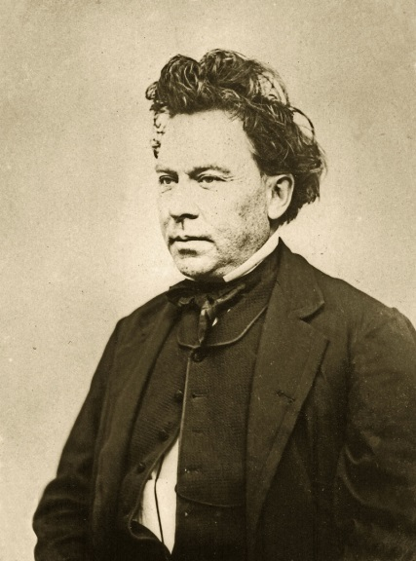
New Administration
Israel Washburn
Governor
John Hodsdon
Adjutant General

Slide 33
Generally Speaking
Maine State Archives Civil War stories:
https://www.maine.gov/sos/arc/sesquicent/civilwarwk.html
"To the soldiers who so nobly volunteered for the defense of the country, language affords but a tame expression of what is due to them, and I refer to the records of this office as my best tribute to their worth."
``John Hodsdon, Maine Adjutant General
retirement letter, 1867

Slide 34
Full measure
Maine Civil War statistics
Population in 1860 628,279
Number of Maine men 17-40: 112,466
Number who served in army/navy 72,945
Average size: 5’7.5” 145 lbs.
Age of majority: 18 years, 6 mos.
Average age: 23 years
Principal occupation: farming, 48 %
Military service: Army 56,000
Navy 14,000
Maine Civil War deaths: 9,398
Battle 3,184
Disease 5,592
Confederate Prison 541
Drowning 118
Murdered 13
Sunstroke 16
Suicides 5
Executions 5
Missing in action 616
Disabled by injury/illness 11,309
Civil War veterans buried in Maine 38,000
(Maine Adjutant General’s Reports, cumulative, 1861-1866)

Slide 35
Government Program
Maine Conscription (Draft) Civil War
Total drafted: 16,087
Furnished substitutes 1,737
Paid commutation 1,937
Exempted: Physical disability 6,115
Alienage 292
Non-residence 396
Unsuitable age 653
Sect. 2, Enrolment Act 1,780
Uncertain identity 11
Promotion 4
Felony conviction 1
In Service, March 3, 1863 374
Drafted twice 25
Illegally drafted 2
Permitted to remain home till further orders 5
Died since drafted 34
Failed to report 1,913
Drafted and entered service 808

Slide 36
Home Help
Maine State Aid to Wartime Families
Number of families 46,034
Number of family members 122,183
Aid amount 1862- 66 $1,960,801.99
(“Maine in the War For the Union – A History of the part borne by Maine Troops in the Suppression of the American Rebellion”
William Whitman, Charles True, 1865, Dingley Pub., Lewiston)

