Slide 1
How to Complete the USDA Paid Lunch Equity Tool
Sarah D. Platt, RD, SNS
Maine Department of Education
Child Nutrition
May 2020
Notes:
Good afternoon. I’m Sarah Platt, Child Nutrition Consultant with the Maine Department of Education’s Child Nutrition Program. Welcome to our monthly webinar series. Today we are focusing on How to Complete the USDA’s Paid Lunch Equity Tool for School Year 2019. A copy of the tool can be found in the handouts. You may wish to have this open to reference throughout the webinar.
During today’s webinar, all attendees have been placed on mute. This webinar is being recorded so you can view it at any time. Certificates of attendance will be emailed once the webinar has concluded. Now let’s get started…

Slide 2
Paid Lunch Equity
Section 205 of the 2010 Child Nutrition Reauthorization Act: Equity in School Lunch Pricing
Ensures equity in the level of financial support to the school food service account for paid lunches
This provision applies only to lunches
Notes:
Section 205 of the Healthy Hunger Free Kids Act of 2010 requires that schools participating in the National School Lunch Program ensure sufficient funds are provided to the nonprofit school food service account for lunches served to students that are not eligible for free or reduced price meals. The intent is to make sure the Federal subsidy for free student meals does not subsidize paid student meals.
This requirement applies to student lunches only and each year, the USDA releases a new target price.

Slide 3
Paid Lunch Equity
USDA issues a target price each year
Based on the difference between the reimbursement rate for free meals and the reimbursement rate for paid meals
SY 2021 Target Price is $3.09
Notes:
Each year, the USDA releases a new target price. This target price is based on the difference between the reimbursement rate for free meals and the reimbursement rate for paid meals. For SY 21, the target weighted average price is $3.09.

Slide 4
Is My District Required to Complete the PLE Tool?
You are not required to complete the PLE tool if the SFA:
Has implemented CEP district-wide
Is already charging a weighted average that meets or exceeds the requirement
Has a positive CBB as stated in NEO as of December 31, 2019
Notes:
It is important to note that you are not required to complete the PLE tool if:
your district has implemented Community Eligibility Provision, or CEP, district-wide
Your district is already charging a weighted average price the meets or exceeds the price requirement
Or, if the school food service account has a positive CBB as stated in NEO as of December 31, 2019
However, we strongly recommend completing the tool each year so that you have the necessary information should you need to complete the tool next year.

Slide 5
Paid Lunch Equity Tool
The PLE tool calculates:
Weighted average paid lunch price based on what you charged for SY 2020
Required weighted average paid lunch price increase for SY 2021
Required non-federal contribution required (if needed)
Notes:
The Paid Lunch Equity tool calculates:
Your current weighted average paid lunch price based on what you charged for SY 2020
The Required weighted average paid lunch price increase for SY 2021
And the required non-federal contribution required for SY 2021, if needed

Slide 6
Getting Started
You will need:
The unrounded price requirement for the completed PLE tool from the current school year (SY 2020)
The current tool for the upcoming year (SY 2021)
Notes:
To get started, you will need your program’s completed tool for the current school year because you will need to know your unrounded price requirement. This number changes each year which is why we recommend completing the tool, even if you are not currently required to.
You will also need a copy of the current price equity tool for the upcoming school year.

Slide 7
Getting Started
Completed tool in NEO
Notes:
If you are not able to locate a copy of last year’s completed PLE tool. you can always find a copy in NEO, under supplemental attachments, as seen here.

Slide 8
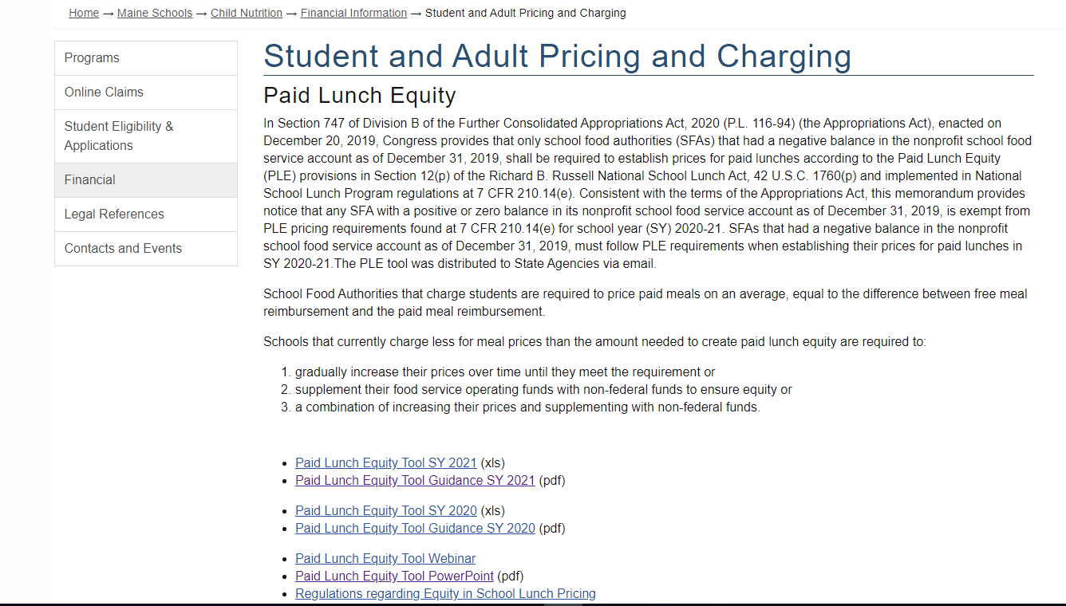
Getting Started
Download the SY 2021 PLE tool
https://www.maine.gov/doe/schools/nutrition/financial/schoolmealpricing
Notes:
To access the current PLE tool for SY2021, you can download it from our website, on the Financial page under Resources and Guidance.

Slide 9
IMPORTANT!
If the tool will not let you enter data, it is probably because you are trying to enter information into the WRONG cell.
Notes:
It is important to note that the worksheet is formatted so that a district may only enter information in the peach shaded cells. As data is entered, formulas populate the appropriate white cells with information.

Slide 10
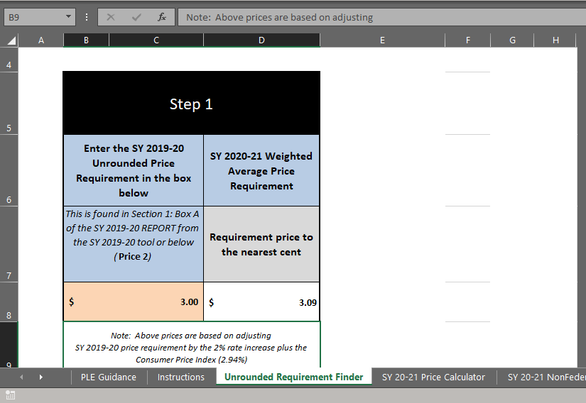
There are tabs along the bottom of the excel tool
You do NOT have to complete them all
Notes:
The worksheet has multiple tabs along the bottom. You do not need to complete all of them. Use the navigation arrows found to the left of the tabs (click) as some tabs may not be visible. We will begin by completing the ‘Unrounded Requirement Finder’ tab (click).

Slide 11
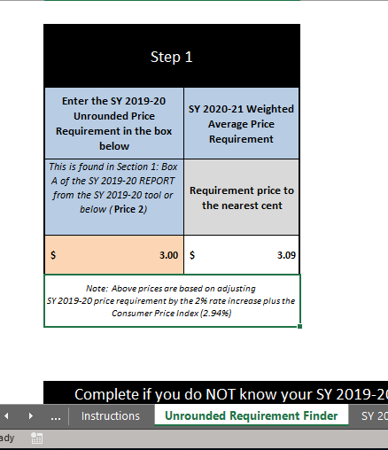
Unrounded Requirement Finder tab
“Step 1”: Enter the previous year’s price requirement from SY 2020 completed PLE Tool
Notes:
We are now on the Unrounded Requirement Finder tab, (click) which is the first step to completing the PLE tool. You will start by entering the previous year’s unrounded requirement into the peach shaded box under Step 1 (click). You will find this number on last year’s completed tool.

Slide 12
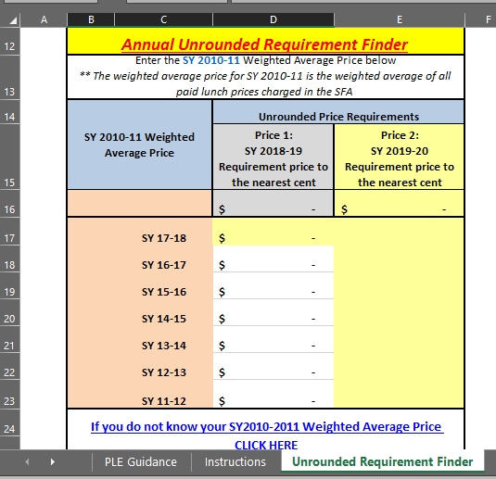
Unrounded Requirement Finder tab
If you do not know your prior year’s unrounded price requirement, you will calculate it based on the weighted average price from SY 2010-2011 data.
Notes:
If you do not know the prior year’s Unrounded Price Requirement, you will calculate this by determining the weighted average price from the 2010-2011 school year by clicking on the link that says “If You DO Not Know Your SY10-11 Weighted Average Price CLICK HERE”. This was the first year Price Equity was a requirement.

Slide 13
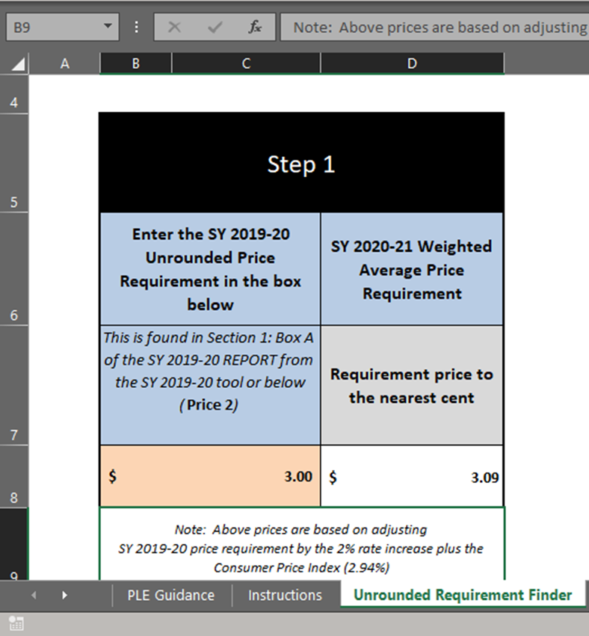
Enter the Unrounded Price Requirement from last year into the peach colored cell.
This will populate the SY20-21 Weighted Average Price Requirement
Notes:
Once you know the 2017-2018 unrounded price requirement, either from last year’s completed tool or from completing the SY10-11 Calculator, you will enter this amount in the peach shaded cell under Step 1. Once entered, the tool automatically determines the price requirement for SY19, which, in this example, is $2.90

Slide 14
SY 20-21 Price Calculator tab
This tab is used if you are going to increase prices to meet the requirement
Notes:
The next step is to go to the SY 20-21 Price Calculator tab (click). You do this by clicking on the tab to the right of the Unrounded Requirement Finder. This tab is used ONLY if you are not using non-federal funds to off-set a price increase.

Slide 15
The WAP Requirement is auto-filled & rounded down to the nearest 5 cents
The “Unrounded Requirement Finder” tab MUST be filled out first!
Notes:
Now we are on the SY 20-21Price Calculator tab. As you can see, the requirement of $3.09, from the previous tab carries over to the top section. This requirement can be rounded down to the nearest 5 cents, so the $3.09 requirement is now $3.05 (click) for SY21.

Slide 16
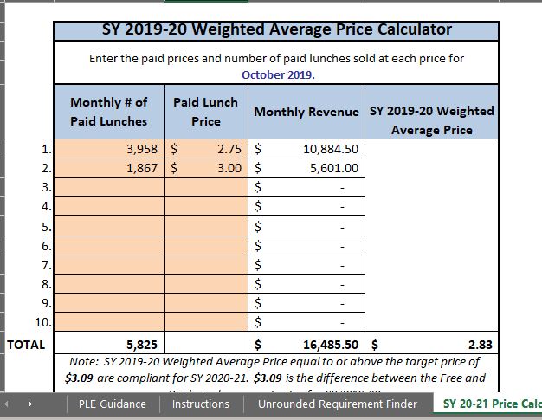
Determine current weighted average price (WAP)
Enter # of student paid lunches & corresponding paid lunch prices from October 2020
Notes:
We are still on the SY 20-21 Price Calculator tab. Now we will scroll down just a bit to the section that says ‘SY 2019-20 Weighted Average Price Calculator’. We are going to calculate your current weighted average price for SY 2020 which will allow us to then determine how much of an increase, if any, is needed. We do this by entering the number of paid student lunches sold in October 2019 in the peach shaded cells, (click) and the corresponding price (click).

Slide 17
Now you have the current school year’s weighted average price & can compare this with the required price
Scroll down in this tab to view whether you need to increase your price
Notes:
In this example, we sold 3958 paid student lunches at $2.75 and 1867 paid student lunches at $3.00 in October 2019. We now have the current year’s actual weighted average price, which is $2.83. (click) We will now scroll down to determine where to go from here.

Slide 18
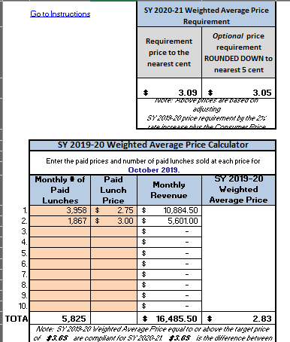
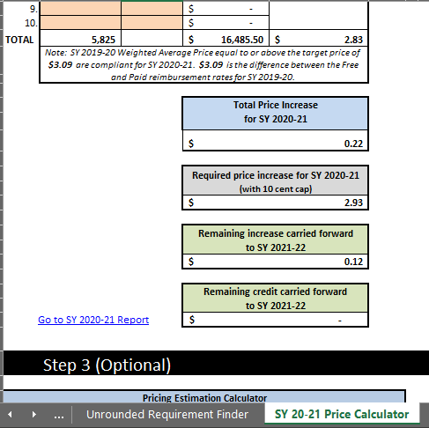
Now you know what your current weighted average price is, and your required price increase (if necessary) with a ten cent cap
Notes:
We are still on the SY 20-21 Price Calculator tab.
So far, we know that our price requirement for next year is $3.05. (click)
Our current weighted average price is $2.83. (click)
If you scroll down on this same tab, you will see that an increase of 22 cents (click) is needed in order to meet the requirement. This is the difference between the 3.05 and 2.83.
However, there is a 10 cent cap, meaning that you are not required to increase more than 10 cents above your current weighted average. You may choose to, but you are not required to.
So now, with the 10 cent cap, the new requirement for next year in this example is a weighted average of $2.93 (click).

Slide 19
If you only increase by the 10 cent maximum, this box would tell you the remaining amount of the required increase that carries forward
Notes:
If you do only increase by the 10 cent maximum, this box tells you the remaining amount of the required increase that will carry forward.

Slide 20
If your current WAP was greater than the required amount, this box would tell you how much you can carryover toward a future increase
Notes:
If your current weighted average price was greater than the price requirement, you would have a credit, which can be carried forward to future increases.

Slide 21
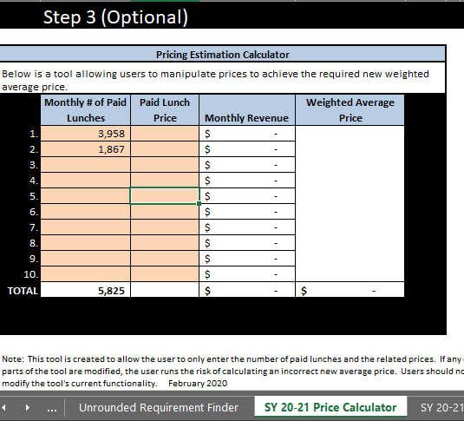
If a price increase is necessary, complete Step 3 (scroll down on this tab) to manipulate the prices between the elementary and secondary to reach the desired weighted average price
Notes:
Still on the SY 20-21 Price Calculator tab, Step 3 is optional, but is recommend if a price increase is necessary. This allows you calculate the prices you would have to charge to achieve the requirement. You will use the same Monthly number of Paid Lunches from October 2017 that you entered above. Next you can split the price increase between your elementary and secondary students. Or you could increase only at one level if you so choose. Because this is a weighted average, you will get a greater affect by increasing prices at the level which served the greater number of paid lunches.

Slide 22
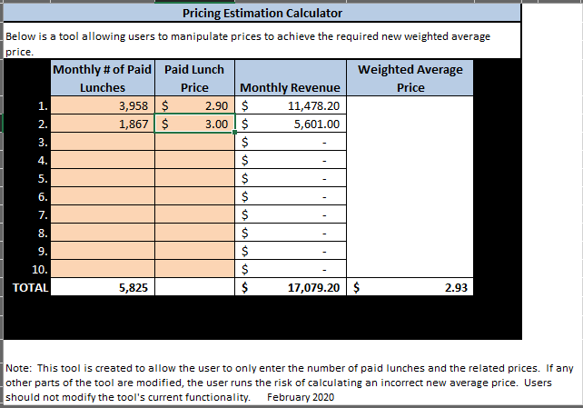
Increase at one level only
Here we increased at only the elementary level to reach the desired weighted average price of 2.93
Notes:
Here we increased at only the elementary level to reach the desired weighted average price of 2.93

Slide 23
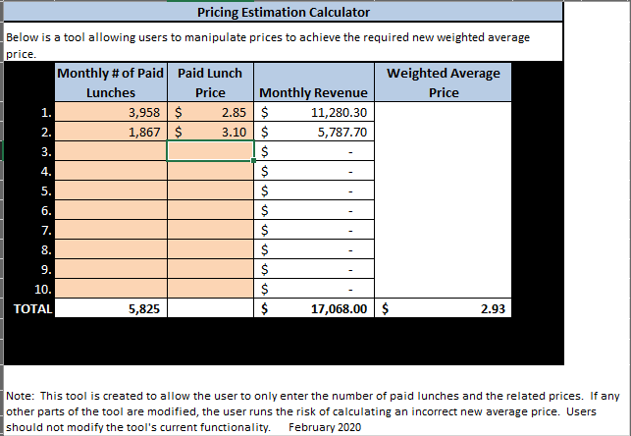
Increase at both levels
Here we increased at both levels to reach the desired weighted average price of $2.93
Notes:
Here we increased at both levels to reach the desired weighted average price of $2.93

Slide 24
Non-Federal Calculator
To use non-federal funds instead of raising the paid student lunch price
Notes:
Another option, if your weighted average price is below the required amount but your district chooses not to raise prices, is to use non-federal funds to off-set a price increase. To do this, you will need to complete the ‘SY 20-21 Non-Federal Calculator’ tab. (click) This is the tab after the SY 20-21 Price Calculator tab. As you can see, the price requirements have beencarried over from the Unrounded Requirement Finder tab we already completed.

Slide 25
Non-Federal Calculator
Enter your current Weighted Average Price ($2.83)
Notes:
The next step is to enter your current Weighted Average paid lunch Price. We already determined this on the SY 20-21 Calculator Tab. Note: the cell you enter the current WAP is blue, not peach as all the others where you enter information.

Slide 26
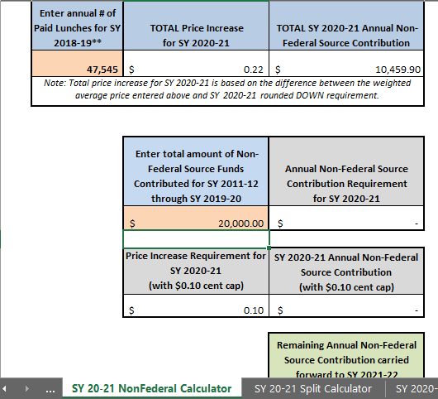
Non-Federal Calculator
Enter the total number of annual paid lunches in the district for SY 2018-19
Enter the non-federal contribution as reported in NEO SY 12-SY20
Notes:
Enter the total number of annual paid lunches (click) in the district for the prior year.
And, enter the total amount of non-federal funds (click) contributed to the school food service account for School Year 2012 through School year 2020.

Slide 27
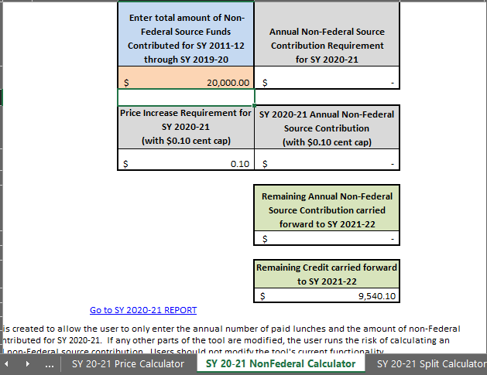
Non-Federal Calculator
Notes:
If you scroll down on the page, you will see that the program has received sufficient non-federal funds and even has a credit carried forward for next year. Now let’s see what it looks like when the program has not received sufficient funds.

Slide 28
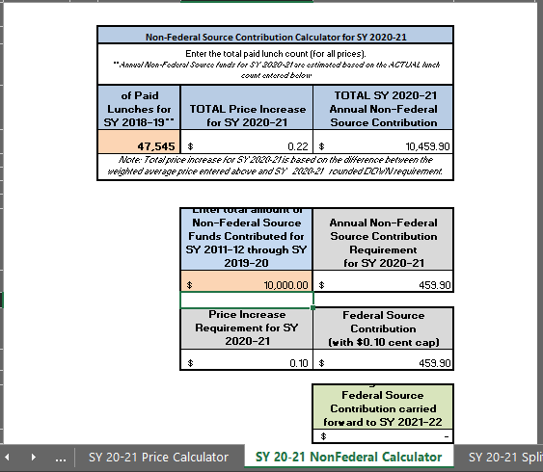
Non-Federal Calculator
Notes:
In this example, a non-federal contribution of $10,459.90 (click) is necessary. The program has only received $10,000 in non federal funds therefore the non-federal requirement is now $459.90 (click).

Slide 29
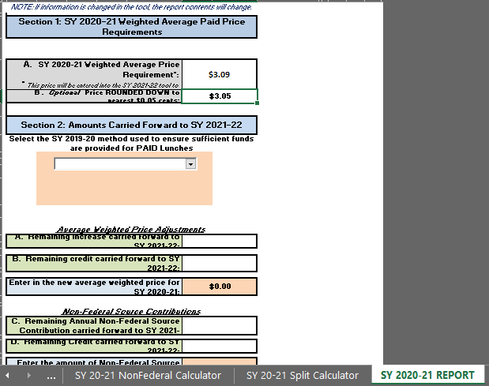
SY 2020-21 REPORT
Scroll over to the “REPORT” tab
Weighted average price to use in next year’s PLE tool
Select the method used from the drop-down
Summary of the information to justify your price change
Notes:
The final step, whether completing the Price Calculator tab or the Non-Federal Calculator tab, is to scroll over to the REPORT tab. You can get there by clicking on the arrows in the bottom left-hand corner of the tool. (click)
Here you will find the weighted average price requirement to use in Step 1 on next year’s PLE tool. (click)
In the drop-down box, (click) select the method used to ensure sufficient funds are provided to paid lunches (Increase prices or use non-federal funds)

Slide 30
Congratulations!
Save a copy
Upload a copy in NEO with the Annual Application Packet
‘Supplemental Attachments’
Notes:
Congratulations! You have successfully completed the SY 2021 PLE Tool! It is important that you save this in a location where you can easily locate it again, as it will need to be uploaded in NEO as part of your district’s Annual Application Packet. It will be uploaded in the Supplemental Attachments section.

Slide 31
Questions
Sarah Platt
624-6879
sarah.d.platt@maine.gov
Notes:
If you have any questions while working on your district’s tool, don’t hesitate to contact our office. You can reach me specifically at 624-6879.
This concludes our webinar. Thank you for your time today. I hope this has been helpful.
Have a good day everyone.

Slide 32
In accordance with Federal civil rights law and U.S. Department of Agriculture (USDA) civil rights regulations and policies, the USDA, its Agencies, offices, and employees, and institutions participating in or administering USDA programs are prohibited from discriminating based on race, color, national origin, sex, disability, age, or reprisal or retaliation for prior civil rights activity in any program or activity conducted or funded by USDA.
Persons with disabilities who require alternative means of communication for program information (e.g. Braille, large print, audiotape, American Sign Language, etc.), should contact the Agency (State or local) where they applied for benefits. Individuals who are deaf, hard of hearing or have speech disabilities may contact USDA through the Federal Relay Service at (800) 877-8339. Additionally, program information may be made available in languages other than English.
To file a program complaint of discrimination, complete the USDA Program Discrimination Complaint Form, (AD-3027) found online at: http://www.ascr.usda.gov/complaint_filing_cust.html, and at any USDA office, or write a letter addressed to USDA and provide in the letter all of the information requested in the form. To request a copy of the complaint form, call (866) 632-9992. Submit your completed form or letter to USDA by:
(1) mail: U.S. Department of Agriculture Office of the Assistant Secretary for Civil Rights 1400 Independence Avenue, SW Washington, D.C. 20250-9410;
(2) fax: (202) 690-7442; or
(3) email: program.intake@usda.gov.
This institution is an equal opportunity provider.
(Federal statement updated 1/3/2020)
The Maine Human Rights Act prohibits discrimination because of race, color, sex, sexual orientation, age, physical or mental disability, genetic information, religion, ancestry or national origin.
Complaints of discrimination must be filed at the office of the Maine Human Rights Commission, 51 State House Station, Augusta, Maine 04333-0051. If you wish to file a discrimination complaint electronically, visit the Human Rights Commission website at https://www.maine.gov/mhrc/file/instructions and complete an intake questionnaire. Maine is an equal opportunity provider and employer.

