Slide 1
Maine events
Influences on Statehood Development

Slide 2
Present concepts through people,
the more local the people, the better.
Maine a medium-sized small town;
people know other people.
Maine’s core story remains the same;
local details provide immediacy.

Slide 3
Source material available:
Local historical societies/libraries
State Library
Digital Maine
State Archives
State Museum
Maine Historical Society
Maine200.org
Maine Public
Masthead Maine
with people willing to help.

Slide 4
Light Reading
Maine Becomes a State - Ron Banks
Maine: a Narrative History - Neil Rolde
Wabanaki Homeland and
the New State of Maine - Micah Pawling
Maine Adjutant General Reports - John Hodsdon
A Story of Maine in 112 Objects - Bernard Fishman
Eminent Mainers - Douglas Stover
Maine – The Pine Tree State
From Prehistory to the Present- Ed Churchill
History of the State of Maine - William Williamson

Slide 5
By the Numbers
Maine population
1790 96,540
1800 151,719
228,725
1820 298,335

Slide 6
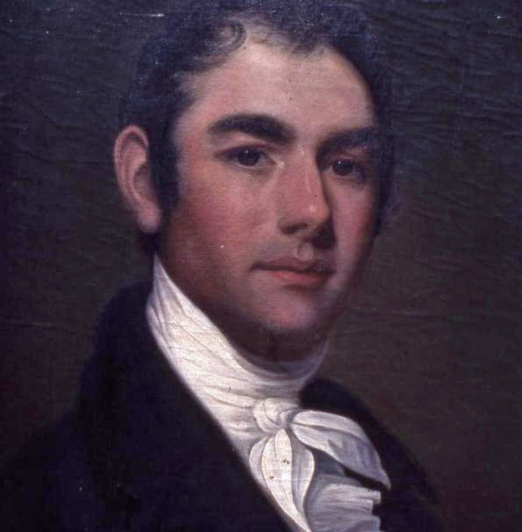
Early Politics
William King
Bath banker, ship owner
Developer, State Senator,
Democrat-Republican

Slide 7
Yearning to Fight
War of 1812
Major General William King
11th Division
Massachusetts Militia
Prepared Maine’s coastal defenses

Slide 8
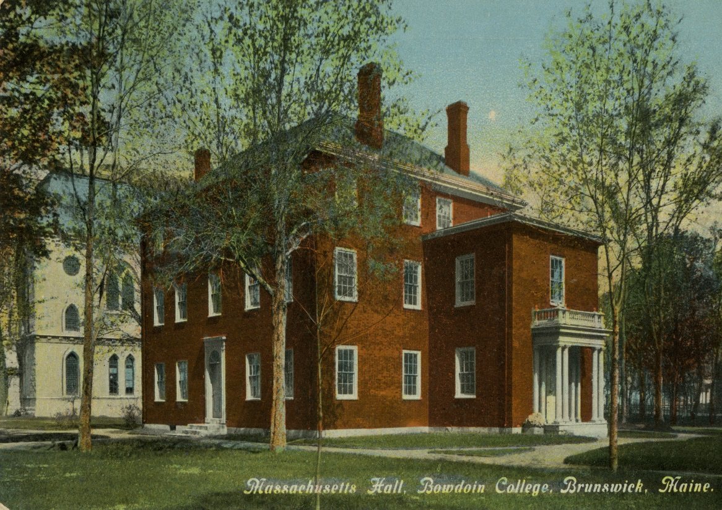
Frustration Festers
Bowdoin College
Brunswick
Chartered 1794

Slide 9
Family That Prays Together
Bowdoin College Overseers
All Congregationalists….
William King, Board member, brother-in-law to…
Benjamin Jones Porter, Board Treasurer.
Jesse Appleton, Bowdoin President
Benjamin Orr, Board Attorney

Slide 10
Peace in the Family
Benjamin Porter pledges funds to Bowdoin.
Porter owns 3 mills on the Androscoggin River.
William King guarantees brother-in-law’s pledge.
King agitates for second college in Maine.
Bowdoin President, other trustees, displeased.

Slide 11
Keeping it Freshet
Spring, 1814:
Androscoggin River flooding
washes downriver from Turner
Benjamin Porter’s three mills.

Slide 12
Lien on Me
Porter defaults on his bond to Bowdoin.
Orr, with President Appleton’s support,
then sues King for payment.
Orr attaches liens on King’s properties.
King needs 4 years (1818) to pay off debt.

Slide 13
Safety in Numbers
Maine Baptist population
1787 183
1800 1,600
1810 5,144
1820 9,328
Methodist Population
1787 0
1820 6,000

Slide 14
Can’t Get There From Here
October, 1818: William King asks
half-brother Rufus’s Congressional help to revise or repeal federal “Coasting Law”
that is inhibiting support for
Maine separating from Massachusetts.
Rufus King succeeds.

Slide 15
Education costs
March, 1819: William King proposes
to Massachusetts’ General Court
that it equitably grant townships,
and $3,000 annual support, to new
Maine Literary and Theological Seminary.
The General Court declines.

Slide 16
Fess Up
“One college is all that is necessary
in the District of Maine, and I have no idea of conveying or giving away any aid
to any College whatever
that is to be in the way, or a rival to Brunswick (Bowdoin) College…”

Slide 17
Suspect Motives
“…If the Baptists want a College…
I have no objections…provided they can afford it.
Sir, situated as it now is,
there appears to be a disposition
to bring it forward, not only as a rival,
but as an Institution calculated
to destroy Bowdoin College.”
~~ Samuel Fessenden, March, 1819

Slide 18
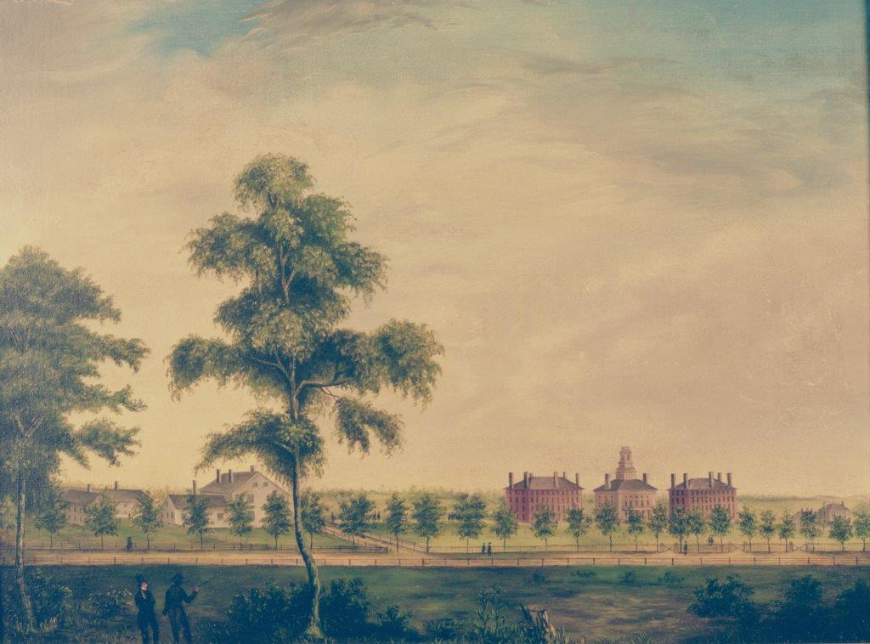
Baptists unite
Maine Literary
Theological Seminary
Waterville
Chartered: 1814
1st student: 1818

Slide 19
People Speak
Votes for Separation
County Yeas Nays Total
York 2,086 1,646 3,732
Cumberland 3,315 1,394 4,709
Lincoln 2,523 1,534 4,057
Hancock 820 761 1,581
Kennebec 3,950 641 4,591
Oxford 1,893 550 2,443
Somerset 1,440 237 1,677
Washington 480 138 618 Penobscot 584 231 815
Totals 17,091 7,132 24,223

Slide 20
VIII for Vendetta
Maine Constitution, Article 8
“…No donation, grant or endowment shall at any time be made…to any Literary Institution now established, or which may hereafter be established, unless… the Legislature of the State shall have the right to grant any further powers to alter, limit, or restrain any of the powers vested in any such literary institution,
as shall be judged necessary to promote the best interests thereof.”

Slide 21
What Are You Drinking?
1854-56: Kansas-Nebraska Act passes
Republican Party formally begins in Maine
Biddeford-Saco split
Frederick Douglas speaks in Biddeford
Neal Dow elected Portland Mayor

Slide 22
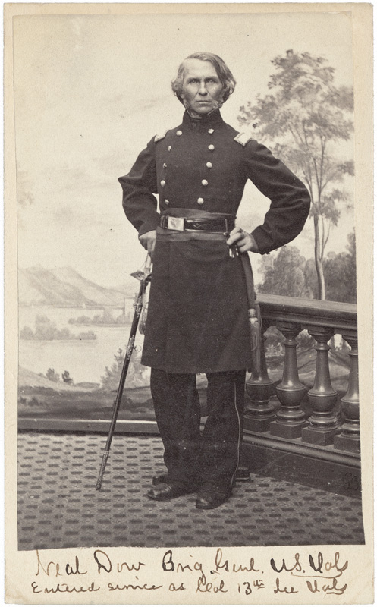
Portland dry dock
Neal Dow, elected Portland Mayor, 1855, pushes Abstinence Order for City.
Dockworkers, distillers, learn Dow signed for purchase of $1,600 in “medicinal alcohol.”
Small protest grows to angry mob.
Dow summons two militia companies to maintain order. One protester is killed.
Portland’s “Rum Riot” kills Dow’s political ambitions.
Neal Dow

Slide 23
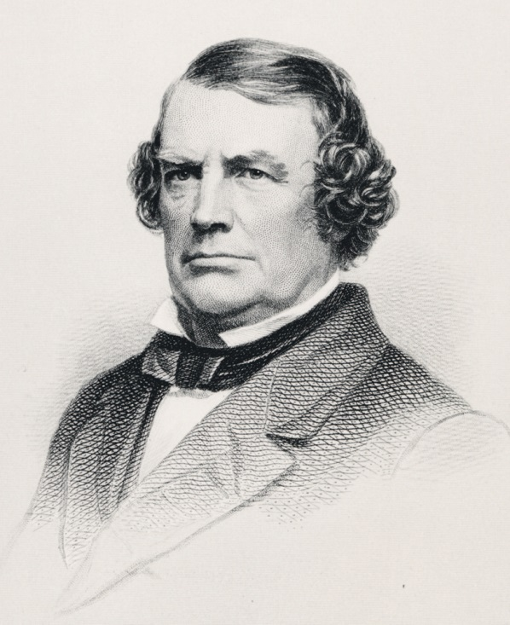
All Aboard
John Poor, teacher, businessman,
attorney, editor, railroad booster,
takes sleigh ride in winter, 1845;
proves Montreal-Portland a quicker route than Montreal-Boston.
St. Lawrence-Atlantic Railroad constructed.
Poor forms Portland Company on city’s waterfront.
Asked by Governor Israel Washburn to serve on three-person commission to assay Portland’s value at Civil War outbreak.
John Poor

Slide 24
Say what?
“An enemy in possession of Portland would find it to be the terminus of the longest line of railroad in the world. The Grand Trunk railway of Canada embraces a line of 1,131 miles, of which 1,096 miles are in actual operation…
“This line has the capacity to move 10,000 troops between Portland and Quebec or Toronto and Detroit in a single day."

Slide 25
Exceptional Portland
“The highest military authorities would undoubtedly concur…that Portland should be made the great naval depot of the United States on the Atlantic ocean… Its geographical position commands Canada on the north, and the lower provinces on the east, if properly fortified, as lines of railway, completed or in the process of construction, radiate from it to Quebec and Montreal, and to St. John and Halifax….
“The harbor is one of the finest on the Atlantic Ocean, or in the world, and can easily be so fortified as to be as impregnable as Gibraltar, and far stronger than Quebec, Sebastopol, or Cherbourg.”

Slide 26
Can You See?
“As a harbor of refuge, that of Portland is unrivaled, and the approach of a storm is foreshadowed by a movement of vessels in that direction. Between five and six hundred sail have been known to enter Portland harbor for shelter in a single night, and six hundred sail can often be counted, on a clear morning, standing out to sea after an easterly storm…
“The first intimation of trouble with any leading foreign power would be the entrance of a hostile fleet into Portland harbor.”
~~ Governor Israel Washburn,
October 23, 1861

Slide 27
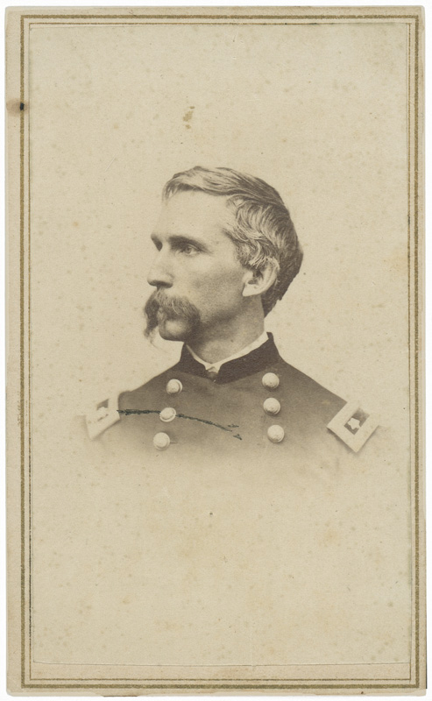
Little Known Volunteer
“…but, I fear, this war, so costly of blood and treasure, will not cease until the men of the North are willing to leave good positions, and sacrifice the dearest personal interests, to rescue our country from desolation, and defend the national existence against treachery at home and jealousy abroad.”
Bowdoin Professor Joshua Chamberlain To Gov. Israel Washburn
July 14, 1862

Slide 28
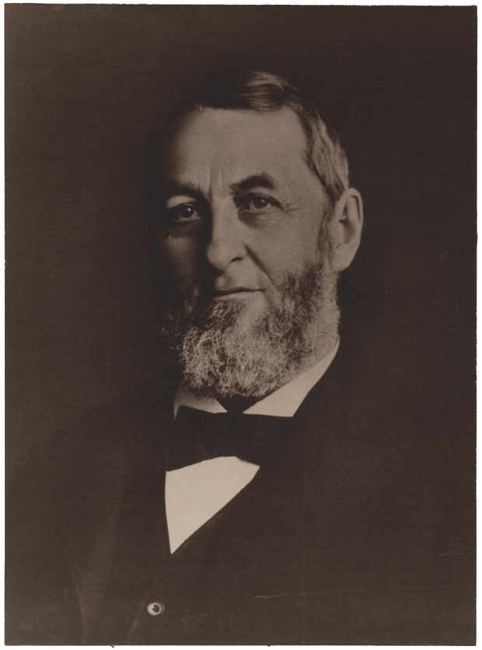
Ask A Friend
“Have you appointed Chamberlain Col. of the 20th? His old classmates etc. here say you have been deceived: that C. is Nothing at all: that is the universal expression of those who knew him.”
Attorney General Josiah Drummond
To Gov. Israel Washburn July 21, 1862

Slide 29
Nurses’ Special Qualities
“All nurses are required to be plain looking women, Their dresses must be brown or black, with no bows, no curls, no jewelry, and no hoopskirts.”
`` Dorothea Dix, Hampden
Superintendent of Union Army Nurses

Slide 30
Humbly Qualified
“I have been a Nurse for over 15 years, am over 30, and have a cheerful temperament; and think as a Nurse I could do a great deal of good, as well as receive some little compensation, for my services…I cannot offer my services gratuitously, as some generous souls have done, because I am too poor, have no home, and am dependent upon myself entirely for a living. I can procure certificates if necessary of my moral character and qualifications as a Nurse.”
`` Cynthia Averill, Waterville,
To Gov. Israel Washburn, May 1862

Slide 31
Tally Ho
Maine Civil War deaths: 9,398
Battle 3,184
Disease 5,592
Confederate Prison 541
Drowning 118
Murdered 13
Sunstroke 6
Suicides 5
Executions 5
Missing in action 616
Disabled by injury/illness 11,309
Civil War veterans buried in Maine 38,000
(Maine Adjutant General’s Reports, cumulative, 1861-1866)

Slide 32
Government Program
Maine Conscription (Draft) Civil War
Total drafted: 16,087
Furnished substitutes 1,737
Paid commutation 1,937
Exempted: Physical disability 6,115
Alienage 292
Non-residence 396
Unsuitable age 653
Sect. 2, Enrolment Act 1,780
Uncertain identity 11
Promotion 4
Felony conviction 1
In Service, March 3, 1863 374
Drafted twice 25
Illegally drafted 2
Permitted to remain home till further orders 5
Died since drafted 34
Failed to report 1,913
Drafted and entered service 808

Slide 33
Home Help
Maine State Aid to Wartime Families
Number of families 46,034
Number of family members 122,183
Aid amount 1862- 66 $1,960,801.99
(“Maine in the War For the Union – A History of the part borne by Maine Troops in the Suppression of the American Rebellion”
William Whitman, Charles True, 1865, Dingley Pub., Lewiston)

