Slide 1
MMN Resources for Using Primary Sources in the Classroom
Kathleen Neumann
Curator of Education & Public Programs
Maine Historical Society

Slide 2

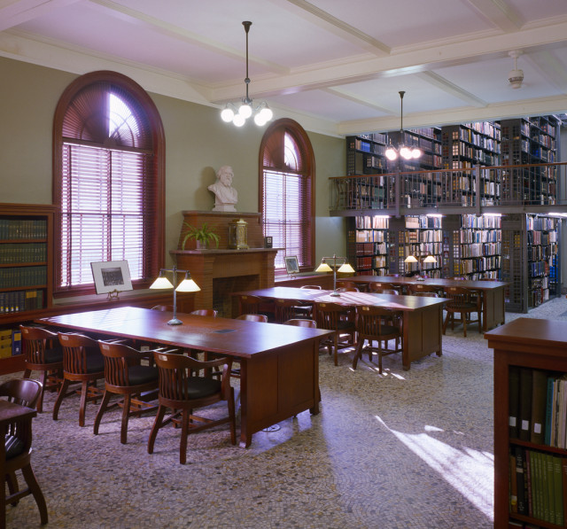
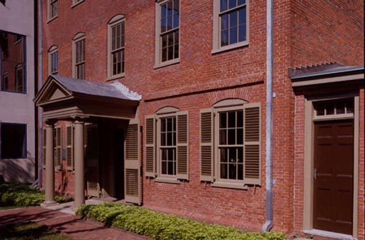
MHS in a nutshell
founded in 1822
Library
Museum
Wadsworth-Longfellow House & Longfellow Garden
Maine Memory Network

Slide 3
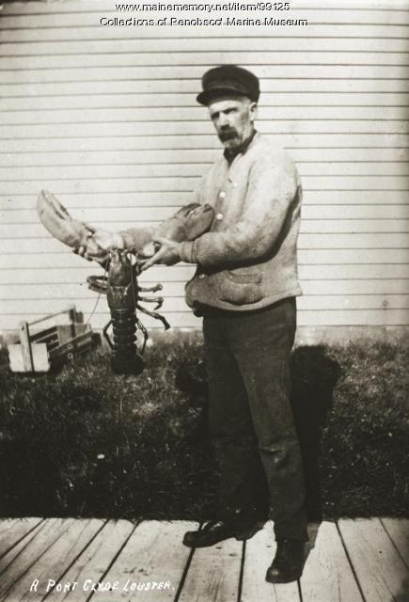
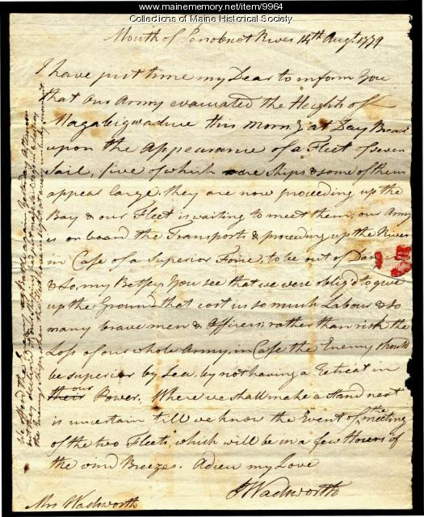
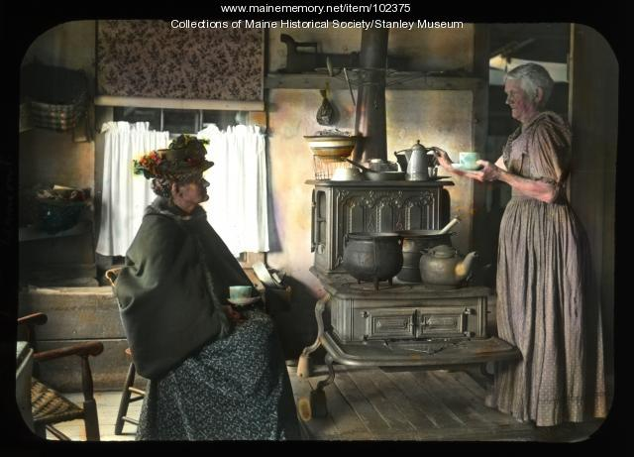
Maine Memory Network (MMN)
online database, made up of 270+ collecting organizations from across the state of Maine
45,000+ items
access and accounts are FREE
keyword search and browse features
save and share historical items in albums
www.mainememory.net

Slide 4
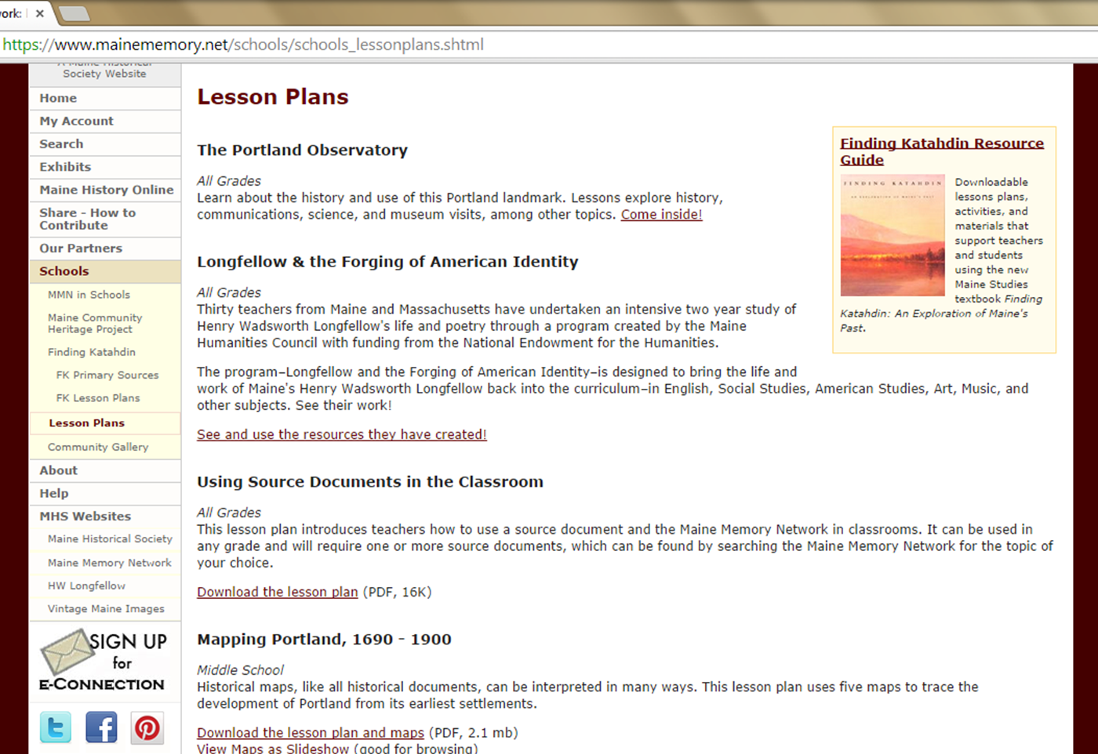
Tools for Teachers on MMN
Guides to using MMN and primary sources
Lesson Plan Library

Slide 5

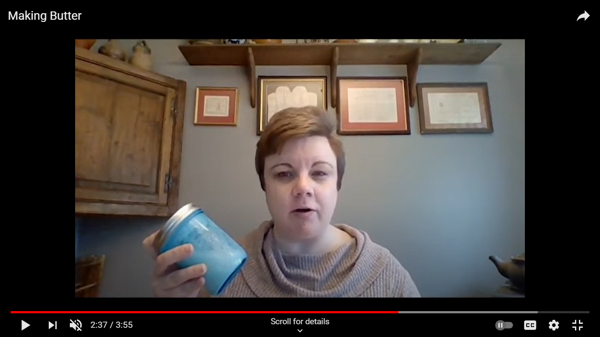
Virtual Learning Hub
Virtual Field Trips
Video Mini-Lessons
Online Exhibits and Response Questions
Links to Lesson Plans/Lesson Plan Library

Slide 6
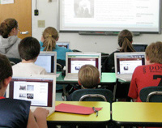
Training in the Classroom
MMN Training/Demo
  learn how to access MMN, search/browse, open a free account, and create albums
Take a Closer Look
  Students learn how to approach and work with images (photographs, cartoons, posters, etc.) as historical primary sources

Slide 7
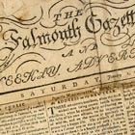

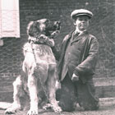
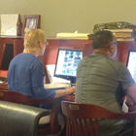
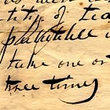
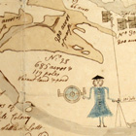
Brown Research Library

Slide 8
Historical Research at MHS for Individual Students
Students visiting the Brown Research Library at MHS as individuals can access the library for free*.
  *photography is only allowed during the class visits; if students wish to photograph during an individual visit, they must purchase a student membership ($20/year) or be accompanied by a member parent/guardian
Visiting the Brown Research Library
  Wednesday–Saturday 1pm–4pm by appointment only
  typically closed holidays & some holiday weekends
  wisit www.mainehistory.org to learn more about pandemic protocols on the MHS campus and make a reservation/appointment to visit

Slide 9
