Slide 1


Maine’s Updated ELA Standards
WRITING

Slide 2
Goals for today
Understand why the 10 CCSS writing standards became 3 Maine standards
Explore implications of this revision
Consider interpretations of the standards (particularly W1)
Notes:
M

Slide 3
Neal Rioux
Chair of the Writing Standards revision committee
Collaborated with about a dozen faculty from all over the state who represented Pre-K through 12 grade levels
Began with guidance from the Steering Committee and our “non-negotiables”
Facilitated work over several sessions to identify opportunities to strengthen and clarify our MLR’s

Slide 4
What happened and why: professional logic
Our committee’s first “AHA!”
  Other than the first indicator, each mode of writing in the CCSS was essentially asking for the same thing: clear, organized, revised writing
  Standard 4 in the CCSS was a redundant “umbrella” for “clear, organized” writing of any kind
  Why not empower teachers to be free of specified modes and to make skill connections (i.e. - braided learning) among any modes of writing (organization, level of detail, grammatical components, etc.)?
Notes:
N

Slide 5
What happened and why: professional logic
Our committee’s second “AHA!”
  Why don’t we present the standards in a way that embraces the process of writing (inquiry > drafting/editing/revising > publishing)?
  This was an opportunity to braid the writing standards with many of the other MLR’s, effectively allowing for overlapping cycles of rigor, scaffolding (as needed), and assessment
    In other words, students should have multiple opportunities to learn, grow, and change as thinkers and communicators
  With fewer standards, teachers would have autonomy to decide what kind(s) of writing their students need most, and it reinforced the idea that writing is not an isolated task
Notes:
N

Slide 6
COMMON CORE STATE STANDARDS | MAINE LEARNING RESULTS | CHANGES EXPLAINED
Text Types and Purposes Write arguments to support claims in an analysis of substantive topics or texts, using valid reasoning and relevant and sufficient evidence. Write informative/explanatory texts to examine and convey complex ideas and information clearly and accurately through the effective selection, organization, and analysis of content. Write narratives to develop real or imagined experiences or events using effective technique, well-chosen details, and well-structured event sequences. |  | Text Types and Purposes The standards outlining modes of writing have been moved out of rule and are suggested as reference documents to support professional learning and classroom practice. In rule, these three standards reach too far into legislated curriculum. As a reference document, they provide guidance while encouraging flexibility at the local level.
Focusing on writing of any kind empowers teachers to look for braided learning opportunities that may not have been possible with more restrictive, defined modes.
Notes:
N

Slide 7
COMMON CORE STATE STANDARDS | MAINE LEARNING RESULTS | CHANGES EXPLAINED
Research to Build and Present Knowledge 7. Conduct short as well as more sustained research projects based on focused questions, demonstrating understanding of the subject under investigation. 8. Gather relevant information from multiple print and digital sources, assess the credibility and accuracy of each source, and integrate the information while avoiding plagiarism. 9. Draw evidence from literary or informational texts to support analysis, reflection, and research. | Inquiry to Build and Present Knowledge Use an inquiry process to gather relevant, credible information/evidence from a variety of sources (e.g., print, digital, discussions, etc.) that build understanding of and lead to conclusions about a subject under investigation. | Inquiry to Build and Present Knowledge Standards #7, #8, and #9 are combined for efficiency into one standard and moved to the first position. This standard now focuses on how writing begins - with inquiry. The standard encourages credible evaluation of a variety of sources in all formats.
“Using an inquiry process” is MORE than “doing research”... discussion is one of the most powerful learning tools that
we have available to us in the classroom.
Notes:
N

Slide 8
COMMON CORE STATE STANDARDS | MAINE LEARNING RESULTS | CHANGES EXPLAINED
Production and Distribution of Writing 4. Produce clear and coherent writing in which the development, organization, and style are appropriate to task, purpose, and audience. 5. Develop and strengthen writing as needed by planning, revising, editing, rewriting, or trying a new approach. 6. Use technology, including the Internet, to produce and publish writing and to interact and collaborate with others. | Process and Production 2. Develop, strengthen, and produce polished writing by using a collaborative process that includes the age-appropriate use of technology. | Process and Production The three standards have been collapsed into one emphasizing use of various processes, appropriate to context.
W2 represented a “flip” in thinking,
focusing on the natural flow from inquiry/collaboration, to drafting, to production. Let’s emphasize
the process before the product,
thinking about where technology is a natural fit along the way.
Notes:
N

Slide 9
COMMON CORE STATE STANDARDS | MAINE LEARNING RESULTS | CHANGES EXPLAINED
Range of Writing 10. Write routinely over extended time frames (time for research, reflection, and revision) and shorter time frames (a single sitting or a day or two) for a range of tasks, purposes, and audiences. | Composing for Audience and Purpose Routinely produce a variety of clear and coherent writing in which the development, organization, and style are appropriate to task, audience, and purpose while avoiding plagiarism. | Composing for Audience and Purpose Form and format should follow context. Determining audience, purpose, and specific task will set the goals for quality whether the task is literary analysis or writing for science. This standard is in last position and reflects the culmination of a process that includes all of the standards that have come before. Range of writing statement moved to writing preamble.
With great choice comes great responsibility...as teachers select relevant writing modes for their learners, consider dedicating more time to conversation about (and modeling of) what any piece of writing should look like, sound like, etc. This is an opportunity to build single-point rubrics around task-specific communication!
Notes:
N

Slide 10
Discussion - in small groups
What are students writing now?
Where are students writing?
Are the parameters of writing clear and distinct?
Notes:
What are the required writing modes?

Slide 11


Slide 12
Modes of Writing
Instructional tool versus rule
In reality: most writing presents a blend of different modes
Focus on good writing and effective communication
Notes:
Addressing CCSS W.1, W.2, and W.3

Slide 13
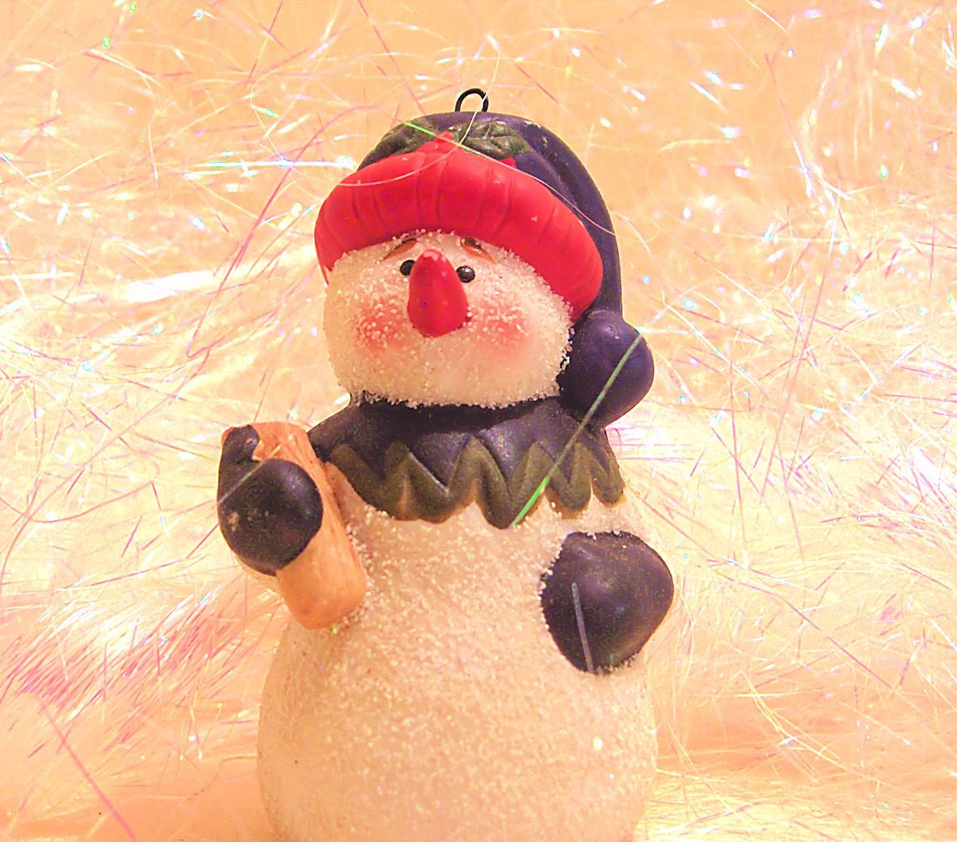
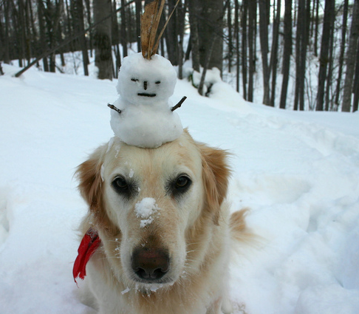

STAMP
Find the stamp option and place a stamp on a picture
Notes:
This is practice for the next task. Which snow sculpture do you prefer?

Slide 14
Inquiry to build and present knowledge
Use an inquiry process to gather relevant, credible information/evidence from a variety of sources (e.g., print, digital, discussions, etc.) that build understanding of and lead to conclusions about a subject under investigation.
Notes:
Place a stamp on the word that needs the most attention when discussing the standard.

Slide 15
Guiding Principles (B and C)
A self-directed and lifelong learner: Students apply knowledge in new contexts and demonstrate flexibility including the ability to learn, unlearn and relearn.
A creative and practical problem solver: Students use inquiry and writing processes that require adaptation to feedback through the use of reflection, sometimes persevering through multiple attempts.
Language (L3 and L5)
Apply knowledge of language to understand how language functions in different contexts, to make effective choices for meaning or style, and to comprehend more fully when reading or listening.
Demonstrate understanding of figurative language, word relationships, and nuances in word meanings sufficient for reading, writing, speaking, and listening.
Speaking and Listening (SL 1)
Prepare for and participate in conversations across a range of topics, types, and forums, building on others’ ideas and expressing their own.
W1
Use an inquiry process to gather relevant, credible information/evidence from a variety of sources that build understanding of and lead to conclusions about a subject under investigation.

Slide 16
Discussion - in small groups
What are you thinking?
What are you feeling?
What are you wondering?

Slide 18
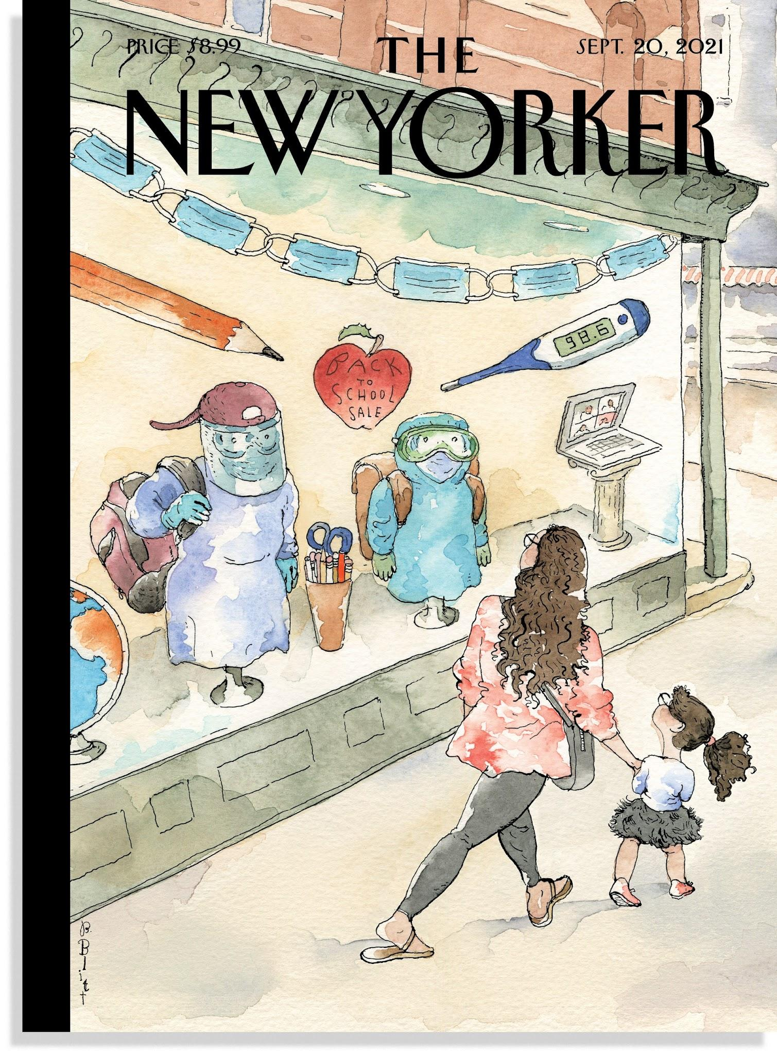

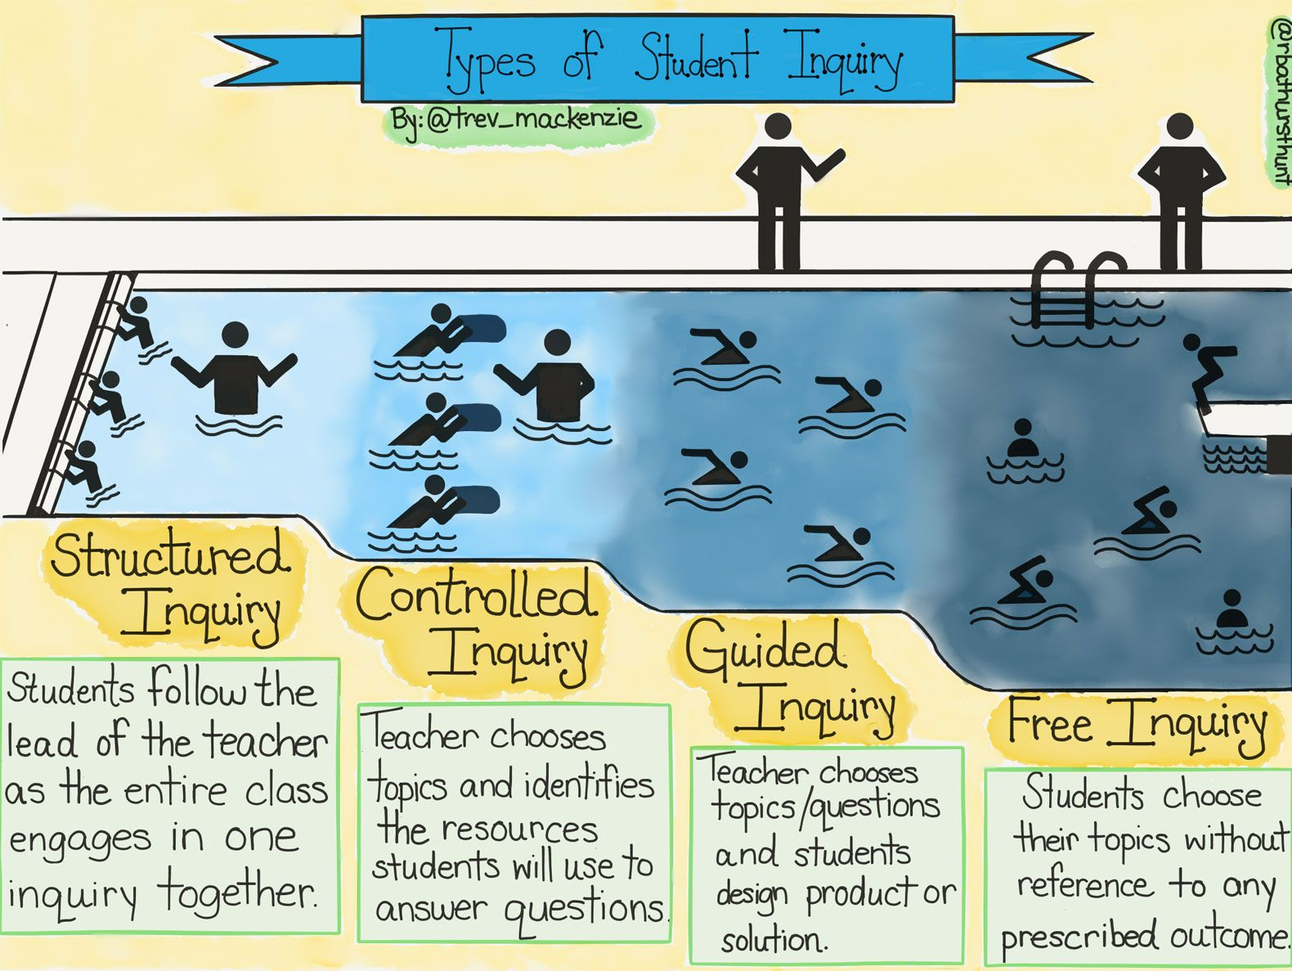
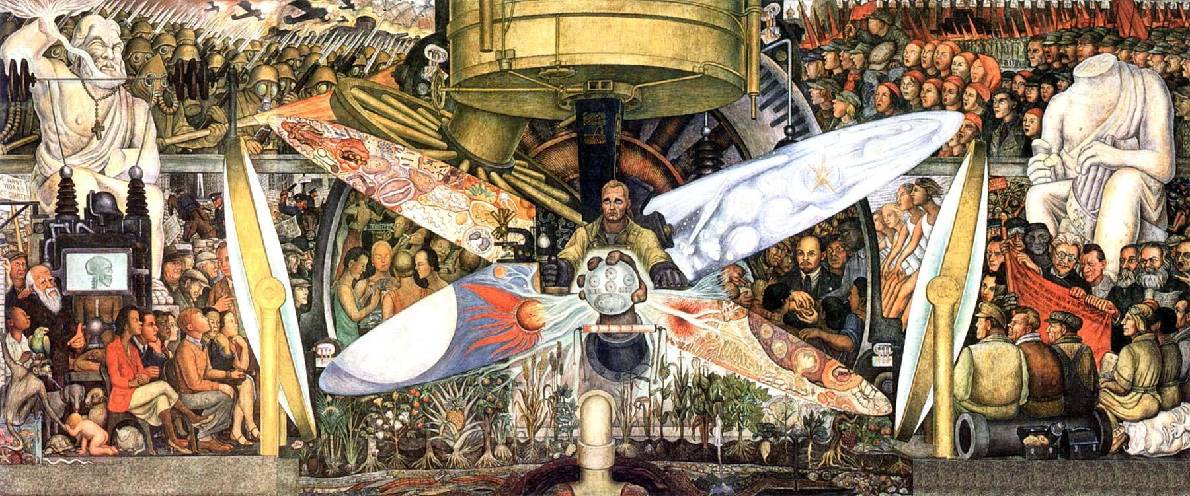
INQUIRY
FOR ME
New Yorker Covers
(click at right
for a sample)
Annotating Text
Inductive vs. Deductive Reasoning (click above for a packet)
Five-
Word Summaries
Are Powerful

Slide 19
Consequences
Add your ideas to the Jamboard. This Jamboard will remain so open so anyone watching the recording can still add ideas.
https://jamboard.google.com/d/1b_QKgx__W-1hzXpJzM8G-JA_kbPyTFpCIuXaF02g39E/edit?usp=sharing

Slide 20
Questions? Fellow collaborator?
Feel free to email Neal Rioux:
neal.rioux@msad52.org

