Slide 1
Interrupting hate and bias in school
Tina m. Ellsworth, Ph.D. | @DrTinaellsworth | She.her

Slide 2
Land acknowledgement
i respectfully acknowledge that I am coming to you from the traditional territory of the Sioux, kaw, and osage.
https://usdac.us/nativeland
https://native-land.ca/
Confronting hate and bias in school | Tina M. Ellsworth, Ph.D. | @DrTinaEllsworth

Slide 3
Confronting hate and bias in school
Who is this for?
What is the purpose?
Full credit to Teaching Tolerance (tolerance.org) @tolerance
Confronting hate and bias in school | Tina M. Ellsworth, Ph.D. | @DrTinaEllsworth
Notes:
It’s for educators who want to develop the skills to speak up themselves and who want to help their students ﬁnd the courage to speak up too.
This guide is for the adults in the school. It offers advice about how to respond to remarks made by students and by other adults and gives guidance for helping students learn to speak up as well. We believe that modeling the kind of behavior we want from students is one of the most effective ways of teaching it.

Slide 4
Notes:
White, middle-class, heterosexual, middle-class, English speaker, able-bodied, cisgendered female. Why do I tell you this? Why does it matter? This is my worldview. It’s how my worldview informs my work and helps you better understand me and the work I do. It’s how I interact with the world and how the world interacts with me.

Slide 5
Community agreements
Use and receive “I” statements with respect
Respect confidentiality
Embrace messiness and kindness
Practice accountability (intent v impact)
Be aware of equity of voice (move up, move back)
Notes:
Not asking you to come to a belief today. Just want to spur your thinking a little.

Slide 6
Friendly reminders
What you learn here, leaves here!
We are all at different spots in this journey. You’re encouraged to ask questions that will deepen your experience. Be patient if I move faster or slower than you’d like.
During each activity, consider how it will work in your context and share those thoughts with others.

Slide 7
In advance—preparing yourself
Tell yourself you are someone who will speak up
Develop ready responses—practice out loud, memorize, don’t let them pass.
Assess the risk of speaking up—don’t let fear silence you—weigh risks against not speaking up
Understand the dynamics of change
Don’t undermine your own efforts
Confronting hate and bias in school | Tina M. Ellsworth, Ph.D. | @DrTinaEllsworth

Slide 8
In advance—preparing students
What kind of climate/culture do you want in your school and classroom?
Provide language and context to help them speak up, or brainstorm with them! Be proactive.
Discuss why some words hurt.
Build classroom community on relationships, and they will be more ready to speak up.
Confronting hate and bias in school | Tina M. Ellsworth, Ph.D. | @DrTinaEllsworth

Slide 9
In advance—preparing students
Rules: We want everyone to feel safe in this classroom. Then, when something happens, point back to that mission.
Be proactive!
Have diverse groupings in your classroom to help foster authentic relationships.
Model behavior for students
Follow same preparations as you would for yourself: mindset, safety
Confronting hate and bias in school | Tina M. Ellsworth, Ph.D. | @DrTinaEllsworth

Slide 10
Basic strategies
What are some examples of biased language you hear at your school?
What words have become colloquial, yet are still harmful, biased language?
Do your students understand intent v impact?
What are you currently doing or what have you done in the past to establish a safe environment where all students can learn?
Confronting hate and bias in school | Tina M. Ellsworth, Ph.D. | @DrTinaEllsworth

Slide 11
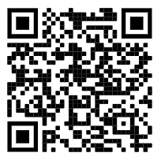
Basic strategies
Small group breakout—rooms of 4.
Each person picks a different strategy to read about.
Then, share out the strategy with your group.
You have 10 min.
Begin on page 18: Basic strategies
https://bit.ly/BasicStrategies
Confronting hate and bias in school | Tina M. Ellsworth, Ph.D. | @DrTinaEllsworth

Slide 12
Basic strategies
Strategy | Things I can say
Interrupt
Question
Educate
Echo
Confronting hate and bias in school | Tina M. Ellsworth, Ph.D. | @DrTinaEllsworth

Slide 13
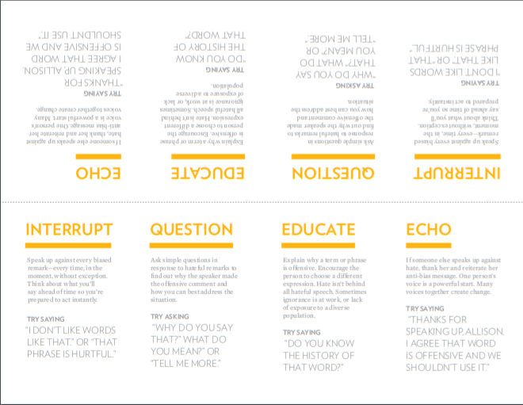
Pocket guide
https://bit.ly/PocketGuide2020
Confronting hate and bias in school | Tina M. Ellsworth, Ph.D. | @DrTinaEllsworth

Slide 14
Let’s practice
https://bit.ly/PocketGuide2020
Confronting hate and bias in school | Tina M. Ellsworth, Ph.D. | @DrTinaEllsworth

Slide 15
How can these strategies help you? How could it help students?
Confronting hate and bias in school | Tina M. Ellsworth, Ph.D. | @DrTinaEllsworth

Slide 16
be prepared. be positive. be confident. be encouraging and work together.
Confronting hate and bias in school | Tina M. Ellsworth, Ph.D. | @DrTinaEllsworth

Slide 17
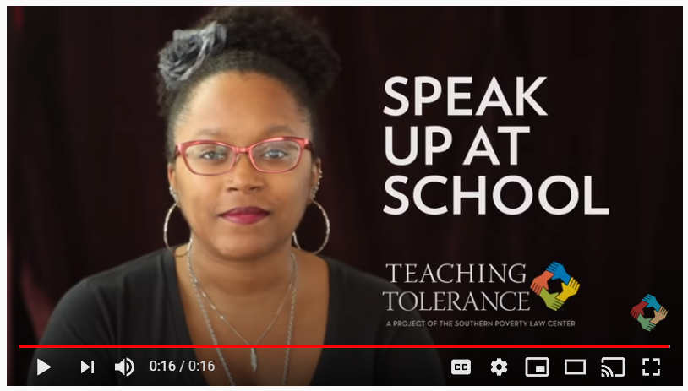
Role Play
How can you make it clear that you are attentive to the needs of the child and also appeal to the parent’s sense of fairness?
https://bit.ly/30vEXMG
Confronting hate and bias in school | Tina M. Ellsworth, Ph.D. | @DrTinaEllsworth

Slide 18
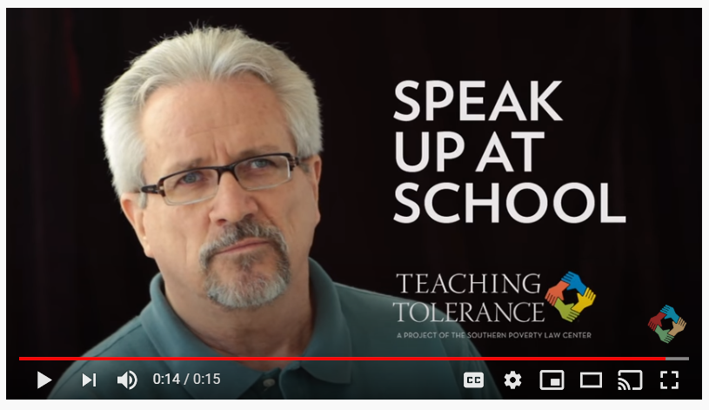
Role Play
What does the student understand about stereotypes and privilege? What do those who were laughing understand about stereotypes and privilege?
Confronting hate and bias in school | Tina M. Ellsworth, Ph.D. | @DrTinaEllsworth

Slide 19
Role Play
What might the principal in this case do? What might an individual teacher do or say?
Confronting hate and bias in school | Tina M. Ellsworth, Ph.D. | @DrTinaEllsworth

Slide 20
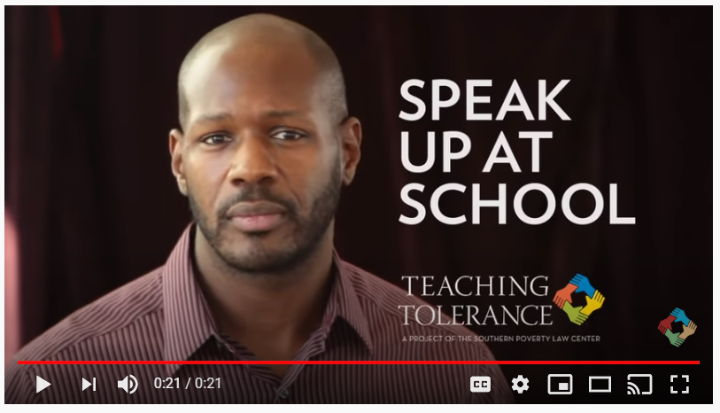
Role Play
How might the targeted student have felt when this comment was made?
Confronting hate and bias in school | Tina M. Ellsworth, Ph.D. | @DrTinaEllsworth

Slide 21
Conclusion—final exercise
Think about a situation or remark you have experienced in school.
How will you respond differently now, from how you may have responded then?
How will you respond next time?
Confronting hate and bias in school | Tina M. Ellsworth, Ph.D. | @DrTinaEllsworth

Slide 22
Thank you!
Tina m. Ellsworth, Ph.D. | @DrTinaellsworth | She.her

