Slide 1

Maine Department of Education
McKinney Vento
Head Start

Slide 2

Recognize when a child may be eligible under the McKinney-Vento Homeless Education Act
Know how to contact the local district liaison
Know what rights these students have
Be able to share with families about their rights
Know who to contact if you hit a dead end
This Photo by Unknown Author is licensed under CC BY-SA

Slide 3
McKinney-Vento Homeless Education Act
Defines homeless
Requires local McKinney-Vento liaison in each district
Requires state coordinator
Explains rights of homeless students in education

Slide 4

Definition of Homeless Under McKinney-Vento Act
Homelessness is defined as lacking a fixed, regular, and adequate nighttime residence. Situations specifically described in the McKinney-Vento Act include
  sharing housing due to loss of housing, economic hardship, or a similar reason,
  living in hotels, motels, trailer parks, or camping grounds due to lack of adequate housing,
  living in emergency or transitional housing,
  or children abandoned at hospitals.
  It also includes a primary nighttime residence that is not designed for or ordinarily used as a sleeping accommodation for humans, living in cars, parks, public spaces, abandoned buildings, substandard housing, bus or train stations, and migratory children living in one of the circumstances described previously.

Slide 5

Definitions
If a housing situation does not clearly fall under one of the categories provided in the definition of homelessness provided in the law, you should ask yourself if the student can go to the same place every night to sleep in a safe and sufficient space. If the answer is no, the student likely meets the criteria of lacking a fixed, regular, and adequate nighttime residence and should be considered homeless.
Homelessness must be documented each school year, but a child is eligible for MV services through the academic year, even if they become stably housed part way through the year
If you believe you know a student who may qualify, connect with your district McKinney-Vento Liaison to determine next steps.

Slide 6
Rights of McKinney-Vento Students
Help families and youth experiencing homelessness connect to resources at school and exercise their right to an education. Public schools are required to identify, enroll, and serve homeless children and youth. Specific rights include:
  Staying in the same school even if they move, and receiving transportation to that school, as long as it is in the student’s best interest
  Enrolling in school immediately without the documents schools usually require
  Receiving free school meals
  Getting help with school supplies and other needs
  Connecting young children with early childhood services
  Families have a right to dispute resolution if they disagree with the determination
  Right to confidentiality

Slide 7
PRESCHOOL
Do McKinney-Vento Act requirements apply to homeless children attending preschool?
To the extent that an LEA offers a public education to preschool children, including LEA-administered Head Start programs, an LEA must meet the McKinney-Vento Act requirements for homeless children in preschool, including ensuring that a homeless child remains in his or her public preschool of origin, unless a determination is made that it is not in the child’s best interest.
EHCY Guidance, Question N-4

Slide 8
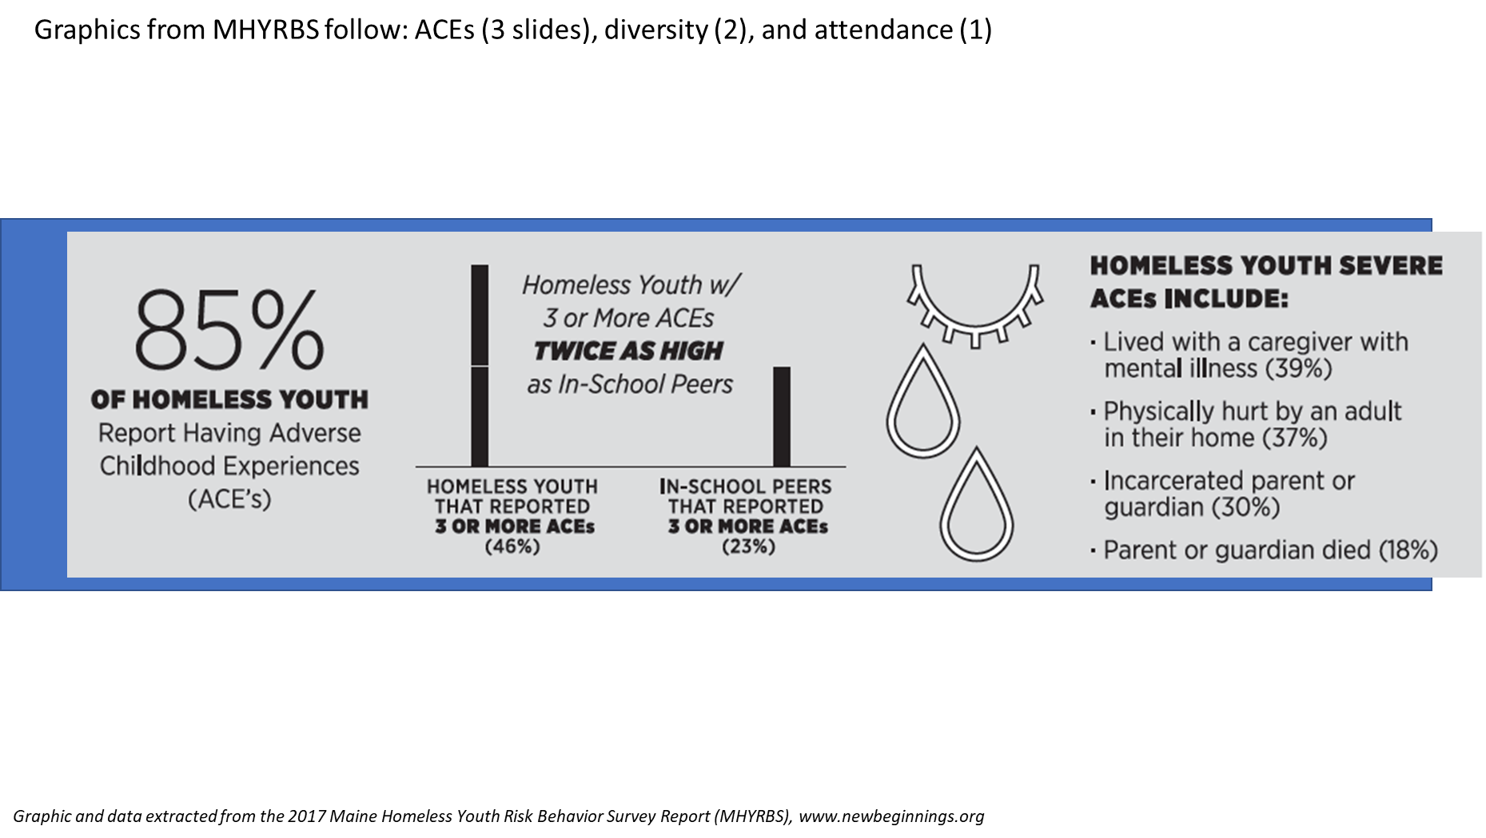

Slide 9
DETERMINATIONS OF ELIGIBILITY
The local liaison has the authority and responsibility to ensure that eligible students are identified; this should be a collaborative effort with school personnel, and through outreach and coordination activities with other entities and agencies [42 U.S.C. § 11432(g)(6)(A)(i)].
Eligibility determinations should be made on a case-by-case basis, considering the circumstances of each student.
Pay close attention to the legislative wording, as it may provide needed clarity.
  Download Determining Eligibility for McKinney-Vento Rights and Services at https://nche.ed.gov/determining-eligibility/ for more information

Slide 10
IMMEDIATE ENROLLMENT
Children and youth experiencing homelessness have the right to immediate school enrollment
  even if lacking paperwork normally required for enrollment; or
  even if having missed application or enrollment deadlines during any period of homelessness [42 U.S.C. § 11432(g)(3)(C)(i)].
Enrollment is defined as “attending classes and participating fully in school activities” [42 U.S.C. § 11434a(1)].

Slide 11
SCHOOL STABILITY
Children and youth experiencing homelessness have the right to attend
  The school of origin [42 U.S.C. § 11432(g)(3)(I)(i)]
    The school that a child or youth attended when permanently housed, or
    The school in which the child or youth was last enrolled
    Includes public preschools
    Includes receiving schools
  The local attendance area school [42 U.S.C. § 11432(g)(3)(A)(ii)]
    Any public school that non-homeless students who live in the attendance area in which the child or youth is actually living are eligible to attend

Slide 12
MCKINNEY-VENTO SCHOOL OF ORIGIN TRANSPORTATION
Does the McKinney-Vento Act require an LEA to provide transportation services to homeless children attending preschool?
Yes. The McKinney-Vento Act requires LEAs to provide transportation services to the school of origin, which includes public preschools. Accordingly, transportation to the school of origin must be provided even if a homeless preschooler who is enrolled in a public preschool in one LEA moves to another LEA that does not provide widely available or universal preschool.
EHCY Guidance, Question N-5

Slide 13
MCKINNEY-VENTO SCHOOL OF ORIGIN TRANSPORTATION
Transportation must be provided to and from the school of origin at the request of the parent or guardian, or, in the case of an unaccompanied youth, at the request of the local liaison [42 U.S.C. §11432(g)(1)(J)(iii)].
School of origin transportation rights extend to public preschools and receiving schools.

Slide 14
MCKINNEY-VENTO SCHOOL OF ORIGIN TRANSPORTATION
Must LEAs continue to provide transportation to and from the school of origin for formerly homeless students who have become permanently housed?
Yes. LEAs must continue to provide transportation to and from the school of origin to formerly homeless students who have become permanently housed for the remainder of the academic year during which the child or youth becomes permanently housed.
EHCY Guidance, Question J-5

Slide 15
Identified Barriers to Early Childhood Services following the passage of ESSA (2015)
Transportation: 42% of all calls to the NCHE Helpline concerned transportation challenges
Lack of space: 13% of the calls were related to lack of space or slots

Slide 16
Student Homelessness in Maine
State average over the past 10 years, 1587 homeless students identified
Ranging between .46 % – 1.36% of student population
National averages assume homeless students make up at least 3% of entire student population
Maine is very likely UNDER identifying students who qualify as McKinney-Vento

Slide 17
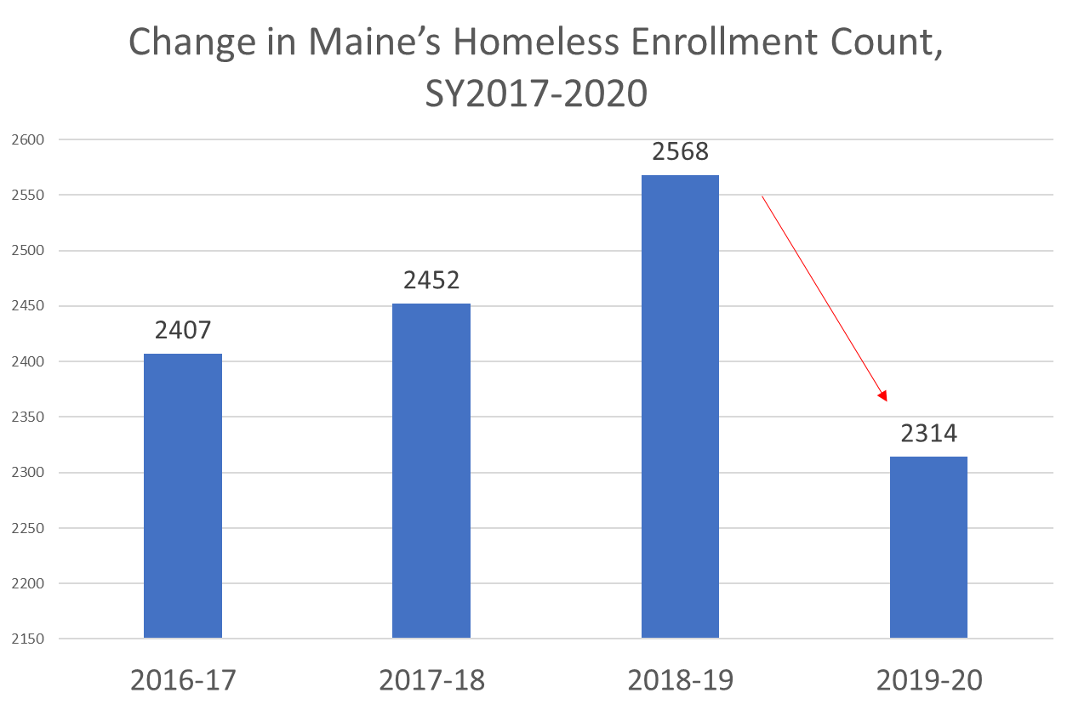

Slide 19
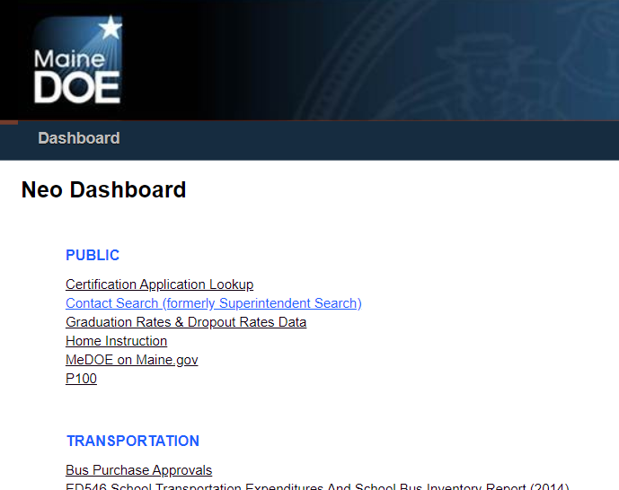
neo.maine.gov
Every school district has a designated McKinney-Vento Liaison who is tasked with identifying and serving homeless children and youth

Slide 20
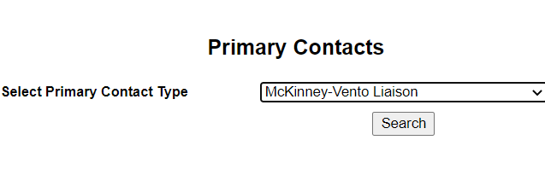
Neo.maine.gov

Slide 21
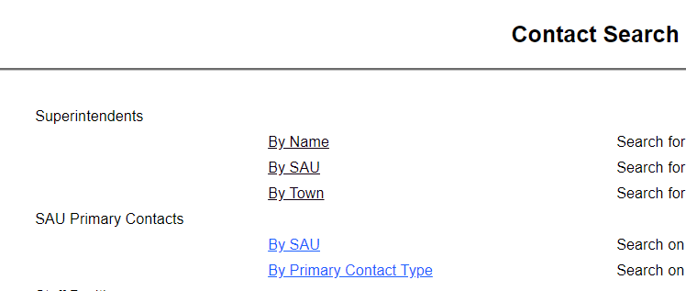
Neo.maine.gov

Slide 22

State Homeless Education Coordinator
Supports local liaisons by providing technical assistance about State and Federal policies
Manages the subgrant process for districts who receive McKinney-Vento funding
Maine’s State Coordinator is available to assist you with any questions you may have:
  Amelia Lyons
  Amelia.lyons@maine.gov
  207-557-1787
  Maine DOE’s website for Homeless Education can be found here

Slide 23
Liaisons Support Students With
Identification
Best Interest Determination
Remain in school of origin with transportation OR
Immediately enroll in school of residence
Support
Free Meals
School supplies
Confidentiality
Complete annual training
Determine eligibility
Dispute
Support family with dispute resolution process if necessary
Train essential staff
Referrals

Slide 24
Collaborate Collaborate Collaborate
State Coordinator
Social Service Providers
Social Service Programs and Eligibility requirements
Local McKinney-Vento Liaison

Slide 25
Reminders
Families who qualify are entitled to this program and the support it entails
The law is written to consider the best interest of the student, NOT the feasibility for the district (cost, availability of vehicles, etc.)
If you are struggling to connect with a liaison or district, reach out to the State Coordinator, Amelia Lyons
When talking with families, it may be better to use terms like “in transition” or “displaced” instead of homeless

Slide 26
Additional Resources
https://nche.ed.gov/preschool-early-childhood/
https://www.maine.gov/doe/schools/safeschools/counseling/highmobility/homelessed
https://nche.ed.gov/contact/

Slide 27
Thank you!
Amelia Lyons
State Homeless Coordinator / Migrant Education Director
Maine Department of Education
Lyons.amelia@gmail.com
207-557-1787

