Slide 1
MSMA: Spotlighting Curiosity & Coregulation In The Classroom
Social Emotional Teaching and Learning In Schools
Kellie Doyle Bailey – Social Emotional Learning & Restorative Practices Specialist
Sarah Norsworthy – Social Emotional Learning Implementation Specialist

Slide 2
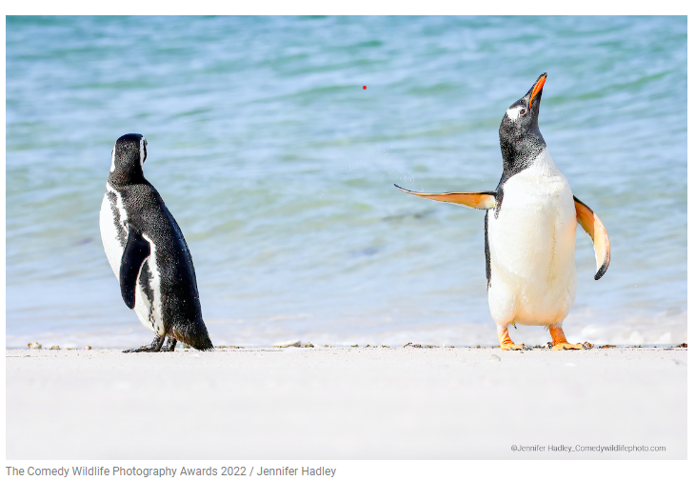
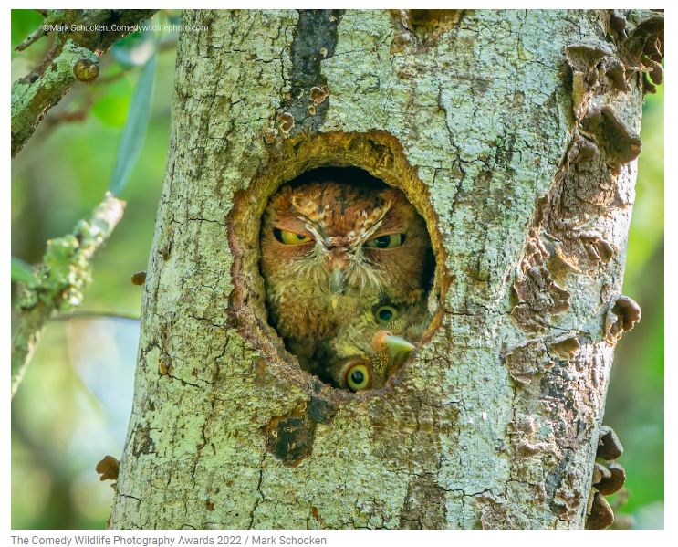
Choose the animal who appears to, most closely, match the feeling which you, most, relate to this morning.
This will be anonymous. Head to this form.
Choose the animal.
Write the emotion.

Slide 3
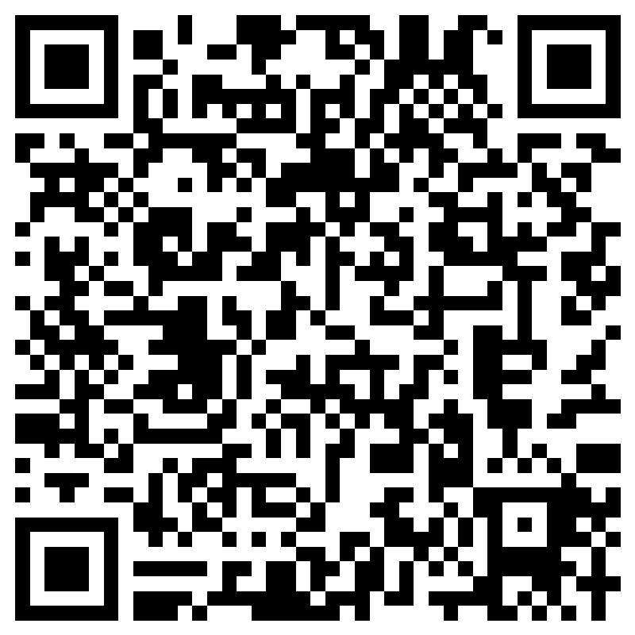
Navigating Our Time Together Who are we? What is SEL? Spotlight: One aspect of SEL Voices of students Spotlight: Coregulation & Classrooms SEL & Adults In Schools Talking Back To The Anti-SEL Narrative Learning from you – New Positions In Schools SEL Reminders

Slide 4
O3S
Office of School and Student Supports
The Office of School and Student Supports (O3S) strives to ensure that Maine schools are inclusive, healthy, safe, and supportive communities where every student thrives. O3S endeavors to coordinate resources and programs that promote equitable, psycho-socially, physically, and environmentally healthy school communities for all.
Each O3S team provides information and guidance to parents, administrators, educators, legislators and other stakeholders within their focus areas:
Photo credit: Sarah Norsworthy

Slide 5
O3S
Office of School and Student Supports
Coordinated School Health Team
School Approval & Enrollment Team
Climate, Culture and Resilience Team
Photo credit: Sarah Norsworthy

Slide 6
O3S
Climate, Culture and Resilience Team
provides trauma informed resources in support of developing safe and inclusive educational communities.
Photo credit: Sarah Norsworthy

Slide 7
O3S
Social Emotional Learning Team
Kellie Doyle Bailey
Social Emotional Learning Specialist
Sarah Norsworthy
Social Emotional Learning Implementation Specialist
Photo credit: Sarah Norsworthy

Slide 8
Social Emotional Learning Specialist
Social Emotional Learning Implementation Specialist
Embedding healthy SEL practices in academic instruction
Thought partnering around plans to teach explicit SEL skills to students
Supporting healthy SEL practices, in students
Raising awareness of how to implement supportive SEL grounded instruction for all students
Collecting/creating resources & presentations designed to support healthy SEL
Thought partnering with schools on creating systems of support for emotionally intelligent practices among adults
Raising awareness of the role of emotional intelligence in learning & its neuroscience
Collecting/creating resources & presentations designed to support emotional intelligence for adults
Supporting emotionally intelligent practicing
Supporting the emotional health & wellbeing those in schools in Maine
Raising awareness of the importance of deepening adult emotional literacy, so that adults are well positioned to support students

Slide 9
Navigating Our Time Together Who are we? What is SEL? Spotlight: One aspect of SEL Voices of students Spotlight: Coregulation & Classrooms SEL & Adults In Schools Talking Back To The Anti-SEL Narrative Learning from you – New Positions In Schools SEL Reminders

Slide 10
SEL is about awareness.
Awareness of ourselves,
Awareness of others,
Awareness of context.
Consequences,
Impact.

Slide 11
This is the work of responsiveness.
Our language,
posture,
tone,
proximity,
intentions,
and our stories,
These are our currencies.
Notes:
Emotional Intelligence – Check Out Kellie’s 101

Slide 12
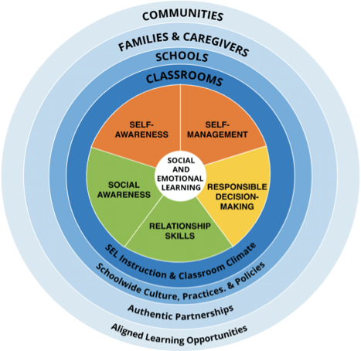
The
CASEL 5...
Five broad and interrelated areas of competence:
Self-awareness
Self-management
Social awareness
Relationship skills
Responsible decision-making
@caselorg | #WhatisSEL
Notes:
The CASEL 5 can be taught and applied at various developmental stages from childhood to adulthood and across diverse cultural contexts. Many school districts, states, and countries have used the CASEL 5 to establish preschool to high school learning standards and competencies that articulate what students should know and be able to do for academic success, school and civic engagement, health and wellness, and fulfilling careers.
Updated descriptions of competencies and added additional bulleted examples to reflect the growing research and more inclusive understanding of competence development and SEL as a lever for equity and excellence
Includes attention to children, adolescents, and adults
Note that bullets are examples not exhaustive

Slide 13
The language of SEL
Self Awareness Identity
Self Management Agency
Social Awareness Belonging
Relationship Skills Collaborative Problem Solving
Responsible Decision Making Curiosity
CASEL language for SEL competencies on the left.
Alternative language on the right.
Photo credit: Sarah Norsworthy

Slide 14
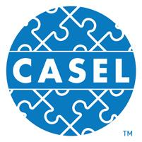
The process of learning the knowledge, skills, and attitudes to develop healthy identities, manage emotions and achieve personal and collective goals, feel and show empathy for others, establish and maintain supportive relationships, and make responsible and caring decisions.
SEL can help address various forms of inequity and empower young people and adults to co-create thriving schools and contribute to safe, healthy, and just communities.
SEL is…
casel.org
Notes:
Updated CASEL’s definition and framework descriptions to reflect our continuous learning from SEL research, practice and policy
4 key points in updating SEL:
Explicit commitment to equity and excellence that emphasizes Identity, agency, belonging
Highlight spaces & places where SEL can be promoted
A need to infuse SEL into curriculum/instruction, OST, discipline, student support services, PL
Reflect the role of ongoing assessment for continuous improvement

Slide 15
When we are socially and emotionally literate – we act in expansively affirming ways.
We hold an asset based view of ourselves and others.
We consider the impact of actions.
We understand that there are many ways of being in our world.
We demonstrate openness and curiosity about the knowledge others carry.
We hear, see and feel the truths in the stories others share about their experiences. Emotionally, perception is reality.
Notes:
Emotionally, perception is reality. Survival not rational

Slide 16
Navigating Our Time Together Who are we? What is SEL? Spotlight: One aspect of SEL Voices of students Spotlight: Coregulation & Classrooms SEL & Adults In Schools Talking Back To The Anti-SEL Narrative Learning from you – New Positions In Schools SEL Reminders

Slide 17
Take A Moment
Ground yourself.
3 things you hear, see, feel
Deep breaths
Notice how you feel – perhaps name an emotion, or several emotions
Notice where in your body those feelings might be

Slide 18
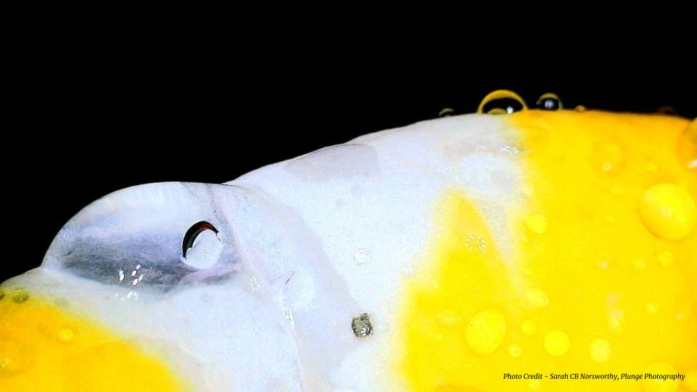
What do you see?

Slide 19
What do you think?

Slide 20
What do you wonder?

Slide 21
Now that you have context -
Notice how you feel – perhaps name an emotion, or several emotions
Notice where in your body those feelings might be

Slide 22
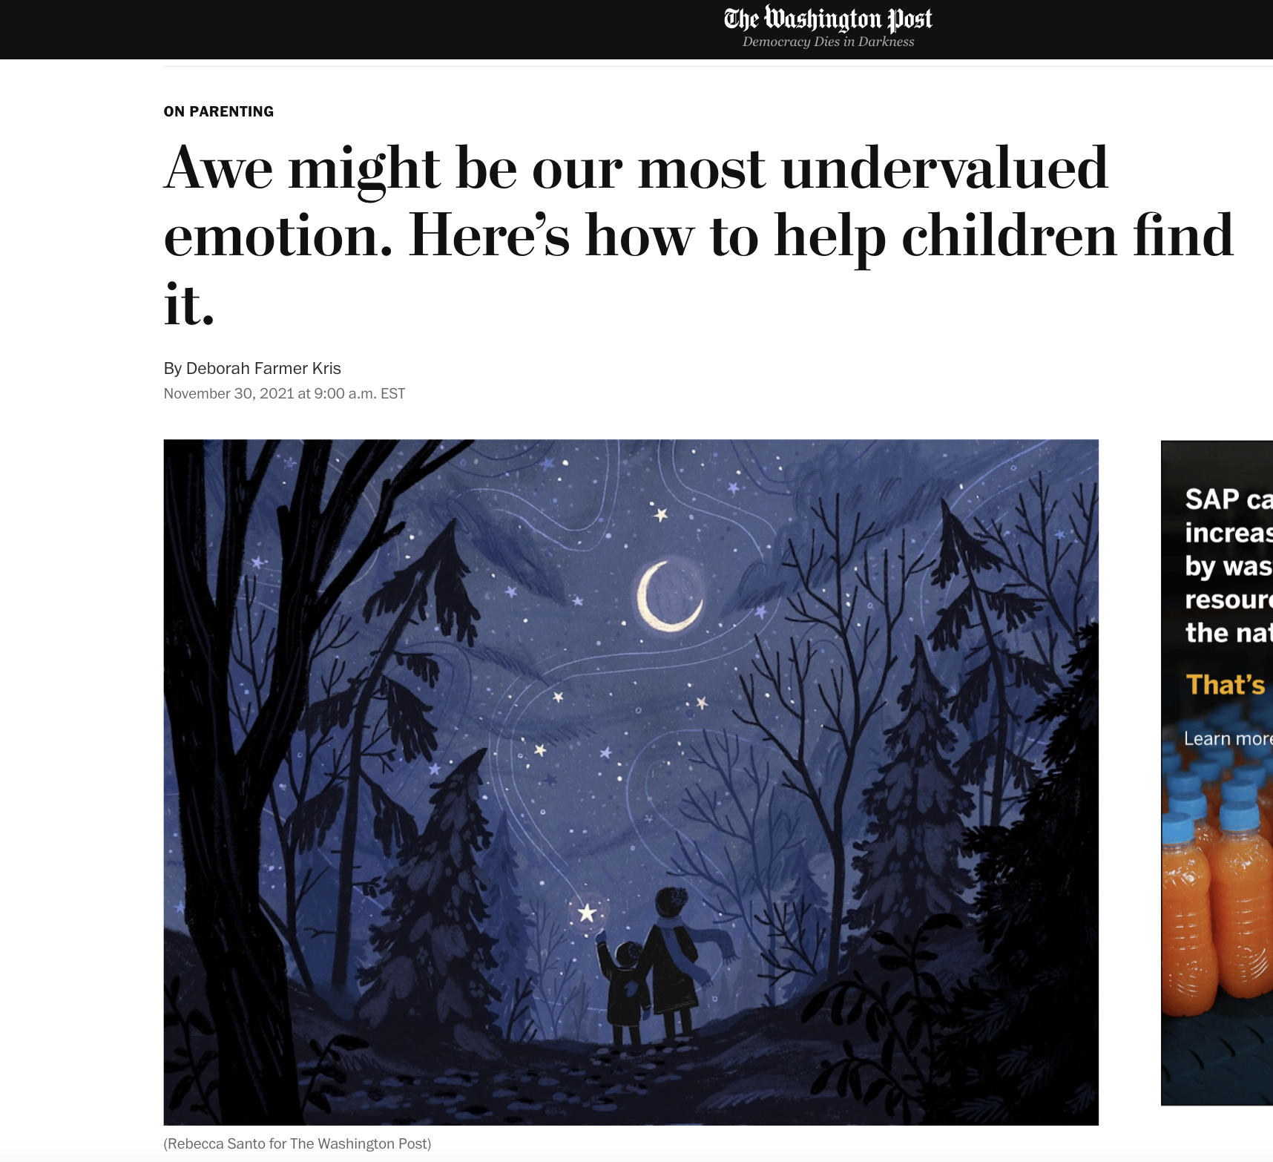
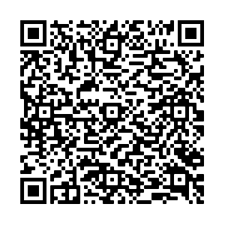
Photo credit: Sarah Norsworthy
Notes:
People commonly feel awe when they spend time in nature, listen to or make music, view or create art, contemplate big ideas, engage in meaningful rituals or enjoy community experiences that make them feel as if they’re a part of something larger than themselves. - By noticing and naming systems, connections - wandering in our thought - noticing thinking and wondering we can generate a positive state of awe.

Slide 23
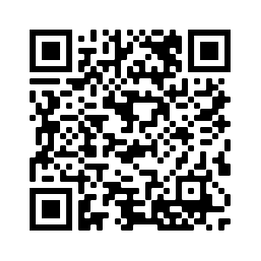
2 types of curiosity activate different parts of the brain - eliciting divergent emotions
surprise/unexpectedness - uncomfortable
excitement/anticipation of a reward
Photo credit: Sarah Norsworthy

Slide 24
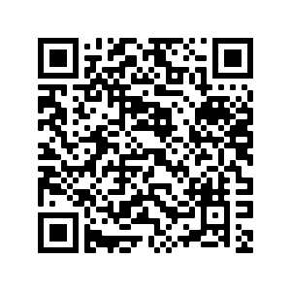
Photo credit: Sarah Norsworthy
Notes:
Let’s watch this short clip to learn more.

Slide 25
Navigating Our Time Together Who are we? What is SEL? Spotlight: One aspect of SEL Voices of students Spotlight: Coregulation & Classrooms SEL & Adults In Schools Talking Back To The Anti-SEL Narrative Learning from you – New Positions In Schools SEL Reminders

Slide 26
16.1%
# of Maine high school students, who answered yes – when asked if they had been bullied on school property during the past 12 months.

Slide 27
32.7%
# of Maine high school students, identifying as Transgender who answered yes – when asked if they had been bullied on school property during the past 12 months.

Slide 28
What are the chances you would intervene or defend someone being verbally abused or bullied at school?
What percentage of Maine high school students answered, “pretty good chance” or “very good chance”?
60%

Slide 29
6.5%
# of Maine high school students, reported that they did not go to school on a least 1 of the past 3o days because they felt they would be unsafe at school, or, on their way to or from school.

Slide 30
10.1% Hispanic Students
6.3% Non-Hispanic Students
# of Maine high school students reported that they did not go to school on a least 1 of the past 3o days because they felt they would be unsafe at school, or, on their way to or from school.

Slide 31
19.8% Native Hawaiian or Other Pacific Islander Students
11.1% American Indian or Alaskan Native Students
Black or African American Students
Multiracial Students
8.1% Asian Students
6.1% White Students
# of Maine high school students reported that they did not go to school on a least 1 of the past 3o days because they felt they would be unsafe at school, or, on their way to or from school.

Slide 32
Navigating Our Time Together Who are we? What is SEL? Spotlight: One aspect of SEL Voices of students Spotlight: Coregulation & Classrooms SEL & Adults In Schools Talking Back To The Anti-SEL Narrative Learning from you – New Positions In Schools SEL Reminders

Slide 33
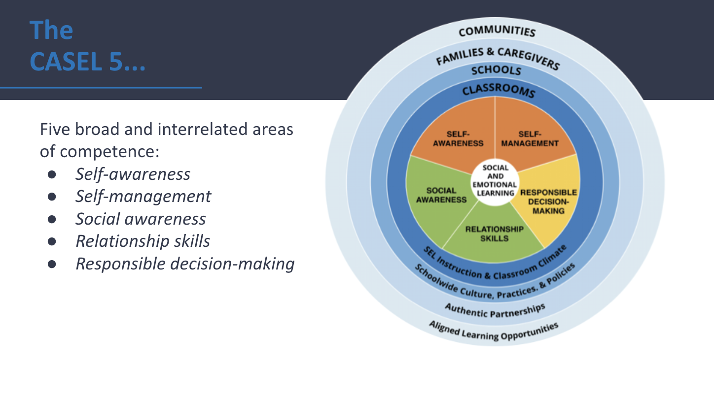
Classroom Adult Emotional Literacy
Co-Regulation is Key
Student Emotional Literacy
“ Effective co-regulation by a supportive caregiver will promote self efficacy and allow children, youth, and young adults to feel secure enough to practice new skills and learn from mistakes. “
Notes:
The supportive process between caring adults and children, youth, or young adults that fosters self-regulation development is called “co-regulation.” This term began as a description of adult support for infants, but is now used to describe an interactive process of regulatory support that can occur within the context of caring relationships across the lifespan.

Slide 34
We Teach & Learn About SEL
What & How
We Teach & Learn With SEL
Practice
This means adults, too.
Sarah Norsworthy
Notes:
We can, and do, teach explicitly ways to be socially and emotionally literate. We also can narrate it, notice it – we MUST practice it.

Slide 35
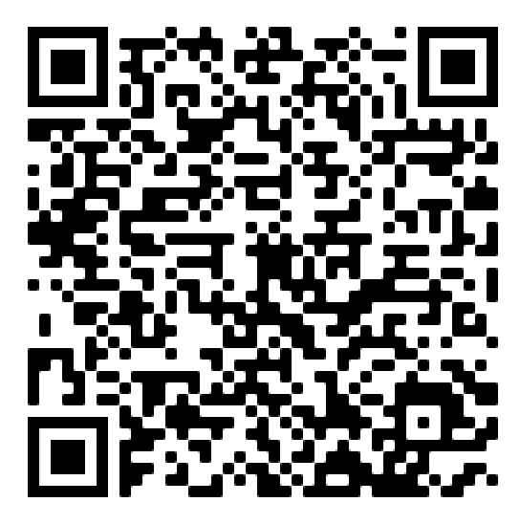
Elementary* Aged Children - Skills Needed
Emotional literacy, including recognizing emotions and using words to express more complex feelings
Emotion regulation:
Ignoring things that are mildly irritating, distracting, or frustrating
Calming down using strategies like deep breathing, relaxation, imagery, or positive self-talk
Social flexibility, such as trying a friend’s idea or considering others’ perspectives
Social skills, like being patient and taking turns
Paying attention and staying focused
Working independently
Persistence with difficult tasks
Problem-solving skills and flexible thinking
Rosanbalm, K.D., & Murray, D.W. (2017). Caregiver Co-regulation Across Development: A Practice Brief. OPRE Brief #2017-80. Washington, DC: Office of Planning, Research, and Evaluation, Administration for Children and Families, US. Department of Health and Human Services.

Slide 36
Elementary* Aged Children - Co-Regulation
Continue to provide a warm, nurturing, supportive relationship
Assist in problem-solving more complex academic, behavioral, and social situations
Model conflict resolution strategies
Prompt and coach coping skills and calm-down strategies, including self-talk and relaxation
Teach and support organization and planning skills needed for academic success
Provide opportunities to make decisions and self-monitor behavior
Continue to provide clear rules, structure, and consequences in a calm manner
Rosanbalm, K.D., & Murray, D.W. (2017). Caregiver Co-regulation Across Development: A Practice Brief. OPRE Brief #2017-80. Washington, DC: Office of Planning, Research, and Evaluation, Administration for Children and Families, US. Department of Health and Human Services.

Slide 37
Adolescents* - Skills Needed
Awareness of and attention to emotions
Strategies to tolerate and manage normal levels of stress/distress
Strategies for seeking help when stress is unmanageable or the context is dangerous
Effective organization, time management, and task completion skills
Setting longer-term goals and self-monitoring to achieve them
Problem-solving complex life situations
Effective decision-making “in the moment”
Anticipating challenges and problem-solving in advance
Decision-making with a future perspective
Compassion for self and others
Rosanbalm, K.D., & Murray, D.W. (2017). Caregiver Co-regulation Across Development: A Practice Brief. OPRE Brief #2017-80. Washington, DC: Office of Planning, Research, and Evaluation, Administration for Children and Families, US. Department of Health and Human Services.

Slide 38
Adolescents* - Co-Regulation
Provide a warm, responsive relationship
Provide support and empathy in times of intense emotion
Model, monitor, and coach more sophisticated self-regulation skills across different contexts
Monitor and limit opportunities for risk-taking behavior
Provide opportunities to make decisions and self-monitor behavior in less risky situations
Give time and space to calm down in times of conflict
Monitor and prompt use of organizational and planning skills for successful task completion
Continue clear rules, boundaries, and consequences to incentivize good choices
Rosanbalm, K.D., & Murray, D.W. (2017). Caregiver Co-regulation Across Development: A Practice Brief. OPRE Brief #2017-80. Washington, DC: Office of Planning, Research, and Evaluation, Administration for Children and Families, US. Department of Health and Human Services.

Slide 39
Young Adult* - Skills Needed
Interpersonal and communication skills for healthy relationships
Decision-making that supports health, wellbeing, and long-term goals
Job skills such as planning, organization, prioritization, time management, and persistence
Self-monitoring and self-reward for progress towards goals
Stress management and strategies to tolerate uncomfortable emotions
Strategies for calming down before responding in a stressful or emotionally intense situation (e.g., take a deep breath rather than reacting in the “heat of the moment”)
Rosanbalm, K.D., & Murray, D.W. (2017). Caregiver Co-regulation Across Development: A Practice Brief. OPRE Brief #2017-80. Washington, DC: Office of Planning, Research, and Evaluation, Administration for Children and Families, US. Department of Health and Human Services.

Slide 40
Young Adult* - Co-Regulation
Provide an ongoing warm, supportive relationship
Provide comfort and empathy during times of strong emotion; prompt and support coping strategies
Support long-term goal achievement by encouraging effective planning, awareness of consequences, and task completion activities
Share perspective and provide coaching for complex problem-solving and decision-making
Ultimately, allow space for the young adult to make his or her own decisions and experience the consequences of those decisions
Rosanbalm, K.D., & Murray, D.W. (2017). Caregiver Co-regulation Across Development: A Practice Brief. OPRE Brief #2017-80. Washington, DC: Office of Planning, Research, and Evaluation, Administration for Children and Families, US. Department of Health and Human Services.

Slide 41
Clip from episode “Juice”

Slide 42
Navigating Our Time Together Who are we? What is SEL? Spotlight: One aspect of SEL Voices of students Spotlight: Coregulation & Classrooms SEL & Adults In Schools Talking Back To The Anti-SEL Narrative Learning from you – New Positions In Schools SEL Reminders

Slide 43
SEL benefits adults, too Positive impact on teachers
Teachers with high levels of social competence are better able to protect themselves from burnout by:
Developing and managing nurturing relationships with their students
Serving as behavioral role models for children
Regulating their own emotions
How are teachers socially and emotionally supported - how is teacher learning developed?
Teachers who possess social and emotional competencies are more likely to stay in the classroom longer.
Source: Jennings, P.A. & Greenberg, M.T. (2009) The Prosocial Classroom: Teacher Social and Emotional Competence in Relation to Student and Classroom Outcomes. American Educational Research Association.
Notes:
This point is also on the summary. You may want to emphasize this to highlight the importance of SEL on teacher retention. Needless to say, this is a good one for teachers and principals to see!

Slide 44
Administrators, your social competencies protect you, too. How are you being supported - how is your learning being developed?
Take a moment and reflect on how your learning about and practice of, supportive social and emotional literacies is being supported?
What is the social and emotional learning environment like for adults?

Slide 45
Navigating Our Time Together Who are we? What is SEL? Spotlight: One aspect of SEL Voices of students Spotlight: Coregulation & Classrooms SEL & Adults In Schools Talking Back To The Anti-SEL Narrative Learning from you – New Positions In Schools SEL Reminders

Slide 46
Learning happens in a social context. Learning brings up feelings. Learning is social and emotional.

Slide 47
Translanguaging Is A Practice of SEL
After all, how can we welcome students in their wholeness and not welcome their language, their art, their wisdom – their SELves?
Sarah Norsworthy

Slide 48
Seeking input from people with diverse perspectives in our schools and communities will strengthen social emotional teaching and learning.

Slide 49
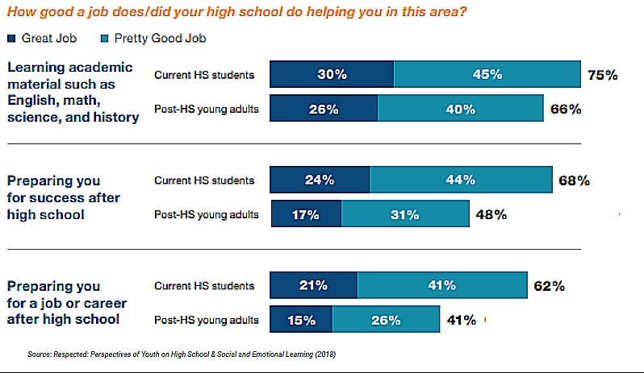
Students value SEL
Recent high school graduates see significant deficits in high schools preparing for life after school.
Source: Respected: Perspectives of Youth on High School & Social and Emotional Learning (2018)
Notes:
In terms of how well their high school prepares students for success after high school: 68 percent of current high school students believe their school is doing a good job of preparing them for success after high school; less than half of former high school students (48 percent) agree.
In terms of how well their high school does at preparing students for a job or career: More than half (62 percent) of current high school students think their high school is doing a good job preparing them for a job or career. Once again, most young adults out of high school disagree.

Slide 52
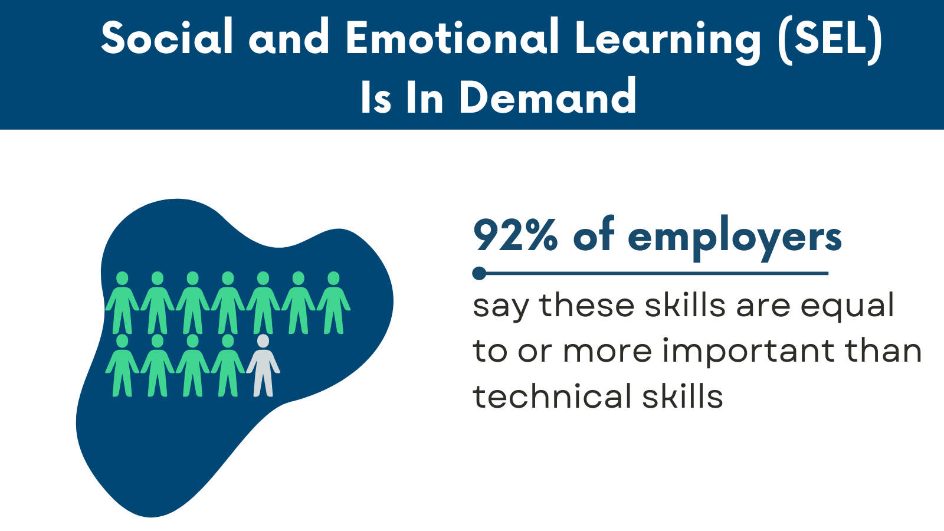

Slide 53
Employers value SEL
The Top 10 skills identified by the World Economic Forum all involve social and emotional competence.
And research shows that social and emotional skills and attitudes also contribute to the other skills such as critical thinking.
Source: Future of Jobs Report, World Economic Forum
Complex problem solving
Critical thinking
Creativity
People management
Coordinating with others
Emotional intelligence
Judgment and decision-making
Service orientation
Negotiation
Cognitive flexibility
Notes:
This slide can be useful for those wanting to know what employers think.

Slide 54
Employers value SEL
7 top characteristics of success at the company are all SEL-related skills, such as communicating and listening well; possessing insights into others; and having empathy.
Priorities: Conflict resolution, leadership, and civic engagement
Wanted: Employees Who Can Shake Hands, Make Small Talk
Bank of America teaches empathy in-house; Subaru pays for soft-skills training (Dec. 10, 2018)
Notes:
For those wanting to know what employers think—part 2

Slide 55
Intentional social & emotional teaching, learning and practice happen across many contexts, and can be explored by anyone.

Slide 56
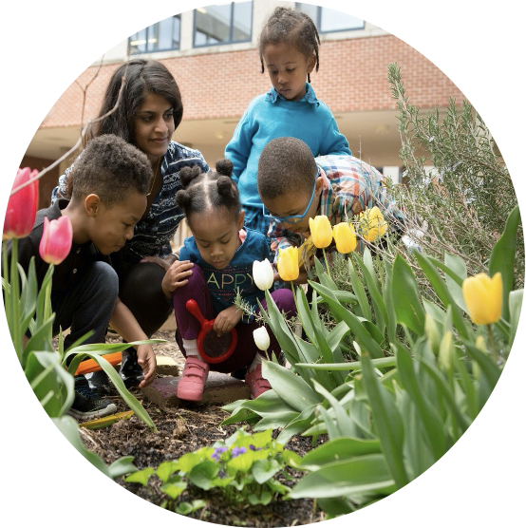
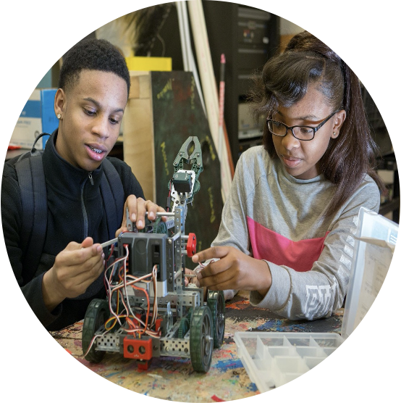
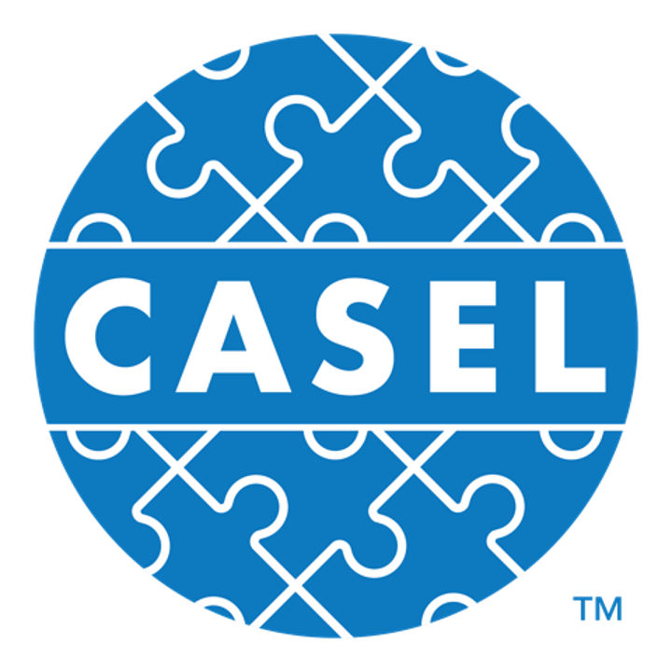
@CASELORG | #SEL101
Crafting Key Priorities
Base priorities on local strengths, needs, and culture
For example:
CIVIC LEARNING
EQUITY
ACADEMICS
MENTAL HEALTH
COLLEGE/CAREER READINESS
SEL can help to support these priority areas, and more.
Notes:
https://casel.org/fundamentals-of-sel/how-does-sel-support-your-priorities/

Slide 57
Reflect:
Which areas jump out to you as areas of need?
What data might you use to understand more?

Slide 58
Navigating Our Time Together Who are we? What is SEL? Spotlight: One aspect of SEL Voices of students Spotlight: Coregulation & Classrooms SEL & Adults In Schools Talking Back To The Anti-SEL Narrative Learning from you – New Positions & Collaborations Reminders

Slide 59
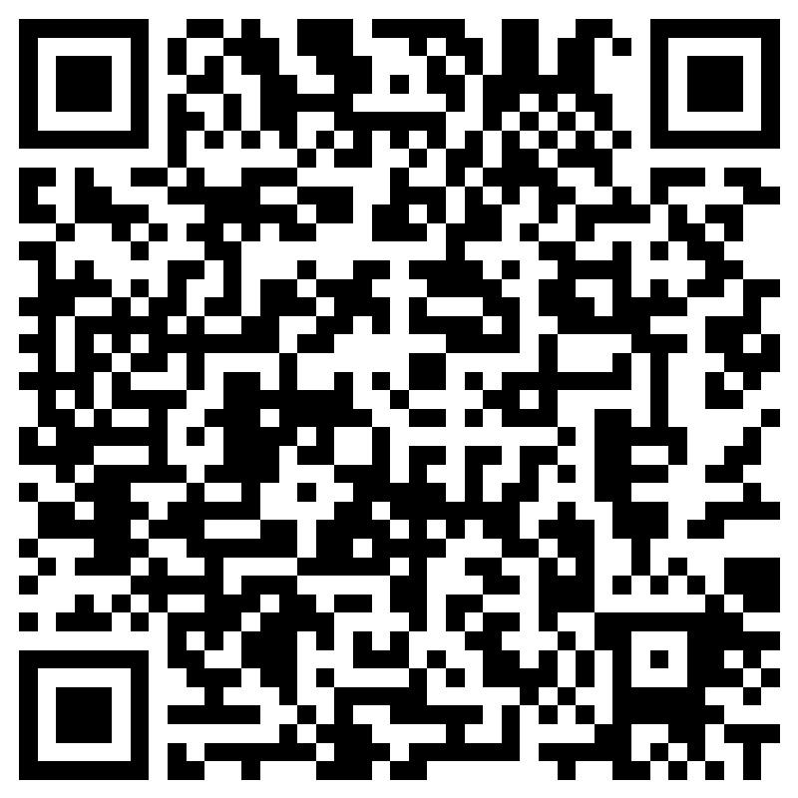
An Opportunity To Learn Explore, Together
Communities of Practice
Supporting the development of social and emotional literacies across contexts.
Pre-K – K
Early Elementary
Late Elementary
Middle & High Schools
Routines, Resources, Tools
& Our Stories
Deepening Understandings Of New Positions In Schools – SEL Coaches, Integrators & …
What is an SEL Integrator, or SEL Coach?

Slide 60
Inspiring
Curiosity & Awe Is Socially and Emotionally Literate
Share.Yours
Sarah Norsworthy

Slide 61
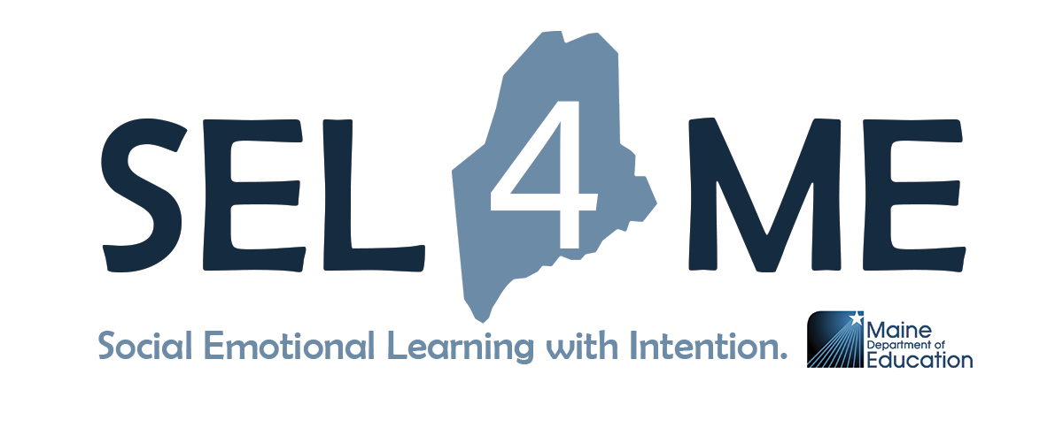
We will meet you where you are.
Accessing & implementing our free content?
Support with SEL grounded practices?
Planning for the future?
Opportunities to embed SEL in your curricula?
We are here.
Photo credit: Sarah Norsworthy

Slide 62
Kellie Doyle Bailey
SEL & Restorative Practice Specialist
kellie.bailey@maine.gov
Sarah Norsworthy
SEL Implementation Specialist
sarah.norsworthy@maine.gov
Photo credit: Sarah Norsworthy

