Slide 1
Geography! It is so much more than you think! (and easy and fun to teach)
Sarah Bailey, South Portland High School
Shana Goodall, Orono High School

Slide 2




Sarah Bailey
South Portland High School
Shana Goodall
Orono High School
AP Human Geography
World Civilizations & Geography
AP Government & Politics
World History
Honors American History
Mother, beachgoer, global traveler, reader
NatGeo certified teacher
2019 NCSS presenter
baileysa@spsdme.org
Mainer, Outdoor Enthusiast, Hiker, Reader, and Awesome Aunt
2015 ACTEM ACHIEVE Award
2018 Penobscot County Teacher of the Year
2019 Maine Teacher of the Year Finalist
2019 Maine Social Studies Teacher of the Year
@MsGoodall_Riots
sgoodall@rsu26.org

Slide 3

Happy GIS Day!

Slide 4
Making geography fun
Mapping boundaries
Geography BINGO
Google Expeditions
NatGeo mapmaker

Slide 5
Sample:
Teaching about geography using NatGeo Mapmaker

Slide 6
Geography: The key to Rome’s economic success
Students understand how geographical features can help a society’s advancement
Students learn about key features of ancient Rome that helped build Rome’s economic power
Students evaluate how the Roman Empire used its power as influence over its population
Students understand the impact of climate change and how to empower themselves for a call of action

Slide 7
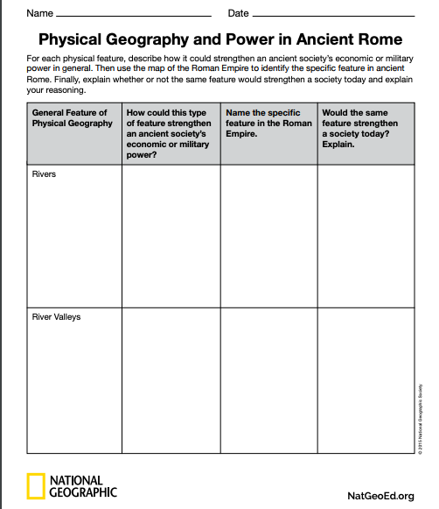
Background geography of ancient Rome
Background for Physical geography and power in ancient Rome
Physical Geography and Power in Rome

Slide 8
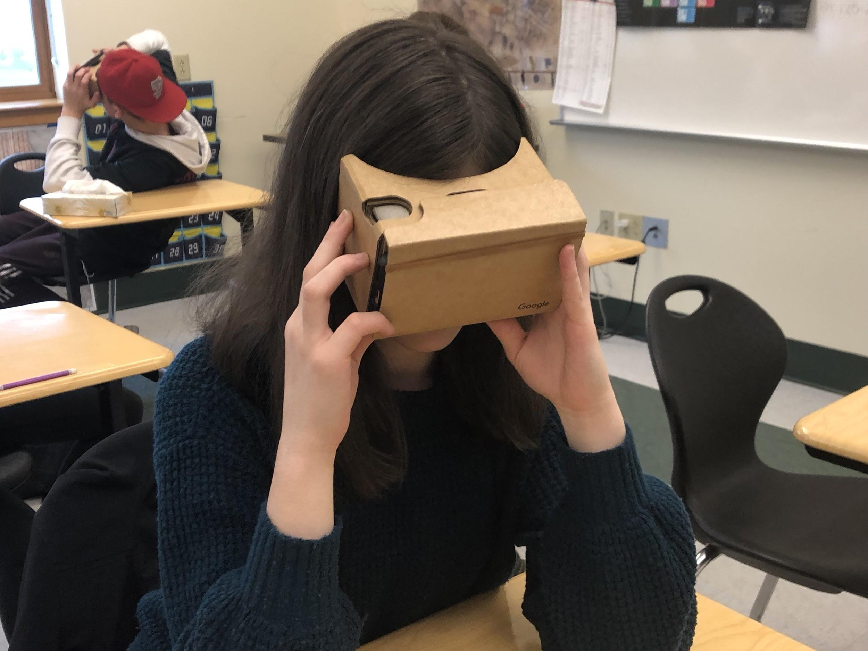
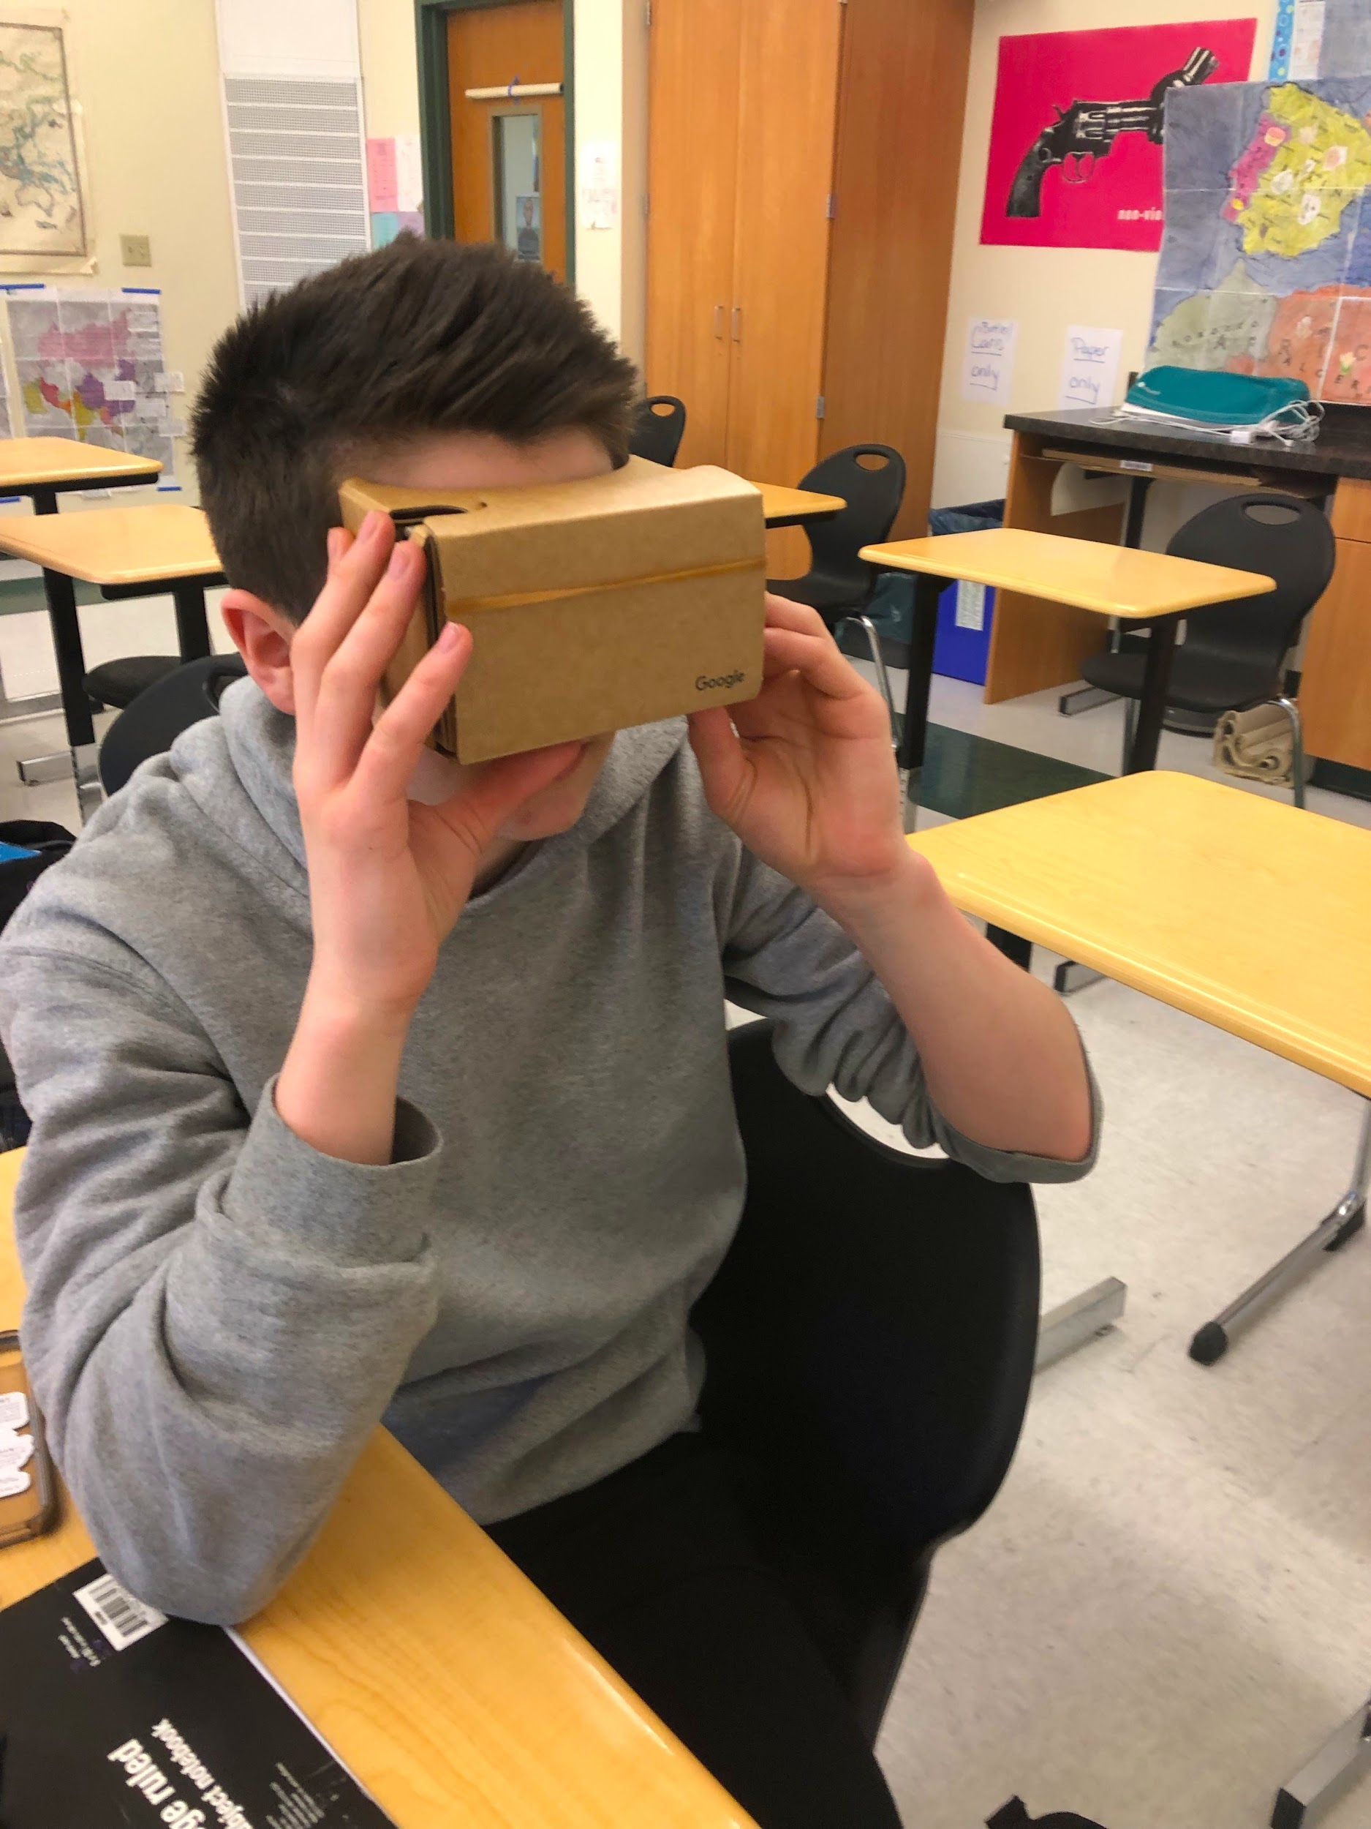

Slide 9
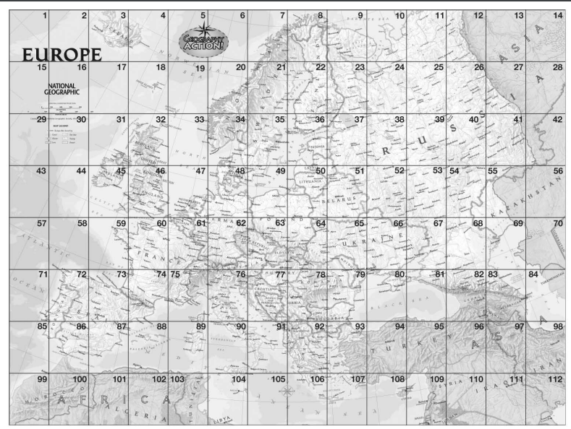

Slide 10
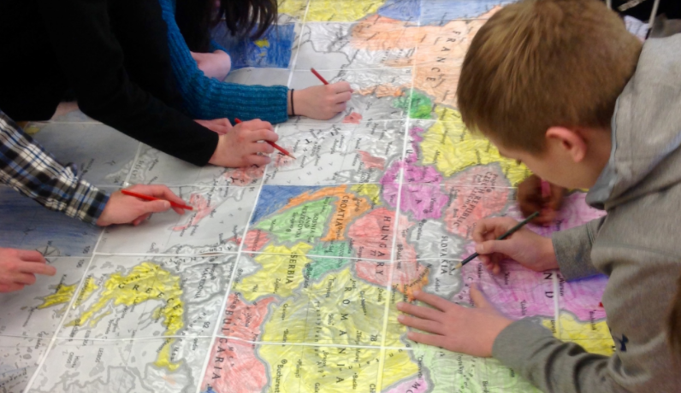

Slide 11
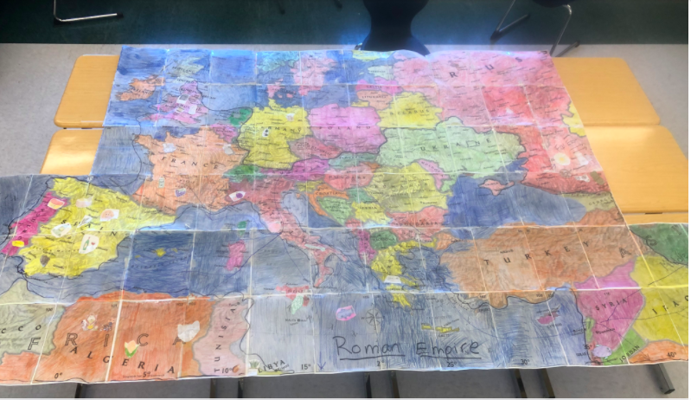

Slide 12

Geography!
GIS
What is GIS?
GIS = GEOSPATIAL INFORMATION SYSTEMS
A framework for gathering, managing, and analyzing data.
It analyzes spatial location and organizes layers of information into visualizations - like maps!
GIS reveals deeper insights into data, such as patterns, relationships, and situations—helping users make smarter decisions.
For More Information on GIS for schools:
https://www.esri.com/en-us/industries/education/schools/schools-mapping-software-bundle
https://www.esri.com/videos/watch?videoid=LHDCRjAxpI0&title=what-is-gis-

Slide 13
Geography!
Story Maps
What is a Story Map?
A simple yet powerful way to inform, engage, and inspire people with any story you want to tell that involves maps, places, locations, or geography.
Esri Story Maps are web applications that let authors combine beautiful maps with narrative text, striking images, and multimedia, including video.
The applications are designed to be attractive and usable by anyone, which makes them great for education and outreach, either to the general public or to a specific audience.
STORY MAPS
About, Gallery
Samples: Downton Abbey, Maple Syrup Festivals (Canada), Urban Ant (High Tech High School), Borderlands (Also in Spanish)

Slide 14
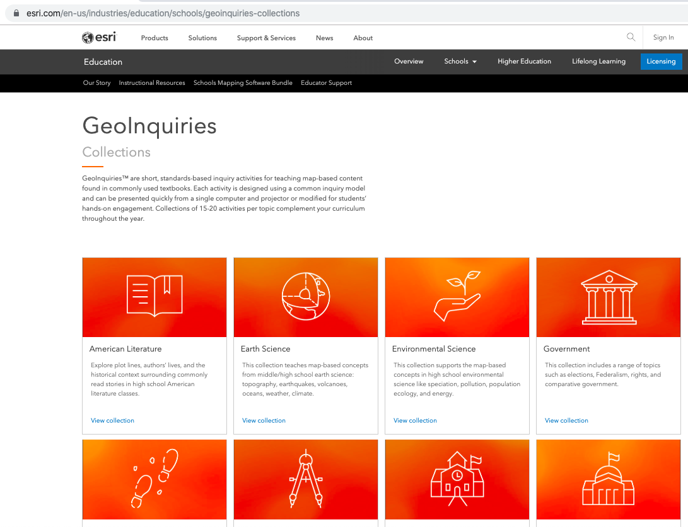
Geography!
GeoInquiries
GeoInquiries are short, standards-based inquiry activities for teaching map-based content found in commonly used textbooks.
Each activity is designed using a common inquiry model and can be presented quickly from a single computer and projector or modified for students’ hands-on engagement.

Slide 15
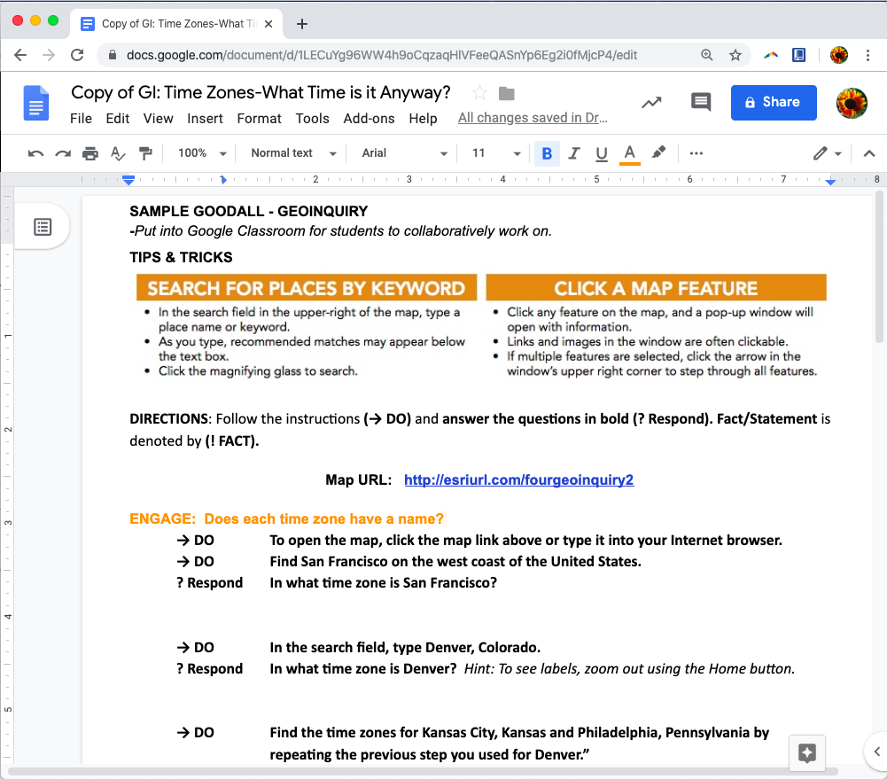
Geography!
GeoInquiries
SHANA’S MODIFIED GEOINQUIRY IN A GOOGLE DOC
The Google Doc will force you to make a copy.

Slide 16
Geography!
Resources
NATIONAL GEOGRAPHIC
EDUCATION RESOURCES
CERTIFICATION
NATIONAL COUNCIL FOR GEOGRAPHIC EDUCATION
RESOURCES
MAINE GEOGRAPHIC ALLIANCE
FACEBOOK PAGE
ESRI
K-12 RESOURCE CENTRAL
GEOINQUIRIES
STORY MAPS
For this presentation
and live links.
bit.ly/GeographyRocks

