Slide 1
Art Studio/Design Studio
Unit 3 Week 4

Slide 2
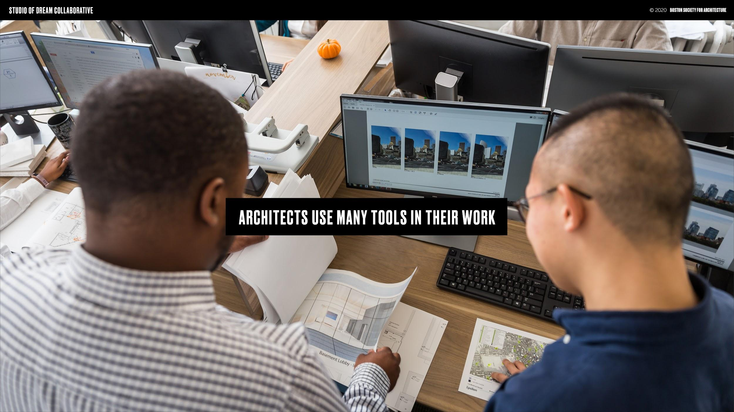

Slide 3
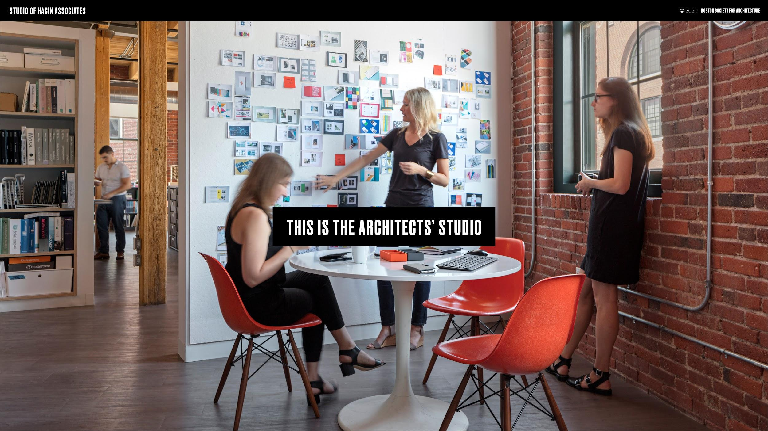

Slide 4
