Slide 1
Art Easel
Unit 3, Week 1
REPLACE WITH IMAGES FROM YOUR TOWN

Slide 2
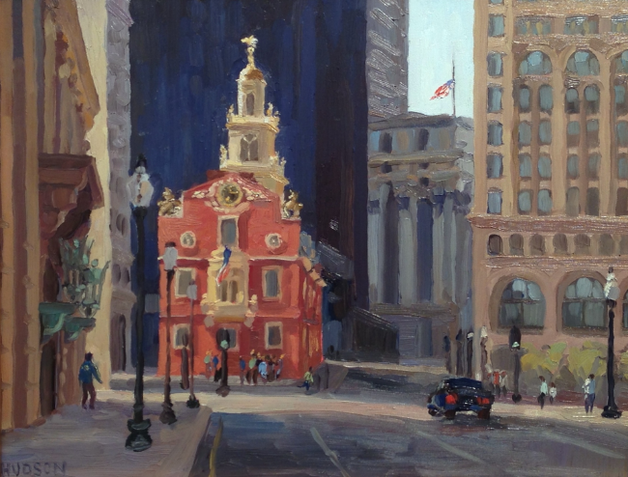
Kathleen Hudson, The Old State House
https://www.kathleenbhudson.com/blog/2013/5/21/summer-in-boston-a-good-time-to-dive-into-the-paints

Slide 3
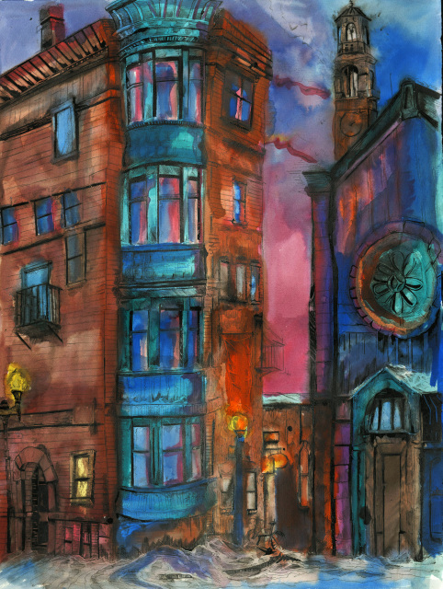
https://www.focusre.com/blog/guest-artist-eli-portman
Eli Portman

Slide 4
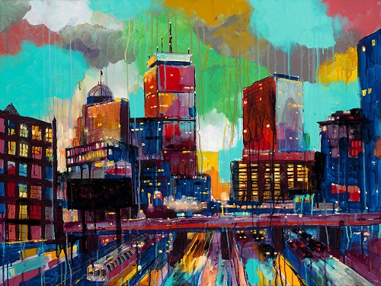
Adam O’Day, Transit
https://www.bostonmagazine.com/arts-entertainment/2014/07/08/artist-adam-o-day-wins-boston-portrait-of-a-city/

Slide 5
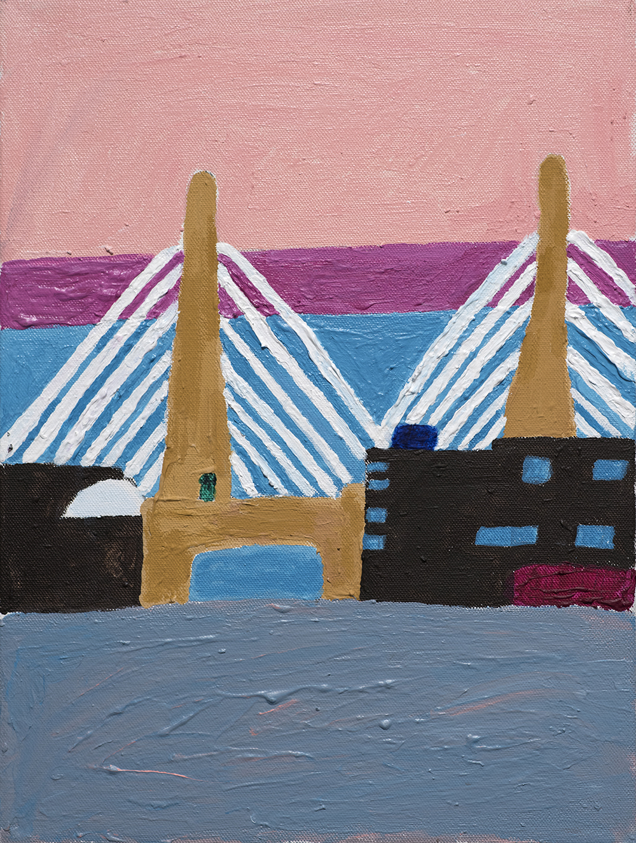
https://www.gatewayarts.org/mcfarland_zakim-bridge-websize-jpg/
Colleen McFarland,
Zakim Bridge

