Slide 1
Art Table
Unit 2, Week 8

Slide 2
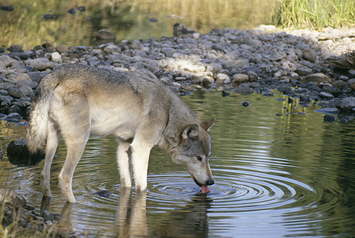
https://www.gailshumway.com/gallery/plog-content/images/my-collection/mammals/tundra-wolf-2.jpg

Slide 3
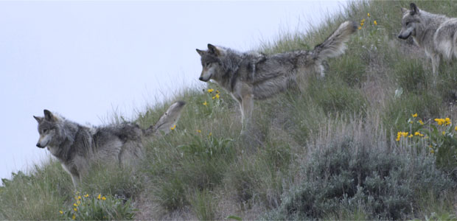
https://www.pbs.org/wnet/nature/river-of-no-return-gray-wolf-fact-sheet/7659/

Slide 4
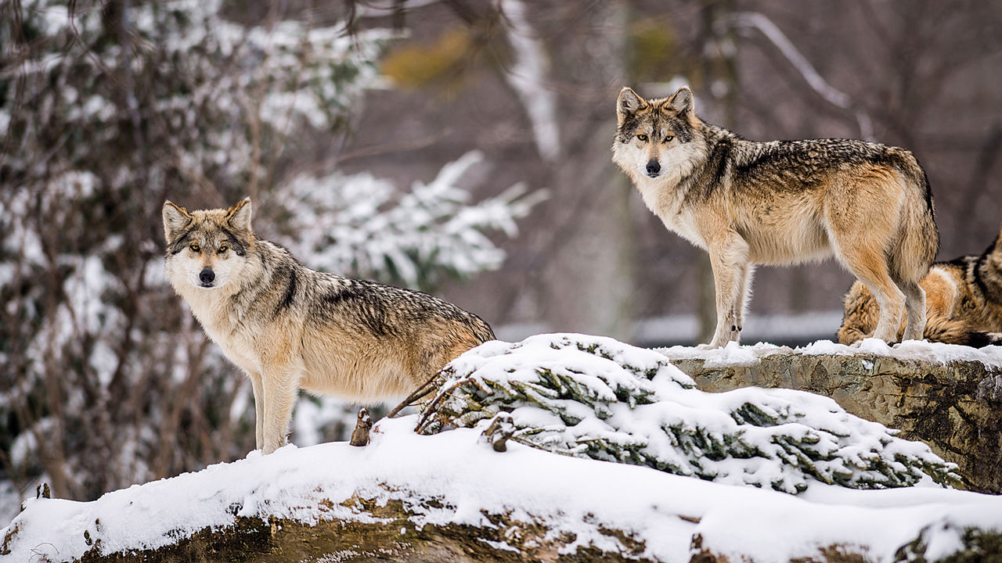
https://www.sciencemag.org/news/2017/09/endangered-us-wolf-denied-new-habitat-critics-charge-politics-trumped-science

Slide 5
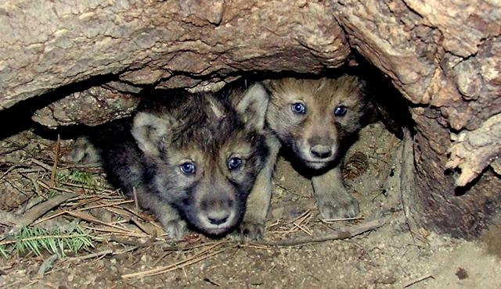
https://urbanecologycenter.org/blog/native-animal-of-the-month-gray-wolf.html

Slide 6
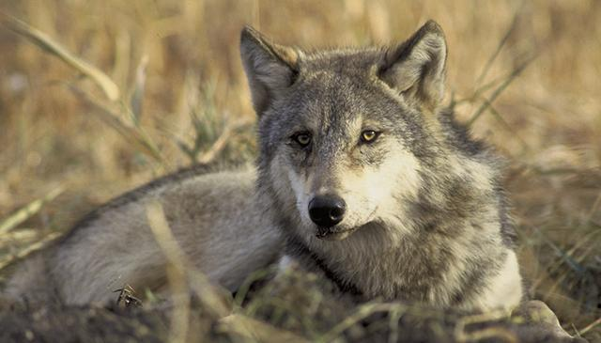
https://urbanecologycenter.org/blog/native-animal-of-the-month-gray-wolf.html

