Slide 1
Workshop #1: Maine State Library Online Resources
Workshop #1
Primary Resources
Getting the Most Out of Digital Maine Library
Alison Maxell, Director
Public and Outreach Services, Research & Innovation
Alison.l.maxell@maine.gov
Notes:
Good afternoon everyone.
I am Alison Maxell, Director of Public and Outreach Services, Research & Innovation at the Maine State Library.
Today I will be sharing information about the Maine State Library, who we are, and the collections, resources, and services we provide.
Then I will introduce you to one of our online resources the “Digital Maine Library” .
I will highlight some basic navigation tools and specific features that hopefully will help you become familiar with the resource.
And then we will plan to finish with an interactive activity.
Due to our limited time allotment today, I will be moving through slides fairly quickly but my slide deck will be made available to you along with other resources after the presentation today.
So let’s get started!

Slide 2
About Maine State Library
MISSION The Maine State Library helps people, makes Maine libraries stronger and transforms information into knowledge.
Maine State Library is unique in having a physical presence and for its combination of services for the public and for librarians, all within the same organization.
The State Library, serving all citizens and visitors, provides access to its information, services, and policies in order to meet educational, informational, recreational and cultural needs.
No longer is the role of librarians to just gather and select information but instead to facilitate, organize, and access information.
Notes:
About the Maine State Library
While this slide speaks to our mission and who we serve, basically today and everyday the Maine State Library is working to meet the educational, informational, recreational and cultural needs of Maine Citizens. We, as librarians, are all about access and want to facilitate your ability to get the information you need where you need it.

Slide 3
Maine State Library – New Location Current Hours: 9:00am to 5:00pm (M-F)
242 State Street, Augusta
www.maine.gov/msl/
(207) 287-5600
Notes:
Yes, I am pleased to report…
We are now open at our new temporary location -242 State Street.
We will be here until such time renovations are completed at the Cultural Building.
At this point, we anticipate being here a couple of years.
Currently we are open 9 to 5 Monday through Friday but at some point in the future, we hope to add evening and Saturday hours again.

Slide 4
Maine State Library Collections
Primary focus: Acquisition of books and materials about Maine and by Maine Authors
Strong non-fiction/research collections
State, county, town histories, town reports, newspapers, genealogies, government documents, maps, and other materials designed to provide comprehensive coverage of Maine history and government are well represented
Notes:
Maine Stat Library collections are primarily Maine focused….
Did you know that: MSL has
350,615 book and serial volumes
848 audio materials
650 videos
474 serial subscriptions
250,888 government documents

Slide 5
Maine State Library Special Collections https://www.maine.gov/msl/maine/index.shtml
Anthoensen Press
Aroostook Oral History
Avery Collection
Ballard Diary
Baxter Collection
Civil War (requires MSL library card)
Historic American Buildings Survey
Kennebec Journal Index
Maine Authors Collection
Maine In Print
Maine Newspapers – Print and Microfilm
Maine Notable Individuals
Maine State Government Documents
Maine Town Annual Reports
Maine Vertical File – Clippings on Maine Topics
Maine Writers Index
Manuscripts – Original Documents from Maine History
Maps – State, Counties, Cities, Historic, Topographical and Contemporary
Northeast Boundary Dispute
Ref USA (requires MSL library card)
Sanborn Fire Insurance Maps
Thomas Bird Mosher Publications
Vaughn Collection
Notes:
The current slide lists some of our special collections. If you go to the web page, click on the title, you will find brief descriptions annotations for each collection.

Slide 6
Maine State Library Services www.maine.gov/msl/
Online Resources:
MSL catalog (URSUS)
DigitalMaine Library, online resources / databases
Download Library for e-books & audiobooks
LearningExpress - Learn for free online
DigitalMaine Repository
Get Help With:
Materials Requests
Photocopying/Reproducing
Reference/Research
Book-A-Librarian
Genealogy Classes
Web Resources
Notes:
In addition to our print resources, we have several online resources:
URSUS is our online catalog shared by the Maine State Library, the University of Maine System, and Bangor Public Library
The Digital Maine Library provides access to a collection of full text articles and abstracts from magazines, newspapers and reference books that are from reputable sources.
The Download Library offers eBooks and audiobooks.
Learning Express provides a comprehensive selection of educational resources for basic skills mastery, academic success, job preparation, and career advancement. Also included are popular software tutorials, Internet instruction and basic computer instruction.
DigitalMaine Repository is a partnership of the Maine State Library, Maine State Archives and community institutions around the state committed to providing access to Maine history, ensuring transparency in government, and sharing the stories of the people and places of the Pine Tree State. The DigitalMaine Repository is working to make digital collections from all Maine cultural institutions freely accessible.

Slide 7
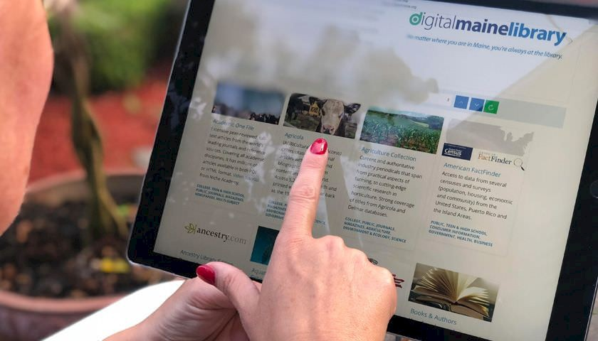
About the
The Digital Maine Library provides every resident of Maine with access to online resources that include a collection of full text articles and abstracts from magazines, newspapers, journals and reference. It also provides students, business people, public library patrons, and higher education students and educators the ability to use online learning tools.
Notes:
For our purposes today, we will feature one online resource - the Digital Maine Library
While not Maine focused, it is a great online learning tool
You will find:
Tons of helpful tools for every subject!
With the end of summer comes the beginning of a new year of learning!
The Digital Maine Library has resources for teachers and young learners from kindergarten through college.
Teachers will find the educator tools invaluable, while students will get easy access to factual information from age-specific databases like World Book Student and National Geographic Kids.
So how do you access the Digital Maine Library?....

Slide 8
How to Access
The Digital Maine Library may be accessed from any public, school or academic library, home or business in Maine.
The state portal is located at: https://library.digitalmaine.org
Using geo-location as the first layer of authentication. This allows us to see that you are located in Maine.
In some locations/instances, you may be prompted to enter a library card barcode or a username and password that you create.
Notes:
You can also access the portal via our website or through google

Slide 9
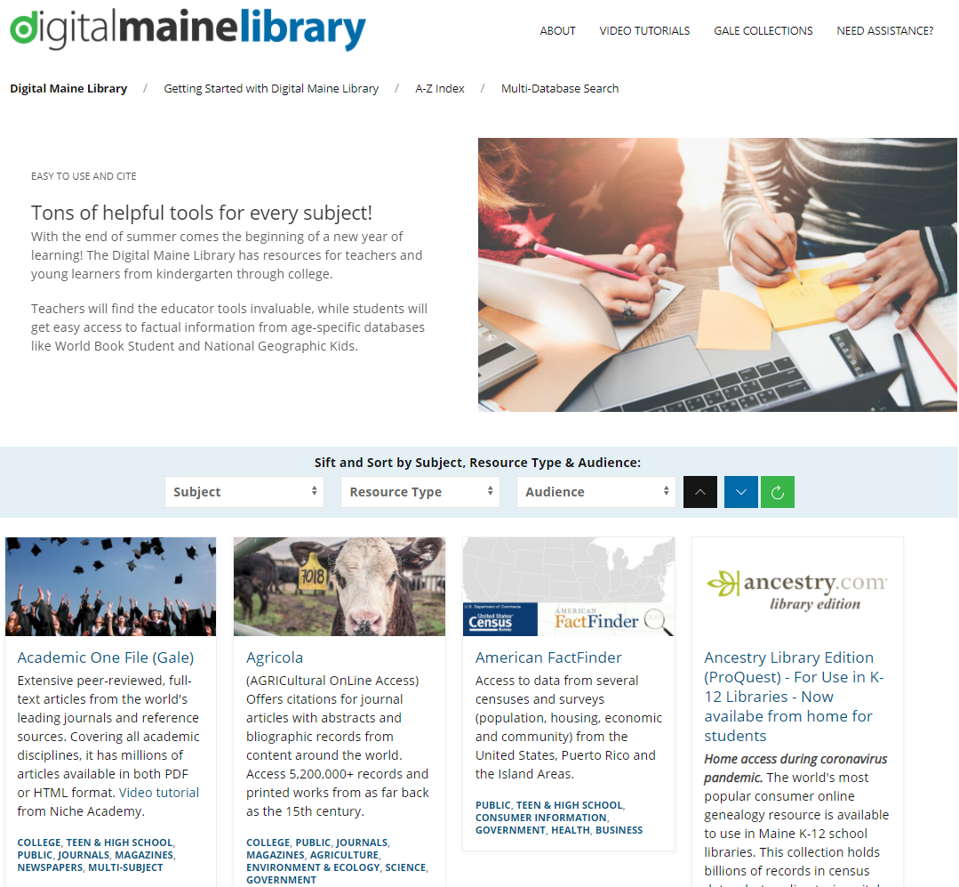
What are we looking at?
1) Support and further information (including Gale Collections, a complete listing of Gale databases contained in Academic and General OneFile resources)
2) FAQ, A-Z index and power search across multiple resources
3) Sift and Sort panel, to narrow searching to resources limited by subject, audience and resource type metatags
4) Resource links, including short description and associated metatags
Notes:
So what are we looking at:
To the right is a screen shot of the Digital Maine Library landing page.
I have highlighted some of the important features and navigation tools
#1 All about Support: here you will find database tutorials, further information aboutGale Collections, and DML Assistance
#2 Helpful quick facts: FAQ, A-Z index, power search
#3 Sift and Sort is a great tool…allows you to narrow your search to resources
#4 These are the actual individual database resource links (simply click on title to open resource), below is a short description of database content and below that are the associated metatags

Slide 10
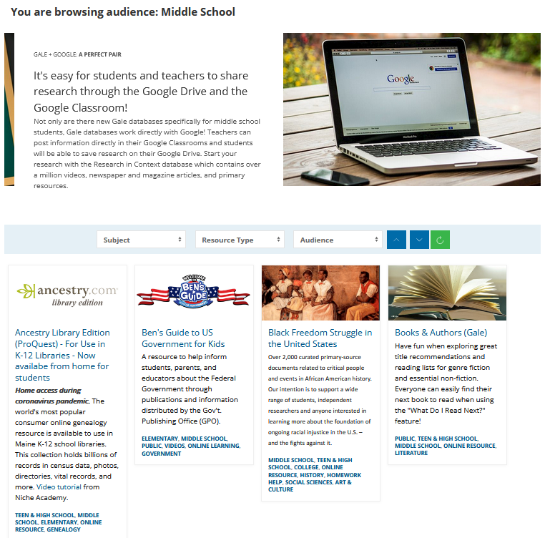
The Power of the Tags
https://library.digitalmaine.org/audience/middle-school/
Click on tags to get a custom and bookmarkable page for all databases for that age group or subject
Notes:
So using those associated metatags you can click on tag, here we have chosen “middle school” and we got a custom and bookmarkable page for all databases for that age group

Slide 11
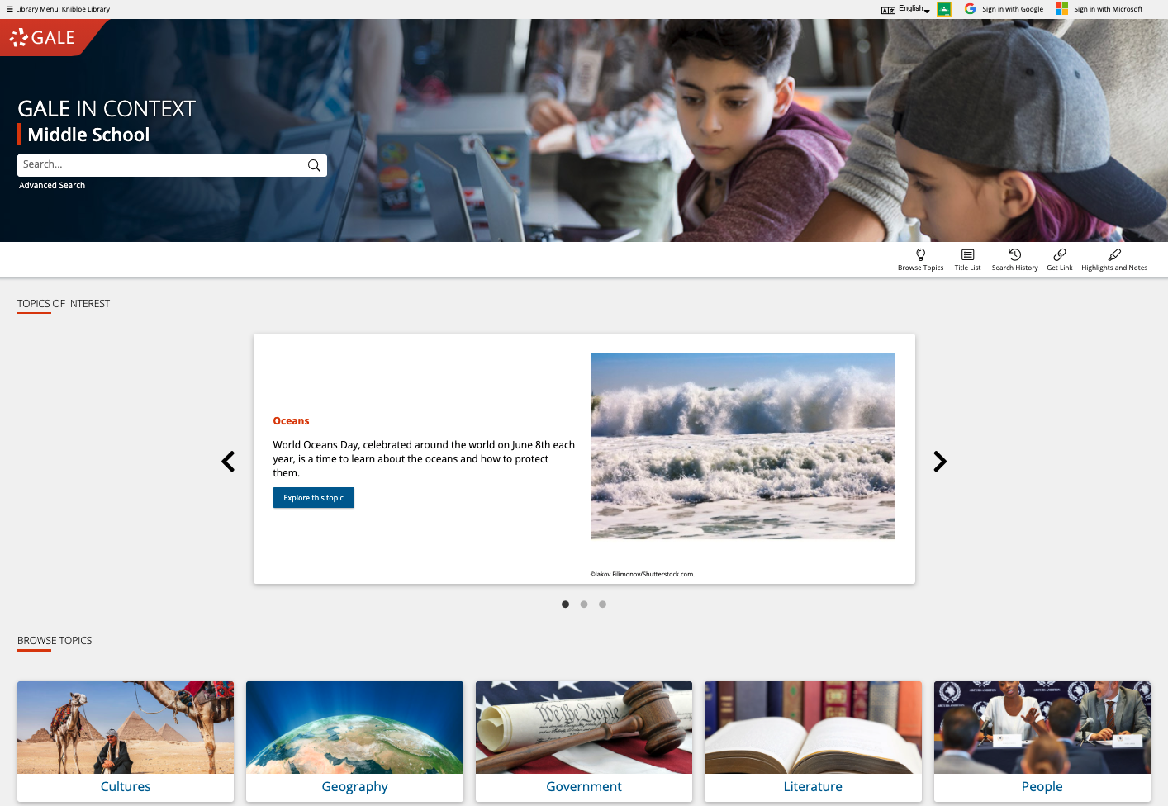
GALE IN CONTEXT: MIDDLE SCHOOL
Discover Premium Resources
Trusted reference, top periodicals, videos, images, audio, primary sources, creative works, biographies
Support Curriculum Standards
Frequently-studied topics in history and social studies, science and health, literature and the arts
Enhance Teaching and Learning
Google/Microsoft integration, unlimited print/download/email, highlights and notes, and more
Notes:
So, now let’s take a look at one of the database resources in Digital Maine Library. The one I selected today is Gale In Context: Middle School. To the right is the database landing page. We’ll be using this later in our interactive exercise.
Created specifically for middle school students, this resource combines reference content with age-appropriate videos, newspapers, magazines, including more than 1.6 million articles as well as primary sources.
Click: Curriculum Standards:
This database also provides cross-curricular content aligned with national and state curriculum standards allowing students to create connections between subject areas and to truly put topics into larger cultural, social, and historical context.​
Click: Enhance Teaching and Learning: You will find a vast array of resources for papers, projects, and presentations. that bolster the development of critical thinking, problem solving, and effective communication skills and the ability to integrate those resources into your classroom setting.

Slide 12
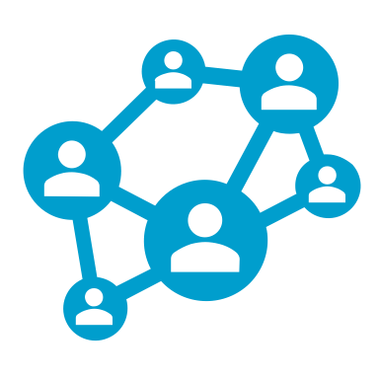
SEARCH OR BROWSE
EXPLORE CONTENT
VIEW AND SHARE RESULTS
Notes:
It’s easy to access all the premium resources by (1) browsing or searching for topics of interest, (2) exploring content organized by type, and (3) then clicking individual result titles to view and use videos, documents, and more.

Slide 13
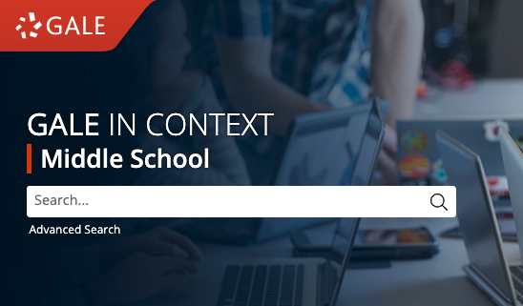
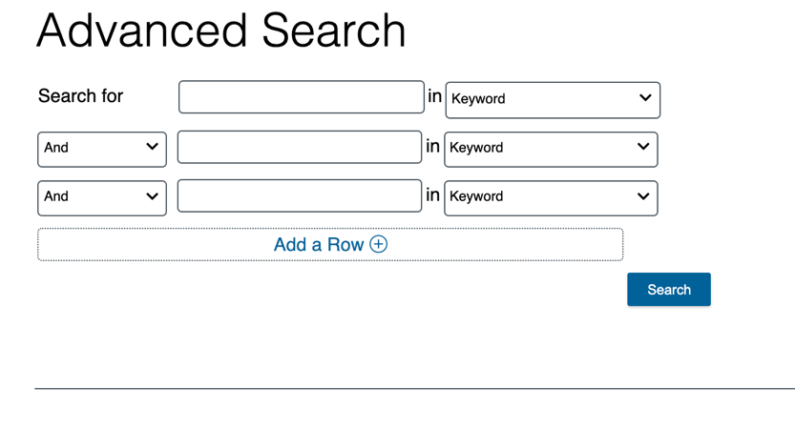
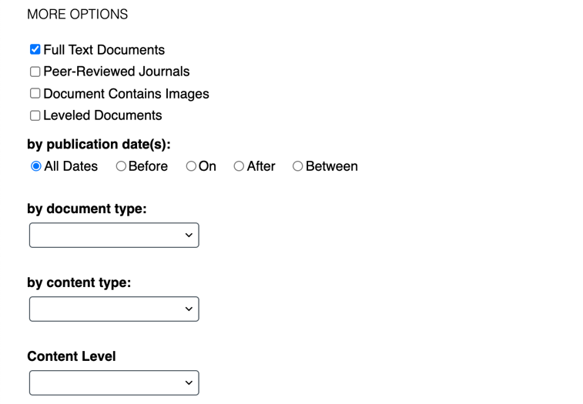
SEARCH
Enter simple search terms
Or, customize multiple fields and limiters
Notes:
Basic Search: Usually the default. Find information based on simple search terms. This is a good place to start your research.
While we will not be doing this today, you can also run a more targeted or customized search by clicking the Advanced Search option beneath or to the side of the basic search box.
Advanced Search provides the option to select specific search fields
If you scroll down the page, you can also include search options to limit results by document type, date, content level, and more.

Slide 14
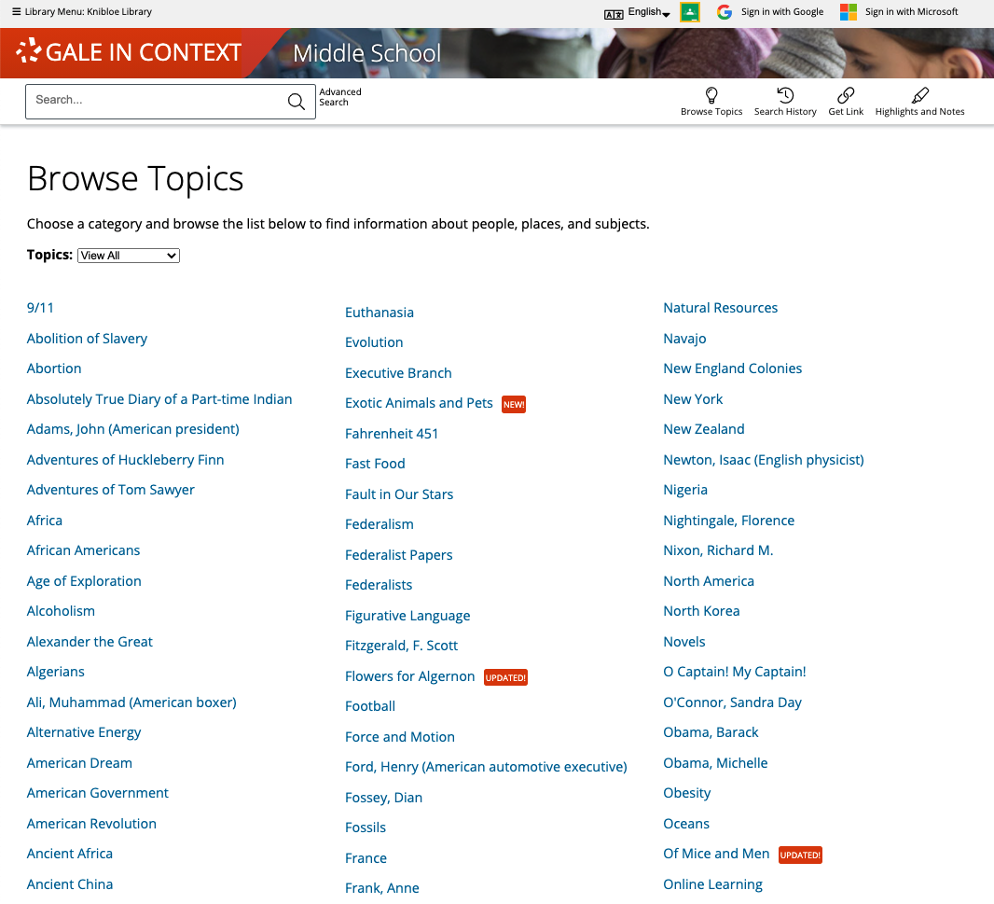
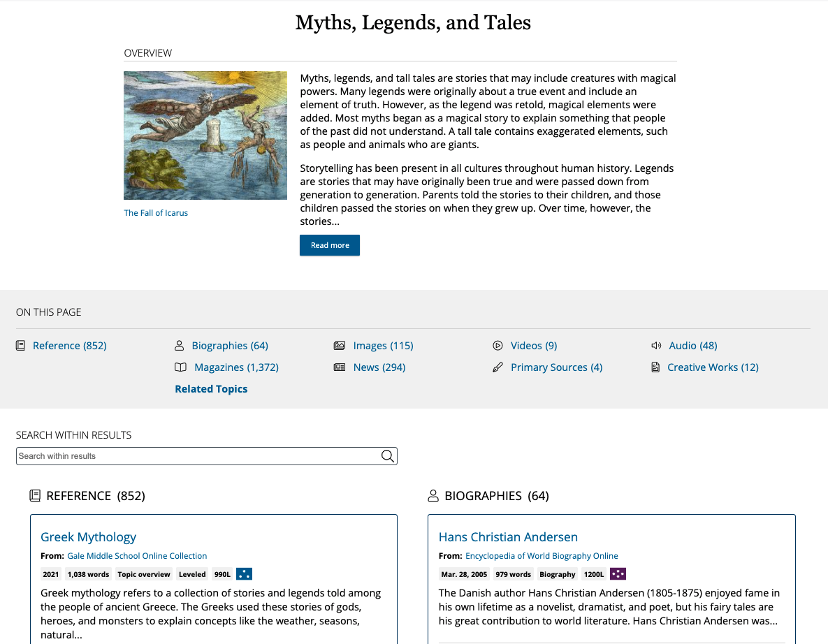
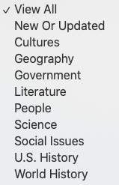
BROWSE
BROWSE TOPICS by subject or view all
Connect to curated overviews and results
Notes:
In addition to searching, Gale In Context: Middle School is designed to make it easy for you and your students to browse for topics of interest.
You can Browse Topics by subject or View All:
Simply click the Browse Topics option in the upper right corner of the homepage and on many other pages throughout to access a list of all topics for which there are curated pages.
Click: If desired, you can use the drop-down menu at the top of this page to view pages based on categories of interest.
Click: This allows you to then connect to curated overviews and results: When you click the title of one of the topics, you’ll be able to access a curated hub of information that contains an overview and image related to the topic, and that then organizes and provides access to content of various types on the topic (for instance, reference materials, magazine articles, videos, etc.).
Simply click the header for a content type to view all results of that format, and click the title of an individual result to view that specific article, video, etc.

Slide 15
EXPLORE CONTENT
REFERENCE
NEWSPAPERS MAGAZINES
VIDEOS AUDIO IMAGES
PRIMARY SOURCES
CREATIVE WORKS AND MORE
Notes:
Depending on the topic you search or browse, you will find a wide variety of content types.

Slide 16
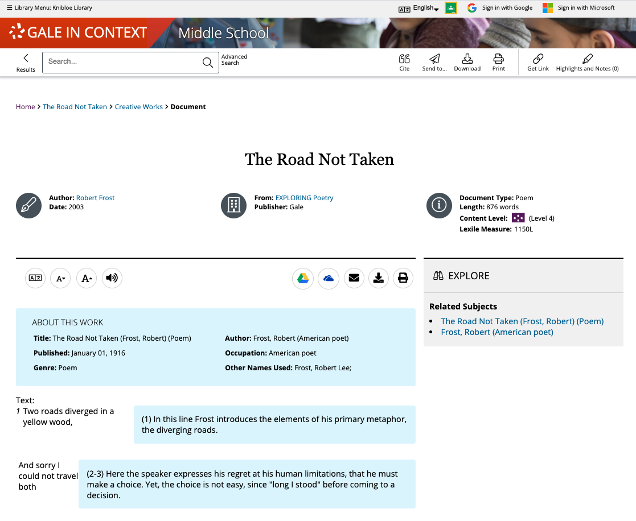
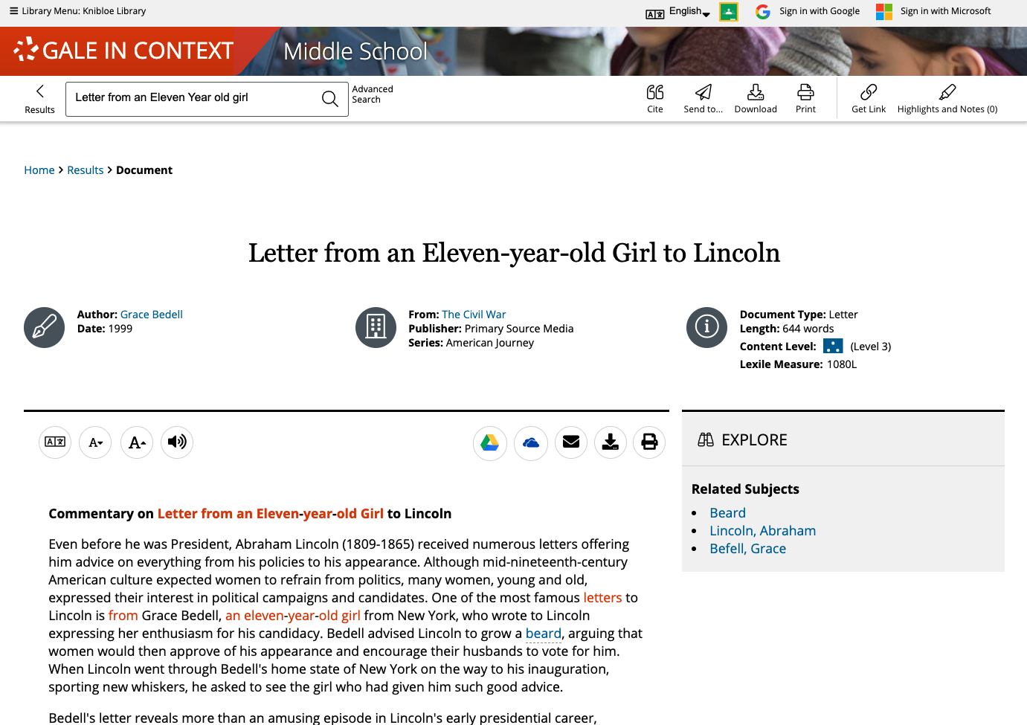
AND MORE!
Encourage critical thinking and research
CREATIVE WORKS
PRIMARY SOURCES
Notes:
Since we are interested in primary sources, what types of content can we expect to find?
Primary Sources include speeches, letters, and personal accounts from key points in history. Many contain commentary or introductions to help students place these sources in context as shown in the pop-out on the right..
Creative works consist of full-text poems, plays, stories, and more, and often include notes to aide understanding (as shown in the pop-out on the left) and interpretation.

Slide 17
SUPPORT DEVELOPING AND ADVANCED READERS
LOWER ELEMENTARY
Up to 500L
UPPER ELEMENTARY
501L – 850L
MIDDLE SCHOOL
851L – 1100L
HIGH SCHOOL
1101L – 1300L
UNDERGRADUATE AND UP
1301L +
Notes:
Another nice feature: If you support developing readers, or advanced students, you can find content targeted to their needs! These content levels can be viewed on search and browse results pages, and can also be used to sort or filter search and browse results.

Slide 18
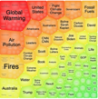
SHARE CONTENT
Get Link, Share to Classroom, Send to…
Push premium results to students and facilitate collaboration
SUPPORT ACCESSIBLE LEARNING
Translate, Font Size, Listen
Provide options for learners with varied needs and preferences
ENCOURAGE ANALYSIS
Highlights and Notes
Promote deeper learning with color-coding and annotation
DEVELOP RESEARCH SKILLS
Topic Pages, Topic Finder, Cite
Advance ability to define topics and use sources responsibly
Notes:
These are really great teaching tools.
With the Get Link you can easily push content to students, or have students share with you/with each other,
Accessible learning makes content accessible to learners with a variety of needs,
the Highlights and Notes tool can be used in many different ways to record student analysis of sources for assignments or research,
And the Topic Pages, Topic Finder and Cite tools help scaffold the research process-– from choosing and refining a topic to citing the information appropriately.

Slide 19
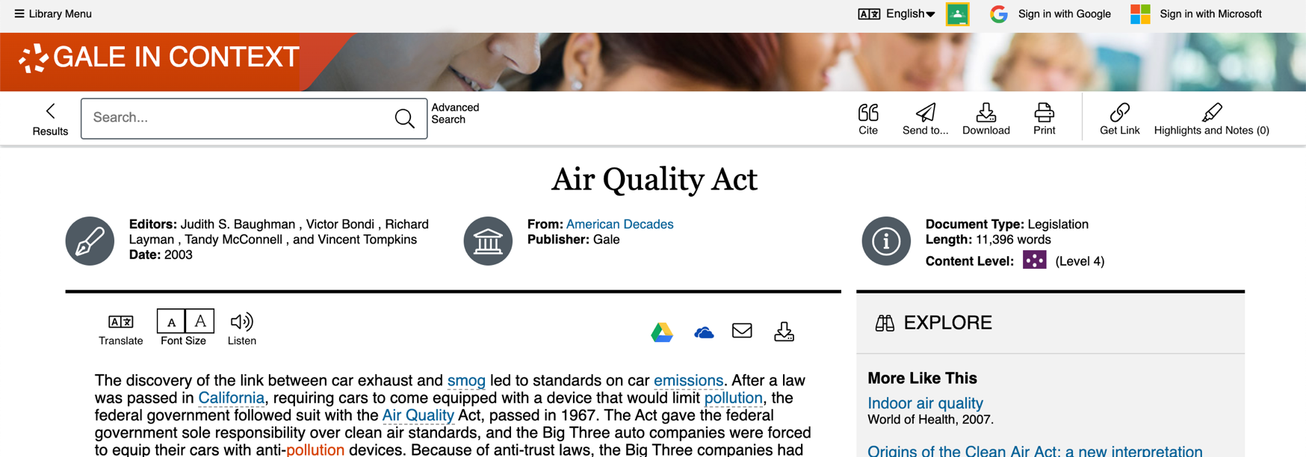
SHARE CONTENT
GET LINK
Create a Persistent URL
SHARE TO CLASSROOM
Push to Google Classroom
SEND TO…
Email, Google, or Microsoft
Notes:
As previously mentioned, all of the content in the Gale resource is accessible 24/7 on any device in any location.
Let’s look a little closer at Sharing Content:, every item within the resource provides a number of options to export or share the content for later use.
Get Link creates a persistent URL that will direct someone right back to the page you were on when you used the Get Link tool.
Click: Share to Classroom allows you to pull content into Google Classroom courses as assignments, announcements, and more.
Click: the Send to feature gives you the ability to push content to an email address, Google Drive, or Microsoft OneDrive account for viewing at any time in the future and
you can also download and print content.

Slide 20
Digital Maine Activity
Using Digital Maine Library: https://library.digitalmaine.org and Gale In Context: Middle School to answer the questions:
Topic: U.S. History; Boston Tea Party
In the “Account of the Tea Party, by Ann Hulton” the commissioners of the Customs & the Tea Consignees were obliged to seek refuge where?
What type of resource did you find?
On Your Own:
Find the citation for this resource. Select and email it to yourself.
Try using GetLink to push content ….
Notes:
So this concludes the overview of the Digital Maine Library and Gale In Context: Middleschool
Let’s now dive In to the actual resources by doing a little interactive activity
You can follow along with me as I continue to screen share and model the exercise or you can minimize and jump into it yourself.
So we are going to be: go down through slide
Let’s go!

