Slide 1
What processes help people construct structures, ideas, and works of art?

Slide 2
What process did you go through when creating your Our Town project?

Slide 3
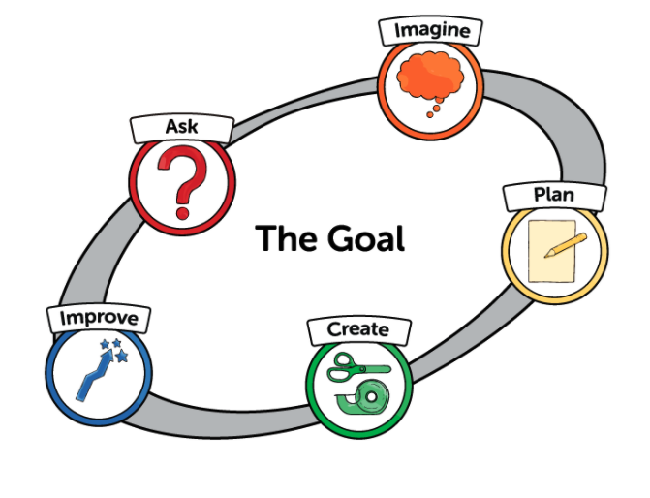
Engineering Design Process

Slide 4

Ask
What is the problem?
What am I trying to accomplish?
https://theconversation.com/kids-may-need-more-help-finding-answers-to-their-questions-in-the-information-age-126911

Slide 5

Imagine and Being Inspired
What are some solutions?
Brainstorm ideas. Choose the best one.
https://dailyparent.com/articles/10-ways-to-spark-your-childs-imagination-video/

Slide 6


Plan
Draw a diagram.
Make lists of needed materials.
https://www.readingrockets.org/looking-at-writing/pre-k-writing-sample-4

Slide 7
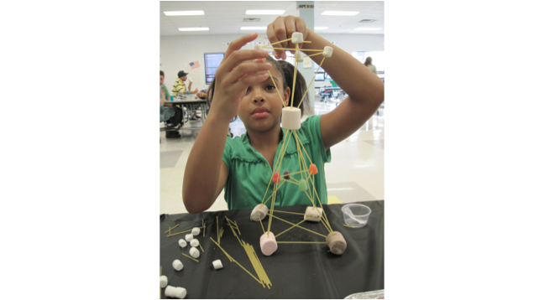
Create
Follow the plan and create something.
Test it out.
Need to find cite

Slide 8


Improve
What works? What doesn't?
What could work better?
Modify the design to make it better.
Test it out.
https://www.nationalgeographic.org/activity/explore-natural-spaces/
https://activeforlife.com/play-centres/

