Slide 1
Fish
FK2 Unit 2 Week 2 Day 5

Slide 2
Fish have fins
And fish have tails.
Fish have skin
Concealed by scales.
Fish are never
Seen on land.
Fish would rather
Swim than stand.

Slide 3
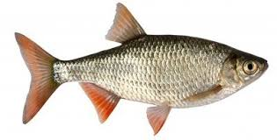
tail
fins

Slide 4
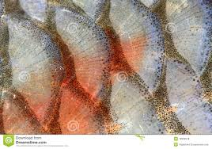
scales

Slide 5
