Slide 1
How to Write a Poem
By Kwame Alexander

Slide 2
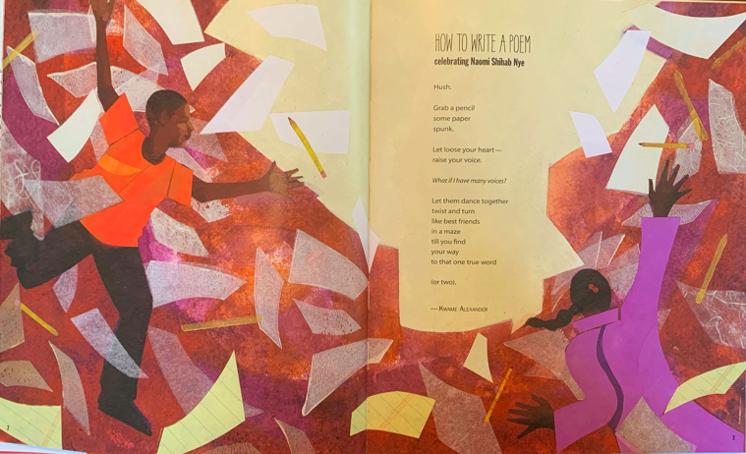

Slide 3
How to Write a Poem
Hush.
Grab a pencil
some paper
Spunk
Let loose your heart--
Raise your voice.
What if I have many voices?
Let them dance together
twist and turn
like best friends
in a maze
till you find
your way
to that one true word
(or two).
--Kwame Alexander

