Slide 1
Dreaming Up: A Celebration of Building
By Christy Hale
Slides for Close Reading
Read Aloud Unit 3, Week 4 Days 4 & 5

Slide 2
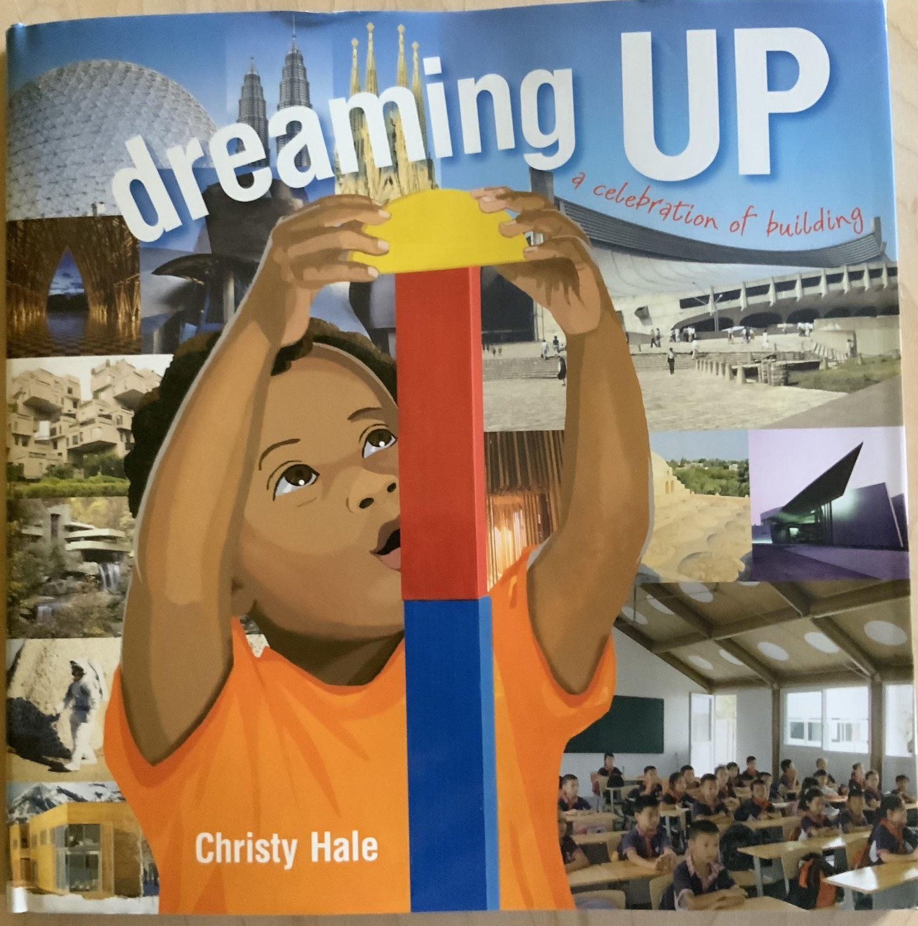

Slide 3
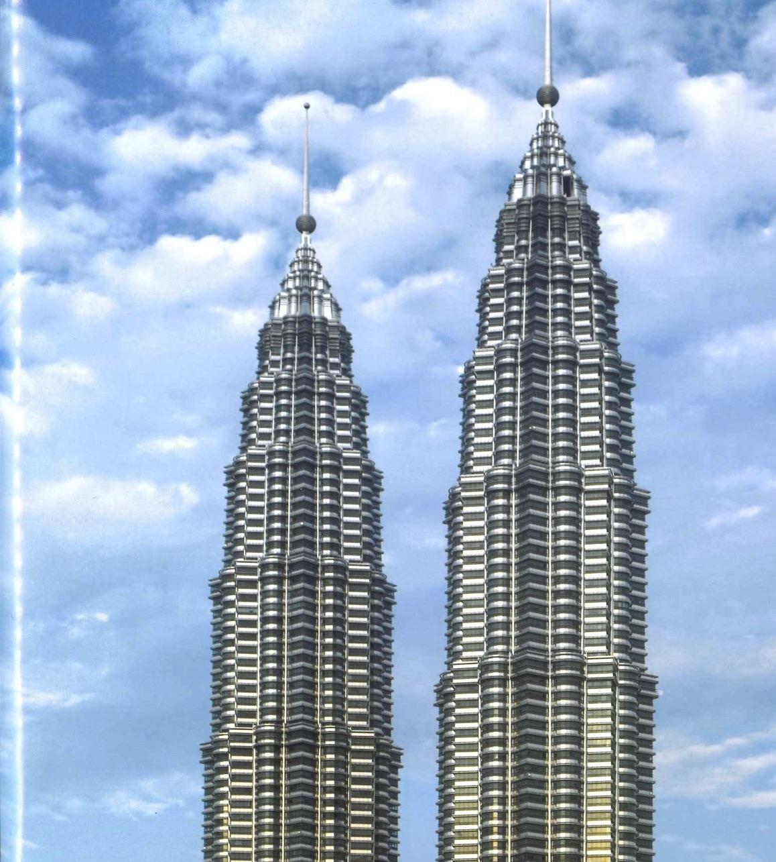

Slide 4
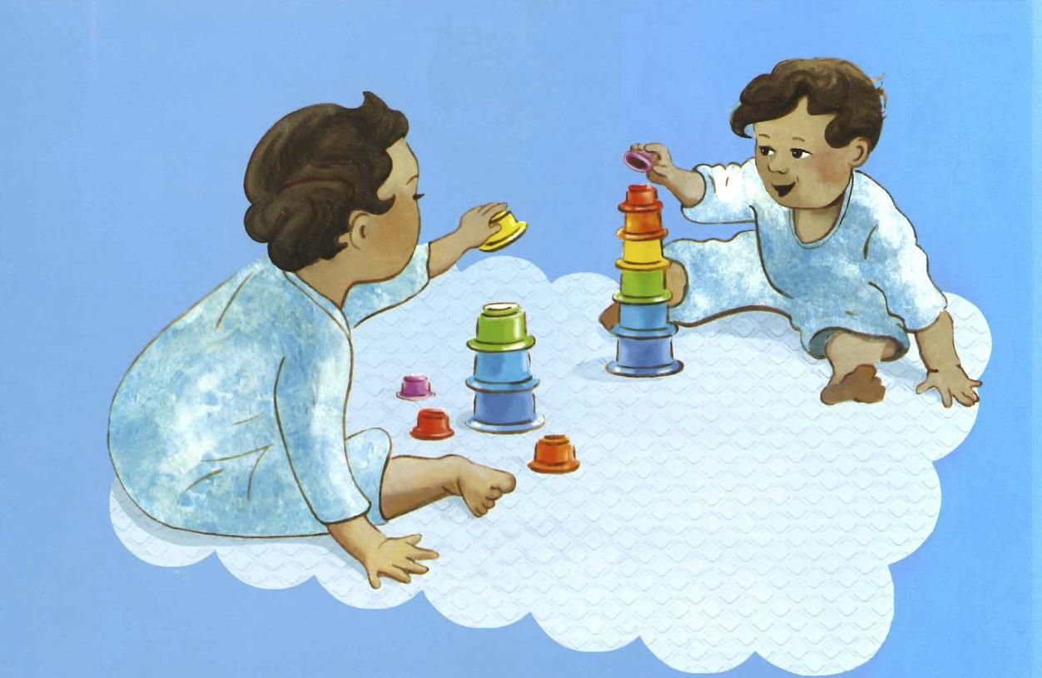

Slide 5
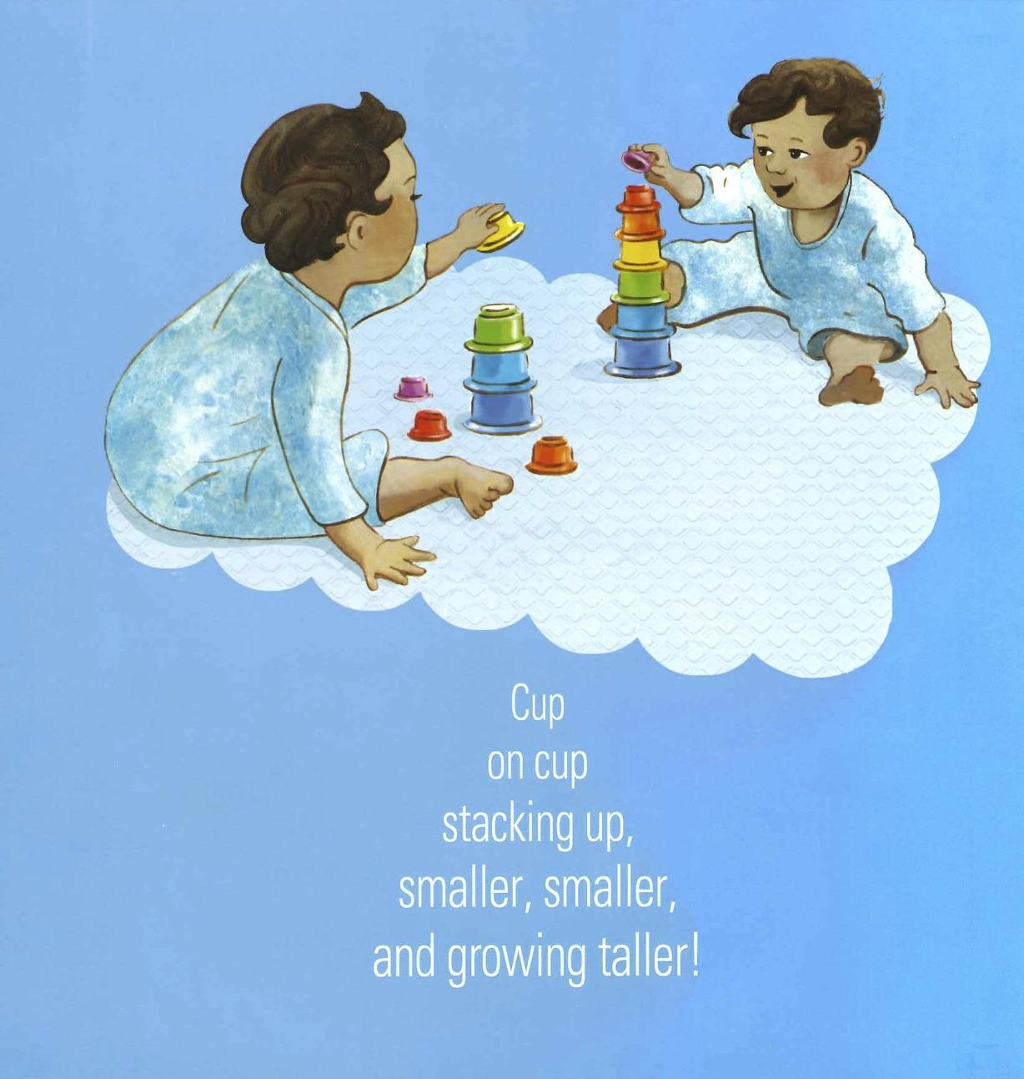

Slide 6
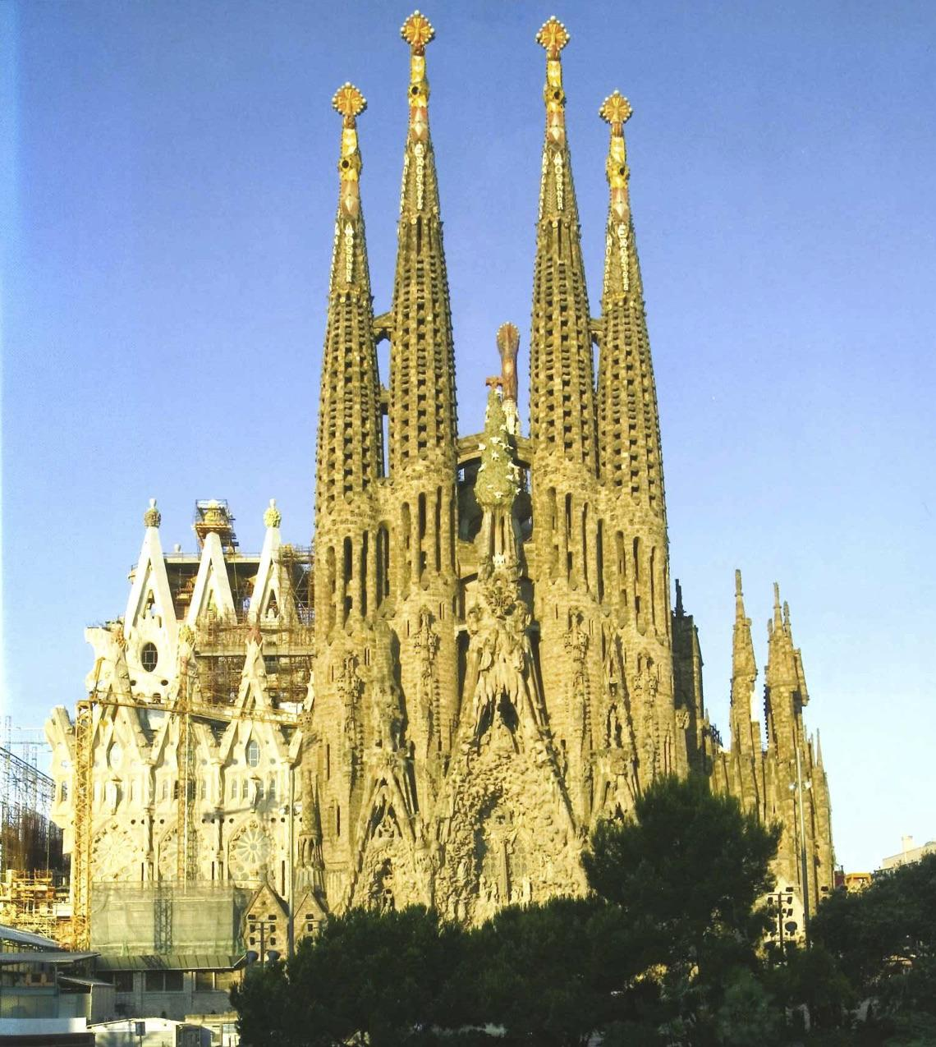

Slide 7
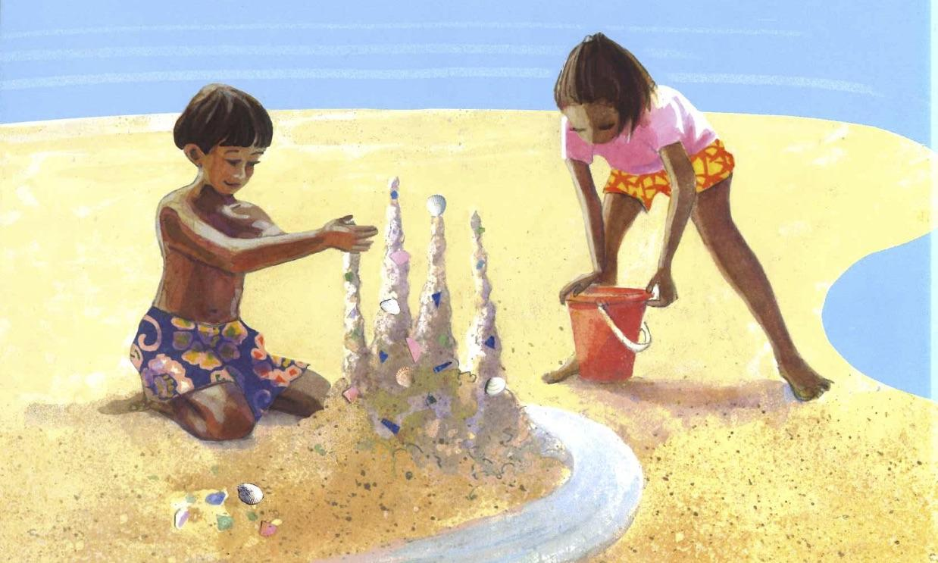

Slide 12
