Slide 1
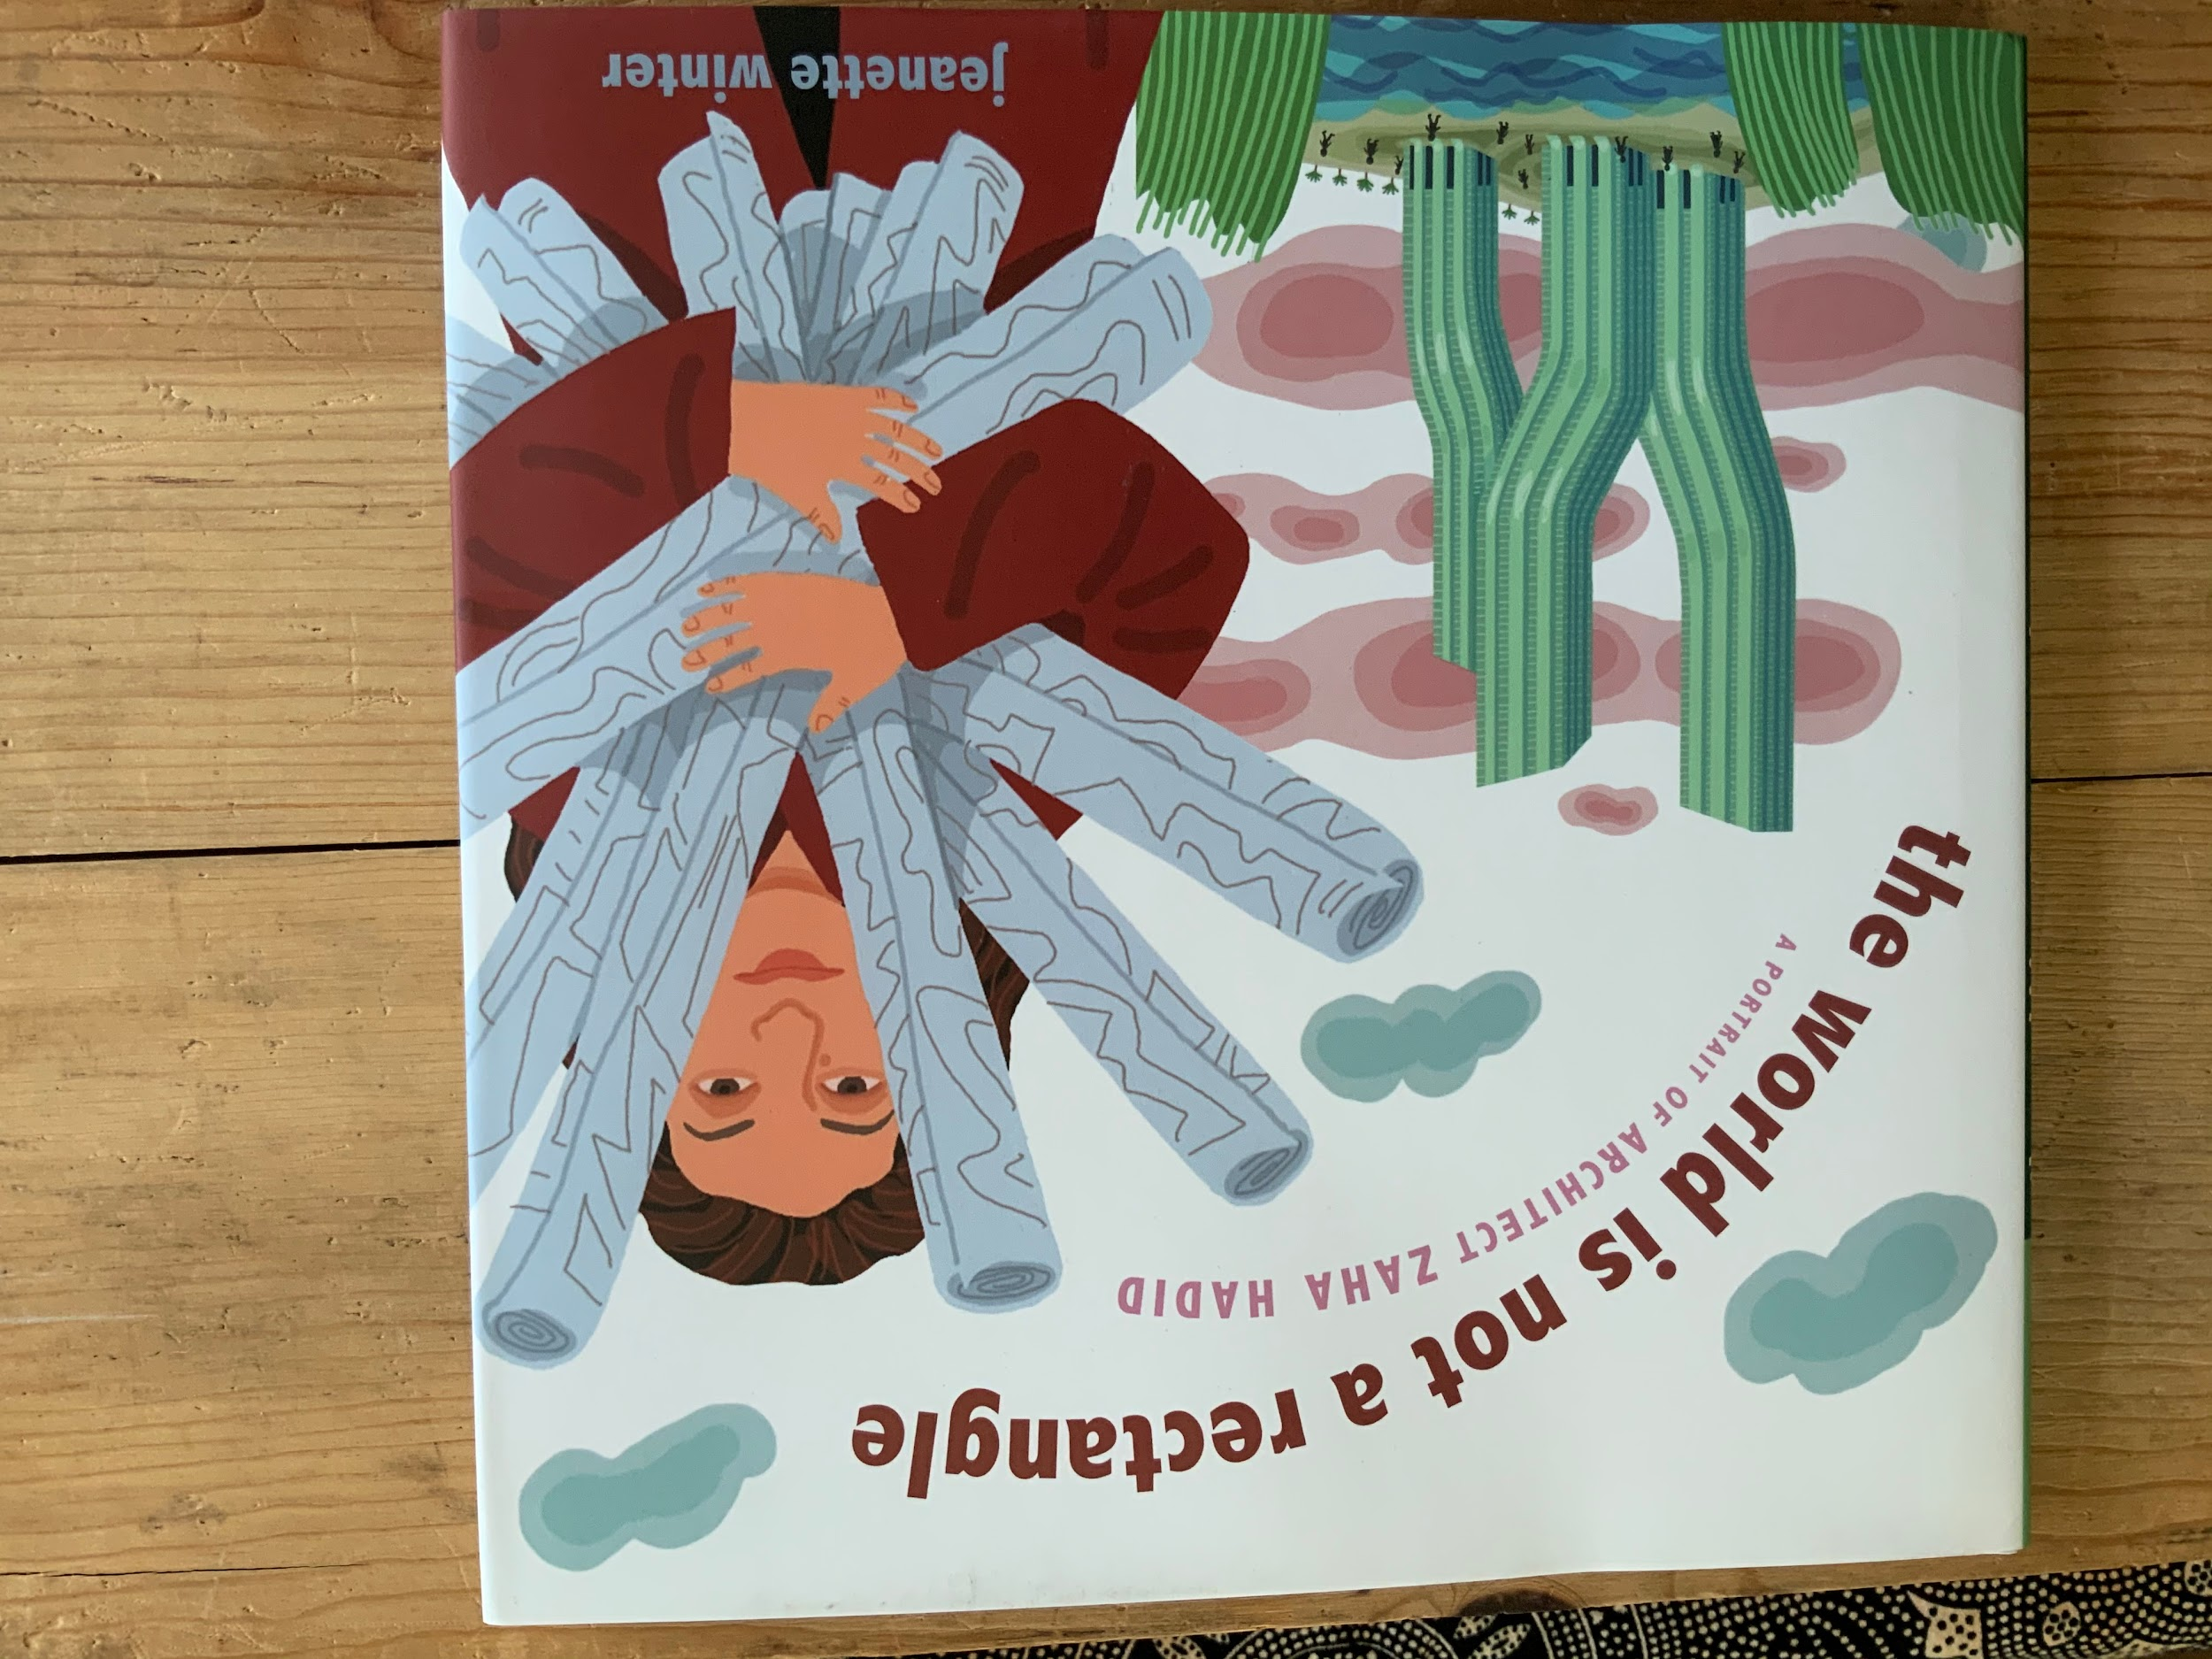

Slide 2
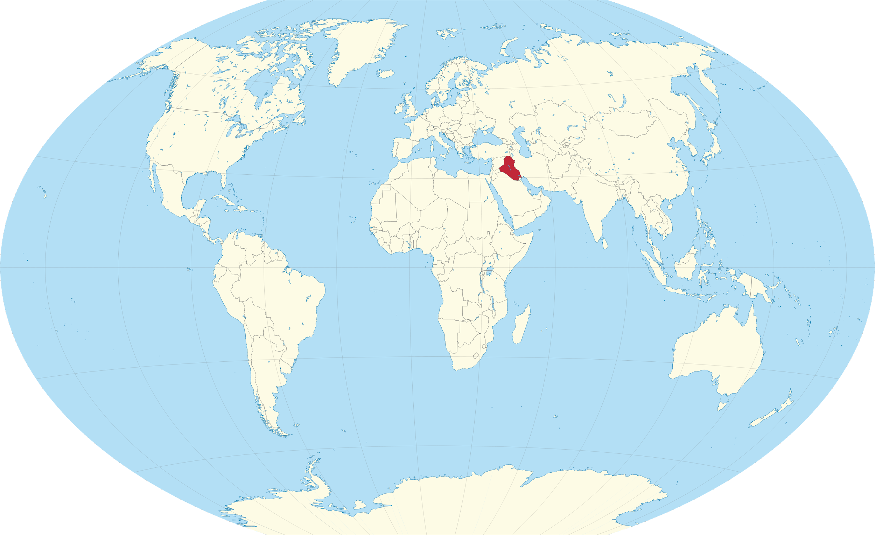
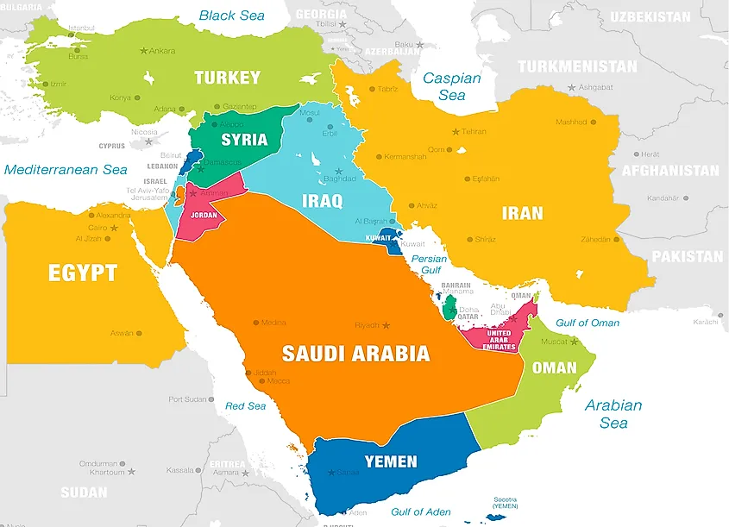
Iraq
Iraq

Slide 3
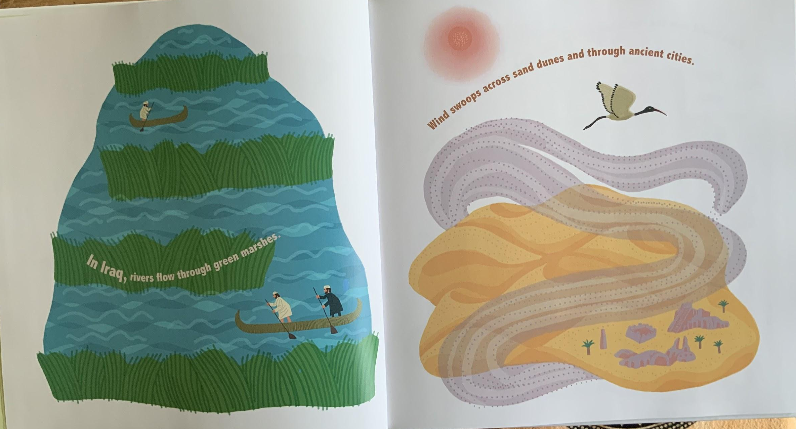

Slide 4
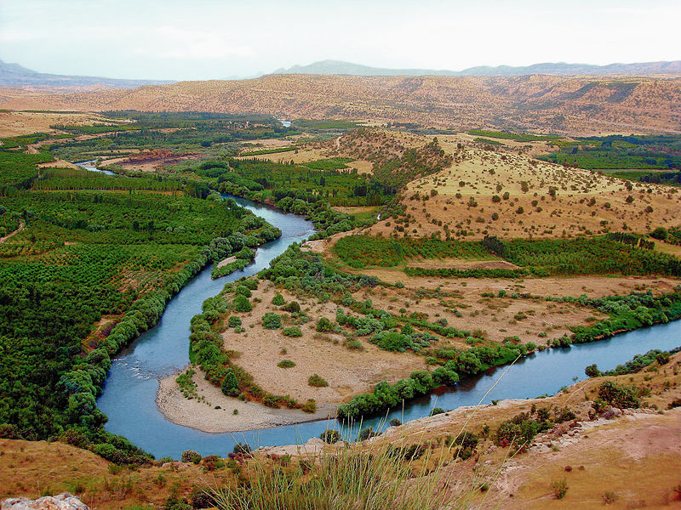
Great Zab River, Iraq
Notes:
https://en.wikipedia.org/wiki/Iraqi_Kurdistan

Slide 5
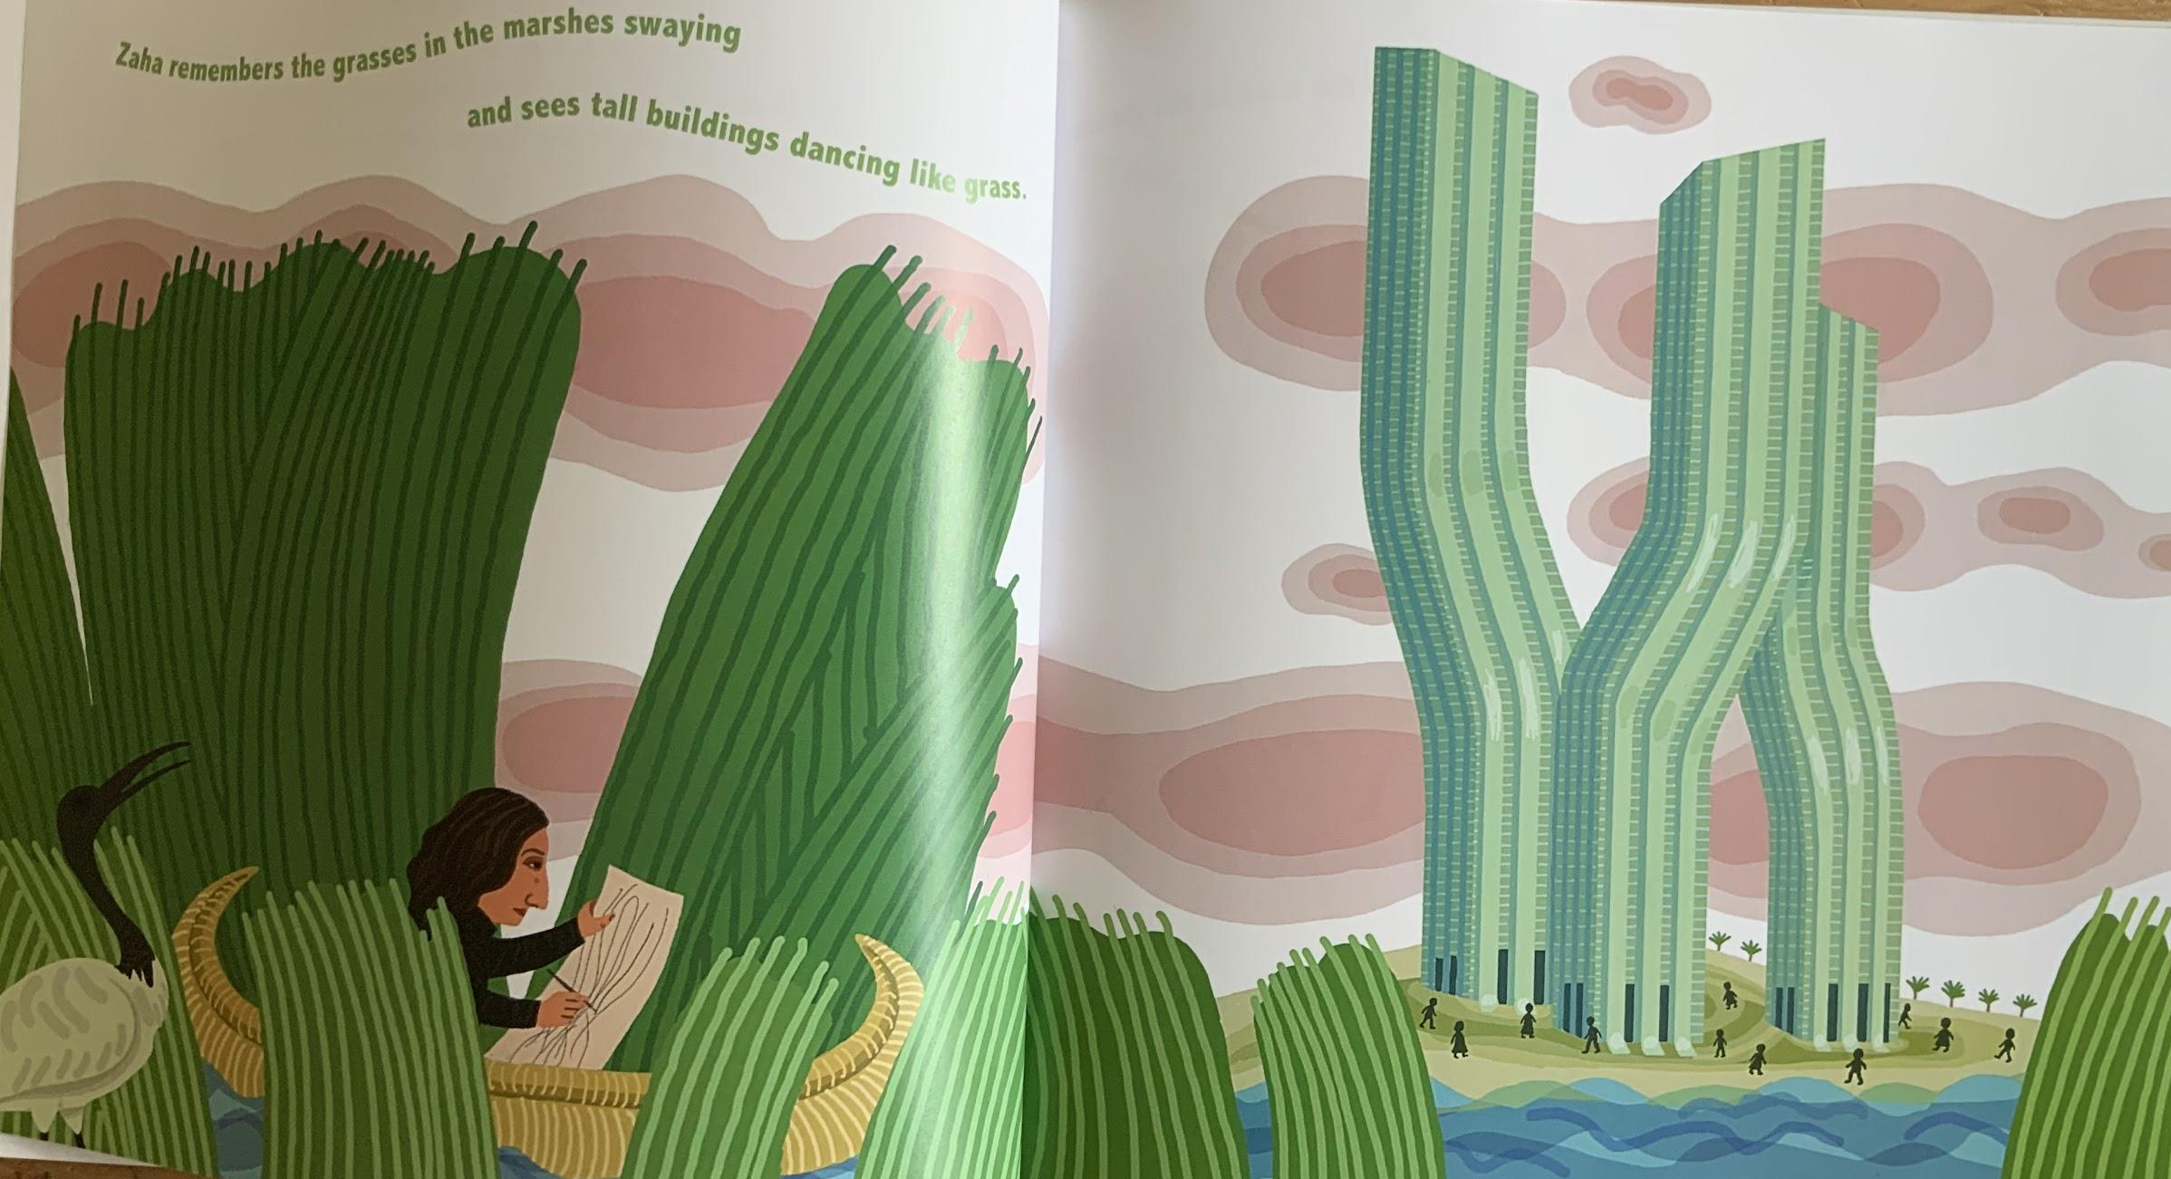

Slide 6
Zaha remembers the grasses in the marshes swaying
and sees tall buildings dancing like grass.

Slide 7
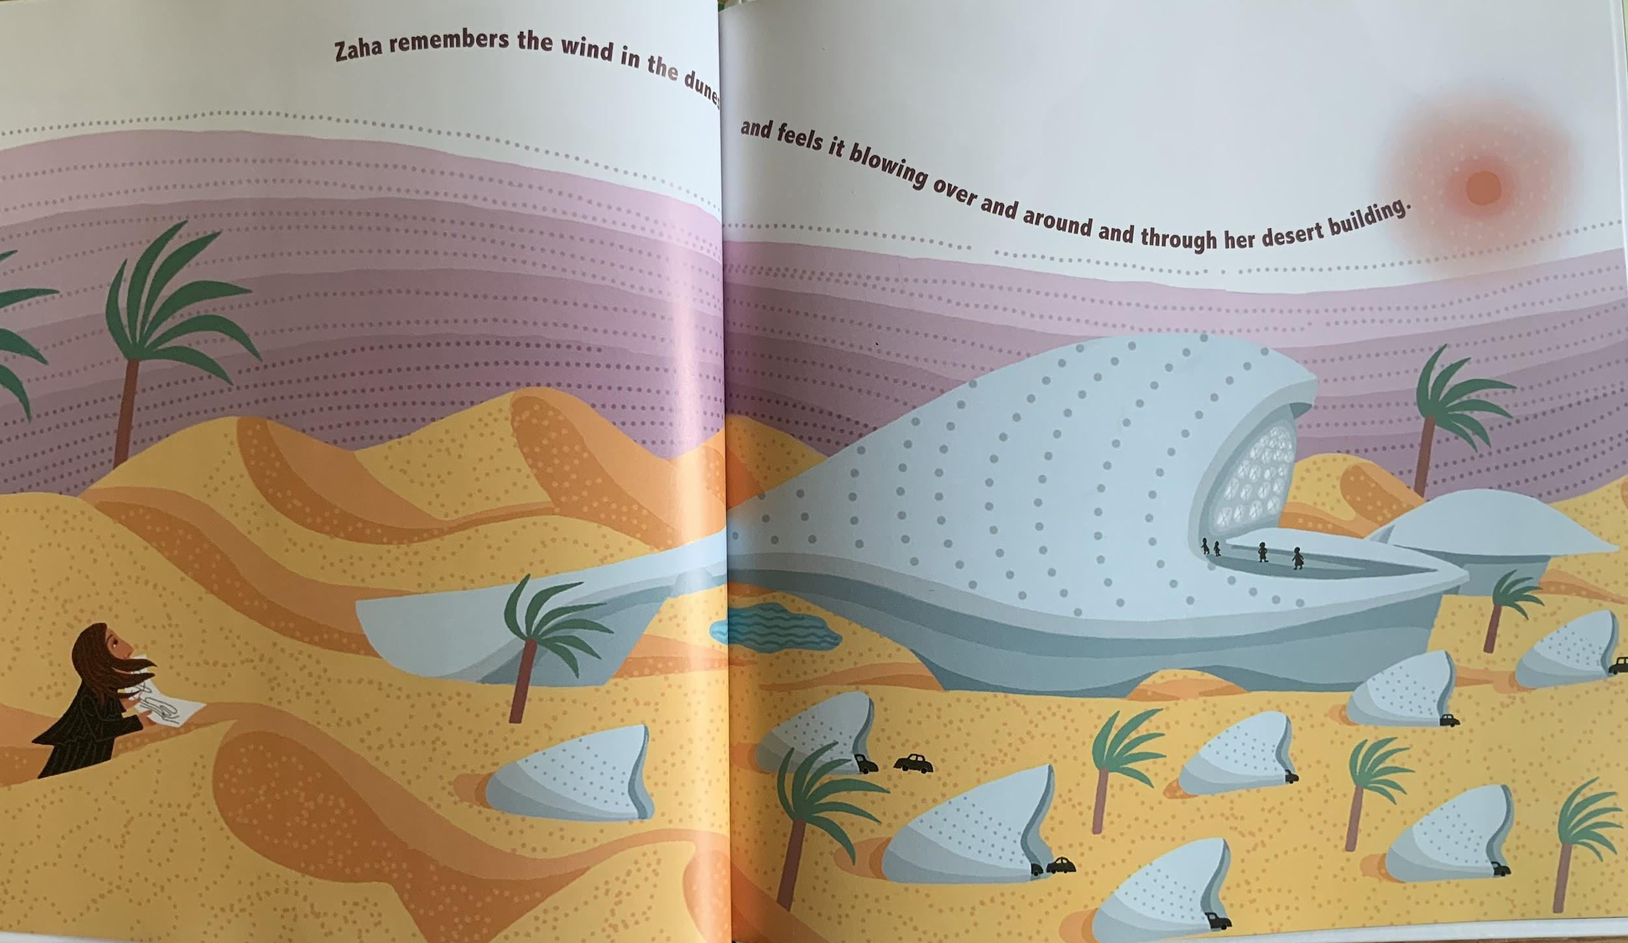

Slide 8
Zaha remembers the wind in the dunes and feels it blowing over and around and through her desert building.

Slide 9
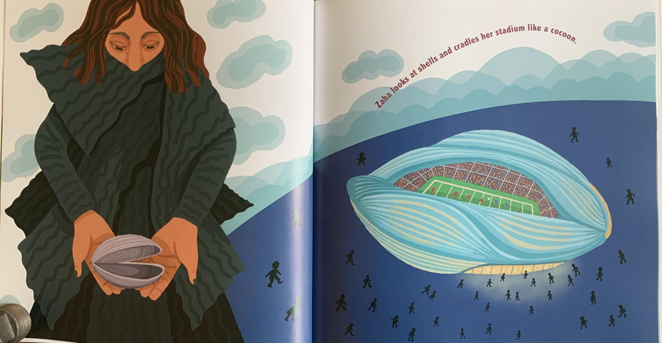

Slide 10
Zaha looks at shells and cradles her stadium like a cocoon.

Slide 11
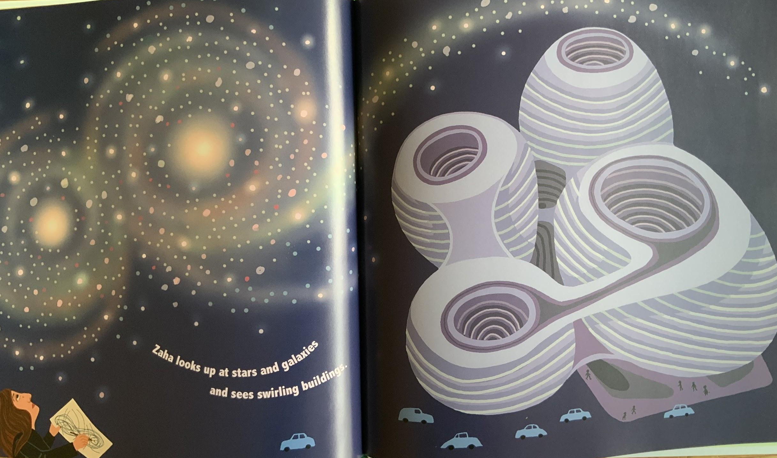

Slide 12
Zaha looks at stars and galaxies
and sees swirling buildings.

Slide 13
