Slide 1
World Map
Read Aloud Week 3 Day 2

Slide 2
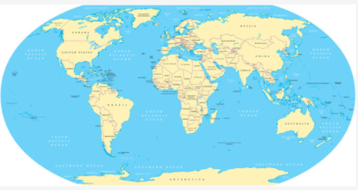
Atlantic Ocean
Pacific Ocean

