Slide 1
Math Pathways in Maine Background & Opportunities
for Secondary Schools
There is intentionally little to no formatting on these slides so schools can use within their own custom themes/backgrounds.

Slide 2
Purpose of this Slide Deck
This deck is meant only as a starting point for schools and districts to use as they introduce the math pathway concept to their own faculty, administrators, and stakeholders.
Feel free to use, modify or delete as slides or images as they fit your needs.
The notes on each slide help to articulate the purpose of the images and can also be pulled in as slide text depending on your style.

Slide 3

Traditional Secondary Math Curriculum
These more abstract courses can deter some students from STEM fields early.
Some of these students might excel first in applied math courses – where they can build confidence and understand the relevance of math.
ALGEBRA I
GEOMETRY
ALGEBRA II
PRECALC
CALCULUS
Too many students reach these courses and either drop out or find confirmation that they are not “math people.”
There are real consequences for high school completion and post-secondary aspiration.
Notes:
This visual is an amalgam of concepts from a number of recent publications. The idea is that the traditional sequences serves one group of students very well – but perhaps doesn’t serve our entire student body well at all. Many students struggle with Algebra II – especially when it is a requirement – and this particular progression does not introduce students to other flavors of math which may be more engaging and relevant.
See: Dana Center (2019). The case for math pathways. Retrieved from https://dcmathpathways.org/sites/ default/files/resources/2019-03/CaseforMathPathways_20190313.pdf Daro, P. and Asturias, H. (2019). Hacker, A. (2016). The math myth: and other STEM delusions. New York, The New Press.

Slide 4
What is the “right math”?
College algebra and traditional developmental math sequences were designed in the 1950’s to prepare students for CALCULUS.
But….the majority of students are in majors that do not require calculus.
Notes:
This is slide from the Dana Center explaining the history of the traditional progression on the previous slide.

Slide 5
Source: Burdman, 2015; Chen & Soldner, 2013.
Notes:
This is older research – but no one has done a more recent, similar survery. For students entering postsecondary education in 2003–2004, just 20% of associate’s degree and about 28% of bachelor’s degree students entered a STEM field. Students in social science, liberal arts, and fine arts would be better served by more relevant preparation in statistics or quantitative reasoning.

Slide 6
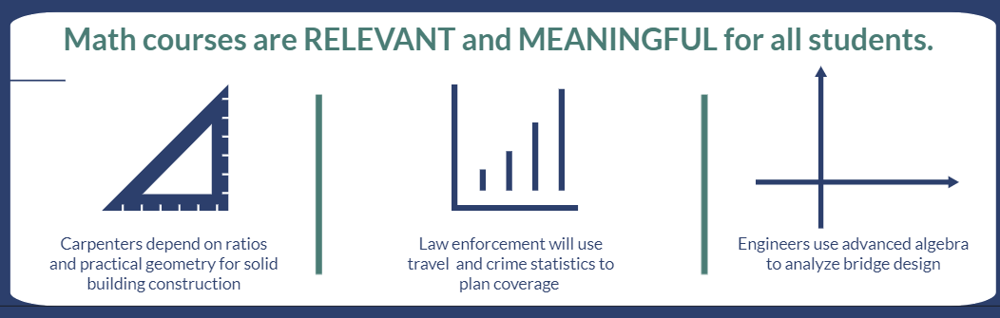
Too many students see math as a barrier rather than an essential skill. All careers require a working knowledge of math, but not all careers require the same kind of math.
Math Pathway reform means making math courses relevant and meaningful for all students rather than prioritizing a single path.
This approach to math has bolstered success and confidence for students in both secondary and post-secondary settings.
Notes:
A visual of the concept of math pathways – it is important to emphasis that math pathways does not mean less math or easier math – these courses can be serious, challenging math – but they can also be engaging and relevant.

Slide 7
Math Pathways
– is a national movement to modernize math education to create paths for all students. This movement spans university, college, and secondary realms.
The reforms focus on:
offering rigorous and meaningful math courses which are relevant to career paths
propelling students to postsecondary options
providing equitable access to quantitative reasoning skills & opportunities

Slide 8
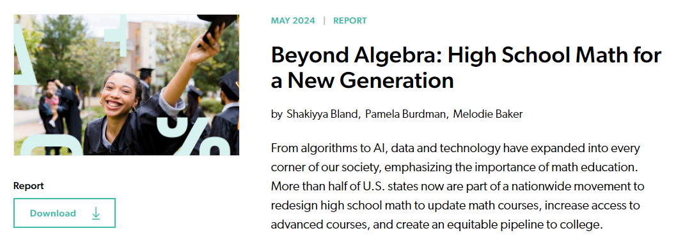
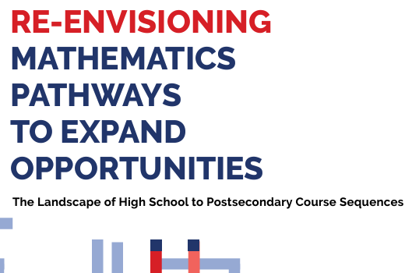
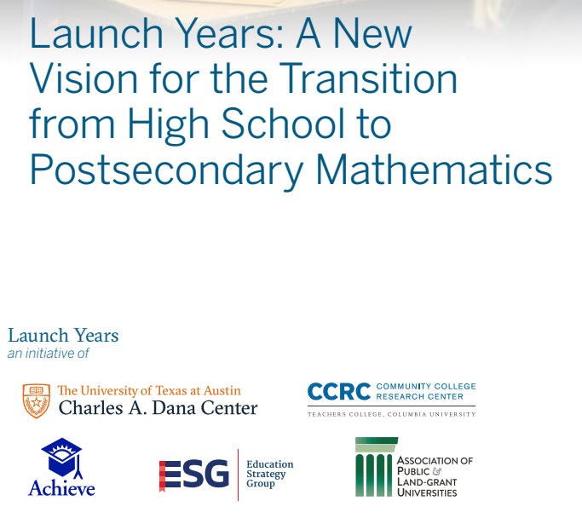
Notes:
There have been a number of recent publications and initiatives on math pathways which provide evidence and justification for considering this approach. The ones shown here come from some organizations which have been particularly active in this sphere. For more information also see the Dana Center at UTexas-Austin, Just Equations, Community College Research Center.

Slide 9
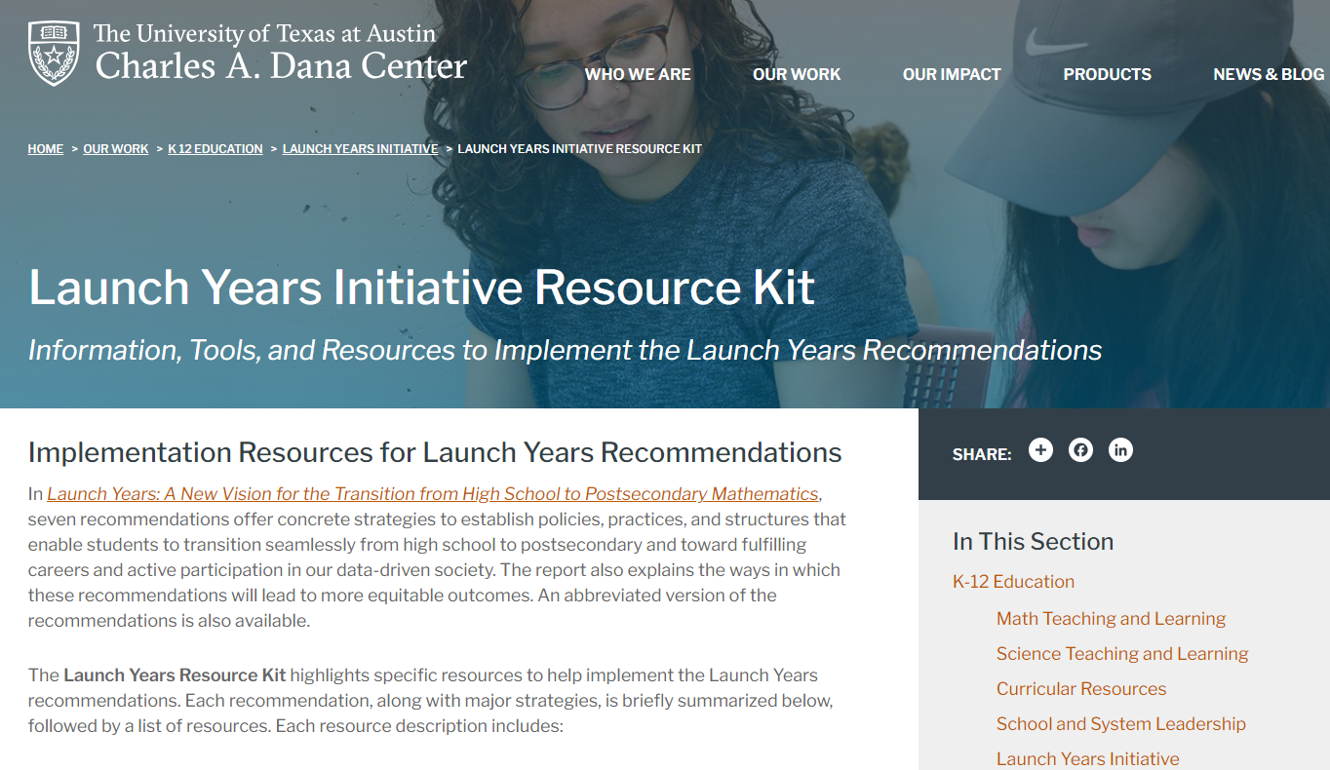
Notes:
The Launch Years is a specific initiative out of the Dana Center which has been working on math pathways at the post-secondary level for years. Maine was fortunate enough to be in the second cohort of the Launch Years Initiative and so many of our working principles, structures, course syllabi, action steps, and implementation plans were based on the resources that the Launch Years have gathered. Any school administrator or math teacher or district leader can visit the Launch Years resource site and see materials that might apply to their particular role.

Slide 10
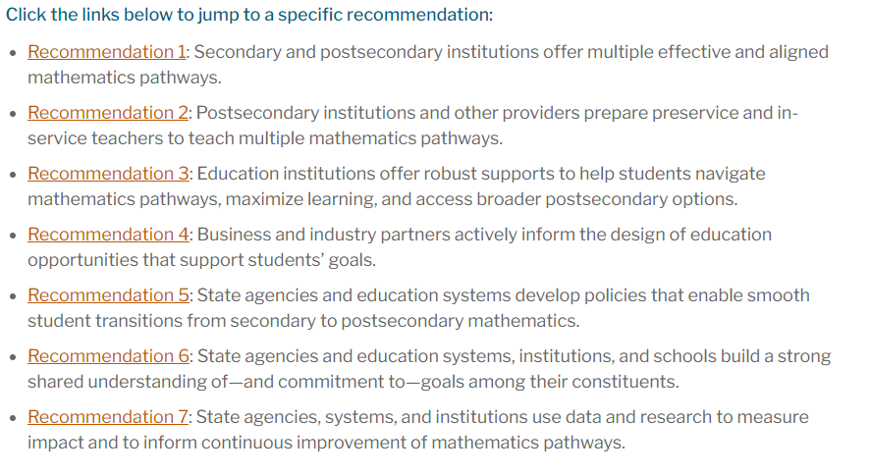
Recommendation 1: Secondary and postsecondary institutions offer multiple effective and aligned mathematics pathways.
Notes:
The Launch Years have a number of recommendations, but because Maine is a local control state we chose to focus on the first. We sought to build up the capacity of districts, schools, even individual math teachers who wanted to explore this concept and bring it back into their building. A task force made up of representatives from the Department of Education, the Maine Community College System, the University of Maine System, math teachers, curriculum leaders, and secondary administrators worked to curate those resources.
(Some other states are building math pathways in the common state curricula.)

Slide 11
 | Offer equivalent courses to Algebra II & beyond Algebra II | Prioritize equitable access and opportunity
 | Multiple pathways encompass modern math (in content and pedagogy) are defined across secondary and postsecondary education (including dual/concurrent enrollment) and align with each other and workforce needs. | Local schools, districts , and partners develop goals and outcomes toward equitable impact based on community demographics, needs, and data.
Examine local policies | Support teachers | Showcase Maine schools
Local schools, districts, and institutions review any policies to ensure support for each student’s smooth mathematics transition from secondary to postsecondary education. | Professional learning is centered on collaboration, data analysis, implementing high-impact instructional strategies, and identifying and using high-quality curricular materials to support teachers and student learning. | Develop and disseminate success stories from Maine high schools and CTEs of equitable implementation of modern mathematics pathways
The Maine Launch Years Initiative taskforce had a number of guiding priorities and built a repository of tools, resources, and case studies to support Maine Schools as they consider Math Pathways:
Weblink here
Notes:
These were the goals of the Maine-based taskforce that designed the Math Pathways Toolkit.

Slide 12
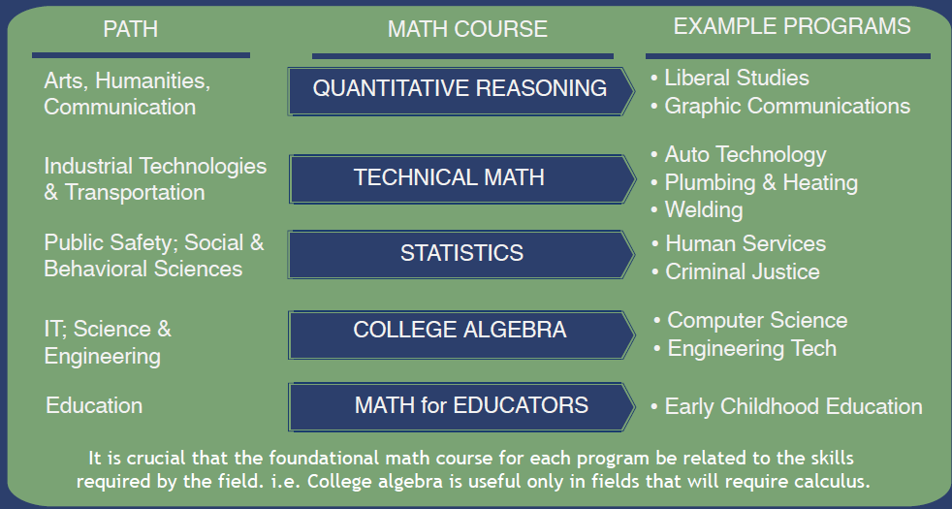

Maine’s Community Colleges adopted math pathways at scale and continue to build clear connections between programs and the math courses required.
The University of Maine System has also been active math pathway reform and scaling implementation where appropriate.
Notes:
The Maine Community College System began Math Pathway reform work in 2018 and included the Maine Department of Education and the University of Maine System in their process. The Community Colleges were tackling the reality of remedial course placement and the low success rates for math progression. This is the framework that the community colleges embraced – though the different colleges are at different places in the process. The colleges that fully embraced math pathways have seen notable increases in both math course success and student success outcomes. MCCS, Maine DOE, and UMS continue to partner in this statewide effort.

Slide 13
Each school builds the pathways
that meet student needs
&
that it can support or access
student academic data?
post-secondary landscape?
potential benefit?
(though examples that follow are from states)
current teacher load?
time and space for curricular change/PD?
dual or concurrent enrollment?
Course sharing?
Notes:
(though examples that follow are from states) -- because in many states this is a policy-driven initiative orchestrated through a common curriculum.

Slide 14
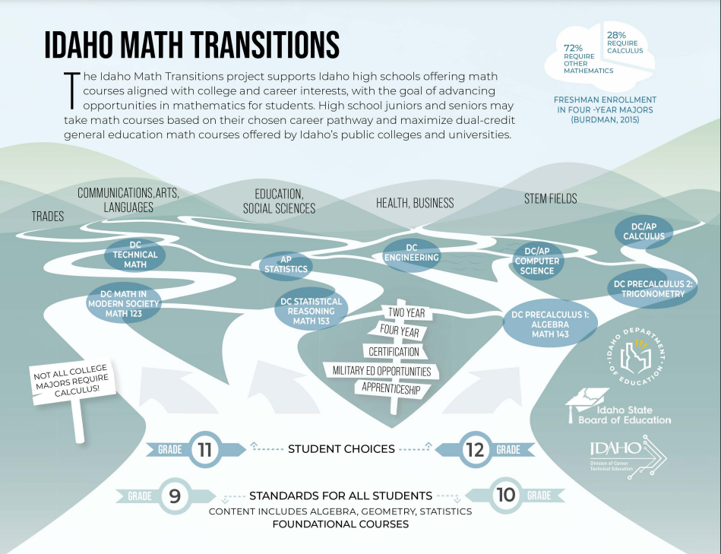

Slide 15
