Slide 1
Grading for Equity
Independent Study
Notes:
Welcome to Grading for Equity, an independent text-based study.

Slide 2
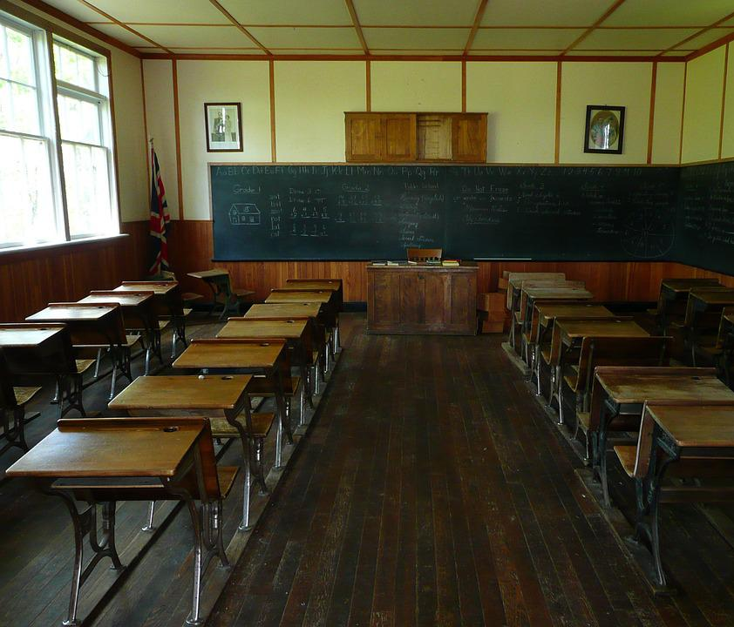
Grading for Equity by Joe Feldman
Why study equitable grading?
Instruction has changed a great deal in the last 100 years, but many of our current grading practices are rooted in 19th century institutional practices. If we are going to change our systems of practice to be more equitable for all students, we must understand all the facets of our grading traditions.
Notes:
Recent global events have inspired us to look closely at our systems of practice and think about what needs to change. With our recent experiences, we may be more willing to consider big questions and significant changes than ever before. Equitable grading practices are an essential foundation for all the other work we want to do. We begin with a text-based study of Joe Feldman’s Grading for Equity.

Slide 3
Text-Based Study
Feldman’s book presents a logical starting point to create a common foundation for rethinking practices.
1. Understand the history of grading and the call to action.
2. Explore the mathematical accuracy of our grading systems
3. Recognize bias and anti-bias practices in grading
4. Find the motivational elements of grading that provide students with agency and voice in their learning.
Notes:
Feldman’s book is organized logically with a history and call to action at the beginning followed by a three “pillar” approach to study.

Slide 4
How to study
While solo is fine, it helps to have thought partners.
Work with your department or PLC or reach further. We know how to work from a distance!
Study the first part of the book – six chapters.
Choose one pillar to study deeply. What is your biggest need or where do you see an opportunity to try something different?
Notes:
It is always helpful to have a thought partner in any study. If you are not approaching this task as part of a PLC in your school or district, consider reaching out through your social networks to collaborate. Study the first part of the book then focus on one pillar to continue. What do you see as the biggest concern to address or perhaps you recognize some “low hanging fruit” to start.

Slide 5
Getting started
Order the book Grading For Equity: What It Is, Why It Matters, and How It Can Transform Schools and Classrooms
Notes:
Get the book.

Slide 6
Check out our syllabus
Link to syllabus
Each session is facilitated by a teacher who has previously studied the book and tried something as a result of the study.
The recordings may be viewed before reading to set a purpose or after to help process.
The recordings were made during live sessions which included breakout discussions. Pause at each breakout opportunity (edited out of these recordings) and discuss with a partner or record thoughts in a learning journal.
Notes:
We have created a syllabus for study with nine sessions designed by teachers who had studied together and applied the practices in their own classrooms. We edited the live talk. You can pause at each breakout opportunity to talk with your peers or record your thoughts in a learning journal.

Slide 7
DOE Support for Study
Join a live session to process
Tuesday, October 4 or Thursday, October 6
3:30 – 5:00
Facilitated discussion of equitable grading: history and call to action
See syllabus for link to event registration.

Slide 8
DOE Support for Study
Join a live session to process
Tuesday, December 6 or Thursday, December 8
3:30 – 5:00
Facilitated discussion of equitable grading: accuracy
See syllabus for link to event registration.

Slide 9
DOE Support for Study
Join a live session to process
Tuesday, February 7 or Thursday, February 9
3:30 – 5:00
Facilitated discussion of equitable grading: anti-bias practices
See syllabus for link to event registration.

Slide 10
DOE Support for Study
Join a live session to process
Tuesday, March 7 or Thursday, March 9
3:30 – 5:00
Facilitated discussion of equitable grading: motivation
See syllabus for link to event registration.

Slide 11
Other resources
Books, blogs, podcasts, articles, and other resources are available as well. Click here for a spreadsheet of resources.
Questions? Contact Beth.Lambert@maine.gov

