Slide 1
IN SEARCH OF MORE EQUITABLE GRADING
Things I've been considering...
Patti Forster, NBCT
Camden Hills Regional High School

Slide 2
Guiding question
WHAT'S BEST
FOR KIDS?

Slide 3
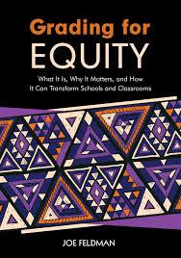
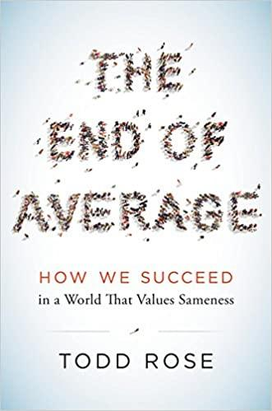
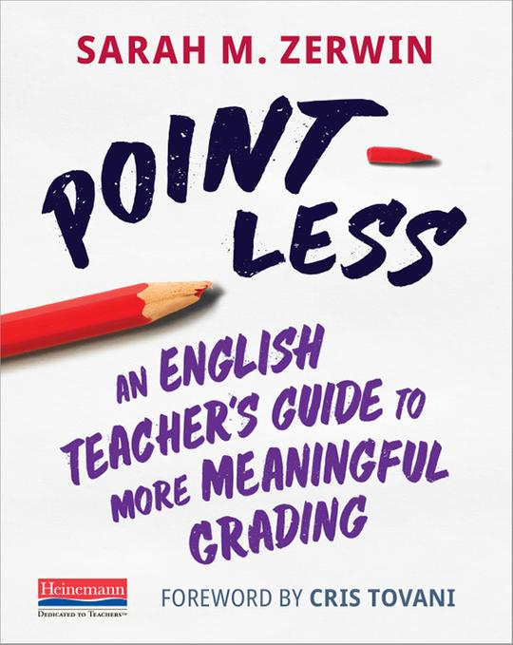

Slide 4
AUTHENTIC ENGAGEMENT AGREEMENTS
Short Presentations
Mute
Video off
Chat box
Thoughts
Questions
Epiphanies
Breakout
group discussions
Share and listen

Slide 5
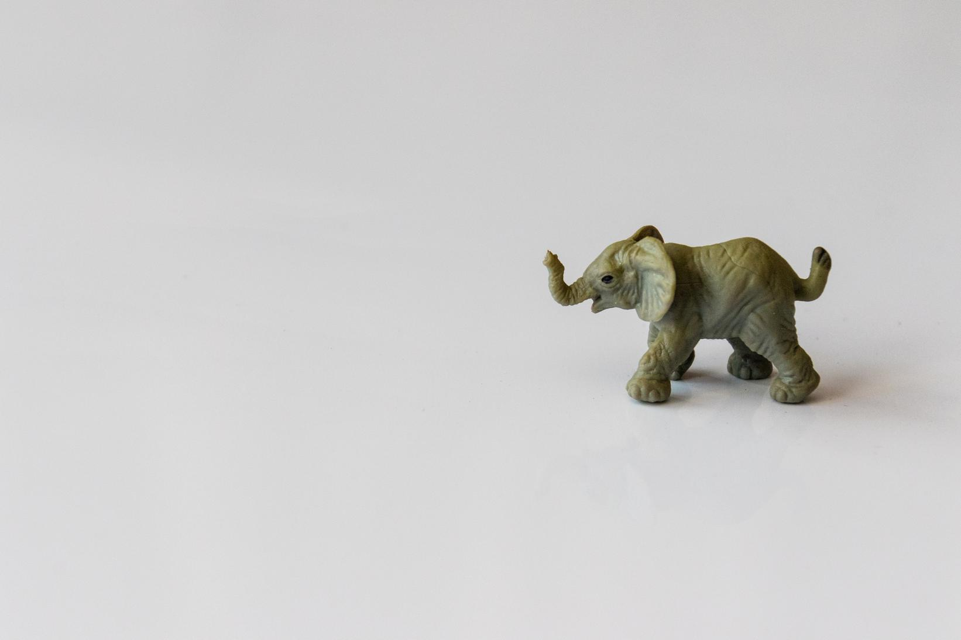
Educators often do not like to talk about grading practices

Slide 6
ISLAND OF AUTONOMY
Grading for Equity | Chapter 1
Grades are the only thing some teachers feel they have control over thanks to unions and state policies

Slide 7
EVERY TEACHER MAKES
VERY DIFFERENT CHOICES
"Because each teacher's grading system is virtually unregulated and unconstrained, a teacher's grading policies and practices reveal how she defines and envisions her relationship with students, what she predicts best prepares them for success, her beliefs about students, and her self-concepts as a teacher."
(Feldman, 6)
Grading for Equity | Chapter 1

Slide 8
Web of Belief
BASED ON EXPERIENCES &
PRIOR UNDERSTANDING
Grading for Equity | Chapter 1
Philosopher W.V. Quine (1978)
"A complex system of what we hold to be true
in the world based on our experiences
and prior understanding."

Slide 9
When our grading experiences and understandings are questioned, we do everything we can to hang onto that foundation,
trying to rebuild it just as it was.

Slide 10
But when a spider's web is broken, she creates new foundations and rebuilds it into a new web, equally as good if not better.

Slide 11
Breakout Discussions
Factors for Success
Facilitator
Timekeeper
Engagement

Slide 12
Breakout 1 Question
What has built your web of belief about grading?
Where/when did your understanding
of grading begin to form?
Share who taught you how to grade and how long ago that was.
Groups of 4 / 1 minute per person

Slide 13
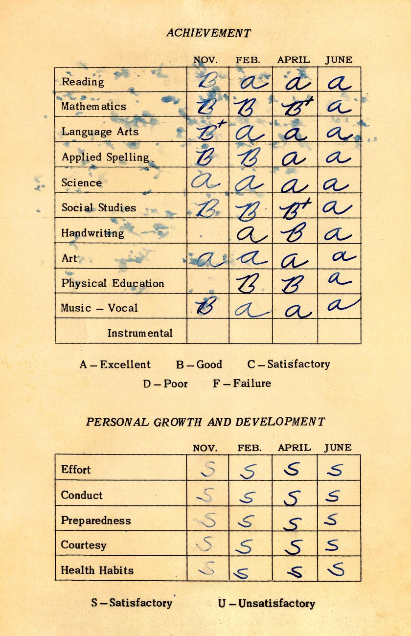
WHERE
WE'VE BEEN

Slide 14
"IF WE'RE GOING TO
UNDERSTAND OUR GRADING, QUESTION IT, AND
FIND WAYS TO IMPROVE IT, PARTICULARLY FOR VULNERABLE
STUDENT POPULATIONS,
WE NEED A BASIC UNDERSTANDING
OF ITS GENEALOGY
AND ITS EVOLUTION."
GRADING FOR EQUITY BY JOE FELDMAN
(FELDMAN, 18)

Slide 15
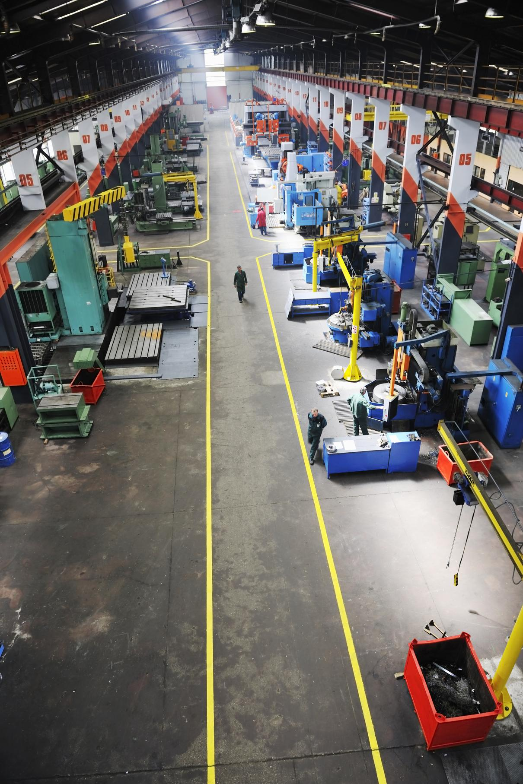
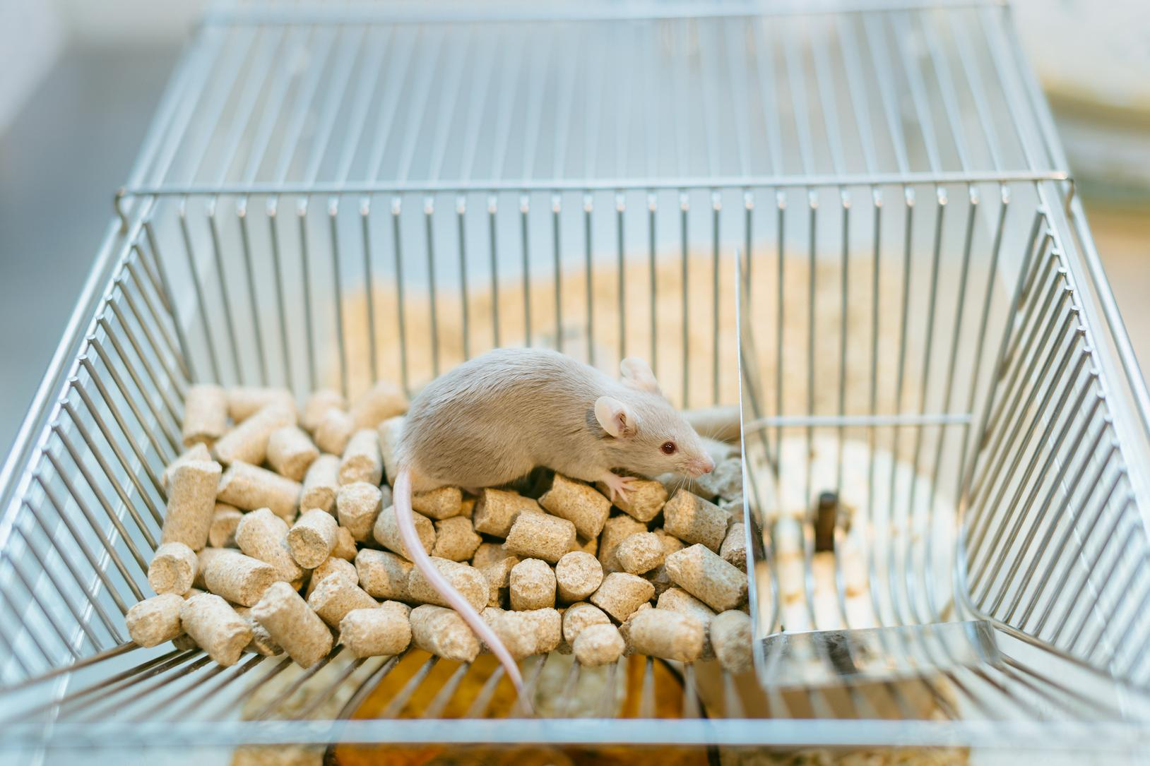
OVER THE PAST 200 YEARS
Changes in American society
The rise of manufacturing
Intelligence testing
& categorization
Progressive Educators
Migration & Immigration
Behaviorism

Slide 16
THE RISE IN MANUFACTURING
Efficiency & Productivity
Pressure to create future employees
Industry characteristics
as models for schools
Chapter 2 | A Brief History of Grading

Slide 17
Specialization
Chain of command
Timed routines
Efficiencies
(Feldman, 19)
Chapter 2 | A Brief History of Grading

Slide 18
PROGRESSIVE EDUCATORS
Like John Dewey who believed in education as a democratic engine:
*Universal--open to all
*Common Curriculum
*Elevate social & economic position
*Support moral development
Chapter 2 | A Brief History of Grading

Slide 19
"In the end, although Dewey's vision of schools-as-democratic-engine provided overarching rhetoric about schools, it was often eclipsed by the vision of schools-as-training-ground." (Feldman, 19).
Chapter 2 | A Brief History of Grading

Slide 20
MIGRATION & IMMIGRATION
Moves from rural living to cities
w/ factory jobs & transportation
Massive waves of immigrants
from Western & then Eastern Europe
Chapter 2 | A Brief History of Grading

Slide 21
U.S. cities w/populations over 25,000
U.S. Census Bureau
100
over 100
75
Chapter 2 | A Brief History of Grading
50
35
25
4
0
1810
1860
1910
New York 96K to 4.5M
Boston 33K to 670K

Slide 22
INTELLIGENCE TESTING & CATEGORIZATION
"Natural intelligence" theories
Skull size
IQ tests believed to asses
intellectual character/disposition
& "justify" racist beliefs.
Chapter 2 | A Brief History of Grading

Slide 23
"Higher scores among white, wealthy Protestants and lower scores among immigrant groups and African Americans were used both to affirm the idea of the United States as a meritocracy and to reinforce the validity of the existing hierarchy" (Feldman, 20).
Chapter 2 | A Brief History of Grading

Slide 24
BEHAVIORISM
Human behavior is the result of external stimuli
B.F. Skinner rat experiments
"operant conditioning"
Chapter 2 | A Brief History of Grading

Slide 25
"This theory of learning–that humans could be taught to act in certain ways through extrinsic reinforcement or consequences–became wildly popular in schools and factories" (Feldman, 20).
Chapter 2 | A Brief History of Grading

Slide 26
Over the past
200 years
HOW DID
THESE CHANGES CHANGE SCHOOLS?
The rise of manufacturing
Intelligence testing
& categorization
Progressive Educators
Migration & Immigration
Behaviorism

Slide 27
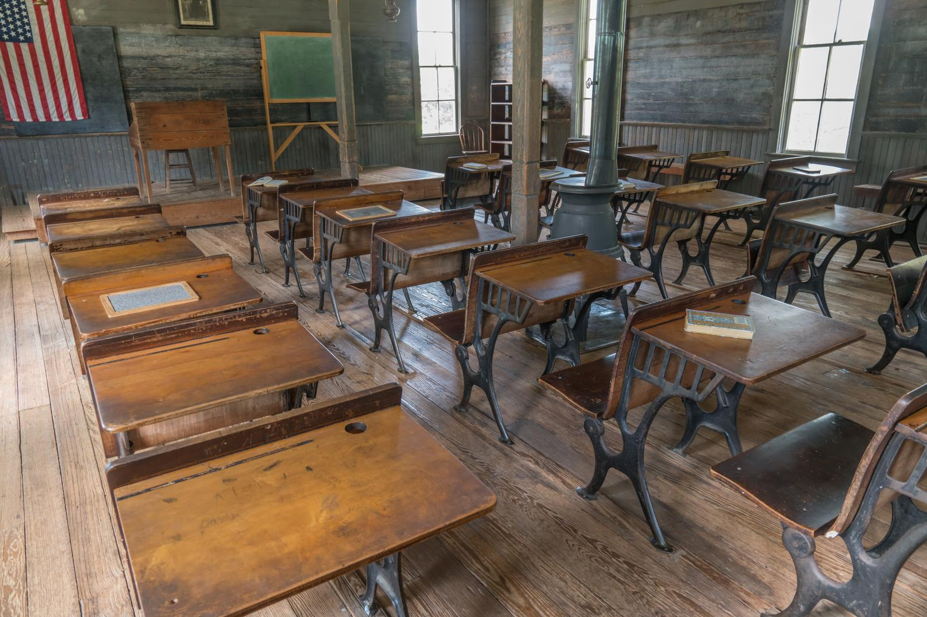
19th Century
Obedience
1 room school house
Teacher/student familiarity
Narrative reports to families

Slide 28
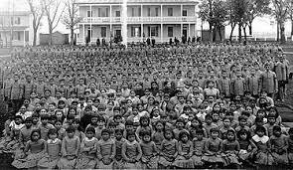
19th & 20th Century
Assimilation
Training immigrants to be "Americans"
Native American children placed in boarding schools

Slide 29
A little detour
The idea of an “average man”–early 19th century
Belgian mathematician, Adolphe Quetelet.
Average=Perfection
Francis Galton–divided humankind into 14 classes
From “Imbeciles” through “Mediocre” to the “Eminent."
Average=Mediocre
from The End of Average by Todd Rose

Slide 30
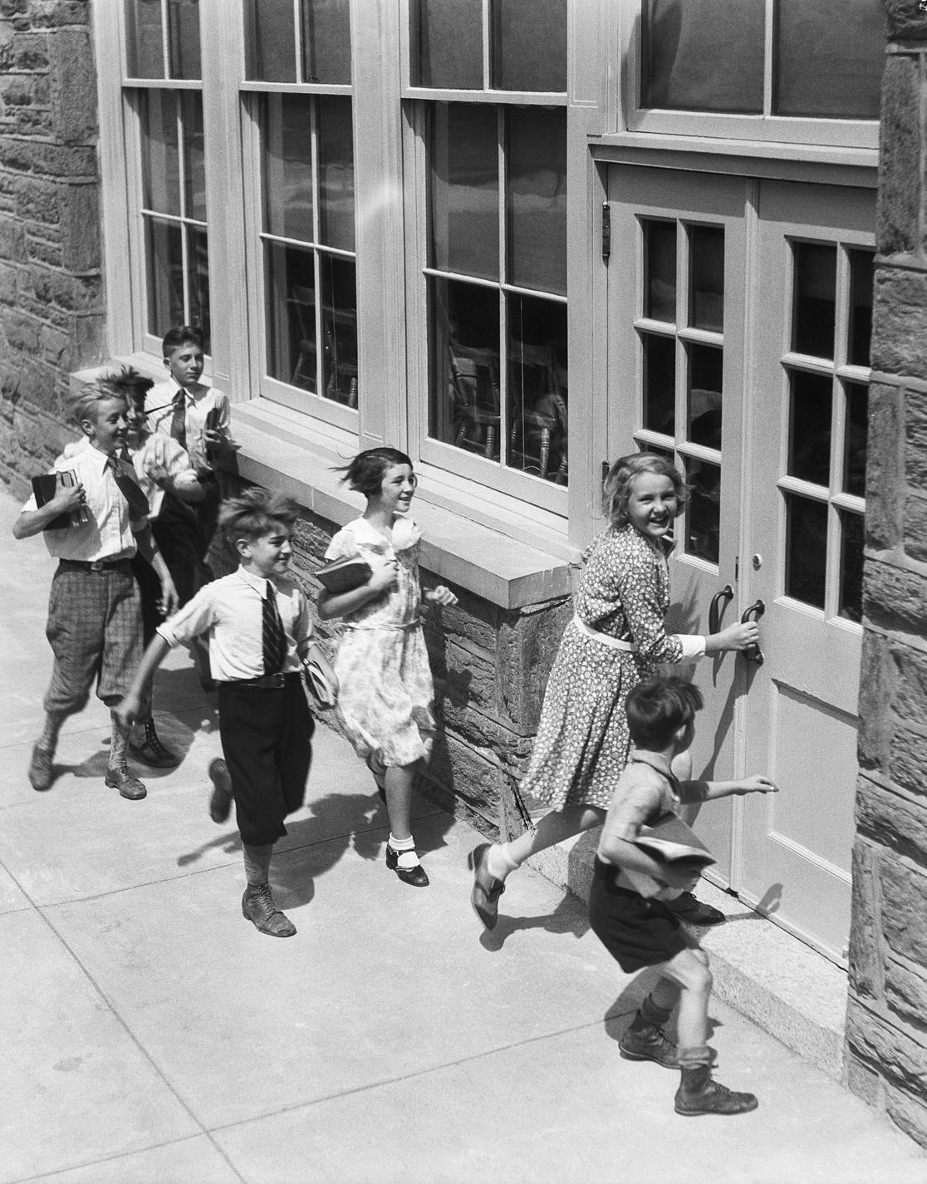
20th Century
Sorting and Ranking
Larger public schools
Need for efficiency & accountability
Single letter grades A-F
Norm-referenced grades/bell curve

Slide 31
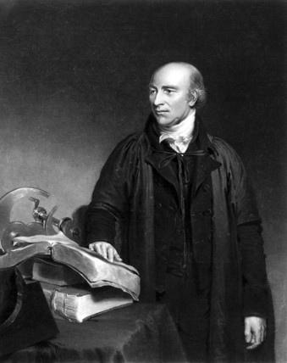
Another detour
William Farish--Cambridge University Tutor
Process more students in less time, make more money.
Created a letter grade system
modeled after the shoe factory industry
where shoes were given a letter to mark if "up to grade."

Slide 32
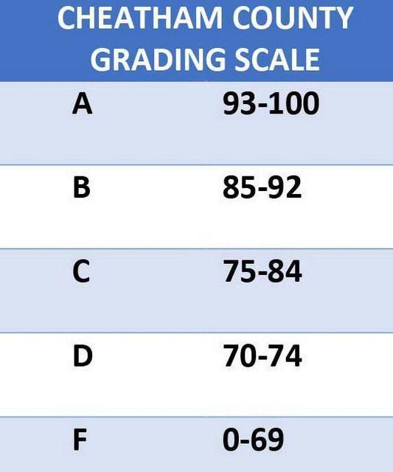
Why no "E"
Mount Holyoke College, Massachusetts–
1st in United States to use letter grades (1887)
High schools followed suite in early 1900s.
Schools removed the E in the 1930s–worried some might think the E (failure) could equate to an E for excellent.

Slide 33
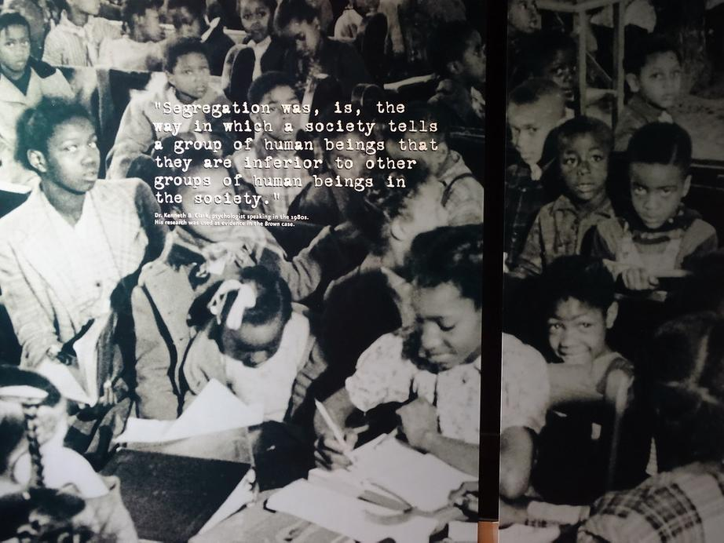
20th Century
Tracking
IQ tests used in schools
Work track & college track
Socioeconomic & racial hierarchy

Slide 34
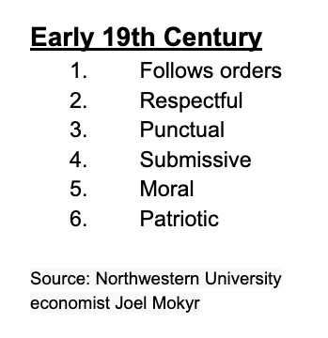
GRADES DID WORK AS EXTRINSIC MOTIVATORS
FOR 19TH CENTURY
WORKPLACE SKILLS

Slide 35
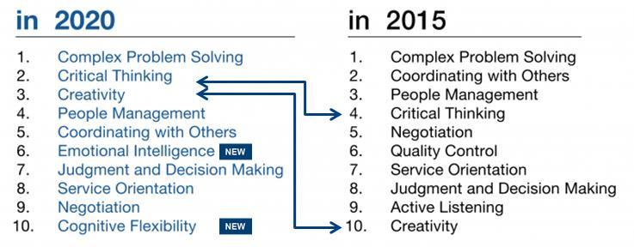
BUT...CAN GRADES STILL MOTIVATE
21ST CENTURY WORKPLACE SKILLS??
Source, World Economic Forum
"Future of Jobs Report" 2015

Slide 36
2015 "Future of Jobs Report"
World Economic Forum
2018 "Future of Jobs Report"
World Economic Forum

Slide 37
EXTRINSIC MOTIVATION
INTRINSIC MOTIVATION
Impact of grades on learning:
Diminishes interest
Creates a preference for easiest posssible task
Reduces quality of thinking
Increases engagement
Creates a preference for challenging, enriching tasks
Improves quality of thinking
Based on Daniel Pink's work, "The Importance of Intrinsic Motivation" by Iain Lancaster
Alfie Kohn, "The Case Against Grades"

Slide 38
And yet today...
Grades still=
Obedience/compliance
Assimilation/good citizens
Sorting & Ranking/bell curve
Tracking/voc.ed or college

Slide 39
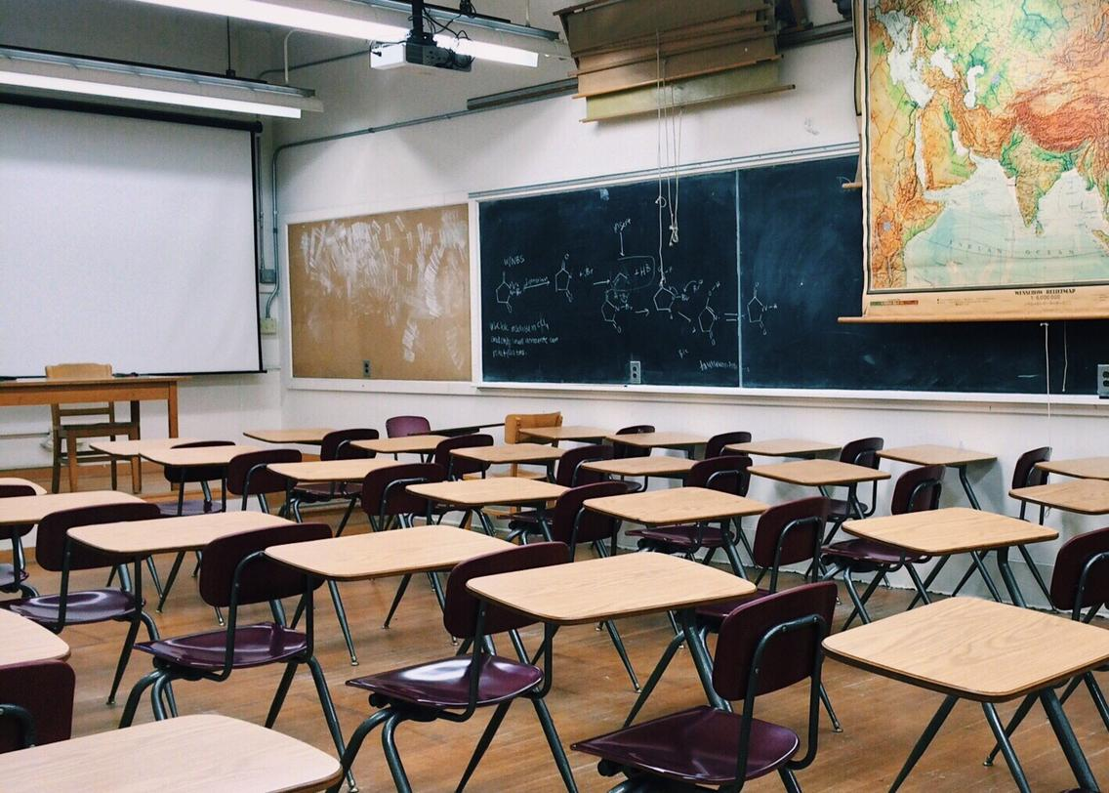
PRESENT DAY GRADING
"We continue
to place a premium
on punctuality, quiet attention,
and following directions,
the same behaviors desired of students over a century ago."
Joe Feldman, Grading for Equity

Slide 40
AND NOW...
COVID-19 GRADING
"DO NO HARM."

Slide 41
Breakout 2 Question
How do you see the ideas and beliefs from
the early 20th century manifesting themselves through our school's grading system and teachers' grading practices and how do some harm learners?
Groups of 4 / 2 minutes per person

Slide 42
WHERE
DO WE GO FROM HERE?
We should consider the impact
of grades and ask questions
about our grading practices...

Slide 43
How does
traditional grading
cause harm?

Slide 44
Does the system of traditional grading create inequities?
Ethnicity
Socioeconomic Status
Gender
Disabilities
from "The Grade Divide" by Gary Chu

Slide 45
Ethnicity
The National Assessment
of Educational Progress (NAEP)
Data on achievement gaps shows that
"there is a widening gap between
White and Black/Hispanic students."
from "The Grade Divide" by Gary Chu

Slide 46
Socioeconomic Status
"Socioeconomic status
has a 'substantial effect'
on student grades."
(Johnson, McGue, & Iacono)
from "The Grade Divide" by Gary Chu

Slide 47
Gender
"For over three decades,
girls have earned higher grades
and grade point averages
than boys in school (Grasgreen)"
from "The Grade Divide" by Gary Chu

Slide 48
Disabilities
"60-70% of included students with disabilities receive below-average grades in their
general education classes (Munk & Bursuck)."
from "The Grade Divide" by Gary Chu

Slide 49
Once, a science teacher gave my son an
even though he passed all of the assessments!
She said he didn't pass because
he didn't do the daily science journal,
and she thought that was important.
COMPETENCE VS. COMPLIANCE

Slide 50
What are the Problems with Traditional Grading & Practices?
1
2
3
4
PROVIDE UNCLEAR
AND OFTEN MISLEADING INFORMATION
OFTEN INFECTED BY IMPLICIT RACIAL, CLASS, AND GENDER BIASES
VARY FROM TEACHER TO TEACHER
BASED ON MATHEMATICALLY UNSOUND CALCULATIONS
Joe Feldman, "Accurate and Equitable Grading"

Slide 51
GRADES
VARY FROM TEACHER TO TEACHER
Grades reflect a "teacher’s specific grading practices
as well as
the student’s achievement."
Joe Feldman, "Accurate and Equitable Grading"

Slide 52
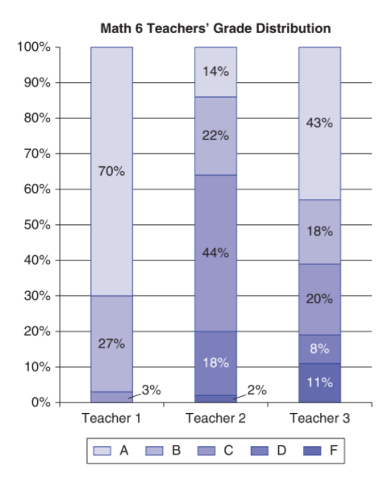
Math Teachers
TEACHER 1
70%=As
TEACHER 2
14%=As
TEACHER 2
2%=Fs
TEACHER 3
11%=Fs
from Grading for Equity
by Joe Feldman

Slide 53
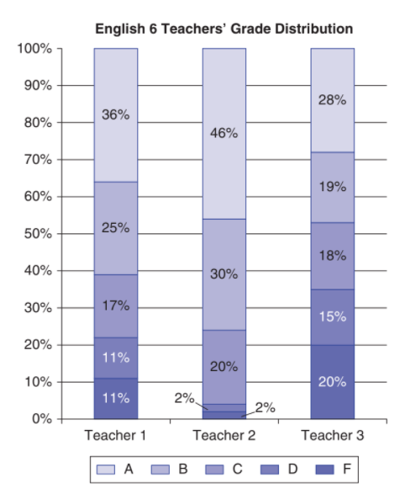
English Teachers
TEACHER 2
46%=As
TEACHER 3
28%=As
TEACHER 2
2%=Fs
TEACHER 3
20%=Fs
from Grading for Equity
by Joe Feldman

Slide 54
IN ALL CLASSES
WHAT VARIED BETWEEN CLASSES?
Similar students
Similar standardized test scores
Similar instruction
Same curriculum
Same assessments
Team scoring of assessments
1 teacher didn't accept homework after the bell
some teachers gave late penalties from 2 points to 2 letter grades
1 teacher took off points for no heading
1 teacher took off points if paper had ripped edges or holes
Weightings for grade categories varied from teacher to teacher
Some teachers didn't use weighting but adjusted points based on size of assignment

Slide 55
GRADES
PROVIDE UNCLEAR AND OFTEN MISLEADING INFORMATION TO KEY STAKEHOLDERS
Academic proficiency
Soft skills
Behaviors
Attendance
Participation
Effort
"It is often impossible to determine what grades represent."
Joe Feldman, "Accurate and Equitable Grading"

Slide 56
GRADES
ARE OFTEN INFECTED BY IMPLICIT RACIAL, CLASS, AND GENDER BIASES
"Subjective and culturally biased lenses...frequently penalize African-American, Latino,
low-income, and special education students."
Joe Feldman, "Accurate and Equitable Grading"

Slide 57
GRADES
ARE BASED ON MATHEMATICALLY UNSOUND CALCULATIONS
"An F earned early in learning and an A at the end of learning traditionally average
as a C, regardless
of the progress
and final achievement, punishing students
for early struggles."
Joe Feldman, "Accurate and Equitable Grading"

Slide 58
How could we shift the
way we grade to focus
on learning and growth?
WHERE
WE'RE GOING

Slide 59
Our "task is developing them,
not ranking and sorting them...
to help our children become
the best version of themselves."
Todd Rose, author of The End of Average: How We Succeed in a World that Values Sameness

Slide 60
TEACHER AS GUIDE
NOT JUDGE & JURY
Feedback
vs.
Grades
Competence vs. Compliance
Learning
vs.
Points

Slide 61
Discussion Question
With what we know now, how could we shift the way we grade to develop our students,
to focus on learning not points
and growth not grades?
2 minutes each
Remember your group # & select a speaker for your group
If time, we'll call on a a few groups to report out to the whole group

Slide 62
FOCUS ON FEEDBACK THAT MOVES LEARNING FORWARD

Slide 63
AND USE
GRADING TO REFLECT LEARNING
AND GROWTH

Slide 64
REFERENCES
Click here for these
equitable grading
resources and more!
Gary Chu
"The Grade Divide"
Joe Feldman
Grading for Equity
"Accurate and Equitable Grading"
Todd Rose
The End of Average: How We Succeed in a World That Values Sameness
Sarah Zerwin
Point-Less: An English Teacher's Guide to
More Meaningful Grading
"Pass/Fail or No Grades During Online Pandemic Teaching? A gift.”

