Slide 1
“Dirt on My Shirt”
Read Aloud Unit 3, Week 8, Day 5

Slide 2
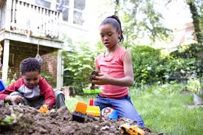
Dirt on My Shirt
By Jeff Foxworthy
There’s dirt on my shirt
And leaves in my hair
There’s mud on my boots
But I don’t really care

Slide 3
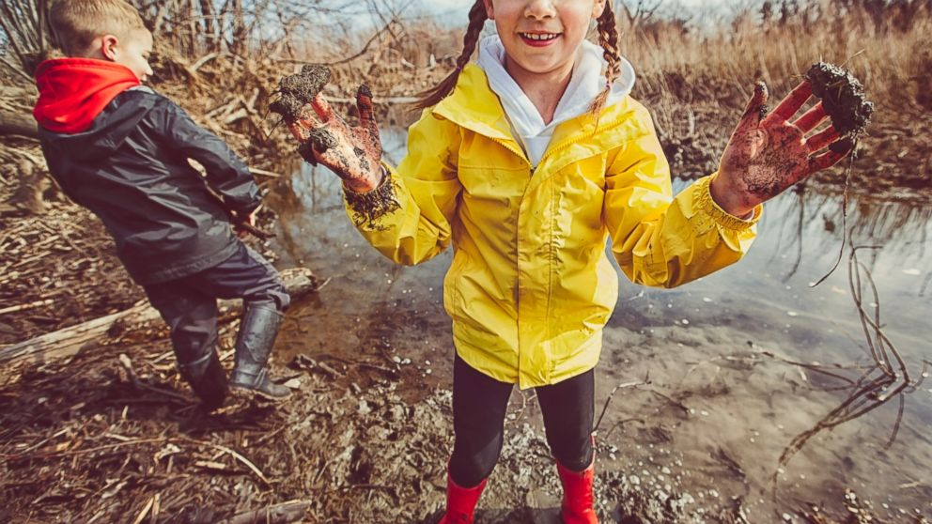
Playing outside is so much fun
To breathe the clean air
And feel the warm sun
To stomp in a puddle
Or climb a big tree
Makes me quite happy
Just look and you’ll see

