Slide 1
Close Viewing: Owl Moon
Unit 2, Week 5, Day 3

Slide 3
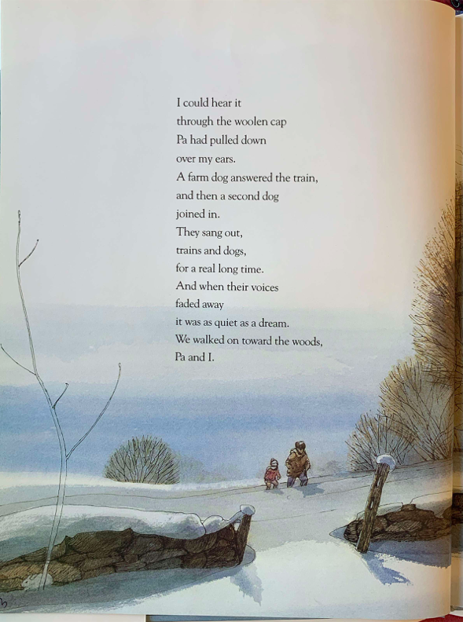
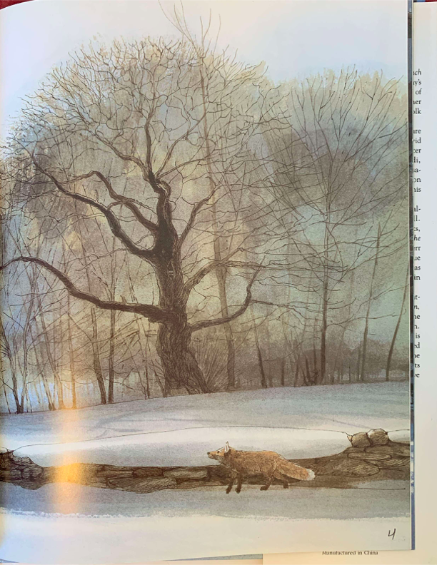

Slide 4
