Slide 1
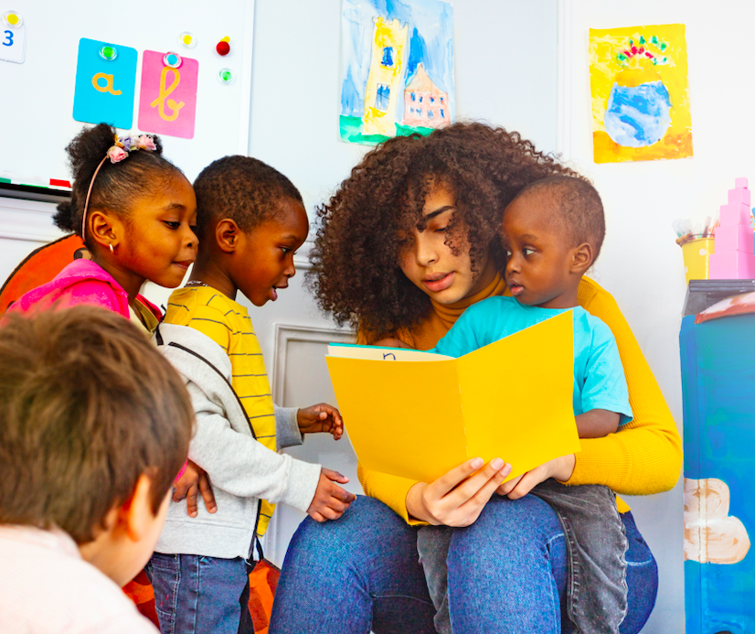
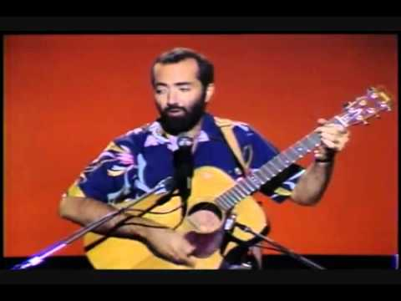
The More we Get Together
by Raffi
Listen here:

Slide 2
The more we get together
Together, together
The more we get together
The happier we'll be.

Slide 3
'Cause your friends are my friends
And my friends are your friends
The more we get together
The happier we'll be

Slide 4
Oh, the more we get together
Together, together
The more we get together
The happier we'll be

Slide 5
There's ________ (name) and ________ (name)
And ______ (name) and ________ (name)
The more we get together
The happier we'll be.

