Slide 1
How do animals grow and change?

Slide 4
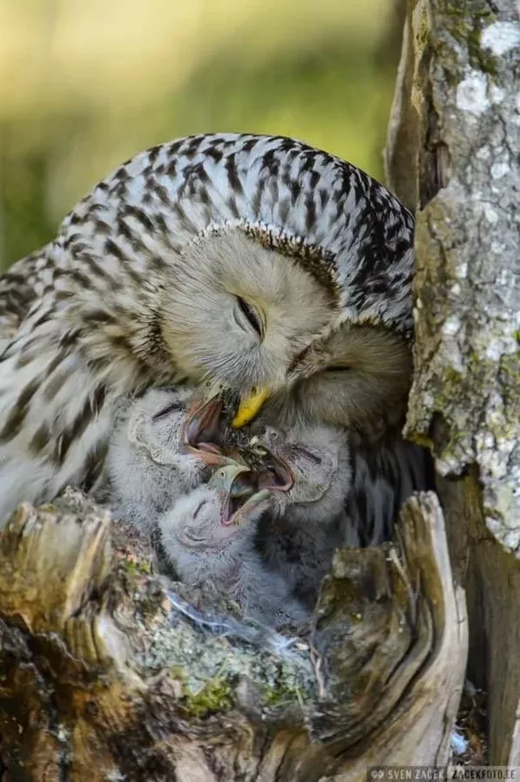

Slide 5
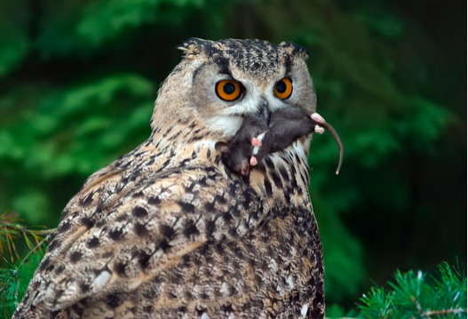

Slide 6
