Slide 1
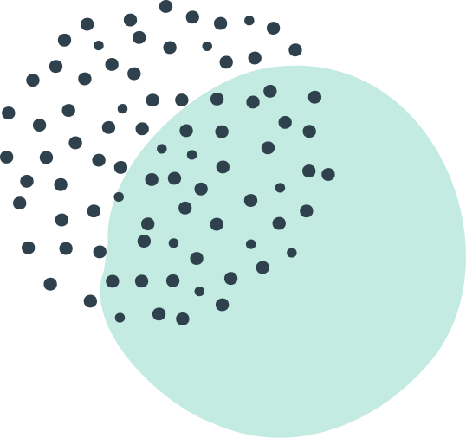
MAINE DOE BOOK STUDY
SESSION
GRADING FOR EQUITY
By Joe Feldman

Slide 2
Today's Webinar
CHAPTER PREVIEWS & DISCUSSION
Chapter 1: What Makes Grading so Difficult to Talk About (and Even Harder to Change)?
Chapter 2: A Brief History of Grading
Grading for Equity
by Joe Feldman

Slide 3
Guiding question:
What's best for students?
GRADING FOR EQUITY
BOOK STUDY

Slide 4
CHAPTER
1
PREVIEW
BREAKOUT DISCUSSION GROUP
LEARNING STRUCTURE
CHAPTER
2
PREVIEW
BREAKOUT DISCUSSION GROUP

Slide 5
AUTHENTIC ENGAGEMENT AGREEMENTS
Presentation/
chapter previews
10 minutes
Please mute
Consider turning off your video to relax
while learning
Time for discussion
in breakout groups–
Be prepared to think and share
Use the chat during the presentation to post THOUGHTS, QUESTIONS, EPIPHANIES
(TQEs idea from Marissa Thompson)

Slide 6
CHAPTER 1
GRADING AS IDENTITY

Slide 7
Grades are the only thing some teachers feel they have control over thanks to unions and state policies
CHAPTER 1
ISLAND OF AUTONOMY

Slide 8
EVERY TEACHER MAKES
VERY DIFFERENT CHOICES
"Because each teacher's grading system is virtually unregulated and unconstrained, a teacher's grading policies and practices reveal how she defines and envisions her relationship with students, what she predicts best prepares them for success, her beliefs about students, and her self-concepts as a teacher."
(Feldman, 6)
Chapter 1 | Grading as Identity

Slide 9
CHAPTER 1
GRADING & OUR "WEB OF BELIEF"

Slide 10
Web of Belief
BASED ON EXPERIENCES &
PRIOR UNDERSTANDING
Chapter 1 | Grading as Identity
Philosopher W.V. Quine (1978)
"A complex system of what we hold to be true
in the world based on our experiences
and prior understanding."

Slide 12
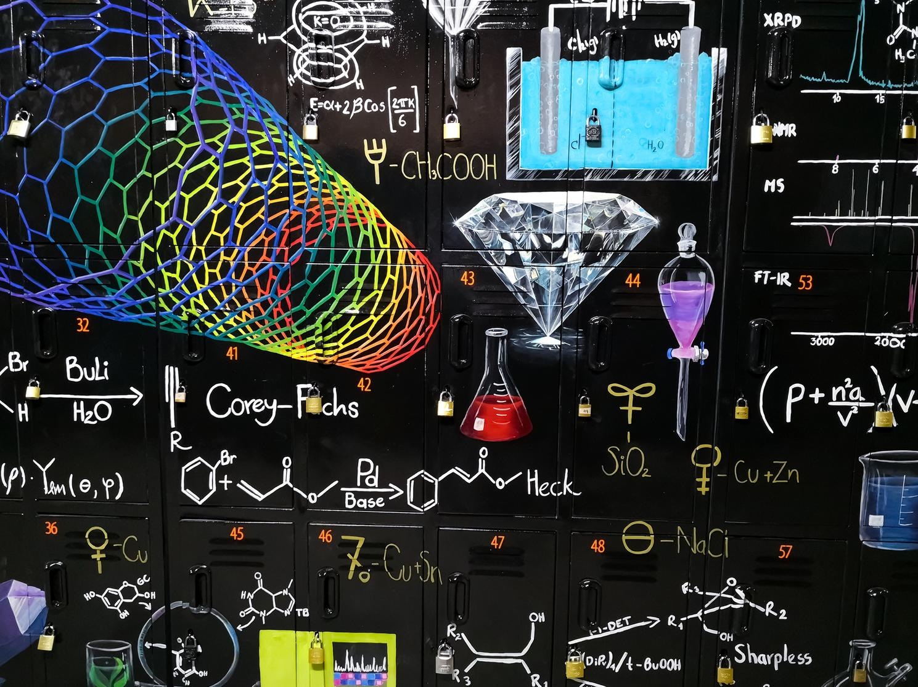
CHAPTER 1
BLENDING THE
TECHNICAL & THEORETICAL

Slide 13
How and Why
TECHNICAL=THE HOW
OF GRADING PRACTICES
&
THEORETICAL=THE WHY BEHIND THESE PRACTICES
Chapter 1 | Grading as Identity

Slide 14
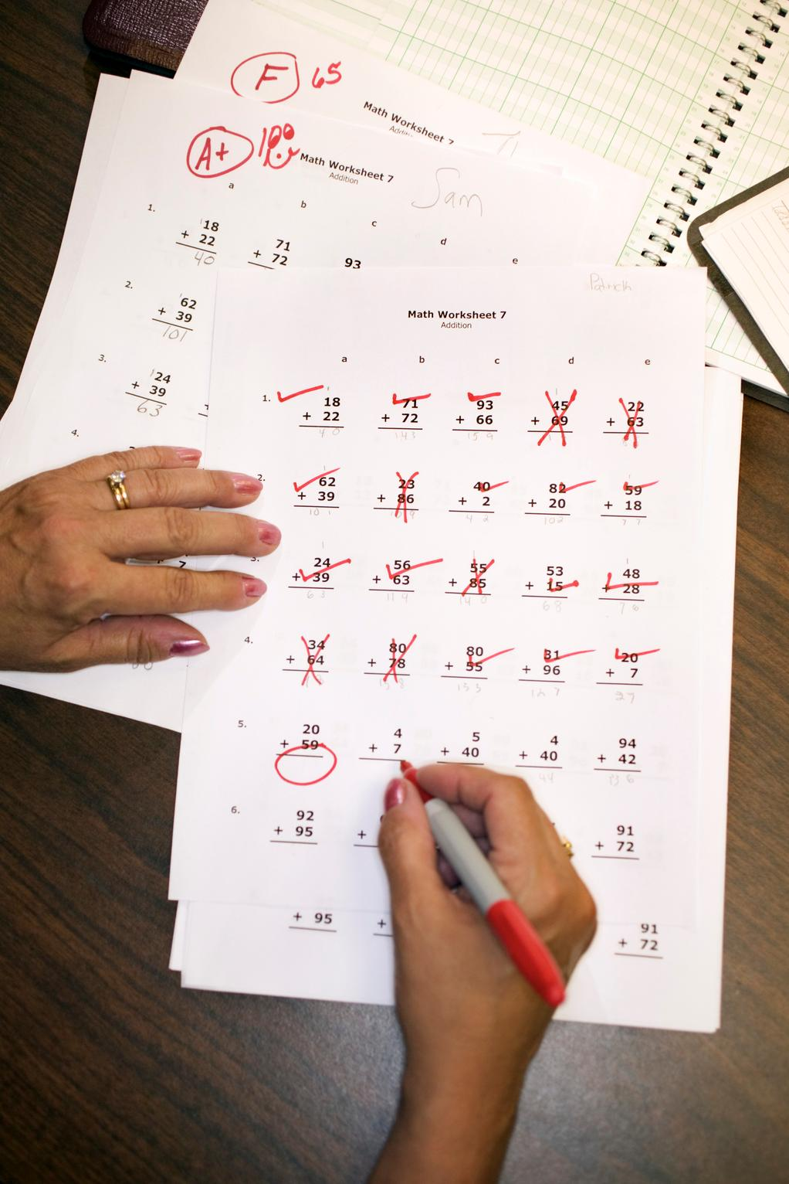
Technical
MORE EQUITABLE PRACTICES
How to implement:
Changes required for time, messaging, assessment design, and gradebook software
Successful, concrete examples
Struggles and successes
Chapter 1 | Grading as Identity

Slide 15
Theoretical
EVOLUTION OF GRADING
Grading purpose & inequities:
Current, research-based knowledge
Messages of current grading practices to students & stakeholders
More equitable practices and how they can improve assessments, curriculum designs, and instructional decisions.
Chapter 1 | Grading as Identity

Slide 16
PART I–FOUNDATIONS
Book Organization
Grading identity & history
PART II–CASE FOR CHANGE
Current practices & inequity
+ Proposal for more equitable grading
PART III–PRACTICES
Equitable grading practices

Slide 17
PART I–FOUNDATIONS
Book Study Organization
Today Chapters 1 & 2
PART II–CASE FOR CHANGE
6/9 Webinar Chapter 3
6/16 Webinar Chapter 4
6/23 Webinar Chapters 5 & 6
PART III–PRACTICES
July--Choice work groups.
Groups determine meeting/study.
August–Whole group report out

Slide 18
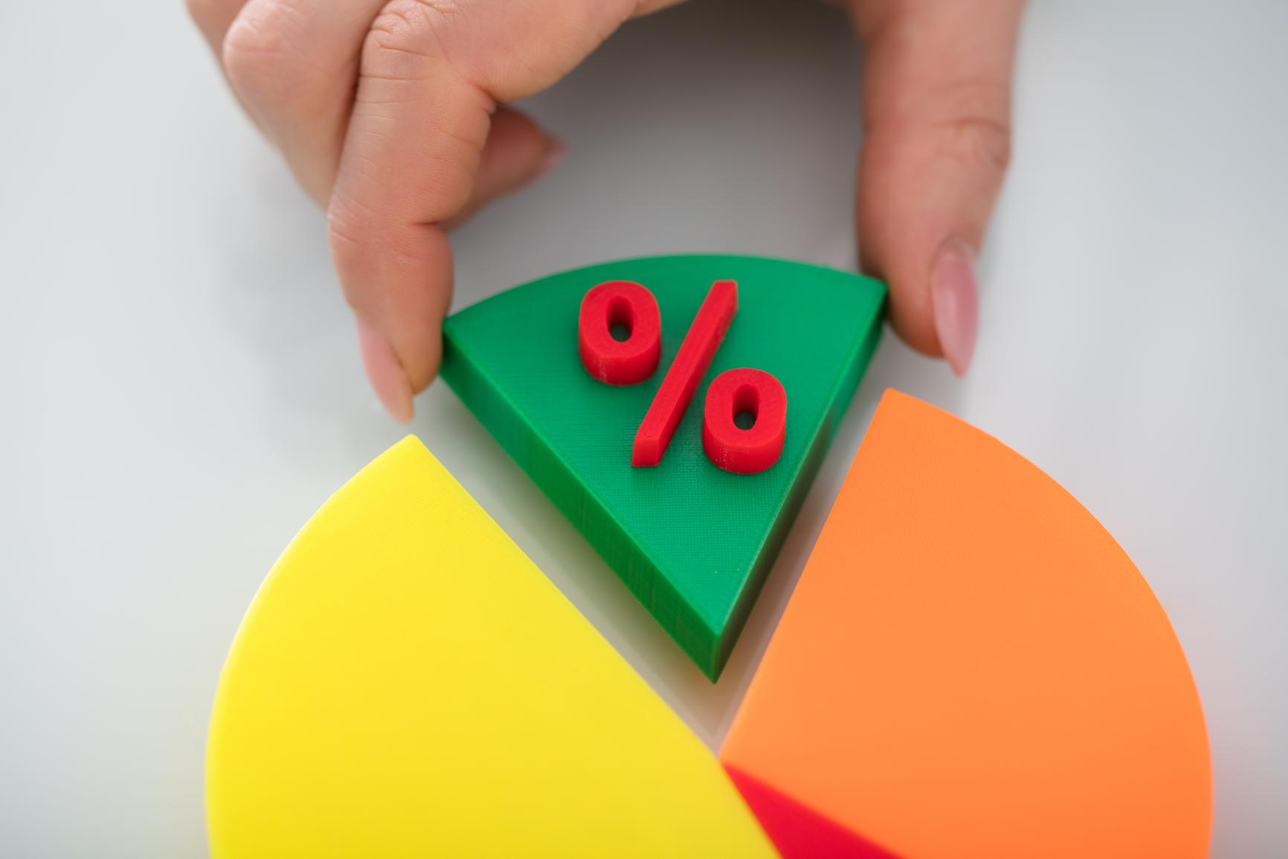
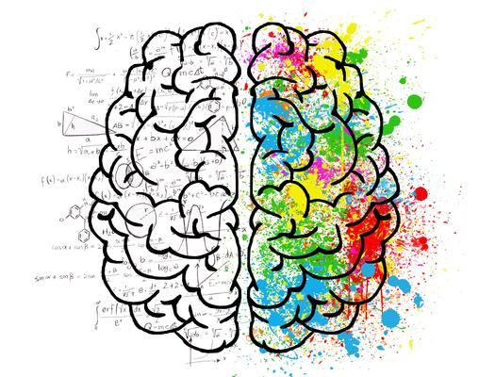
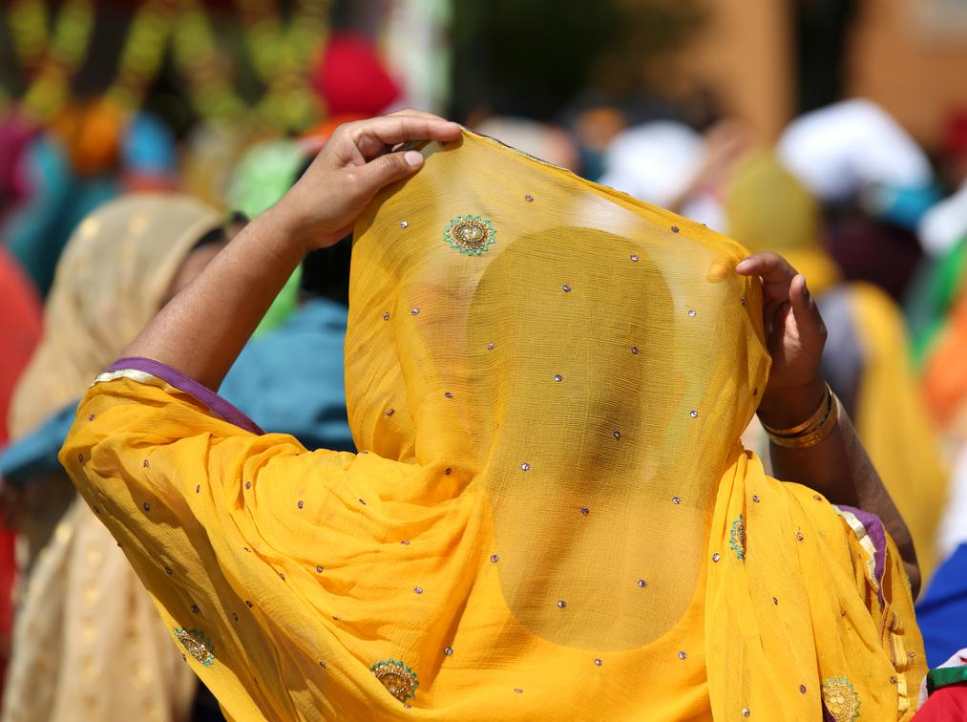
MORE EQUITABLE GRADING PRACTICES
Are accurate & mathematically sound
Value knowledge, not environment or behavior
Support hope
& a growth mindset
Lift the veil
on how to succeed
Build "soft skills"
& motivate students

Slide 19
A Final Word
ENVISION THE POSSIBIILITIES
Chapter 1 | Grading as Identity
A message from Joe Feldman:
"As we learn new ideas, let us be open, humble, honest, and forgive ourselves if we weren't aware that things could be different" (13).

Slide 20
Break out Groups
Factors for Success
Facilitator
Timekeeper
Engagement

Slide 21
Discussion Question
What brings you to this book/book study?
What are your goals for reading/studying it?
How will the way you read it help or hinder you from realizing those goals?

Slide 22
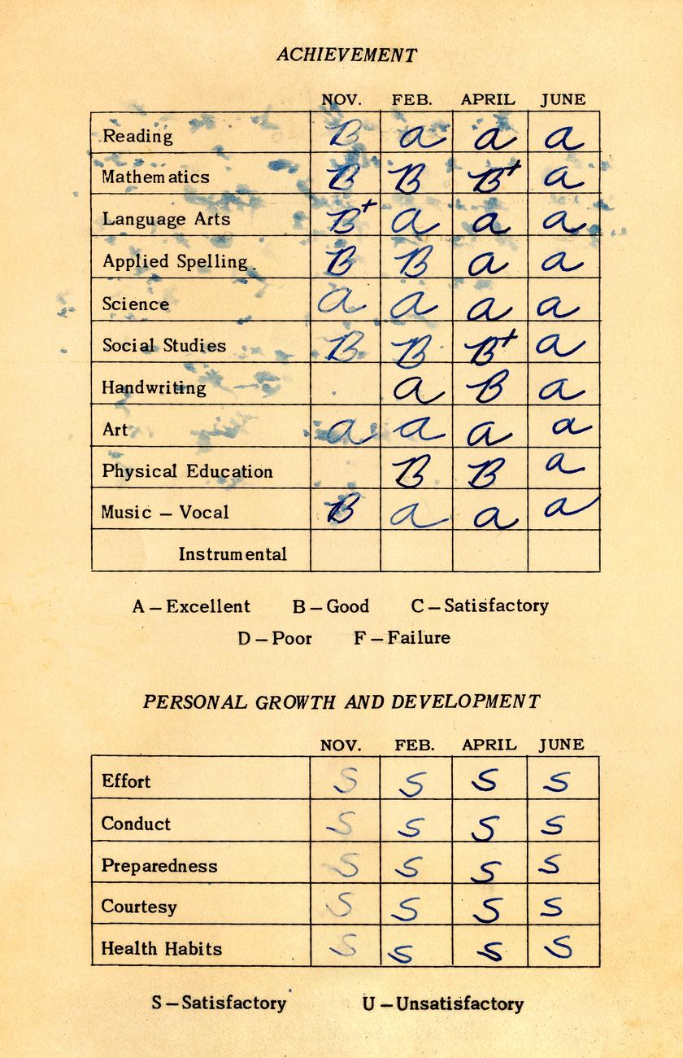
CHAPTER 2
A BRIEF HISTORY OF GRADING

Slide 23
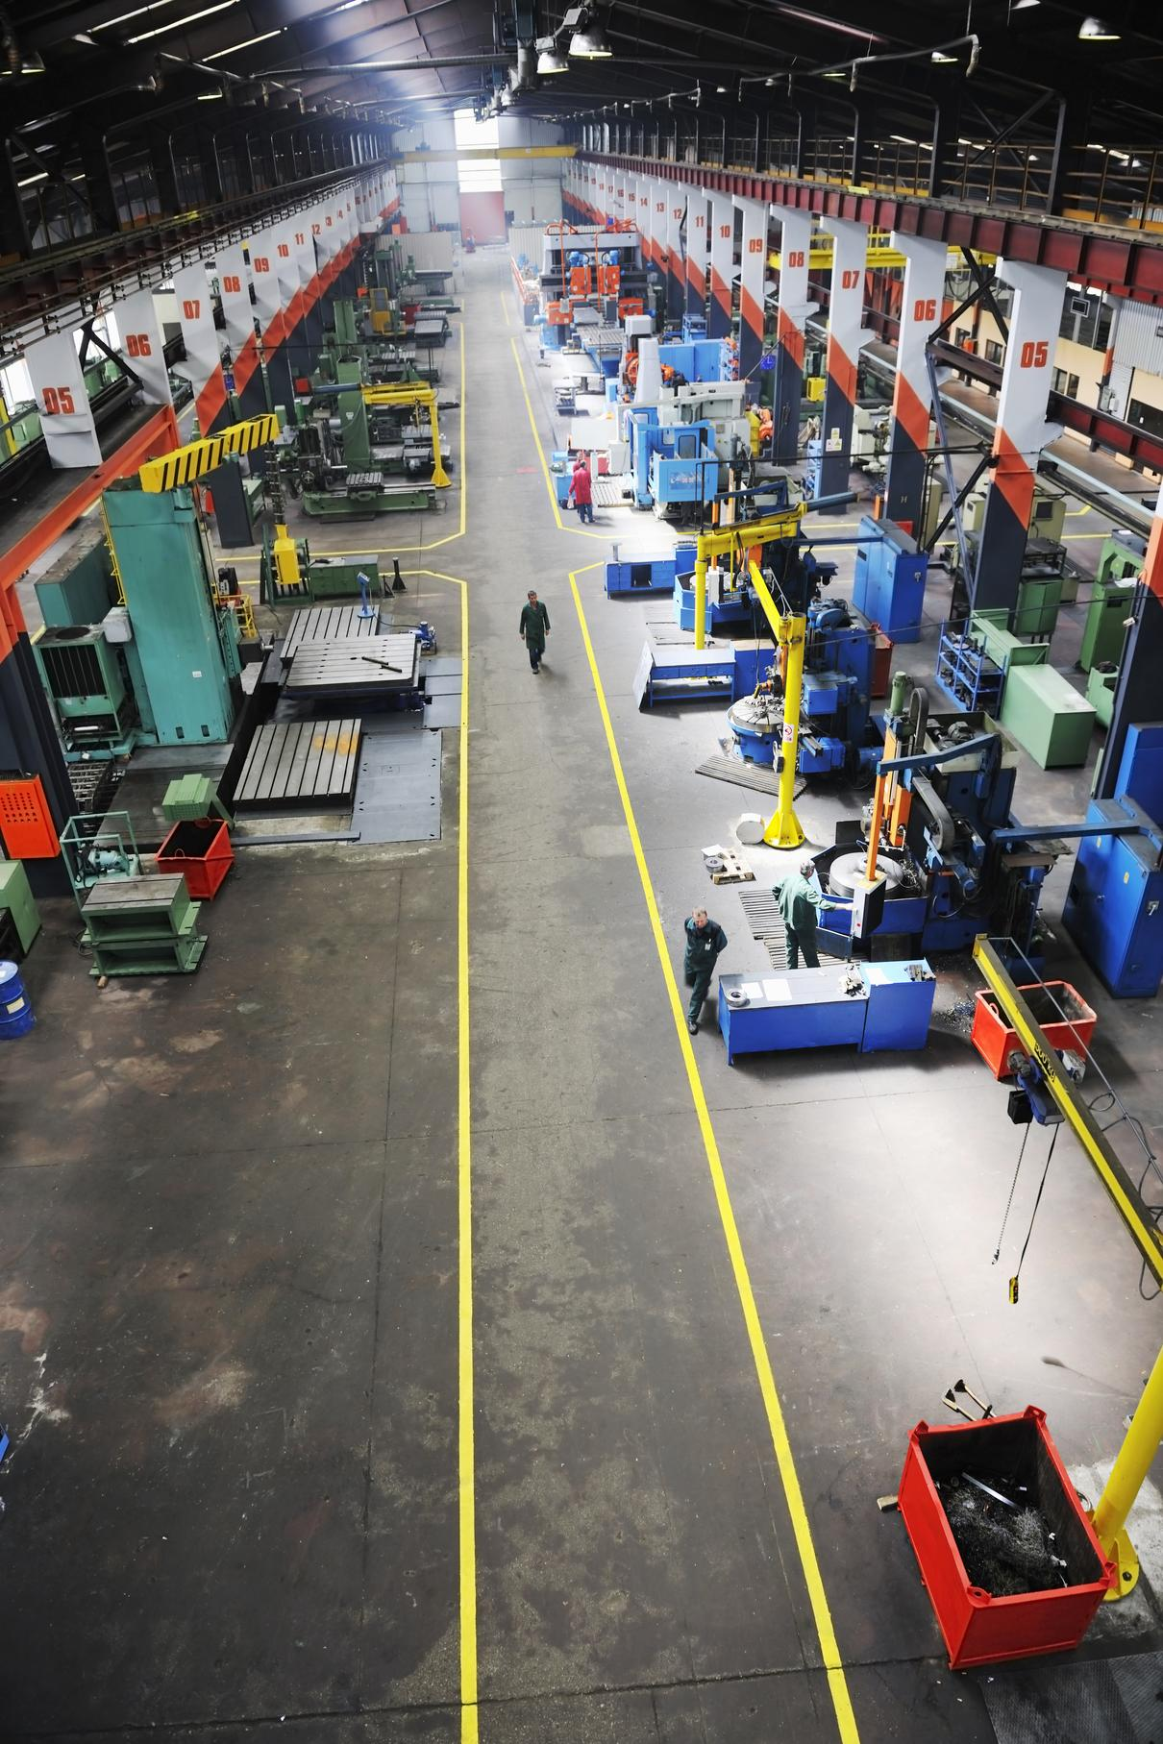
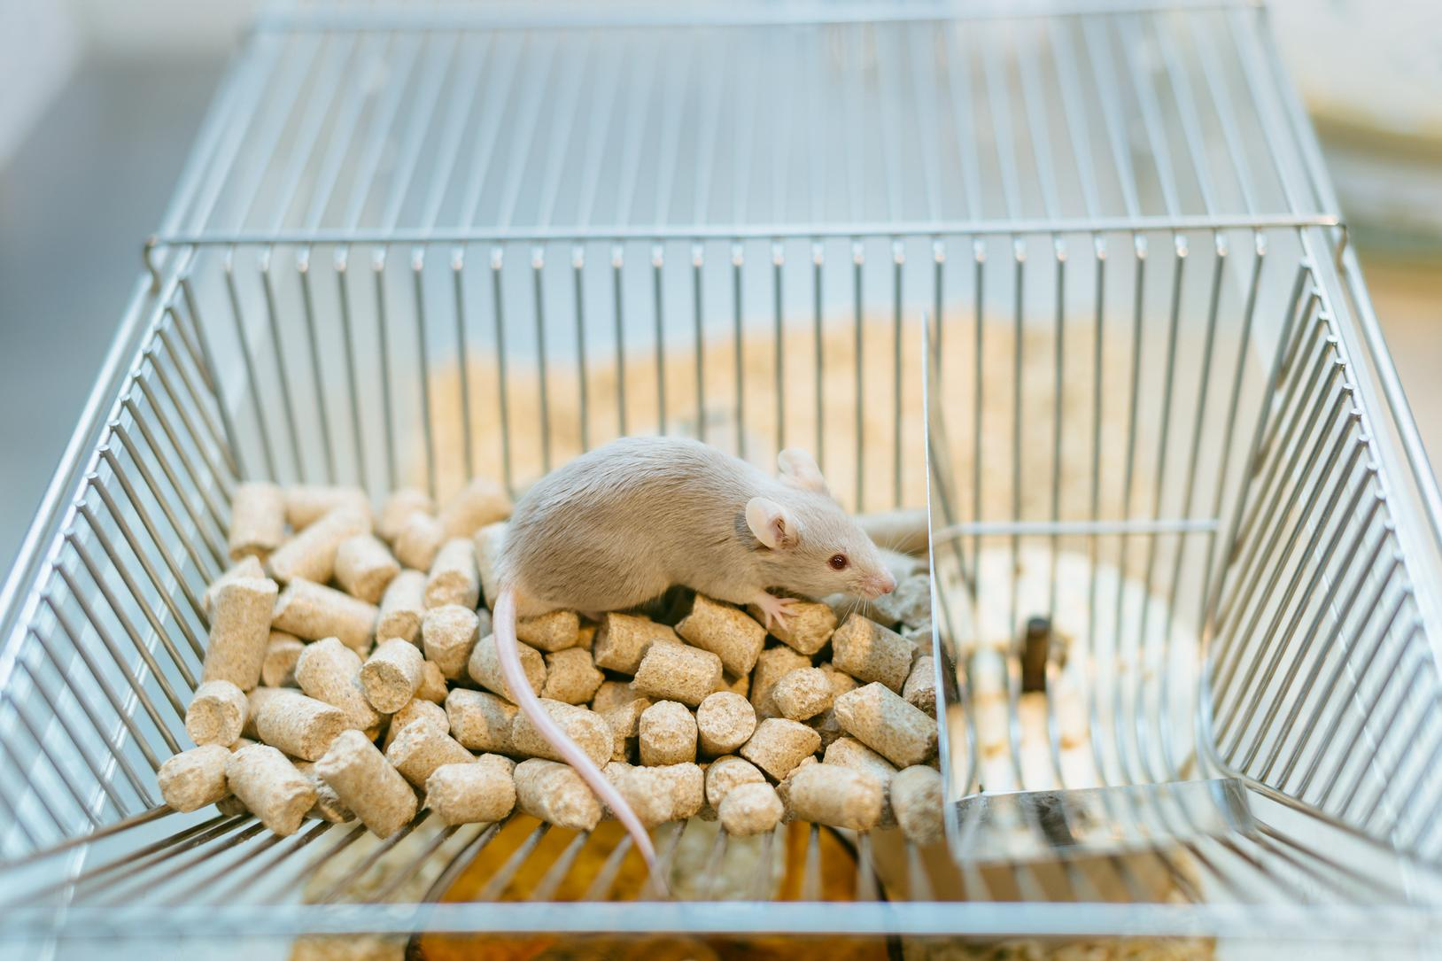
OVER THE PAST 100 YEARS
Changes in American society
The rise of manufacturing
Intelligence testing
& categorization
Progressive Educators
Migration & Immigration
Behaviorism

Slide 24
THE RISE IN MANUFACTURING
Efficiency & Productivity
Pressure to create future employees
Industry characteristics
as models for schools
Chapter 2 | A Brief History of Grading

Slide 25
"There was also a cultural veneration for the power and productivity of factories, which persuaded policy makers to incorporate characteristics of industry–specialization, chain of command, timed routines, and efficiencies–into public institutions, including schools" (Feldman, 19).
Chapter 2 | A Brief History of Grading

Slide 26
PROGRESSIVE EDUCATORS
Universal--open to all
Common Curriculum
Elevate social & economic position
Support moral development
Chapter 2 | A Brief History of Grading

Slide 27
"In the end, although Dewey's vision of schools-as-democratic-engine provided overarching rhetoric about schools, it was often eclipsed by the vision of schools-as-training-ground." (Feldman, 19).
Chapter 2 | A Brief History of Grading

Slide 28
MIGRATION & IMMIGRATION
Moves from rural living to cities
w/ factory jobs & transportation
Massive wave of immigrants
from Western & then Eastern Europe
Chapter 2 | A Brief History of Grading

Slide 29
"While in 1820 there were only four U.S. cities of populations over 25,000 people, four decades later, thirty-five cities had populations of over 25,000, with nine cities of over 100,000. Clearly, the radical changes in the student population couldn't help but profoundly
affect schools" (Feldman, 19).
Chapter 2 | A Brief History of Grading

Slide 30
INTELLIGENCE TESTING & CATEGORIZATION
"Natural intelligence" theories
Skull size
IQ tests believed to asses
intellectual character/disposition
& "justify" racist beliefs.
Chapter 2 | A Brief History of Grading

Slide 31
"Higher scores among white, wealthy Protestants and lower scores among immigrant groups and African Americans were used both to affirm the idea of the United States as a meritocracy and to reinforce the validity of the existing hierarchy" (Feldman, 20).
Chapter 2 | A Brief History of Grading

Slide 32
BEHAVIORISM
Human behavior is the result of external stimuli
B.F. Skinner rat experiments
"operant conditioning"
Chapter 2 | A Brief History of Grading

Slide 33
"This theory of learning–that humans could be taught to act in certain ways through extrinsic reinforcement or consequences–became wildly popular in schools and factories" (Feldman, 20).
Chapter 2 | A Brief History of Grading

Slide 34
Over the past
100 years
HOW DID
THESE CHANGES CHANGE SCHOOLS?
The rise of manufacturing
Intelligence testing
& categorization
Progressive Educators
Migration & Immigration
Behaviorism

Slide 35
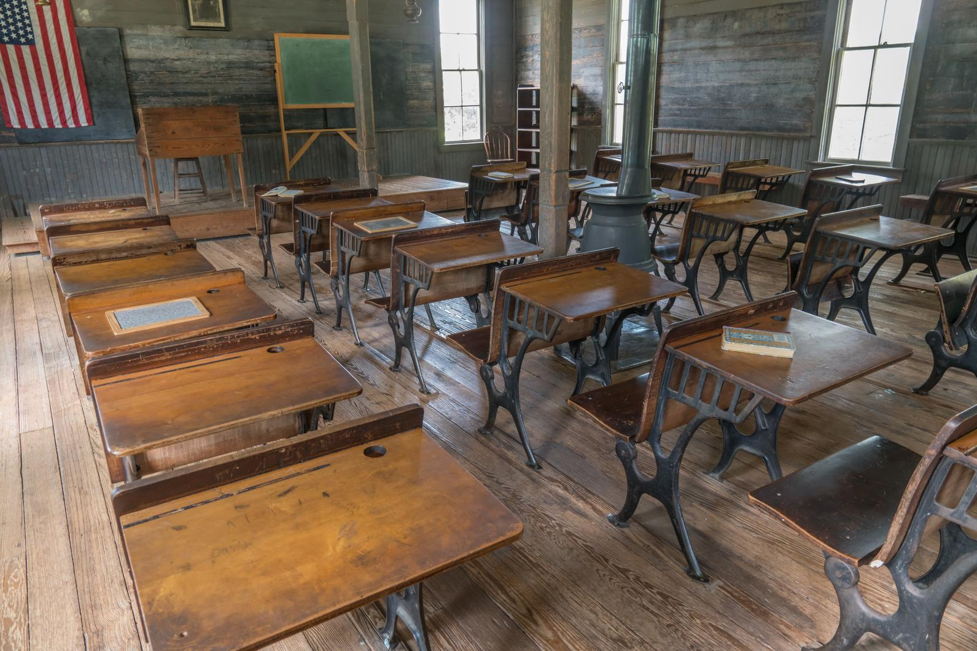
19th Century
Obedience
1 room school house
Teacher/student familiarity
Narrative reports to families

Slide 36
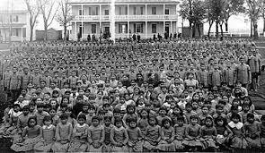
19th & 20th Century
Assimilation
Training immigrants to be "Americans"
Native American children placed in boarding schools

Slide 37
A little detour
The idea of an “average man”–early 19th century
Belgian mathematician, Adolphe Quetelet.
Average=Perfection
Francis Galton–divided humankind into 14 classes
From “Imbeciles” through “Mediocre” to the “Eminent."
Average=Mediocre

Slide 38
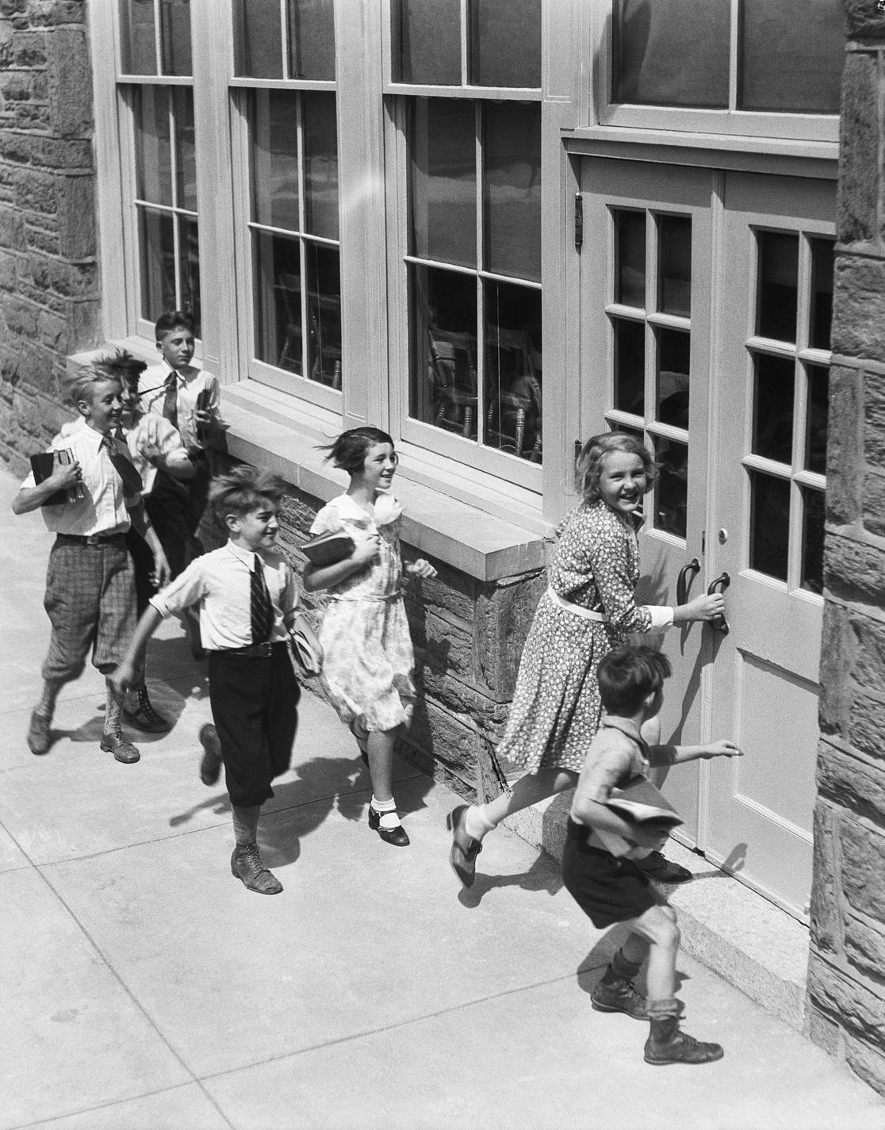
20th Century
Sorting and Ranking
Larger public schools
Need for efficiency & accountability
Single letter grades A-F
Norm-referenced grades/bell curve

Slide 39
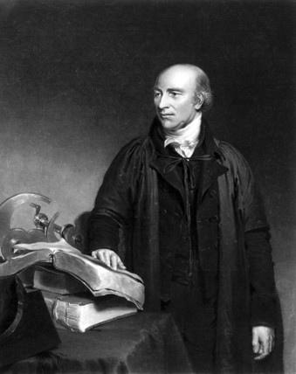
Another detour
William Farish--Cambridge University Tutor
Process more students in less time, make more money.
Created a letter grade system
modeled after the shoe factory industry
to label if shoes were "up to grade."

Slide 40
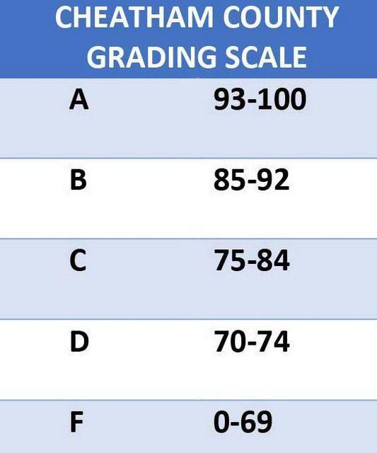
Why no "E"
Mount Holyoke College, Massachusetts–
1st in United States to use letter grades (1887)
High schools followed suite in early 1900s.
Schools removed the E in the 1930s–worried some might think the E (failure) could equate to an E for excellent.

Slide 41
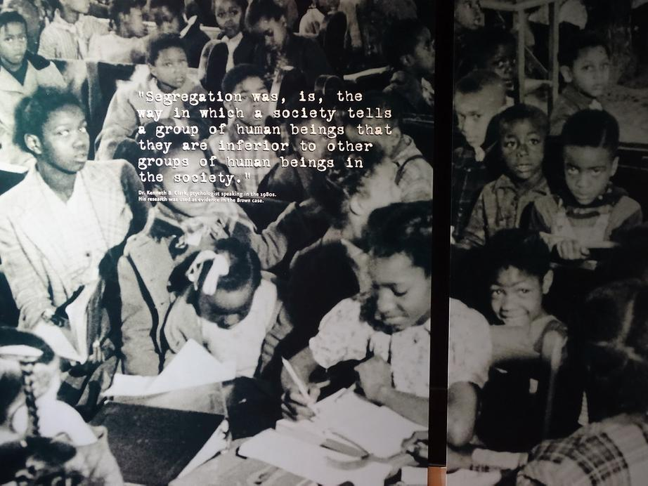
20th Century
Tracking
IQ tests used in schools
Work track & college track
Socioeconomic & racial hierarchy

Slide 42
Today
Grades still=
Obedience/compliance
Assimilation/good citizens
Sorting & Ranking/bell curve
Tracking/voc.ed or college

Slide 43
Discussion Question
How do you see the ideas and beliefs of the early 20th century manifesting themselves through your school's communication, curriculum, instruction, policies, and/or grading?

Slide 44
Time for questions?
GRADING FOR EQUITY
BY JOE FELDMAN

Slide 45
Thank you
for participating
in this learning journey!
NEXT QUESTION
NEXT STEP
NEXT WEBINAR
How does our use of traditional grading send mixed messages?
Read and Reflect on
Chapters 1 & 2
Tuesday, 6/9 @ 3pm
Chapter 3 Preview
How Traditional Grading Stifles Risk-Taking and Supports the "Commodity of Grades

Slide 46
"IF WE'RE GOING TO
UNDERSTAND OUR GRADING, QUESTION IT, AND
FIND WAYS TO IMPROVE IT, PARTICULARLY FOR VULNERABLE
STUDENT POPULATIONS,
WE NEED A BASIC UNDERSTANDING
OF ITS GENEALOGY
AND ITS EVOLUTION."
FINAL WORDS
(FELDMAN, 18)

