Slide 1
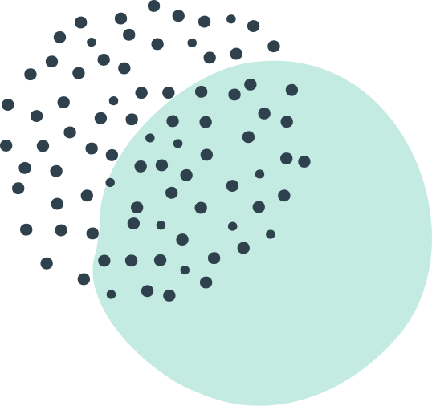
MAINE DOE BOOK STUDY
SESSION
GRADING FOR EQUITY
By Joe Feldman

Slide 2
Today's Webinar
CHAPTER PREVIEW & NEXT STEPS
Chapters 5 & 6
Next Steps
Grading for Equity
by Joe Feldman

Slide 3
Guiding question:
What's best for students?
GRADING FOR EQUITY
BOOK STUDY

Slide 4
BREAKOUT DISCUSSION
CHAPTERS
PREVIEW
PRESENTATION
BREAKOUT DISCUSSION
LEARNING STRUCTURE
WHERE WE'RE GOING FROM HERE...NEXT STEPS

Slide 5
Breakout Discussion #1
What impact does being judged for every mistake, being awarded points for their actions, and being faced with complex and variable grading
have on students' motivation to learn? (Q1, p. 59)
5 minutes to discuss––1 minute each

Slide 6
TRADITIONAL GRADING PRACTICES–
HOW STUDENTS FEEL:
Constantly judged, points added & subtracted for everything
Confused, grading too complex
Overloaded, too much to figure out with each teacher grading differently
Defined by a single grade
CHAPTER 5 | TRADITIONAL GRADING
DEMOTIVATES AND DISEMPOWERS

Slide 7
TRADITIONAL GRADING PRACTICES–
HOW STUDENTS FEEL:
DEFINED BY A SINGLE GRADE
CHAPTER 5 | TRADITIONAL GRADING
DEMOTIVATES AND DISEMPOWERS

Slide 8
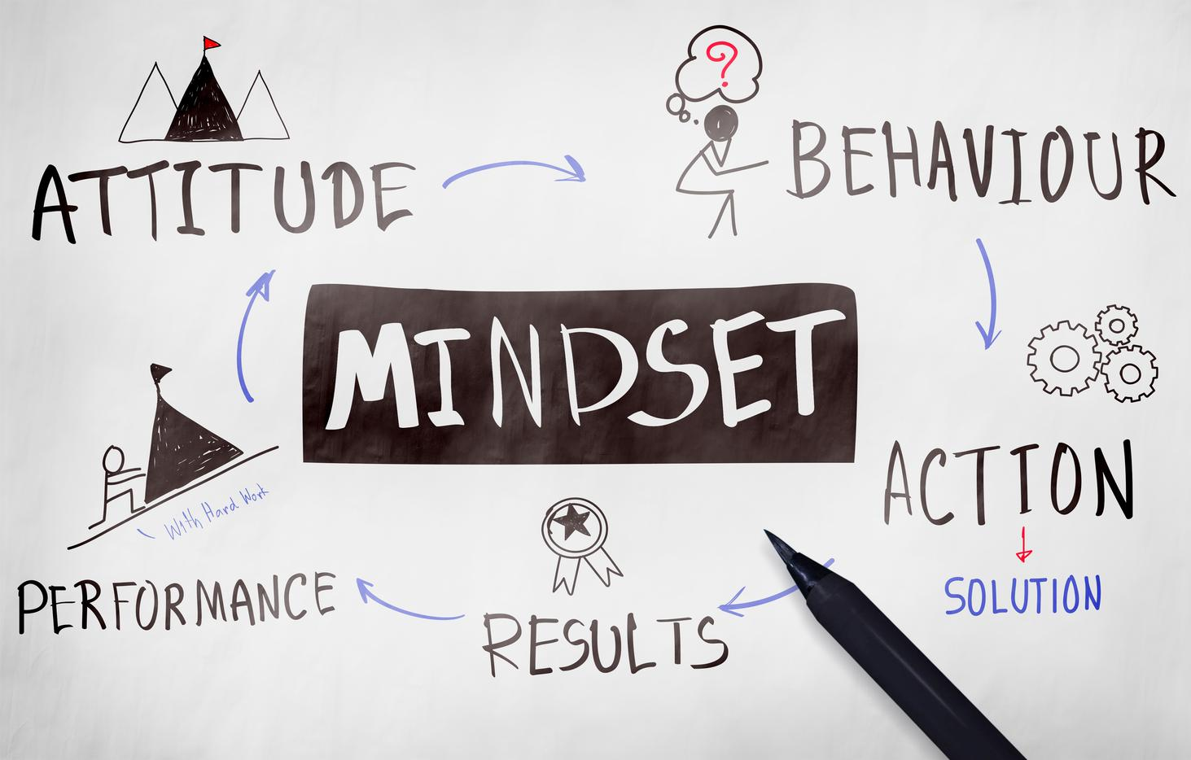
Create a
fixed mindset
The grade says I am dumb,
so I will avoid doing the things that remind me of this.

Slide 9
Students become disengaged and disempowered
Chapter 5 | Traditional Grading
Demotivates and Disempowers

Slide 10
The grade says I am smart, so I will do what I need to do to maintain that.

Slide 11
Students become motivated
to do the wrong thing
Chapter 5 | Traditional Grading
Demotivates and Disempowers

Slide 12
MASTERY GOALS
Success based on student's "own evaluation or whether she reaches some external standard."
Have I learned? Have I improved?
TYPES OF MOTIVATION
PERFORMANCE GOALS
Success "based on demonstrating competence in other's eyes."
Do others think I did well?
Did my teacher like what I wrote?

Slide 13
"Research has found that students define these goals in large part based on their learning environment; we as teachers influence whether students see academic success as a mastery or performance goal, and we therefore influence how they behave in response to the tasks we give them, which in turn affects their likelihood of success" (Felderman, 62).
Based on research from Anderman, Midgley, Roeser, Urdan, Ryan, Alfeld-Liro, Pintrich, Wolders.

Slide 14
WE influence how students behave in response to the tasks we give them.

Slide 15
MOVING FORWARD
MINIMIZE NEGATIVE IMPACT ON LEARNING
EXPAND EDUCATIONAL EQUITY
REIMAGINE TO ENCOURAGE
How can we minimize traditional grading's negative impact on learning, particularly for vulnerable
student populations?
How can we use grading to expand rather than limit educational equity
and achievement
in our schools?
How can we instead reimagine grading to encourage, rather than undermine, effective teaching and learning?

Slide 16
THREE PILLARS FOR EQUITABLE GRADING
ACCURATE
BIAS-RESISTANT
MOTIVATIONAL
VALIDLY REFLECT STUDENT'S ACADEMIC PROGRESS
PREVENT BIASED SUBJECTIVITY FROM INFECTING GRADES
ACADEMIC SUCCESS, PERSEVERANCE, GAINING CRITICAL LIFELONG SKILLS

Slide 17
ACCURATE PILLAR
Our grading must use calculations that are:
Mathematically sound
Correctly describe student's level of academic performance
Practices that make it easy for students to understand

Slide 18
ACCURATE PILLAR
Grading Practices:
Avoiding Zeros
Minimum Grading
0-4 scale
Weighting more recent performance
Grades based on an individual's achievement, not the group's

Slide 19
BIAS-RESISTANT PILLAR
Grades should be based on:
Valid evidence of a student's content knowledge
NOT based on evidence that is likely to be
corrupted by a teacher's implicit bias
or reflect a student's environment
Practices that value knowledge, not environment or behavior

Slide 20
BIAS-RESISTANT PILLAR
Grading Practices:
Based on required content, not extra credit
Based on student work, not the timing of the work
Alternative (non-grade) consequences for cheating
Excluding participation & effort
Based entirely on summative assessments, not formative (like homework)

Slide 21
MOTIVATIONAL PILLAR
Grading practices that:
Achieve academic success
Support a growth mindset
Give opportunities for redemption
Practices that support hope & a growth mindset
Practices that "lift the veil" where targets for academic success are clear & explicit
Practices that build "soft skills" without including them in the grade

Slide 22
MOTIVATIONAL PILLAR
Grading Practices:
Minimum grading and 0-4 scale
Renaming grades
Retakes and redos
Creating a community of feedback
Rubrics
Student trackers
Emphasize self-regulation
Based on standards scales, not points

Slide 23
Breakout Discussion #2
Share what you are thinking at this point. Which pillar confirms your teaching (accurate, bias-resistant, motivational)? Why? Which pillar might challenge your web of belief? Why? Which pillar seems most pressing for you to explore due to your teaching context for the fall? Why?
10 minutes to discuss––2 minutes each

Slide 24
WHERE WE'RE GOING
THIS WEEK:
PICK
YOUR PILLAR!
JULY:
PILLAR TEAMS
DEEP DIVE
AUGUST: CULMINATING EVENT
TUES., 8/4, 9-11 AM
Google Form to
sign up for the pillar you would like to explore with a team. Also need team leaders.
Teams explore the pillar selected. Individuals commit to try out at least one new grading practice. Team will determine best practices to recommend.
Teams will report out on their pillar. Sharing
best practice recommendations & individual commitments.

Slide 25
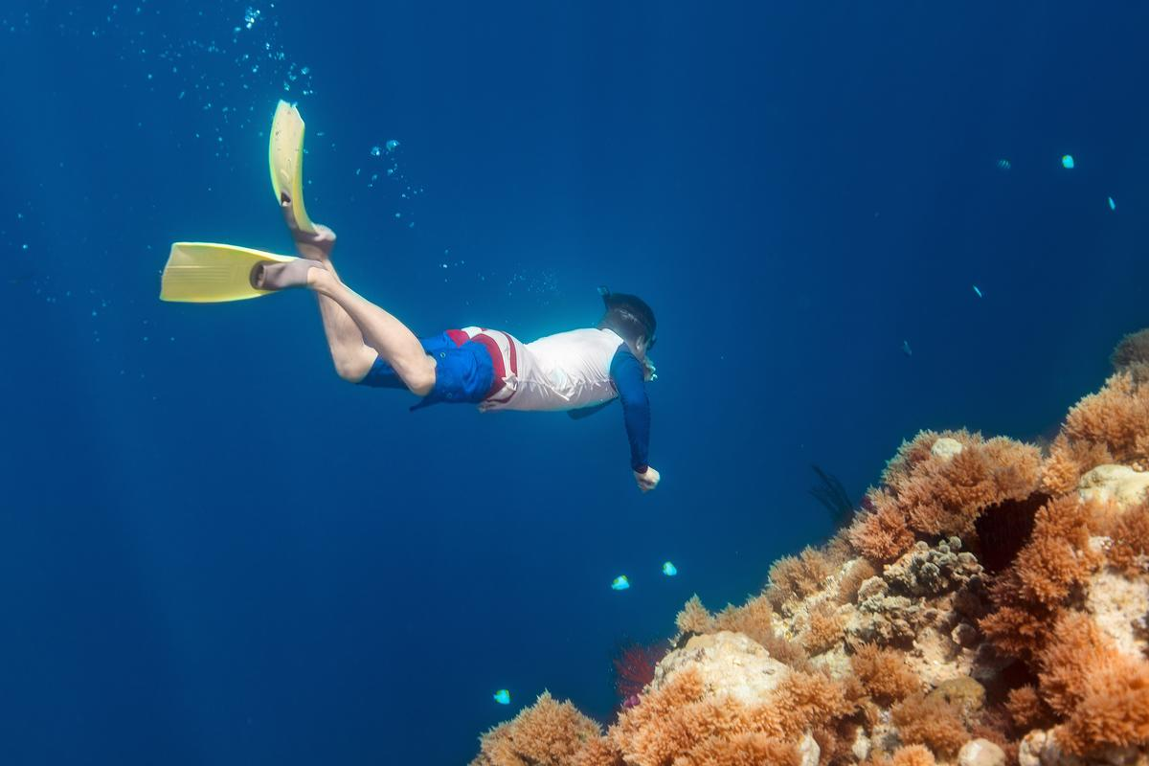
If you prefer
to dive alone...
July: Read, reflect, &
make a grading practice commitment.
August: Attend the culminating event to listen to the group report outs.

Slide 26
STATEWIDE RECOMMENDATIONS
A. Recommended practices within the pillar that would be best for your group level.
B. Barriers and openings to succeed in our school systems with these recommended practices.
PILLAR TEAM DEEP DIVE OUTCOMES
INDIVIDUAL COMMITMENT
A. Which practice will each group member commit to trying out this fall. Why? Why that practice? Why do you think it will work for you in your school system?
B. Barriers and openings to succeed, both individual and systemic.

Slide 27
Team Leaders
ATTEND ORIENTATION MEETING
This week! Thursday, 1pm (Zoom)
CONNECT W/TEAM
& SET UP MEETING(S)
Email team end of this week with study plan
FACILITATE DEEP DIVE
Facilitate meetings to make sure that all members are given the space to process/discuss/listen

Slide 28
Thank you
for participating
in this learning journey!
NEXT STEP
NEXT STEP
NEXT WEBINAR
Fill out Google form to share your learning preferences for July: group, individual, level, team leader.
July
Pillar Deep Dive!
Groups announced by the end of the week.
Tuesday, 8/4 @ 9-11 am
Culminating event with team report outs!

Slide 29
How do we change
ourselves and others?
FINAL WORDS

Slide 30
You're not going to believe what I'm about to tell you...
BY OATMEAL (7:35 MINUTES)
FINAL WORDS

Slide 31
Start with you.
FINAL WORDS

Slide 32
FINAL WORDS

Slide 33
Book Recommendation from Michelle Deblois in Lewiston
" Students should have to work hard to achieve a zero."
"Use incompletes and interventions rather than zeros."
http://www.ascd.org/Publications/Books/Overview/Grading-Smarter-Not-Harder.aspx
FINAL WORDS

Slide 34
Share Feldman's book.
FINAL WORDS

Slide 35
Share what you are doing/thinking with others.
WHEN YOU ARE READY.
FINAL WORDS

Slide 36
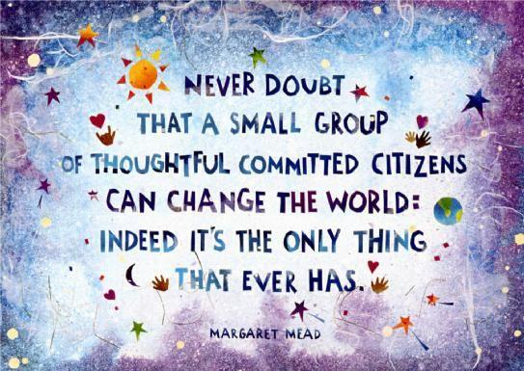
FINAL WORDS

