Slide 1
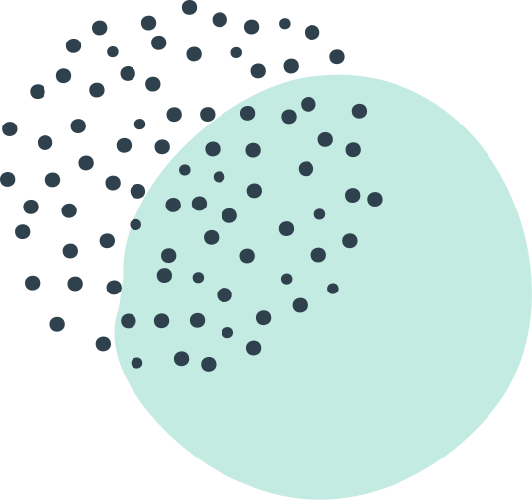
MAINE DOE BOOK STUDY
DAY
GRADING FOR EQUITY
By Joe Feldman

Slide 2
Today's Webinar
CHAPTER PREVIEW & BREAKOUT GROUPS
Chapter 4:
Traditional Grading HIdes Information, Invites Biases,
and Provides Misleading Information
Grading for Equity
by Joe Feldman

Slide 3
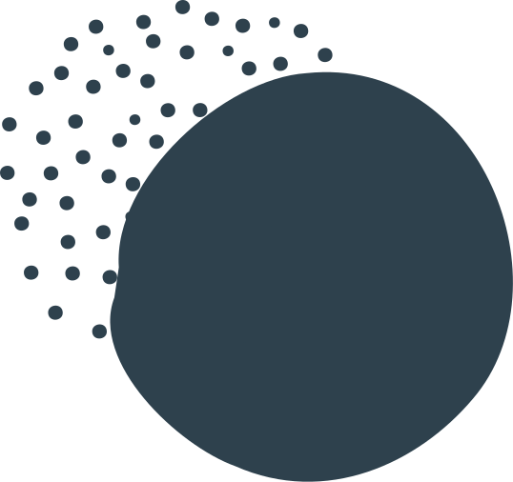
Guiding question:
What's best for students?
GRADING FOR EQUITY
BOOK STUDY

Slide 4
2 PART BREAKOUT DISCUSSION
CHAPTER
PREVIEW
PRESENTATION
BREAKOUT DISCUSSION
LEARNING STRUCTURE
CHAPTER
PREVIEW
PRESENTATION
PADLET NOTES &
CLOSING
BREAKOUT DISCUSSION

Slide 5
AUTHENTIC ENGAGEMENT AGREEMENTS
Short Presentations
Mute
Video off
Longer breakout
group discussions
Share the air
Chat box
TQEs
Discussion prompts

Slide 6
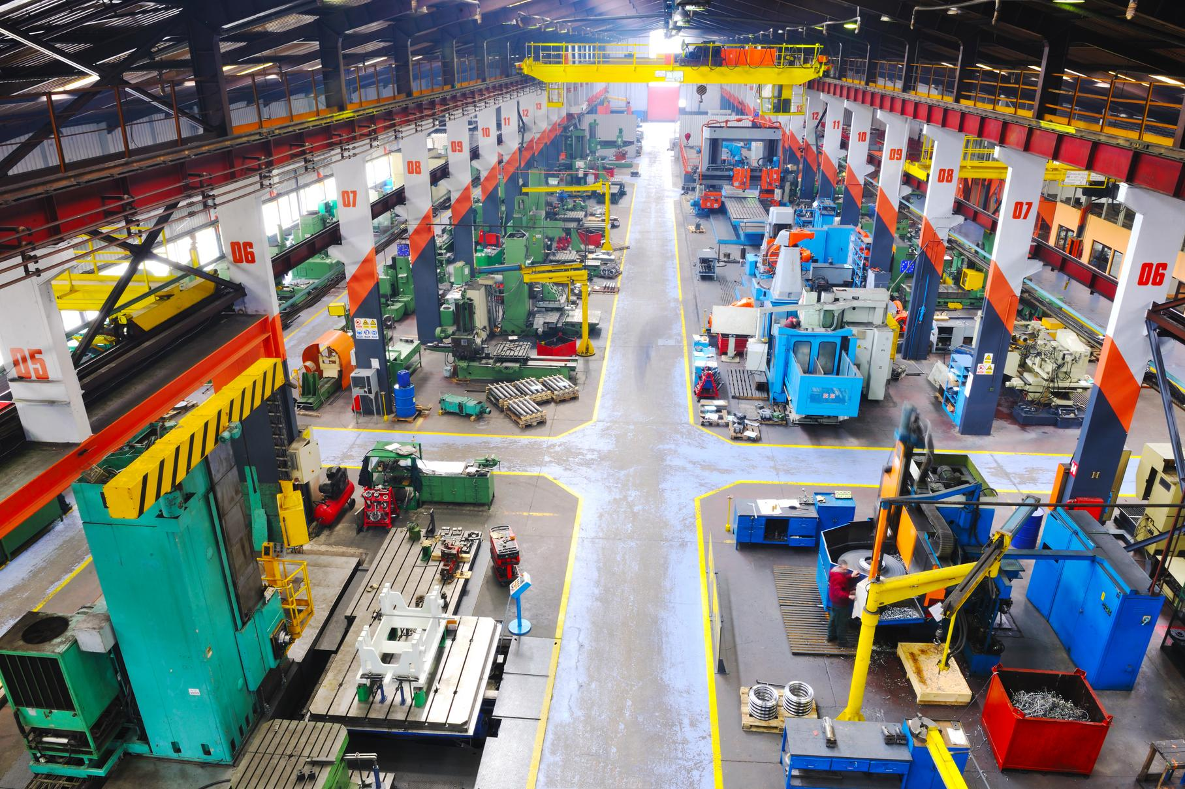
If grades were created for efficiency from
the industrial age
why do they take
so much of our time?
On my mind

Slide 7
Why do we let points/grades have so much power? And what is the impact of that power?
On my mind

Slide 8
Break out Groups
New Factor for Success
New facilitators,
share the roles,
patience

Slide 9
Breakout Discussion Part 1
How effective are the use of points for students who are the least motivated and engaged? How might the use of points–the addition and subtraction throughout a student's day–effect those students' relationship with adults and their self-concept about whether school is "for" them?
5 minutes to discuss––1 minute each

Slide 10
Breakout Discussion Part 2
How effective are the use of points for students who seem the most motivated and engaged? How might their relationship with points/grades impact their desire to learn? What did we learn about this group of students
during remote learning?
5 minutes to discuss––1 minute each

Slide 11
TRADITIONAL SINGLE-LETTER GRADES:
Overly complicated and inappropriate mathematics
Idiosyncratic teacher hacks
Variance & unreliability
create frustrations
for students
CHAPTER 4 | TRADITIONAL GRADING HIDES INFORMATION, INVITES BIASES, AND PROVIDES MISLEADING INFORMATION

Slide 12
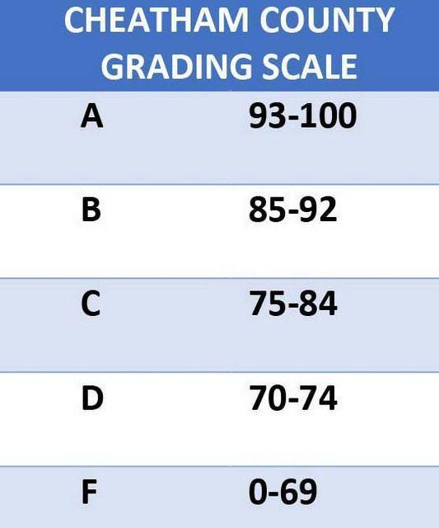
Letter grades
Include:
Content knowledge
Skills
Behaviors
Subjectivity
Bias

Slide 13
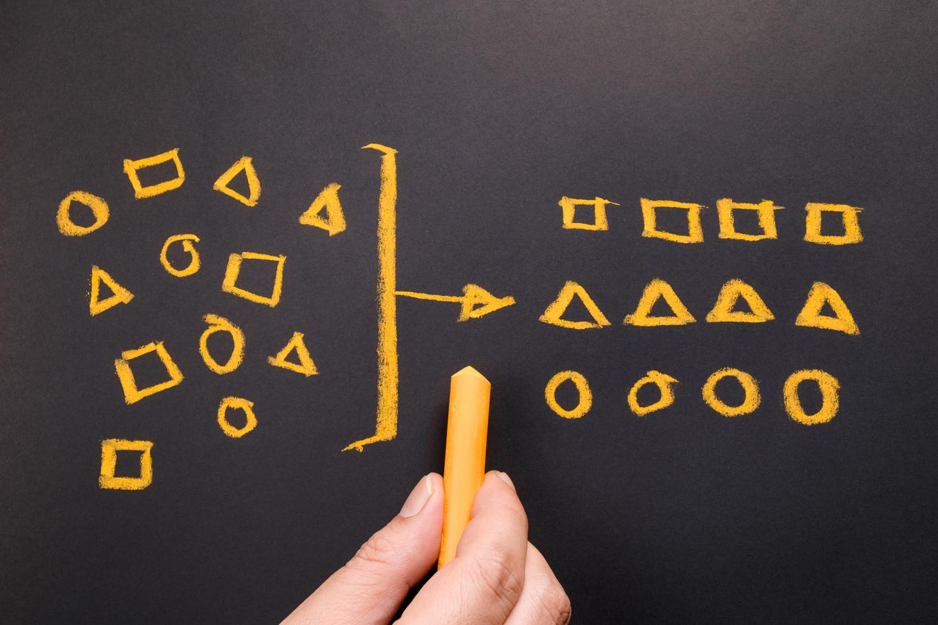
Categorizing knowledge of students
Typcial teacher
grade categories:
Homework
Tests/Projects
Classwork/Activities
Participation

Slide 14
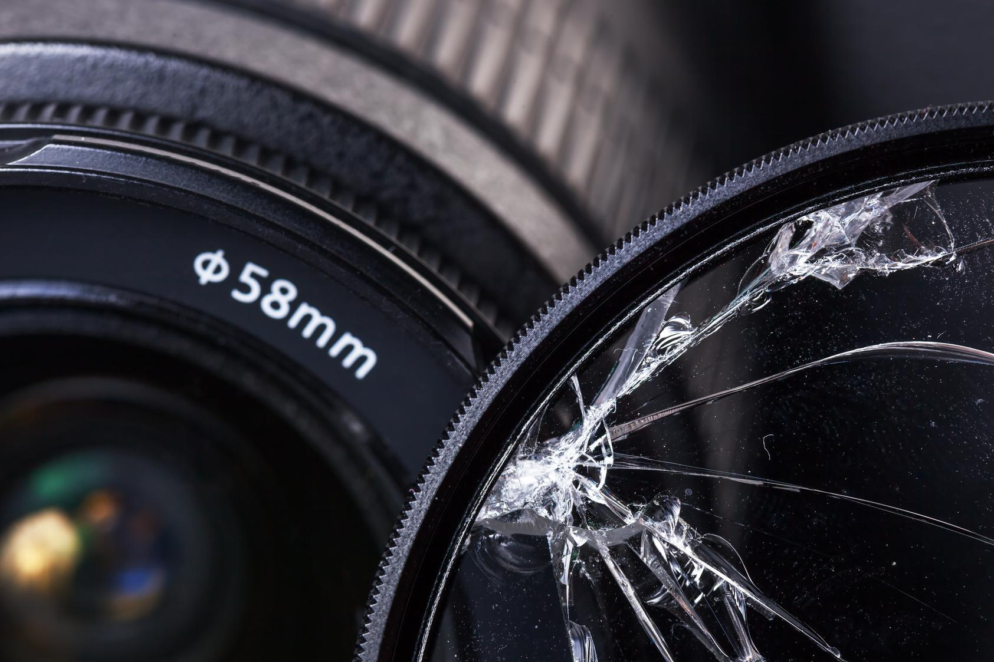
Flawed lens when behavior is included
Not just WHAT
the teacher observes,
but HOW she interprets what she observes.

Slide 15
Teacher observation
Flawed?
Student not talking during group work...
Student interrupting...
Student doodling during lecture...
Did the teacher look at the wrong time?
Is this disrespect or disengagement?
Is this off-task or focused?

Slide 16
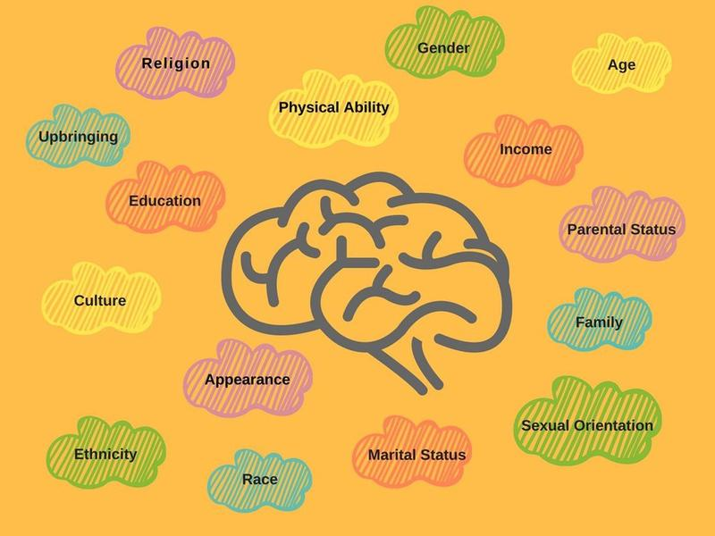
Implicit Bias
OUR ASSUMPTIONS
& BELIEFS
These "color our interpretation of that person's action"
(Feldman, 42)

Slide 17
"White teachers can misinterpret
African-American students' behaviors,
incorrectly believing them
to be signs of disrespect
or stemming from some evil intent
or judging it to be inappropriate
because the teacher comes from a different cultural background in which that behavior
is less familiar or accepted"
(Feldman, 44)

Slide 18
Subjective
awarding or subtracting for points
on behavior
stigmatizes students,
harming academic success
Researchers Gershenson, Holt,
Papageorge, 2015
(Feldman, 45)

Slide 19
"If we can't stop
our implicit biases,
can teachers,
particularly for those of us
who are white teachers,
limit the opportunities to perpetuate inequities
through our racial biases?"
(Feldman, 42)

Slide 20
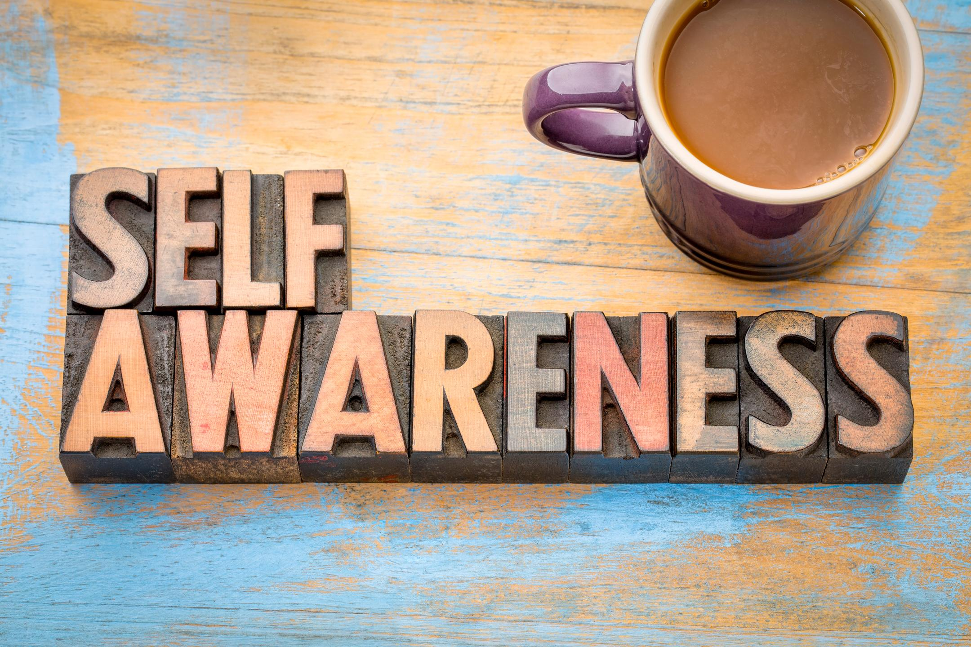
The 1st step is

Slide 21
The 2nd step is to
RECONSIDER policies
that invite bias
to operate.

Slide 22
Breakout #2
What confidence or uncertainty do you have that two teachers in your school would assign
the same grade to a student? Why is that?
With what biases might this be connected?
5 minutes to discuss––1 minute each

Slide 24
https://www.heinemann.com/pd/institutes/

Slide 25
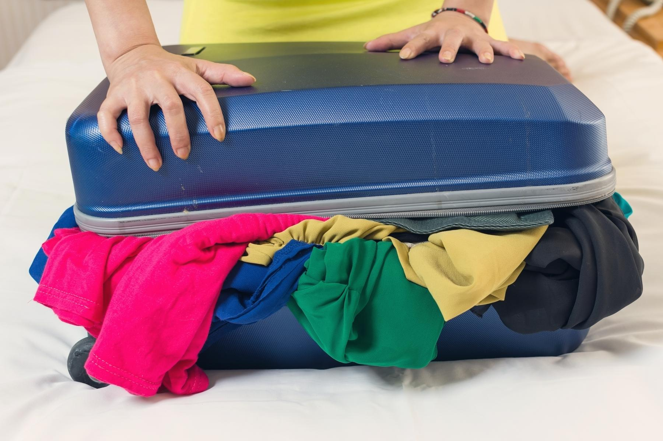
The "Omnibus" Grade
TOO MUCH INFORMATION IN ONE SMALL CONTAINER

Slide 26
Teacher's Try to be Clear
BY WEIGHTING CATEGORIES
OR ADJUSTING POINT VALUES

Slide 27
But these
create..
INFLATED
&
DEFLATED
GRADES

Slide 28
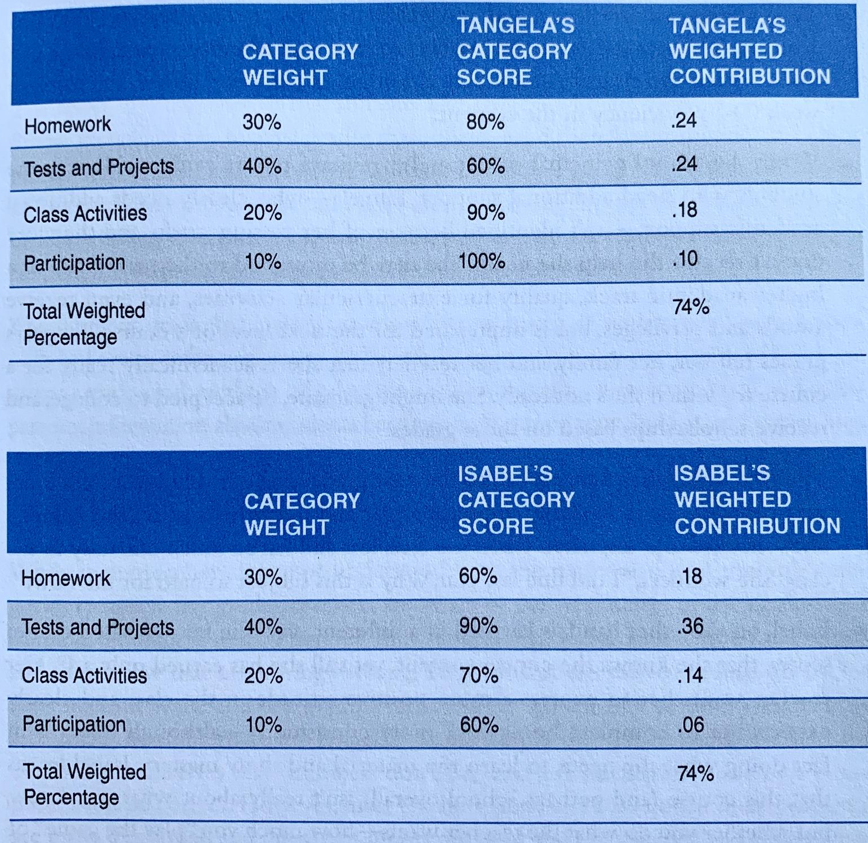
Tangela
On time
Often incorrect
INFLATED
by work ethic
Isabel
Always late
Always correct
DEFLATED
by work ethic
(Feldman, 49)

Slide 29
Compliance rewarded over competence
Tangela's academic weaknesses
overshadowed by work ethic,
doesn't get the support she needs
Isabel learns it's not about what you know but what the teacher wants
becomes less engaged/invested
Tangela
On time
Often incorrect
INFLATED
by work ethic
Isabel
Always late
Always correct
DEFLATED
by work ethic

Slide 30
Grade Hacks
MANIPULATING OUR
GRADING PROGRAMS

Slide 31
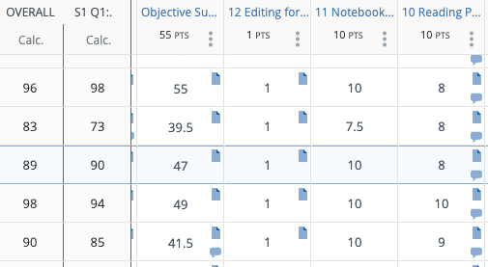
Retroactively make changes to scores
drop lowest test score
selectively average scores
create extra credit
"curve up" scores
"bump up" for effort/growth
"end of term" fudge

Slide 32
"The problem is that each teacher solves for weaknesses in our software and our dysfunctional omnibus grade design in unique ways, guided by individual beliefs about what motivates students and what aspects of a course are most important, different levels of technical knowhow and comfort with grading software, and diverse ideas about what students need to learn and how."
(Feldman, 52)

Slide 33
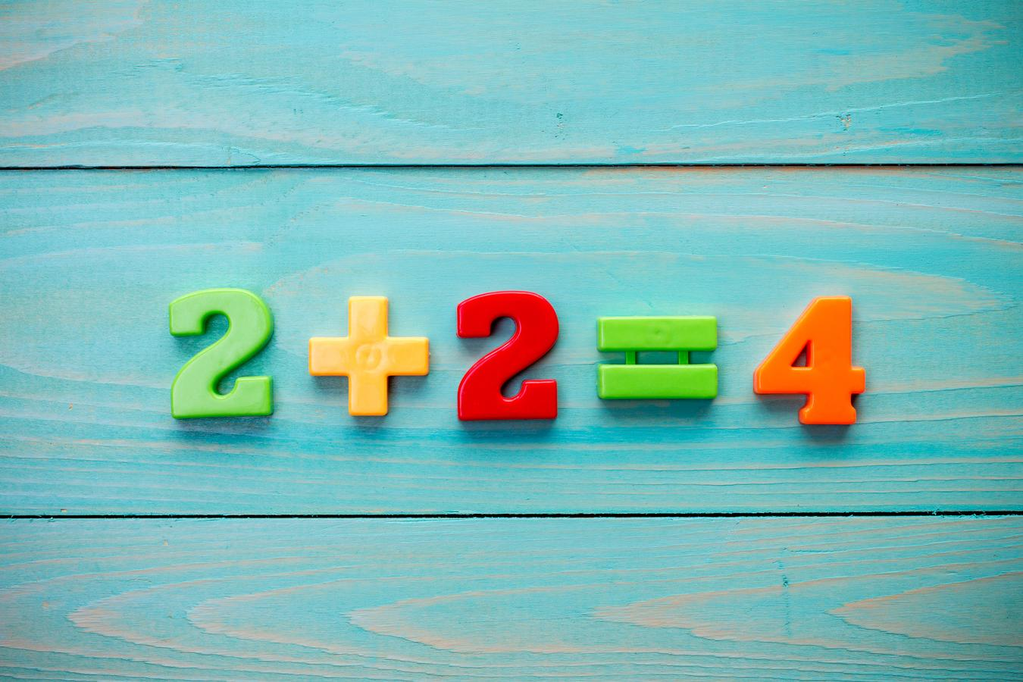
Constraints of traditional grading system +
Well-intentioned grading decisions
by teachers
=
Grade variance & unreliability

Slide 34
Impact of Variable & Unreliable Grading
Difficult for students to navigate
Challenge to keep track of teacher variance
Creating uncertainty & confusion for students
Students misplaced in course levels up & down
Distrust among colleagues

Slide 35
Discussion Question
15 minutes!
Share, take notes, post to Padlet (link in chat)

Slide 36
Discussion Question
Are there teachers with reputations as "hard" or "easy" graders? What, specifically, defines them as that?
How does this categorization make you feel? How does it make the labeled "easy" and "hard" teachers feel? How do students react? How does this impact grading/learning and what does it suggest?

Slide 37
Thank you
for participating
in this learning journey!
NEXT QUESTION
NEXT STEP
NEXT WEBINAR
What impact does being judged for every mistake, awarded points for their actions, and faced with complex and variable grading have on students' motivation to learn? (Q1, p. 59)
Read and Reflect
on Chapter 4
Tuesday, 6/23 @ 9am
Chapters 5 & 6 Preview
July Working Groups Overview

Slide 38
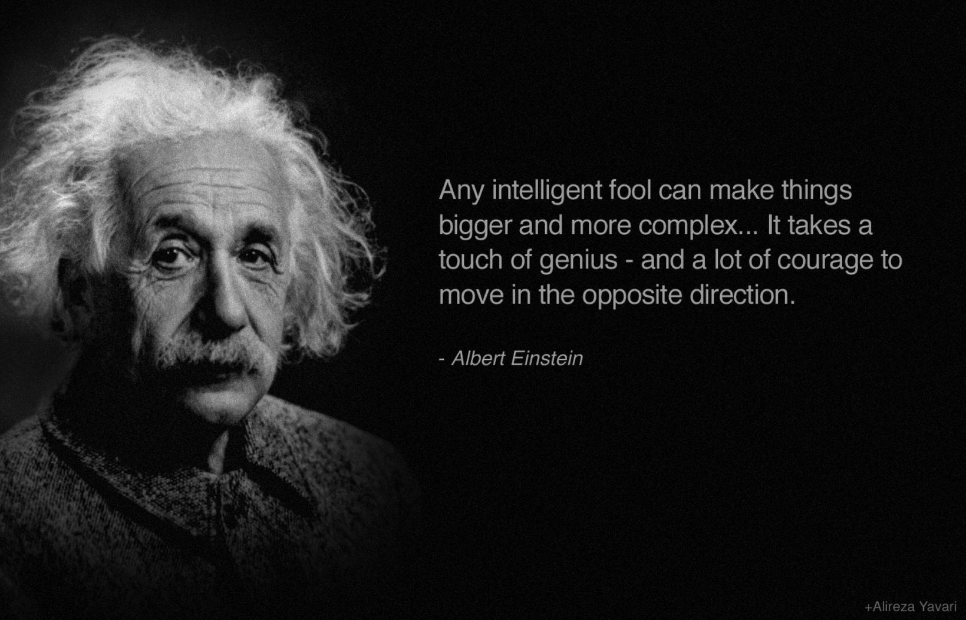
FINAL WORDS

