Slide 1
Towns in Maine
K for ME Read Aloud, Unit 1 Week 2, Day 3
The slides that follow need to be revised to fit your context.
MAKE A COPY

Slide 2
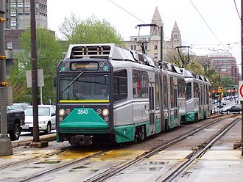
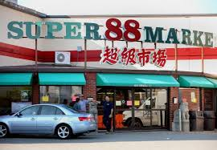
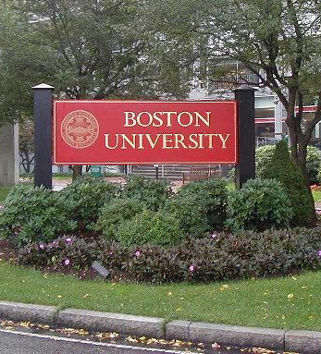
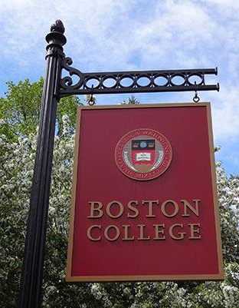
People can take the Green Line in Allston/Brighton from Boston College to Boston University. They might stop at the Super 88 Market. A lot of people live in Allston/Brighton.

Slide 3
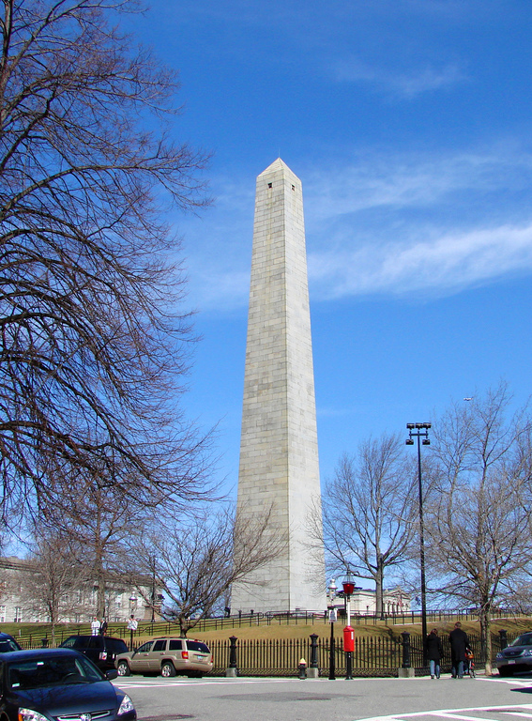
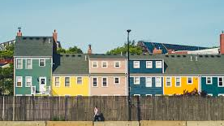
The Bunker Hill Monument is a famous place is Charlestown.
A lot of people visit the monument, and a lot of people live in Charlestown.
Notes:
charlestown

Slide 4
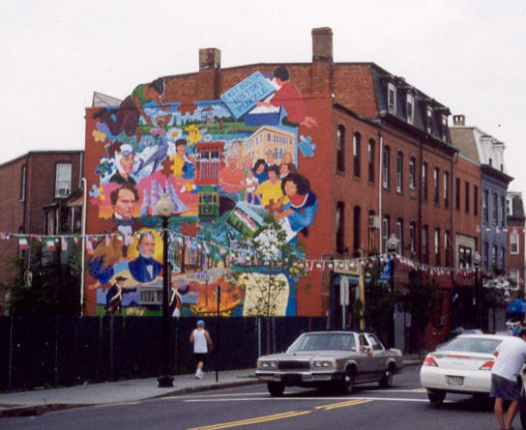
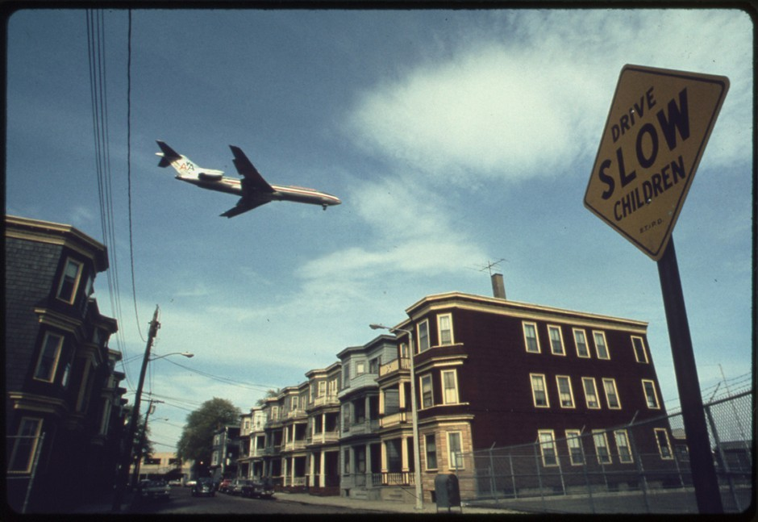
An airplane flies over houses in Boston in 1973. Michael Philip Manheim/NARA
There is art that tells stories about communities in East Boston. The airport is also in East Boston.
A lot of people live in East Boston.
Notes:
East boston

Slide 5
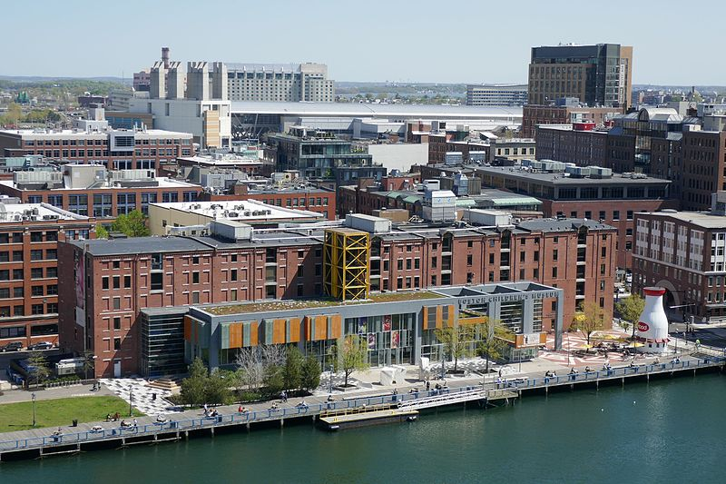
The Children’s Museum is in Fort Point Channel.
People work and explore in Fort Point Channel. Not a lot of people live here.
Notes:
Fort Point Channel

Slide 6
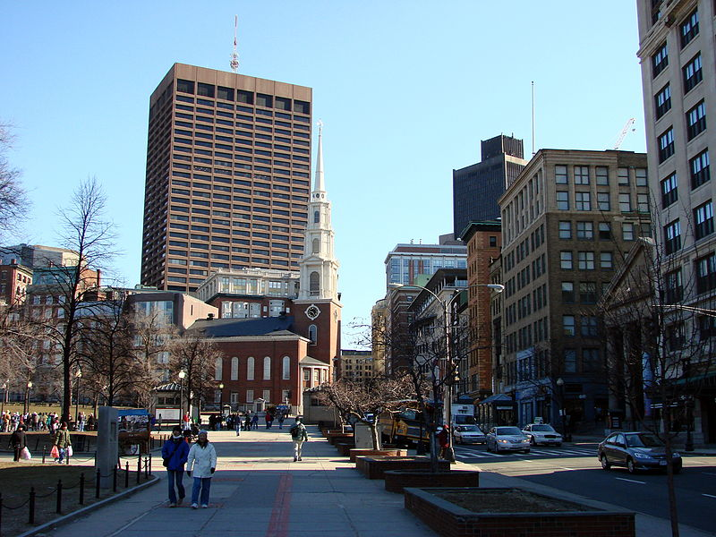
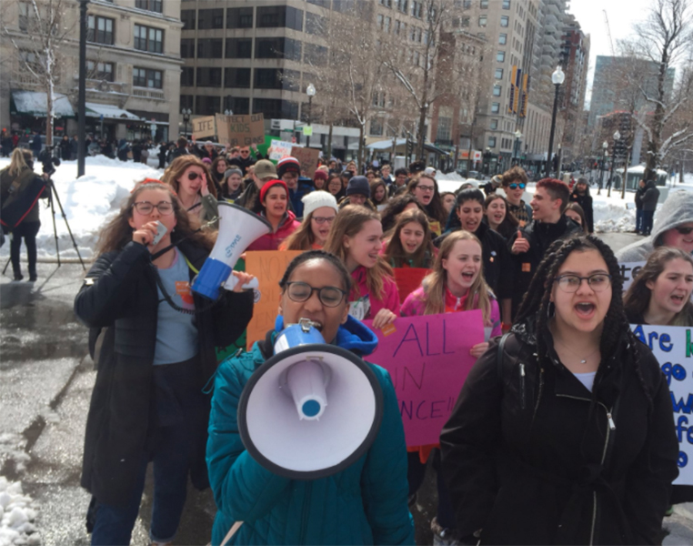
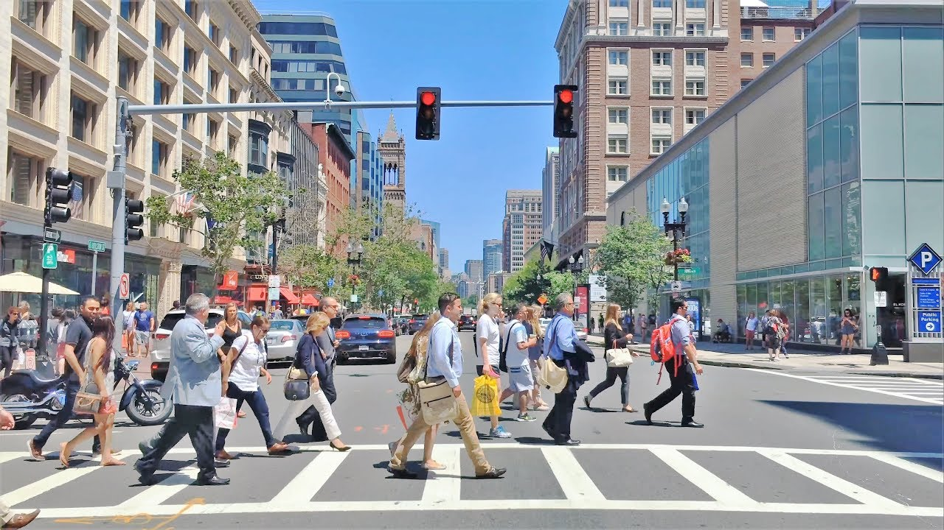
A lot of people work in Downtown Boston. People also gather here to show what they believe in.
A lot of people live here, too.
Notes:
downtown

Slide 7
What town in Maine do you live in?
What community places are in your neighborhood?

