Slide 1
Read Aloud Week 4, Day 2
Selected pages for close reading

Slide 2
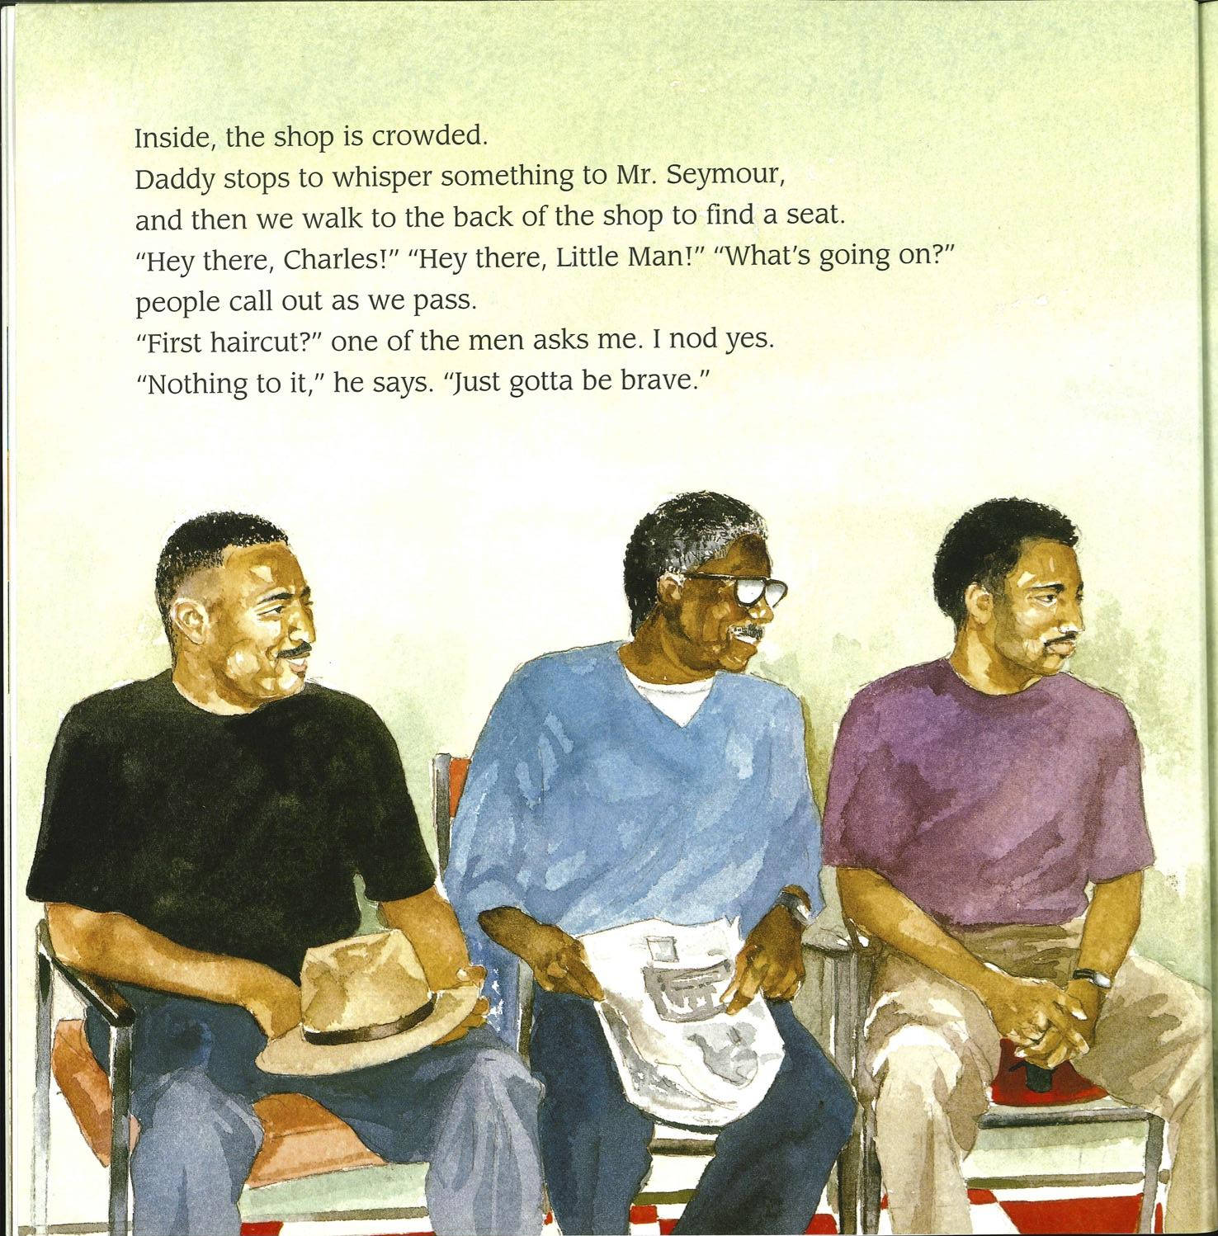
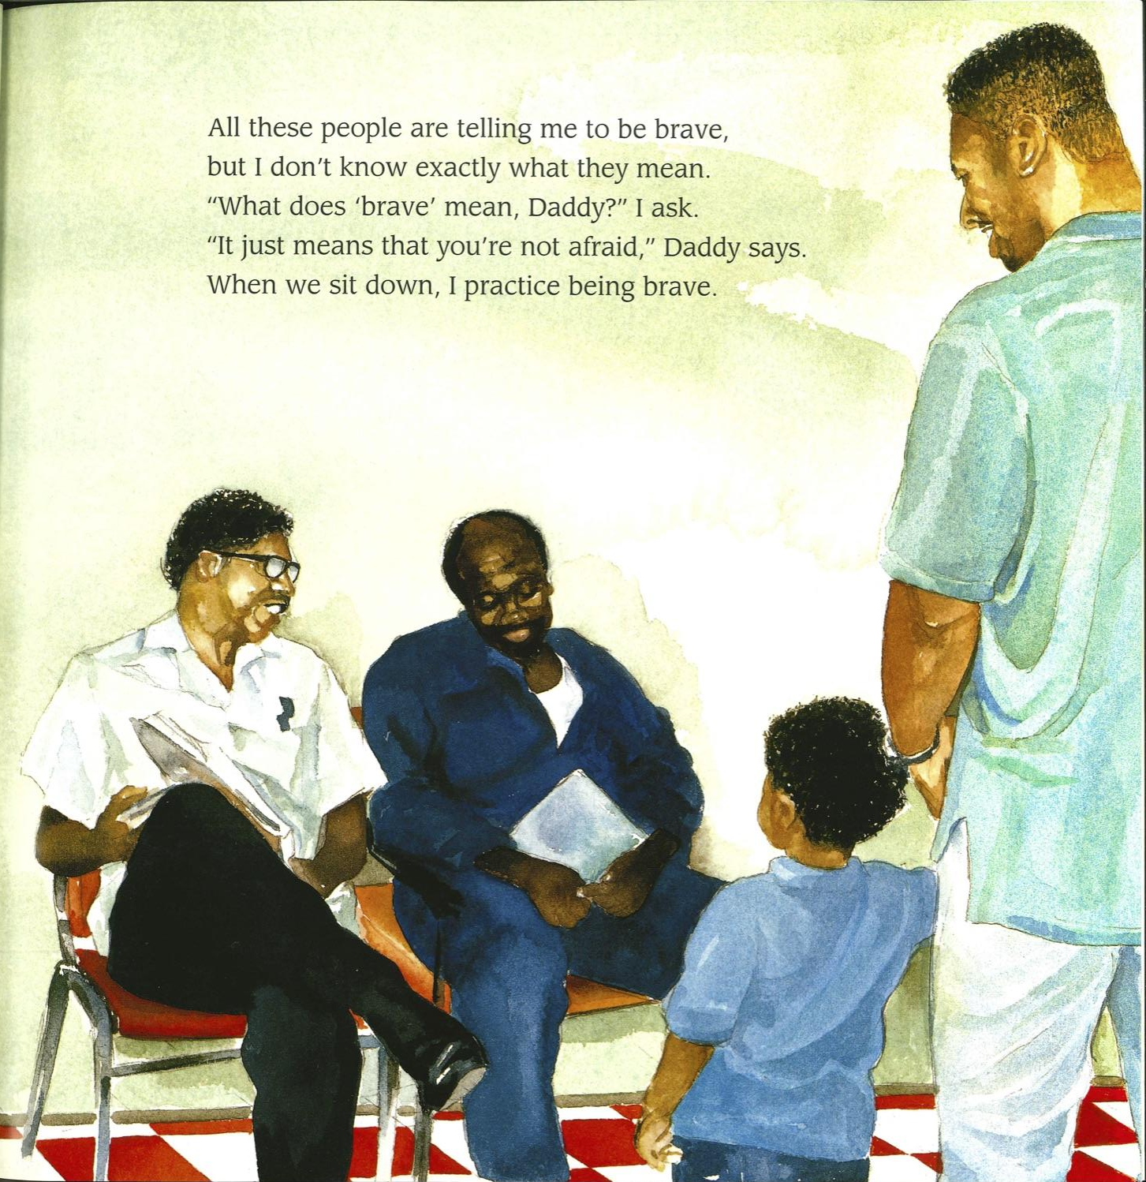

Slide 3
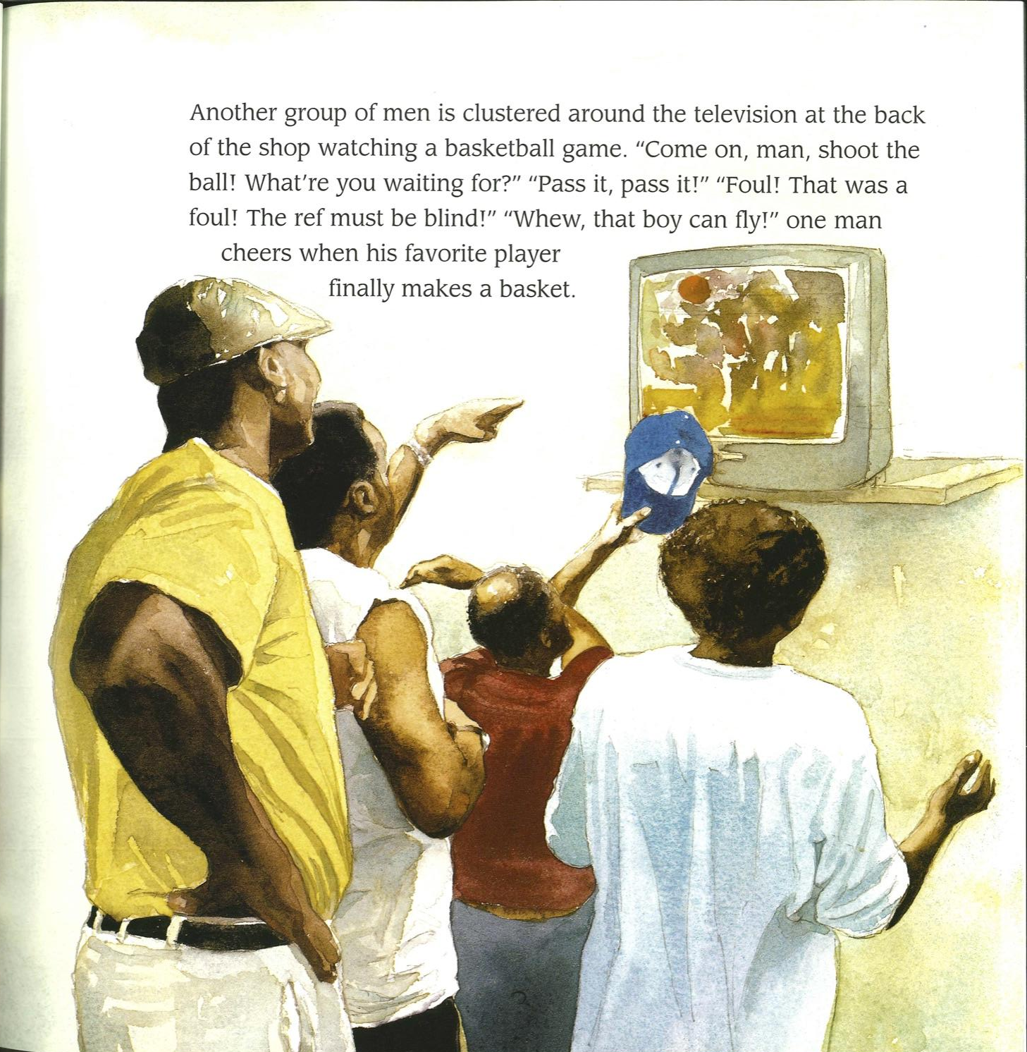

Slide 4
